Slide 1
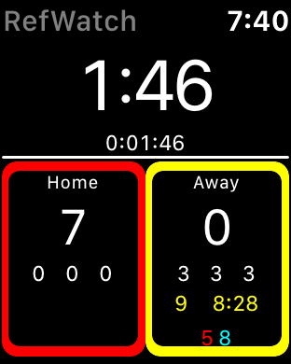
Local Time
Game-Time
Elapsed Time
Away Score
Sin-Bin, Player & Time Left
Cautioned Player
Pen Count Last 10 Mins
Sent Of Player
Pen Count This Half
Total Pen Count

Slide 2
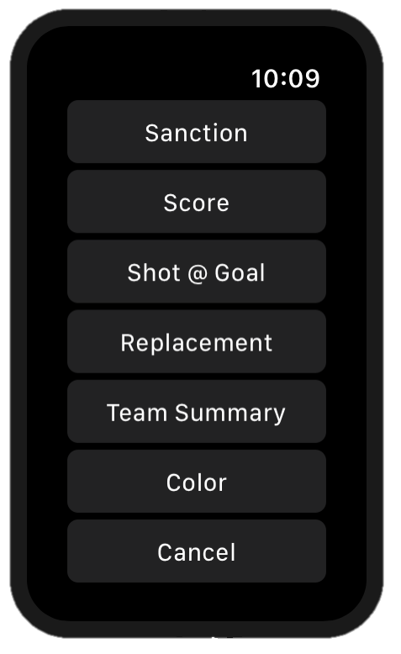
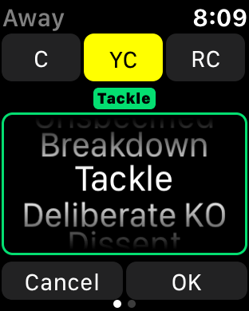
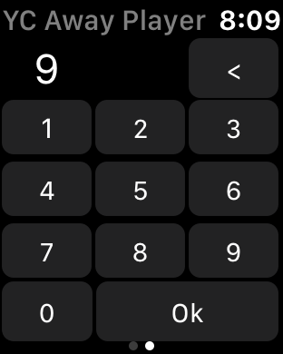
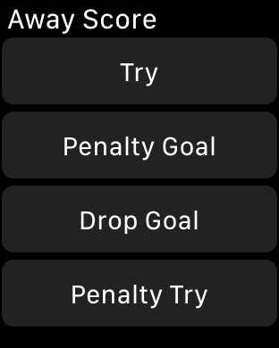
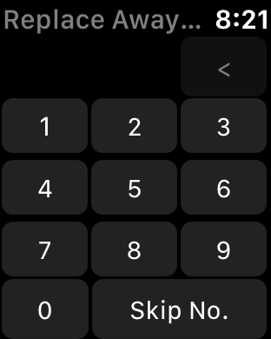
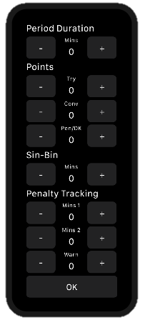
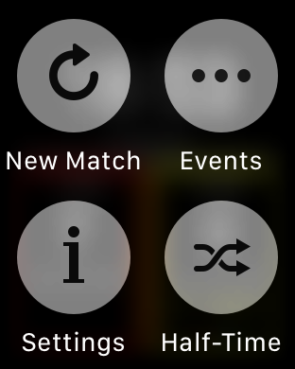
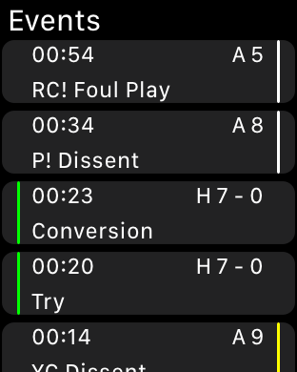
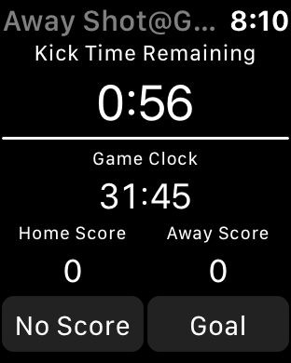
Select Sanction
Select Player
Stop/Start Game-Time
Team Menu
Select Score
Replacement
Force Touch
Shot Clock

