Slide 1





A
solution
Tables and figures

Slide 2
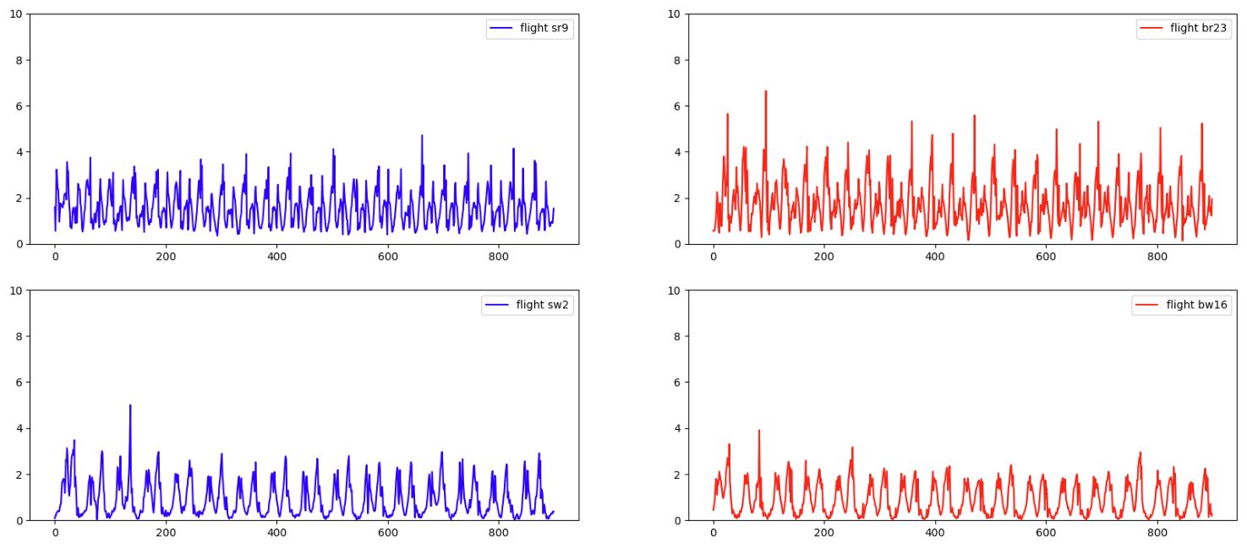
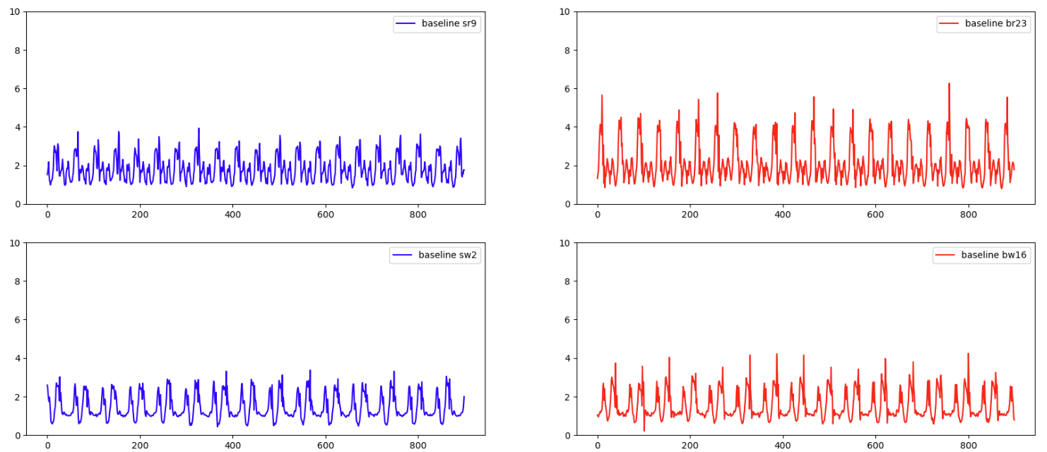

Dot Data Validation
Raw Flight Data – blue: shoes, red: barefoot, 900 samples
Raw Baseline Data – blue: shoes, red: barefoot, 900 samples

Slide 3
Dot Loading Metrics
Experimenter 1
Experimenter 2
Baseline
Shoes: Total: 10.04, left: 9.58, right: 10.51
Barefoot: Total: 10.71, left: 9.97, right: 11.46
Left Axis
shoes: x: 10.14, y: 7.85, z: 9.77
barefoot: x: 10.24, y: 7.61, z: 9.75
Right Axis
shoes: x: 10.65, y: 6.11, z: 11.25
barefoot: x: 11.31, y: 7.62, z: 10.55
Flight
Shoes: Total: 10.31, left: 10.1, right: 10.52
Barefoot: Total: 10.75, left: 10.57, right: 10.93
Left Axis
shoes: x: 7.6, y: 6.57, z: 13.81
barefoot: x: 7.38, y: 7.89, z: 14.36
Right Axis
shoes: x: 6.68, y: 7.0, z: 13.89
barefoot: x: 7.11, y: 7.72, z: 14.09
Baseline
Shoes: Total: 8.99, left: 8.78, right: 9.2
Barefoot: Total: 10.87, left: 10.74, right: 11.0
Left Axis
shoes: x: 8.74, y: 3.84, z: 10.95
barefoot: x: 9.72, y: 4.01, z: 13.45
Right Axis
shoes: x: 9.48, y: 4.36, z: 12.14
barefoot: x: 9.49, y: 5.03, z: 12.26
Flight
shoes: Total: 14.38, left: 14.39, right: 14.37
Barefoot: Total: 11.73, left: 11.7, right: 11.76
Left Axis
shoes: x: 9.65, y: 4.93, z: 16.54
barefoot: x: 8.23, y: 4.9, z: 14.1
Right Axis
shoes: x: 9.35, y: 6.39, z: 16.51
barefoot: x: 7.74, y: 6.09, z: 14.1

Slide 4
Dot Balance Metrics
Experimenter 1
Experimenter 2
Baseline
Shoes: 47.69 52.31
Barefoot: 46.52 53.48
Flight
Shoes: 48.98 51.02
Barefoot: 49.16 50.84
Baseline
Shoes 48.83 51.17
Barefoot: 49.4 50.6
Flight
Shoes: 50.03 49.97
Barefoot: 49.87 50.13

Slide 5
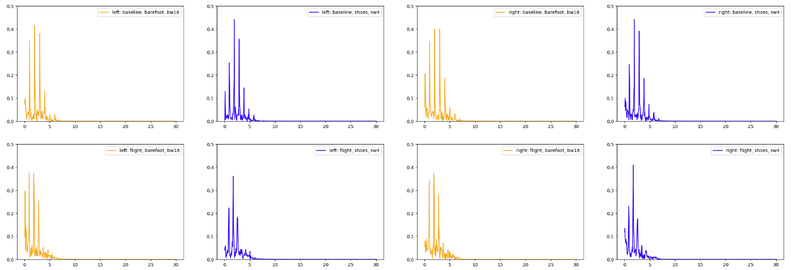
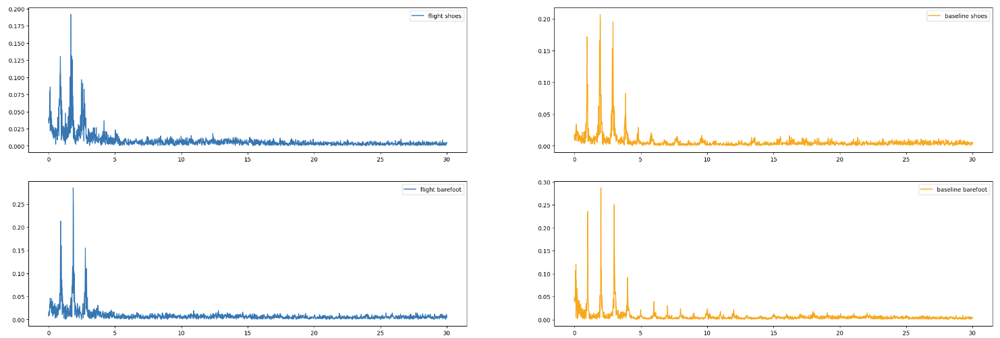
Dot Frequency Response – Exp1
Baseline Total Power shoes left: 0.59 shoes right: 0.67 barefoot left: 0.65 barefoot right: 0.74 Flight Total Power shoes left: 0.48 shoes right: 0.56 barefoot left: 0.81 barefoot right: 0.71
Experimenter 2
Baseline Total Power
shoes left: 0.59
shoes right: 0.67
barefoot left: 0.65
barefoot right: 0.74
Flight Total Power
shoes left: 0.48
shoes right: 0.56
barefoot left: 0.81
barefoot right: 0.71

Slide 6
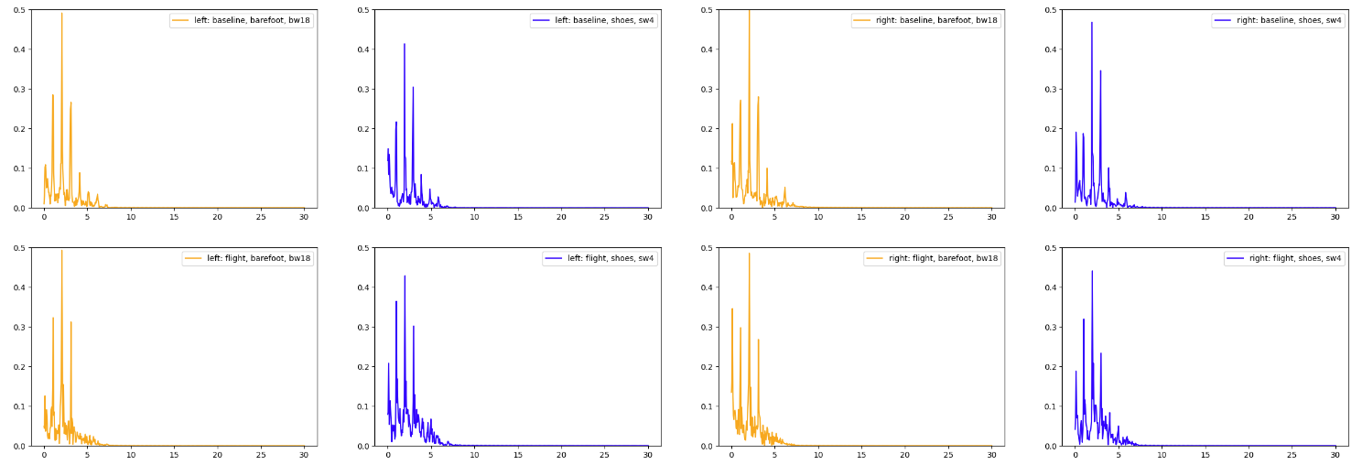
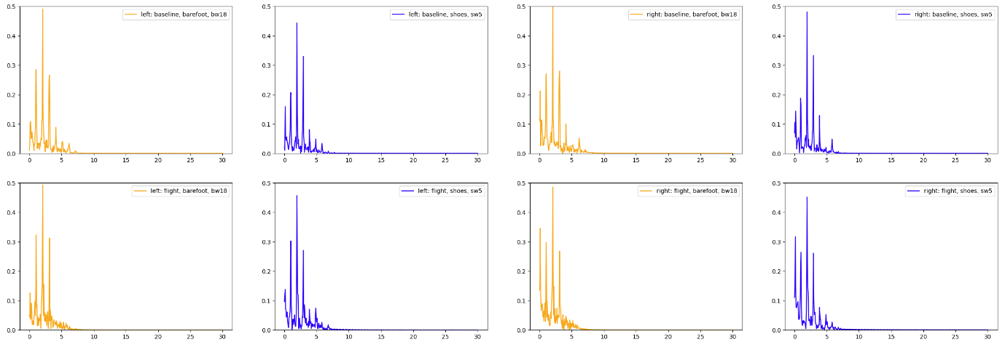
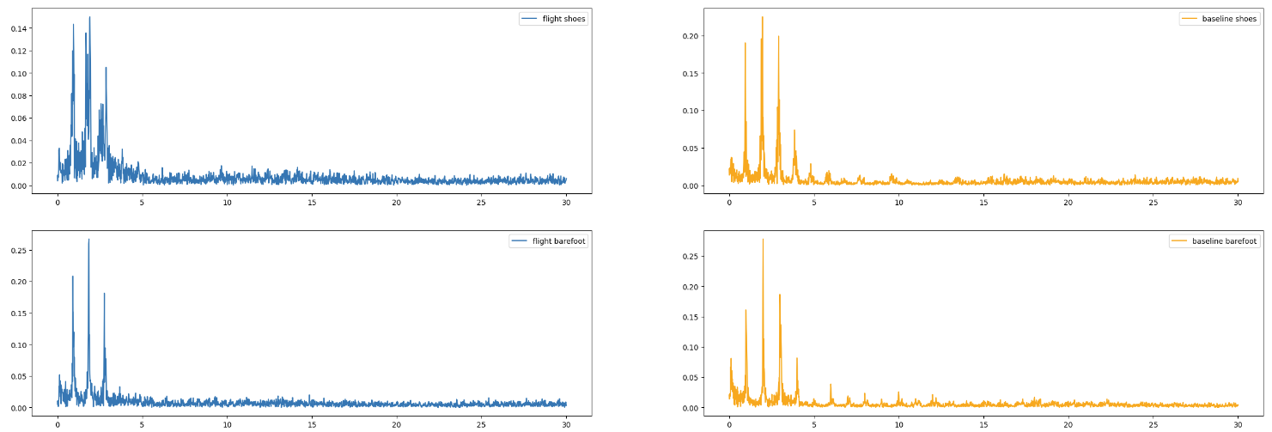
Dot Frequency Response – Exp2
Experimenter 2
Baseline Total Power
shoes left: 0.64
shoes right: 0.81
barefoot left: 0.93
barefoot right: 1.2
Flight Total Power
shoes left: 0.95
shoes right: 0.76
barefoot left: 0.9
barefoot right: 1.11

