Slide 1
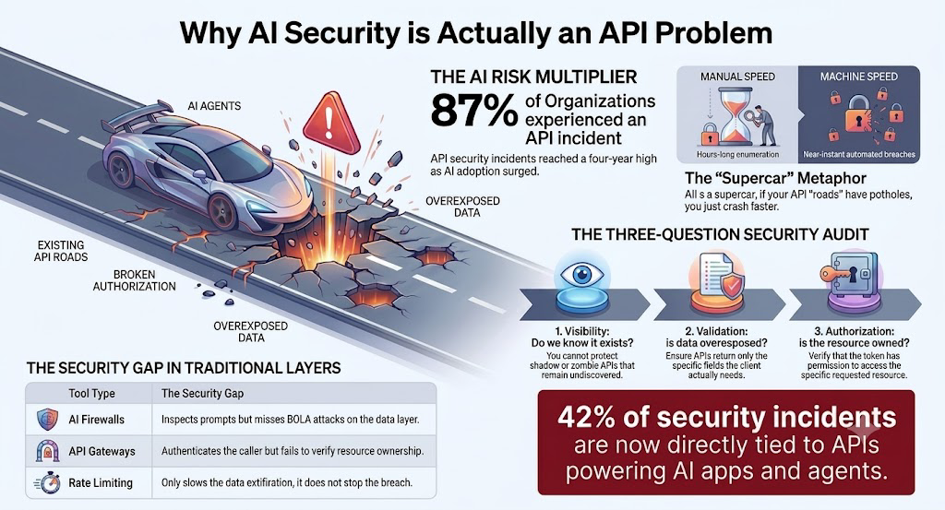

Slide 2
Connect & Explore
Michael Cropsey | Security Solution Architect | Akamai Technologies
▶
in
</>
📋
YouTube
LinkedIn
GitHub
Akamai 2026
Impact Study
youtube.com/@mikecropsey1966
linkedin.com/in/michael-cropsey
github.com/mcropsey
https://github.com/mcropsey/api-mcp-demo
akamai.com/2026-api-security-
impact-study
All demos and code available at github.com/mcropsey

