Slide 1
LOCAL AGENTIC STACK
A 30B model on hardware I own
that can log into my servers.
It can SSH into my servers, search the live internet, install software and fix things — with me approving every command. No API key. Nothing leaves my network.
Laptop · macOS
5090 · .194
Rocky · .101
github.com/mcropsey/local-5090-llm-agent-setup
Notes:
Open with the pitch line, then go straight to the live cold-open demo. Everything after that is proof.

Slide 2
THE MENTAL MODEL
Four parts. People conflate them constantly.
Every agent stack — mine, Claude Code, anyone's — is these same four pieces.
BRAIN
HANDS
SENSES
PERSONALITY
the model
the harness
the tools
the instructions
Qwen3-Coder 30B-A3B
opencode
SearXNG via MCP, bash, SSH
AGENTS.md
lives on 5090 box · .194
lives on Laptop
lives on Laptop → .101
lives on Laptop
When an agent “doesn't work,” it is almost always the brain or the personality — very rarely the hands.
Notes:
Four parts, and people conflate them constantly. Come back to this table between sections.

Slide 3
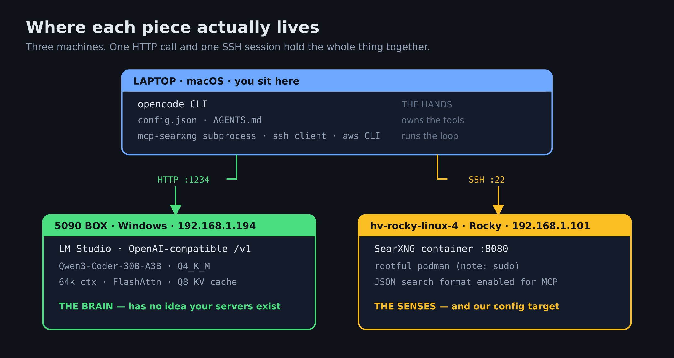
MY ENVIRONMENT
Three machines, two connections
Notes:
Three machines. One HTTP call and one SSH session hold the whole thing together. Point at whichever box the live demo is touching. Colour code: blue laptop, green 5090, amber Rocky — same colours as the terminal prompts.

Slide 4
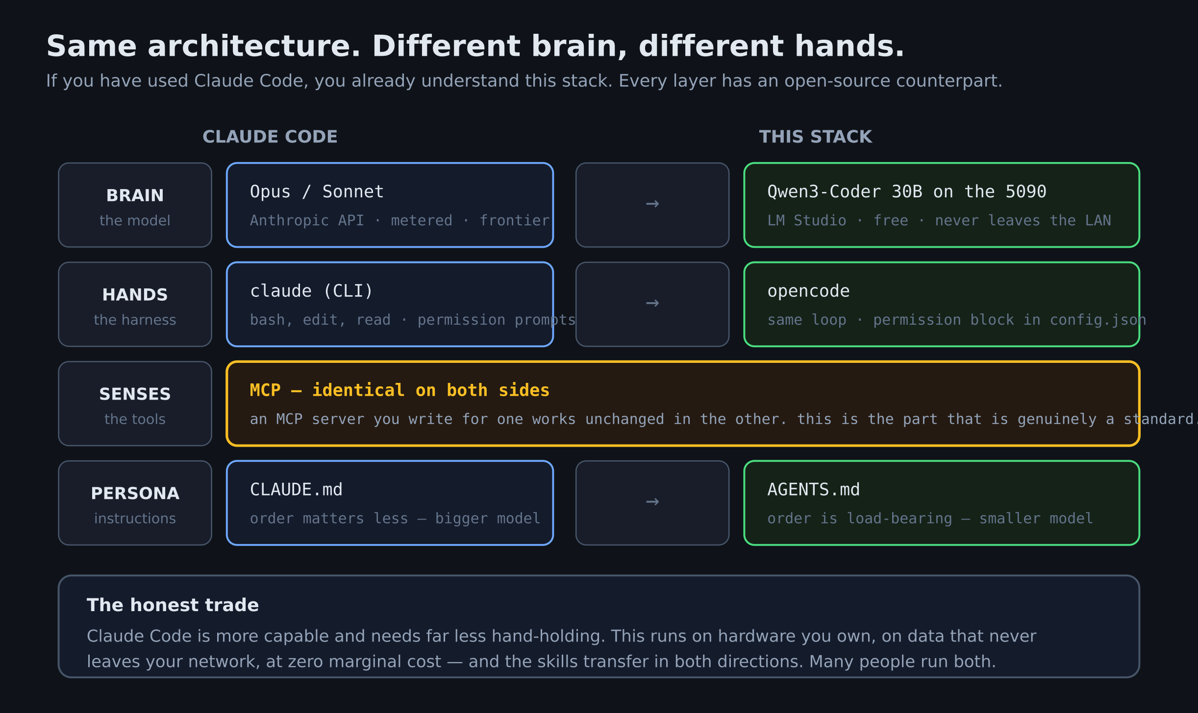
THE OBVIOUS QUESTION
“Isn't this just Claude Code?”
Notes:
Answer this early — most of the room has used Claude Code or seen it, and they will make the comparison silently otherwise.

Slide 5
EVERY FILE I JUST USED
Brain on the 5090. Hands on the laptop. Senses from SearXNG. Personality in a markdown file.
github.com/mcropsey/local-5090-llm-agent-setup
runbook.md
reference.md
how to build it, phase by phase
why it works that way, and what to do when it breaks
Notes:
Leave the repo URL up for at least five seconds, and pin it in the description and the first comment.

