Slide 1
AWS Terraform Small Environment
Maxim Crucovschii, Cloud Automation Engineer

Slide 2

https://github.com/mcrucovschii/SmallEnvironment
mcrucovschii@gmail.com

Slide 3
Contents
Statement Of Work
Architecture
Solution
Code
Questions

Slide 4
Statement Of Work
Assignment

Slide 5
Small Environment, the Requirements:
2 LBs (Custom Hardened Linux AMI)
2 Application-Server (default AWS AMI)
3 DB-Nodes (default AWS AMI)
3 Different VPCs/Networks & Sec-Groups to Isolate Application from DB from Public-Access to LB
How can this be put into a GitHub Action Pipeline to get applied when merged?
Is there any other way to integrate it into our AWX(Ansible Tower) infrastructure to Reflect a IaaC Approach?
What could be the best way to distribute Traffic over 2 LBs or would you prefer Active/Passive? How can this be done without any interaction?
Finally present the examples and you thoughts about the Challenges and mind-gaps in this Request?

Slide 6
Architecture
Architecture that was applied

Slide 7







AWS Small Environment Architecture
AWS Cloud
10.101.0.0/16
10.102.0.0/16
10.103.0.0/16
VPC1 Load Balancers
VPC2 AppSrvs
VPC3 DBNds
Internet gateway
PCX 1-2
PCX 2-3
DB Node1
Application Load Balancer
WebNode1
WebNode2
DB Node2
HAPEE1
HAPEE2
DB Node3

Slide 8
AWS High Availability Multi AZ
AWS Cloud
10.101.0.0/16
10.102.0.0/16
10.103.0.0/16
VPC1 – Load Balancers
VPC2 AppSrvs
VPC3 DBNds
AZ a
HAPEE-1
Web Node1
DB Node1
DB Node2
AZ b
HAPEE-2
Web Node2
DB Node3

Slide 9
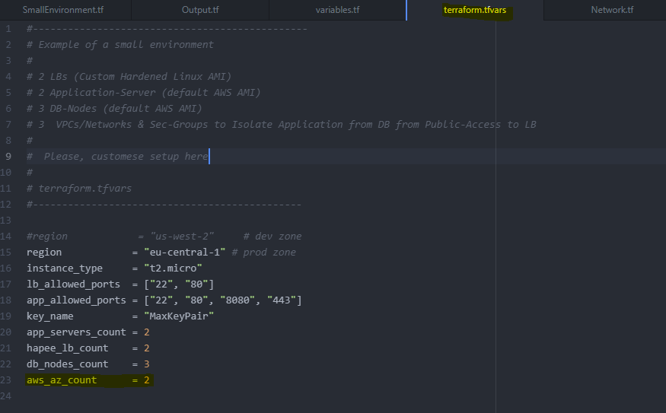
AWS High Availability Multi AZ
AWS Cloud

Slide 10




AWS Small Environment Architecture
AWS Cloud
10.101.0.0/16
10.102.0.0/16
10.103.0.0/16
VPC1 Load Balancers
VPC2 App
VPC3 DB
Auto Scaling
Auto Scaling
IGW
Bastion
WebNode2
Load Balancer
Multi-AZ DB Cluster
NAT gateway
WebNode1
PCX 1-2
PCX 2-3

Slide 11
The Solution
Development decisions and considerations

Slide 12


Small environment: LBs hardening
https://github.com/nozaq/amazon-linux-cis
Bootstrap script for Amazon Linux to comply with CIS Amazon Linux Benchmark

Slide 13
LBs hardening - 149 security policies remediated
Ensure sticky bit is set on all world - writable directories
Ensure ntp is configured
Ensure time synchronization is in use
Ensure chrony is configured
Ensure X Window System is not installed
Ensure mail transfer agent is configured for local - only mode
Set Network Parameters(Host Only)
Set Network Parameters(Host and Router)

Slide 14
LBs hardening - 149 security policies remediated
Ensure IPv6 settings disabled
Ensure TCP Wrappers is installed
Ensure /etc/hosts.allow is configured
Ensure permissions on /etc/hosts.allow are configured
Ensure permissions on /etc/hosts.deny are configured
Uncommon Network Protocols are disabled (dccp, sctp, rds, tipc)
Firewall Configuration reviewed and updated
Reconfigured rsyslog settings

Slide 15
LBs hardening - 149 security policies remediated
Ensure permissions on all logfiles are configured
Ensure cron daemon is enabled
Ensure permissions on /etc/ssh/sshd_config are configured
PAM extensively reconfigured
Set Shadow Password Suite Parameters
Ensure that access to the su command is restricted
Ensure that Amazon Time Sync Service is available

Slide 16


Small environment: HA Proxy Load Balancer
One of the popular balancers in the market, provides high availability, proxy, TCP/HTTP load-balancing. HAProxy is used by some of the reputed brands in the world, like below.

Slide 17
Small environment: HA Proxy Load Balancer. haproxy.cfg
Global
log 127.0.0.1 local2
chroot /var/lib/haproxy
pidfile /var/run/haproxy.pid
maxconn 4000
user haproxy
group haproxy
daemon
defaults
mode http
log global
option httplog
option dontlognull
option http-server-close
option forwardfor except 127.0.0.0/8
option redispatch
retries 3
timeout http-request 10s
timeout queue 1m
timeout connect 10s
timeout client 1m
timeout server 1m
timeout http-keep-alive 10s
timeout check 10s
maxconn 3000
frontend http_front
bind *:80
stats uri /stats
default_backend http_back
#---------------------------------------
# round robin balancing between the various backends
#----------------------------------------
backend http_back
balance roundrobin
${serverlist}

Slide 18
Small environment: HA Proxy. haproxy.cfg.rendered
data "template_file“ "hapee-userdata" {
template = file("hapee-userdata.sh.tpl")
vars = {
serverlist = join("\n", formatlist(" server app-%v %v:80 cookie app-%v check", aws_instance.web_node.*.id, aws_instance.web_node.*.private_ip, aws_instance.web_node.*.id))
}
}

Slide 19
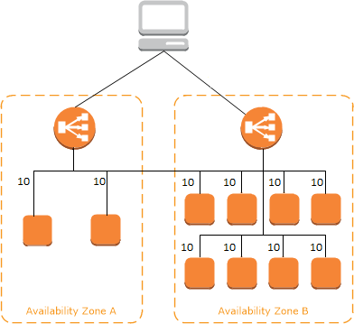
Amazon Application Load Balancer
An Application Load Balancer functions at the application layer, the seventh layer of the OSI model. After the load balancer receives a request, it evaluates the rules and then selects a target from the target group.
The default routing algorithm is round robin.
Health checks are used to monitor the health of the registered targets so that the load balancer can send requests only to the healthy targets.

Slide 20
Code
Playbook structure and code review

Slide 21
https://github.com/mcrucovschii/SmallEnvironment
Main.tf – main Terraform file, no provisioning there
SmallEnvironment.tf - instances declaration
Network.tf – VPCs, subnets, security groups, gateway, route tables, ALB, DNS
terraform.tfvars – settings and adjustments
variables.tf – declaration of variables
Output.tf – CLI output
Crucovschii-AWS-SmallEnvironment.pptx (.pdf) – this presentation

Slide 22
Output.tf
output "data_aws_caller_identity“
output "data_aws_regions_name“
output "aws_availability_zones“
output "Web_node_public_IPs"
output "HAPEE_nodes_public_IPs“
output "LB_HAPEE_DNS_address“

Slide 23
terraform.tfvars
region = region where infrastructure will be deployed
instance_type = instance_type that will be used for hapee, web nodes and db nodes"
key_name = a key pair in the region where you are going to deploy
app_servers_count = a number of app servers (web nodes) to be launched
hapee_lb_count = a number of hapee balancers to be launched
db_nodes_count = a number of db nodes to be launched
aws_az_count = a number of availability zones where infrastructure will be deployed

Slide 24
SmallEnvironment.tf
resource "aws_instance" "db_node“
resource "aws_instance" "web_node“
resource "aws_instance" "hapee_node"

Slide 25
Network.tf
resource "aws_instance" "db_node“
resource "aws_instance" "web_node“
resource "aws_instance" "hapee_node"

Slide 26
Questions
Additional questions

Slide 27

GitHub Action Pipeline
How can this be put into a GitHub Action Pipeline to get applied when merged?

Slide 28

GitHub Action Pipeline
Webhooks allow external services to be notified when certain events happen. When the specified events happen, we’ll send a POST request to each of the URLs you provide. Learn more in ou

Slide 29
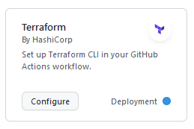
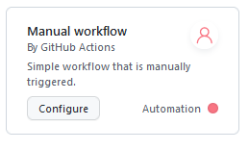
GitHub Action Pipeline

Slide 30
GitHub Action Pipeline. terraform.yml
on: push: branches: - “Master“
jobs: terraform: name: 'Terraform' runs-on: ubuntu-latest environment: production
uses: hashicorp/setup-terraform@v1
with: cli_config_credentials_token: ${{ secrets.TF_API_TOKEN }}
run: terraform init
run: terraform fmt –check
run: terraform plan -input=false
if: github.ref == 'refs/heads/“Master"' && github.event_name == 'push'
run: terraform apply -auto-approve -input=false

Slide 31
AWX / Ansible Tower integration
Is there way to integrate it into our AWX(Ansible Tower) infrastructure to Reflect a IaaC Approach?

Slide 32
integration into our AWX(Ansible Tower) infrastructure
AWX inventory can automatically receive the stack:
Configure terraform output
Ansible Tower provides webhook integration with GitHub (https://docs.ansible.com/ansible-tower/latest/html/userguide/webhooks.html)
https://github.com/adammck/terraform-inventory
https://github.com/mcrucovschii/terraform-null-ansible
https://github.com/opencredo/k8s-terraform-ansible-sample/tree/master/terraform

Slide 33
LB Traffic distribution
What could be the best way to distribute Traffic over 2 LBs or would you prefer Active/Passive? How can this be done without any interaction?

Slide 34






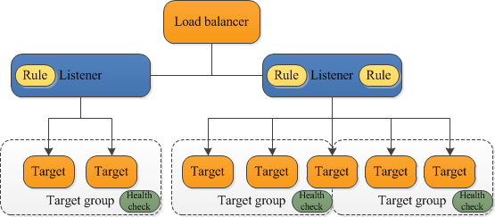
The best way to distribute Traffic over 2 LBs or would you prefer Active/Passive? How can this be done without any interaction?
Application Load Balancer
Network Load Balancer
Amazon Relational Database Service (Amazon RDS)
Auto Scaling
Classic Load Balancer
Gateway Load Balancer
Amazon EC2

Slide 35
The best way to distribute Traffic over 2 LBs or would you prefer Active/Passive? How can this be done without any interaction?
In an active-passive configuration, the load balancer recognizes a failed node and redirects traffic to the next available node.
In an active-active configuration, the load balancer spreads out the workload's traffic among multiple nodes.

Slide 36
My thoughts / My vision
Present the examples and you thoughts about the Challenges and mind-gaps in this Request?

Slide 37
My thoughts / My vision
AWS Cloud
10.101.0.0/16
10.102.0.0/16
10.103.0.0/16
VPC1 Load Balancers
VPC2 App
VPC3 DB
Auto Scaling
Auto Scaling
IGW
Bastion
WebNode2
Load Balancer
Multi-AZ DB Cluster
NAT gateway
WebNode1
PCX 1-2
PCX 2-3

Slide 38
Questions
https://github.com/mcrucovschii/SmallEnvironment

