Slide 1
Biological Sequence Analysis
Introduction

Slide 2
Background
Bioinformatics is an interdisciplinary scientific field where the practitioners come from various fields: biology, computer science, medicine, engineering, etc.
Bioinformatics covers many different aspects:
Biological (what are the appropriate analysis to do for answering certain biological questions ?)
Technical (How to use the tools? Do I need to develop a new tool myself? Where to find the data? )
Theoretical (How does this algorithm work? Why this algorithm will or won’t work for that problem?)

Slide 3
Background
Because of the interdisciplinary nature of bioinformatics, the three different aspects (biological, technical and theoretical) will all be covered but at different depth given different topics.
Course materials will help to prepare you to understand why we need certain analysis, how to do it and why it works. No textbook is required, but additional reading materials or online resources will be provided to facilitate the understanding.

Slide 4
Overall goals of the course
Biological sequences and the relevant biology
Common databases and tools for biological sequence analysis
Algorithms behind common biological sequence analysis tools
Next-generation sequencing and its many applications in biology

Slide 5
Introduction
Biological sequences
Sequence databases
Online sequence analysis tools

Slide 6
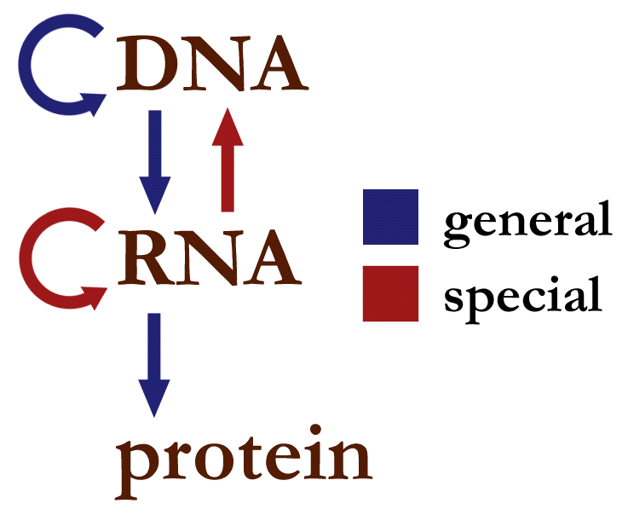
Three main types of biological sequences
DNA
RNA
Protein
Central dogma of molecular biology

Slide 7
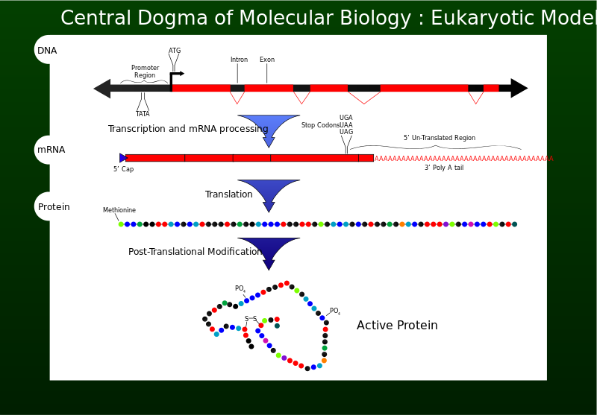
Central dogma of molecular biology

Slide 8
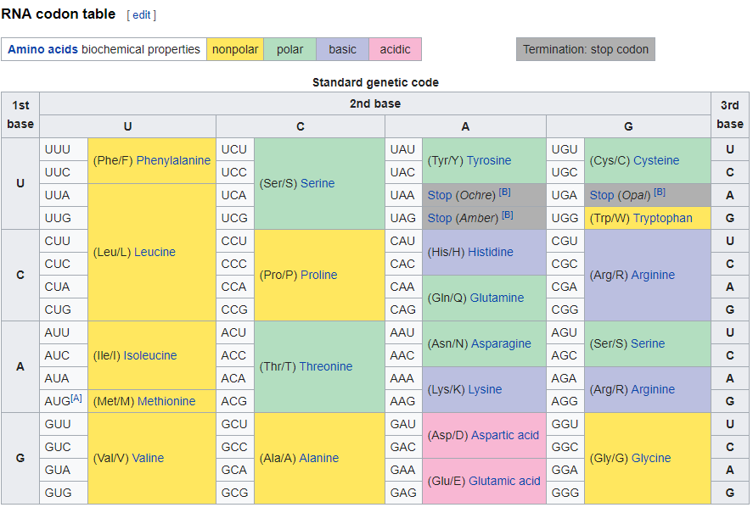
Biological sequences can be represented by strings.
DNA are strings over a 4 letter alphabet(A,C,G,T), and RNA are also strings over a 4 letter alphabet (A,C,G,U).
Protein Sequences are strings over a 20 letter alphabet.

Slide 9
Online databases, portals and tools
Some of the most commonly used:
NCBI (database and analysis tools)
UCSC Genome Browser (database and tools)
ExPASY (online bioinformatics portal)

Slide 10
Sequence databases
Primary sequence databases:
NCBI GenBank (US)
European Nucleotide Archive (EU)
DNA Data Bank of Japan (JP)
Secondary and other databases:
UnitProt, Swiss-Prot, Protein Data Bank, Ensembl
Specialized genomic databases:
FlyBase, Arabidopsis Information Resources, WormBase etc.

Slide 11
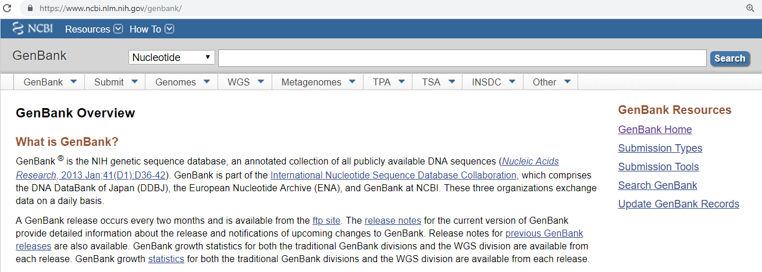
Genbank in its own words
The NCBI (the national center for biotechnology information) houses many databases relevant to biomedicine, and its major databases include GenBank for DNA sequences and PubMed for the biomedical literature. All these databases are available online through the Entrez search engine. Website: www.ncbi.nlm.nih.gov

Slide 12
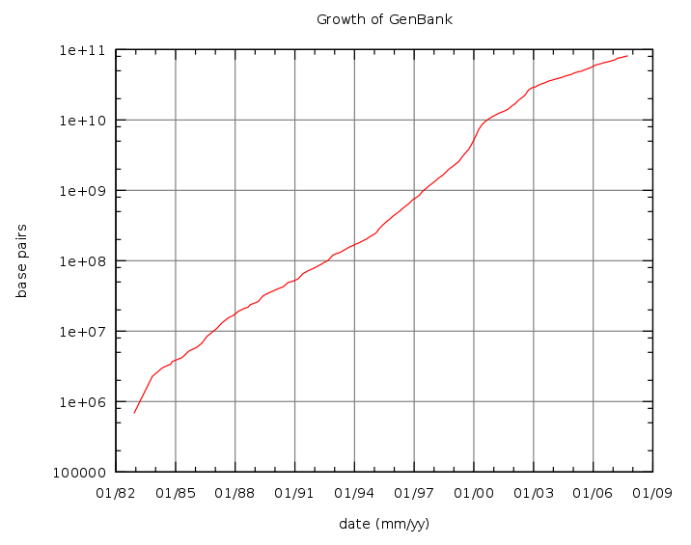
Growth in GenBank base pairs (1982-2007)

Slide 13
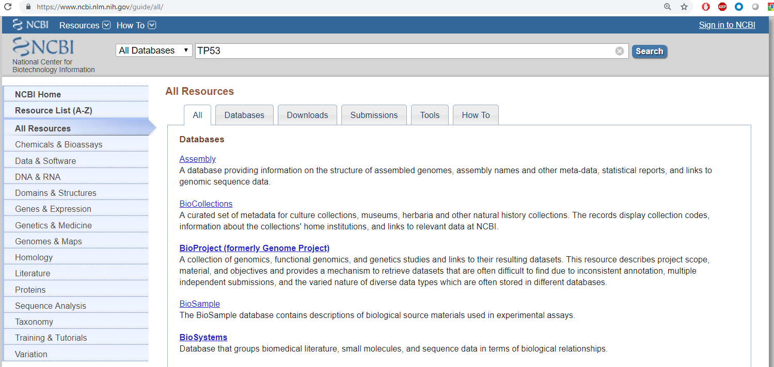
Usage examples: TP53
TP53 is an important tumor suppressor, and it is mutated in many cancer patients. Let’s try to find relevant sequence information of TP53 on NCBI.
Click on Search

Slide 14
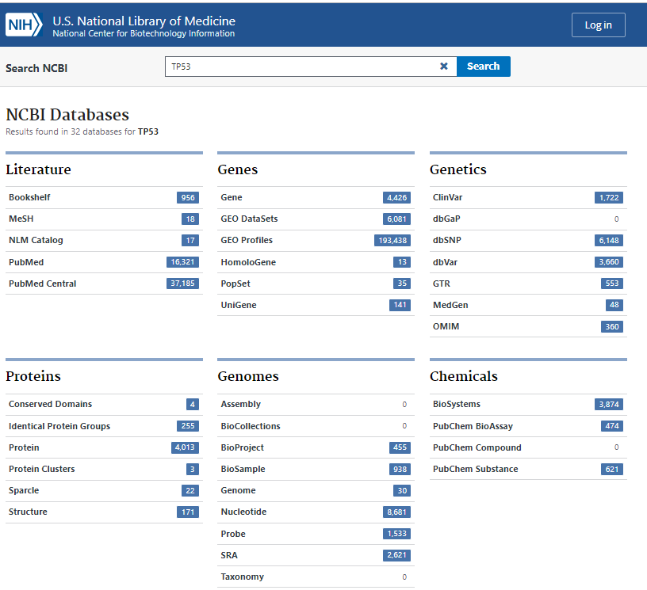
Usage examples: TP53
All the relevant data for TP53 in NCBI.
For example , you an click on “Gene” to find the gene sequence and many other relevant information for the gene TP53.

Slide 15
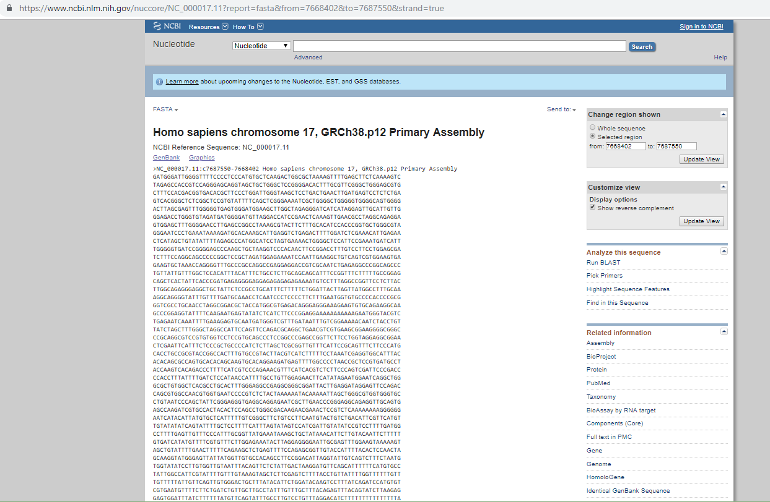
Sequence of a gene in FASTA format (part of a gene sequence)
FASTA format:
>SequenceName
Sequence
https://en.wikipedia.org/wiki/FASTA_format

Slide 16
Question (using NCBI)
Can you find the DNA sequence of human TP53?
Can you find the amino acid sequence of human TP53?
How many isoforms of human TP53 can you find and how many exons do each of them contain?
Can you find the DNA sequence of mouse TP53?

Slide 17
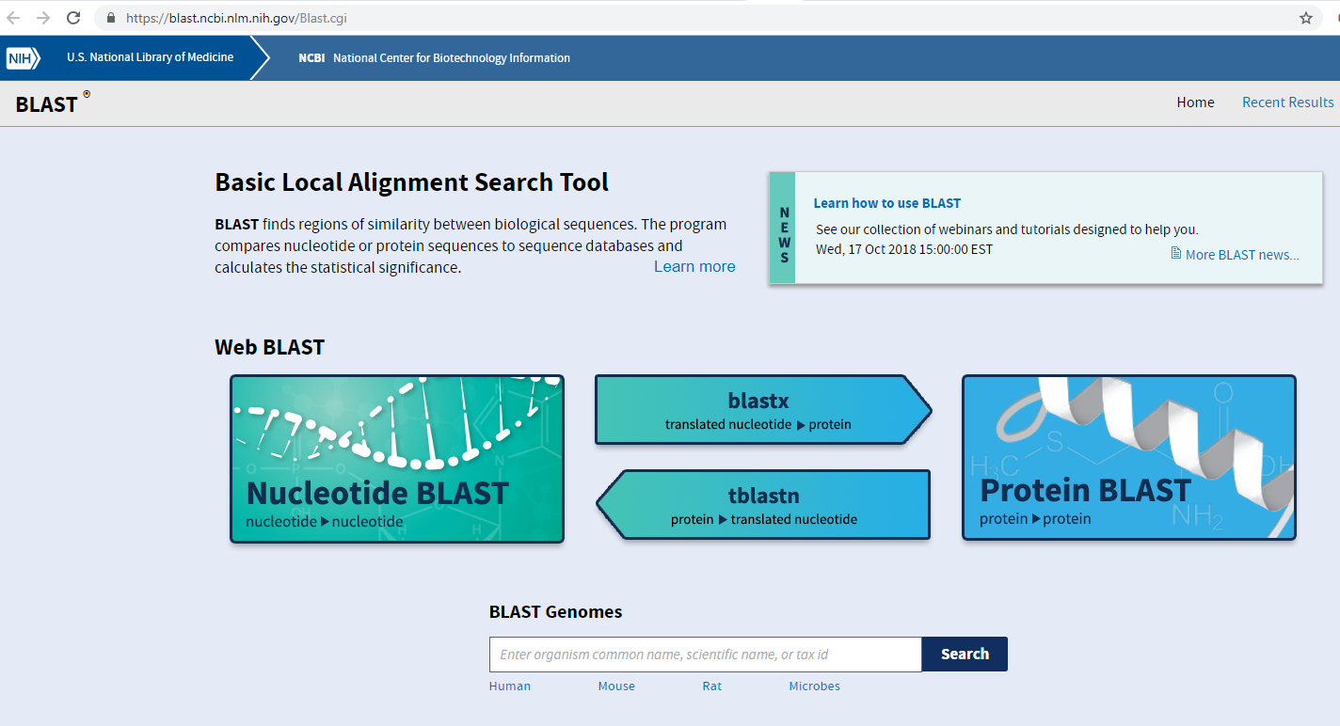
Finding homologous sequences using BLAST
BLAST is probably the most widely-used tool on NCBI and in bioinformatics.

Slide 18
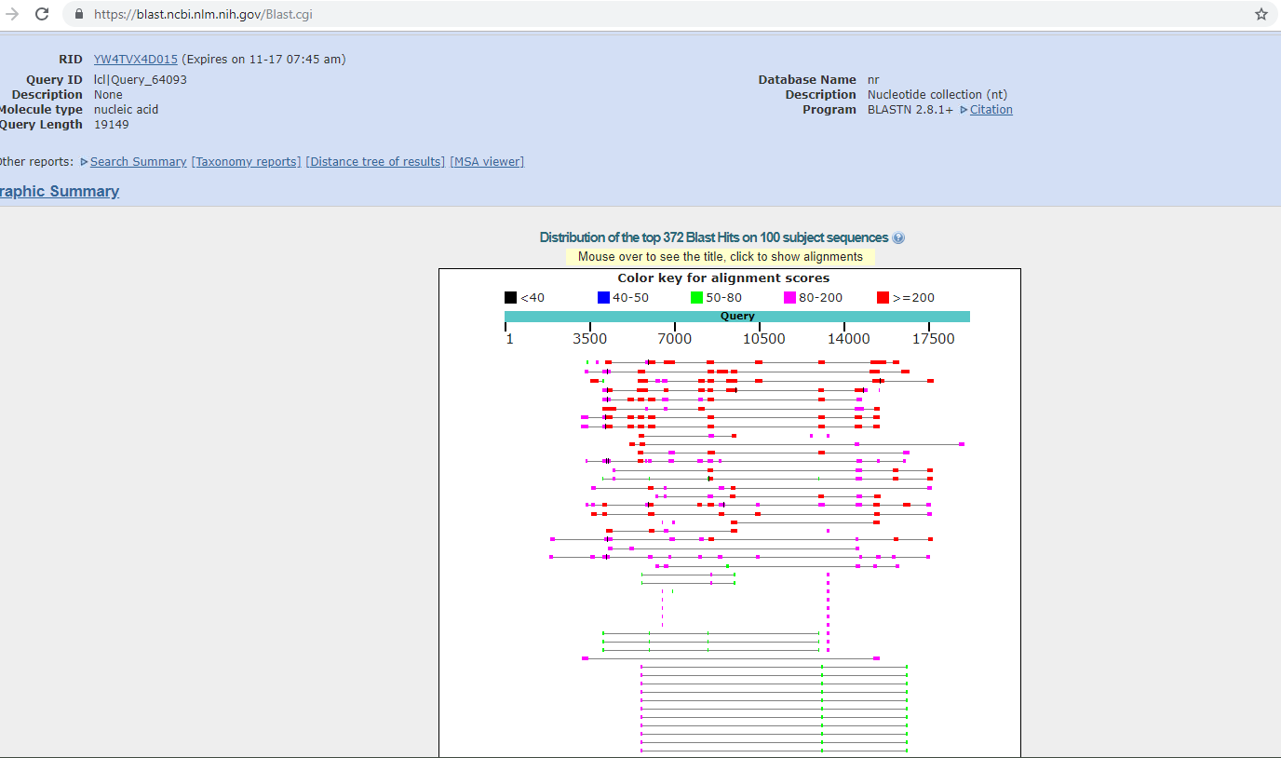
An example of BLAST search results
Both nucleotide and amino acid sequences can be used for BLAST search.

Slide 19
Question (Using BLAST)
Here is a sequence of an unknown gene. Can you protein BLAST to find what sequence in the human genome is the most similar to this sequence?
>seq1
MDDLMLSPDDIEQWFTEDPGPDEAPRMPEAAPPVAPAPAAPTPA APAPAPSWPLSSSVPSQKTYQGSYGFRLGFLHSGTAKSVTCTYSPALNKMFCQLAKTC PVQLWVDSTPPPGTRVRAMAIYKQSQHMTEVVRRCPHHERCSDSDGLAPPQHLIRVEG

Slide 20
BLAST search
The answer for the question in the previous slide is TP53 gene. Actually it matches 100% with the human TP53 protein sequence.
BLAST can not only find the relevant gene given its sequence, but is more often used to help understand the function of an unknown gene by searching the genome databases for similar sequences. The underlying rationale is that similar sequences may lead to similar protein sequences and domains and thus similar functions.

Slide 21
Genomes and genome assemblies
A genome is the genetic materials of an organism. It usually refers to the DNA genome. For example, human genome consists of 23 chromosome pairs in the nucleus and the mitochondria DNA.
A genome assembly, also known as reference genome or reference assembly, is a digital nucleic acid sequence databases assembled by scientists as a representative example of a species’ set of genes. For example, GRCh37, the Genome Reference Consortium human genome (build 37) is derived from 13 volunteers from Buffalo, New York.

Slide 22
Question (using NCBI)
For the human TP53 gene sequence that you found, which genome assembly is it?

Slide 23
UCSC Genome Browser
Commonly used for visualizing the genome and genes
Tables for various genomic information
Visualization tracks for various genomic annotations
Also often used for extracting genomic information and online genomic analysis
BLAT (BLAST-like genomic search tool)
In-Silico PCR: rapidly align PCR primer pairs to the genome
LiftOver: covert genome coordinates between assemblies

Slide 24
Using BLAT in UCSC Genome Browser
Here is a sequence of an unknown gene. Can you protein BLAT to find what sequence in the human genome is the most similar to this sequence?
>seq1
MDDLMLSPDDIEQWFTEDPGPDEAPRMPEAAPPVAPAPAAPTPA APAPAPSWPLSSSVPSQKTYQGSYGFRLGFLHSGTAKSVTCTYSPALNKMFCQLAKTC PVQLWVDSTPPPGTRVRAMAIYKQSQHMTEVVRRCPHHERCSDSDGLAPPQHLIRVEG

Slide 25
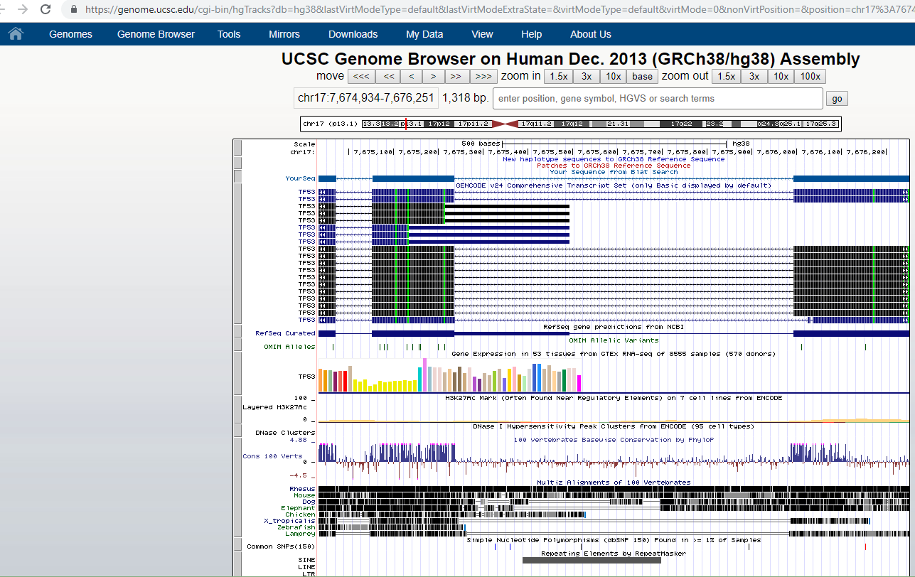
BLAT results on UCSC genome browser
You can see clearly our sequence aligned to the exonic regions of TP53 in the human genome (the genome assembly GRCh38/hgh38 was used)

Slide 26
Question (Using UCSC Genome Browser)
In the UCSC genome browser, you can search for TP53 (or any other gene), and you can see many tracks below the view. One of the track that is included in the default view is the “Conservation” track.
By looking at the track, do you think the exonic region is more conservative or the intronic region is more conservative?
Do you think this applies to most of the genes? Why?

Slide 27
ExPASY
There are many online bioinformatics tools in ExPASY that are really easy to use:
https://www.expasy.org/tools/
For example, there are tools for doing in silico protein translation, sequence reverse complement, motif scan etc.

Slide 28
Question (Using Expasy)
Given the genomic sequence you find in NCBI for the human TP53 gene, can you use the “translate” tool in Expasy to get a predicted protein sequence?
Is this predicted sequence the same as the protein sequence of human TP53? If NOT, why?

Slide 29
Probably the most simple bioinformatics task: reverse complement (RC)
Seq_A: ATGCT
RC of Seq_A: AGCAT

Slide 30
Question (Using Expasy and Programming)
Here is a simple sequence: ATGCGTCAGCCGCGCCATCGAATCCGG
What is its reverse complement using the following three approaches?
Manually
“Reverse Complement” tool in ExPASY
Your own script for reverse complement (python or your language of choice)

Slide 31
Summary
Three commonly-used websites for bioinformatics are introduced:
NCBI
UCSC genome browser
ExPASY
There are more tools in those three websites than what were mentioned in our slides.
There are more online tools and standalone tools than what are available in those three websites.
When there are no appropriate tools around, a bioinformatician may need to develop his or her own tool; the tool may be a sophisticated software, or a simple python script.

Slide 32
Take home message
Familiar yourself with the various online portals and standalone tools and public datasets
Use programming to solve bioinformatics problems (starting with easier ones)
Gain in depth understanding and practical capabilities from the recommended additional resources

Slide 33
Additional resources
Understanding genome browsing (a short 2-page article by James Kent who is a major developer behind UCSC genome browser):
Provided as a pdf
The NCBI Handbook (including BLAST, genome reference, genome annotation, databases, etc. ):
https://www.ncbi.nlm.nih.gov/books/NBK143764/
Practical coding books for bioinformatics:
A primer for computational Biology
http://library.open.oregonstate.edu/computationalbiology/
Bioinformatics Programming Using Python:
http://oez.es/Bioinformatics%20Programming%20Using%20Python.pdf

Slide 34
Future lectures
The slides will contain relevant information about common biological sequence analysis problems and tools/methods/algorithms.
The resources will contain journal articles or other online resources that I found useful for either in depth theoretical understanding or practical application.

