Slide 1
Hemocyanin, a Vaccine Adjuvant – The Search for an Alternative Source
By Dean Hoffer
9/20/20

Slide 2
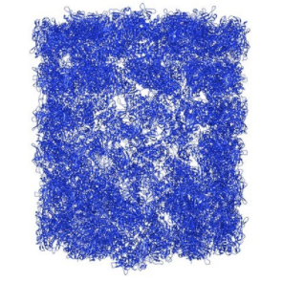
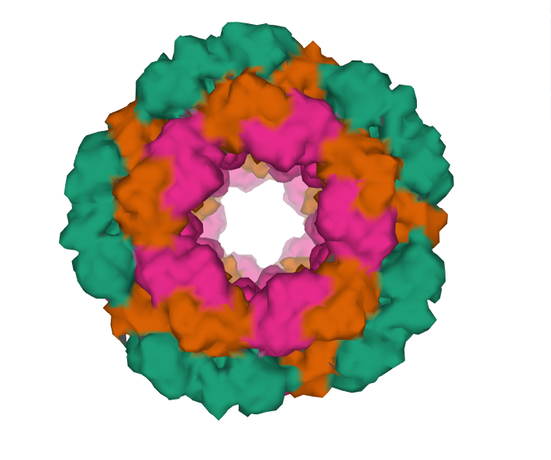
Background - Hemocyanin
Hemocyanin is a 4-8 million Dalton protein similar to hemoglobin
2 forms found in Molluscs and Arthropods
10 sub-units
Extensive post translational modification – Glycosolation
Mollusc hemocyanin is a powerful adjuvant
Keyhole Limpet Hemocyanin
Directs CD4+ T cell activation response
KLH1 and KLH2 genes
[1]Gatsogiannis C, Markl J. Keyhole limpet hemocyanin: 9-A CryoEM structure and molecular model of the KLH1 didecamer reveal the interfaces and intricate topology of the 160 functional units. J Mol Biol. 2009;385(3):963-983. doi:10.1016/j.jmb.2008.10.080
[2]https://www.rcsb.org/structure/4BED

Slide 3
Background – Hemocyanin as an adjuvant
Current adjuvants:
Aluminum derivatives
Good humoral response
Poor cellular response
2019 Roman et al.
Compared KLH, Concholepas concholepas Hemocyanin (CCH), and Fissurella Latimargianta hemocyanin (FHL) in combination with conventional adjuvants
Alum, AddaVax(squalene based oil in water nano emulsion) and QS-21(plant extract) [1]
Results:
KLH and FLH-QS21 formulations reduced tumor development and increased survival
Hemocyanins have no cytotoxic effect
[1]https://www.invivogen.com/addavax

Slide 4
Background – Hemocyanin production
KLH is extremely expensive
$5,000 to more than $150,000 per gram for native protein
Recombinant KLH is difficult to produce
Large protein size
Extensive post-translational modifications
Glycosylation
Only source of recombinant hemocyanin is not suitable for GMP or GCP
Produced in E. coli
Only 95% purity
Recent Sars-COVID-19 vaccine development may result in a shortage of vaccine adjuvants

Slide 5
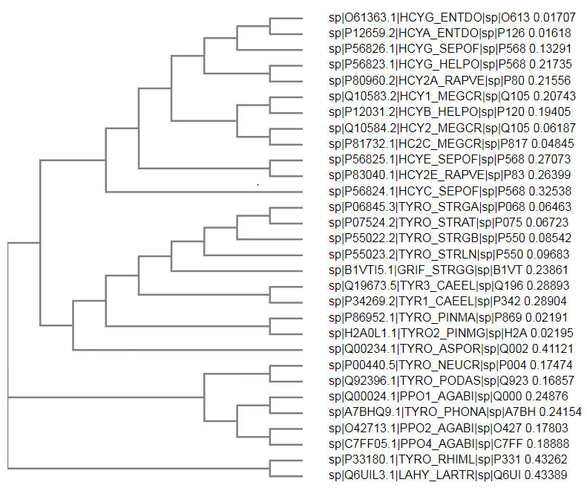
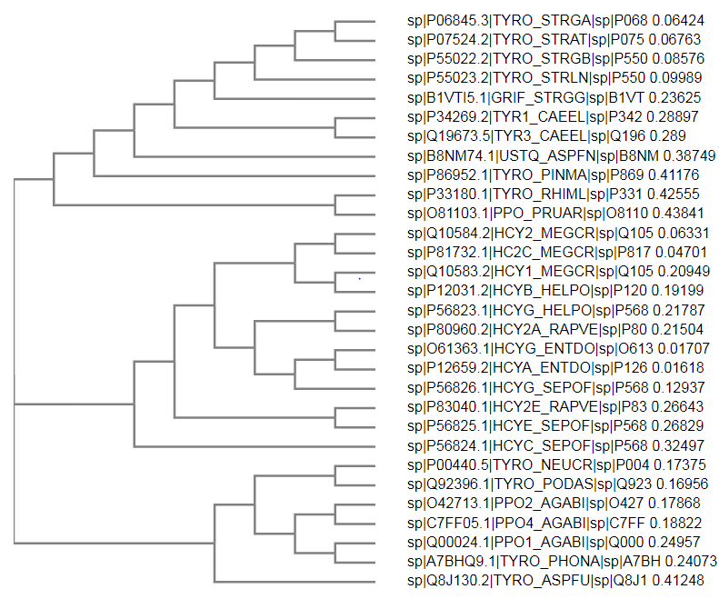
Background – Preliminary Research
KLH1
KLH2

Slide 6
Background – Organisms of Interest
Potential Novel Hemocyanin Adjuvants found in:
Helix pomatia (Burgundy Snail, escargot)
Rapana venosa (Veined Rapa Whelk)
Enteroctopus dolfleini (Giant Pacific Octopus)
Sepia officinalis (Common Cuttlefish)
Concholepas concholepas (Chilean Abalone)
Fissurella Latimargianta (Sea Snail, keyhole limpet family)

Slide 7
Question/Aims
Overarching goal: Can we find an alternative source for hemocyanin production by the means of an alternative organism or production of recombinant sub-units?
Test novel hemocyanin proteins for immune response
Using novel hemocyanin immune response data, identify sequences or regions in the hemocyanin gene that are conserved across hemocyanins with good responses
Using these conserved sequences, identify immunostimulatory sub-units
Produce recombinant sub-unit and characterize immunogenicity
This study will focus on the immunological significance of native hemocyanins to understand sub-unit immunogenicity, not on optimization of purification protocols

Slide 8
Methods – in Vitro
Isolate hemocyanins from: Helix pomatia Rapana venosa, Enteroctopus dofleini, Sepia officinalis, Concholepas concholepas, Fissurella Latimargianta, Megathura crenulata (Keyhole Limpet)
Ultracentrifucation, SDS-PAGE
Characterize T cell activation
Isolate human donor T cells by negative selection
Stimulate with isolated hemocyanins
Flow cytometry for T cell activation (CD4, CD8, CD137, CD56, CD45RA, CD45RO)
Compare sequence similarity of highly immunogenic hemocyanins
Identify similar subunits
Produce recombinant subunits in eukaryotic cell line
Lentiviral transduction with an inducible promotor
Antibiotic resistance selection

Slide 9
Methods – in Vitro Functional Assays
Compare T cell activation response
Recombinant hemocyanin sub-units vs native proteins vs KLH
Flow cytometry for T cell activation (CD4, CD8, CD137, CD56, CD45RA, CD45RO)
Evaluate specific T cell activation response
Isolate Monocytes (CD14+ selection)
Mature Monocytes to Dendritic Cells(DCs) to be used as antigen presenting cells (APCs) (IL-4, GM-CSF)
Load DCs with peptides of interest on to MHCs (peptide, LPS, IFNg, IL-4, GM-CSF)
Isolate naïve CD4/8 T cells
Add naïve T cells to APCs– Add Hemocyanin as an adjuvant
Allow T cells to expand (IL-7, IL-15, IL-2 is optional)
Stain cells with CD137+ antibody as a background stain then restimulate with peptides of interest
Sort activated T cells (CD137+)
Sequence T cell receptors (TCRs)
Engineer T cells with specific TCRs
Cytotoxic T Lympocyte killing assay (CTL assay)
Klinger, M., Pepin, F., Wilkins, J., Asbury, T., Wittkop, T., Zheng, J., Moorhead, M., & Faham, M. (2015). Multiplex Identification of Antigen-Specific T Cell Receptors Using a Combination of Immune Assays and Immune Receptor Sequencing. PLOS ONE, 10(10), e0141561. https://doi.org/10.1371/journal.pone.0141561

Slide 10
Methods – in Vivo
Test top hemocyanin subunits as a vaccine adjuvant in a Patient Derived Xenograft (PDX) mouse model with transplanted human hematopoietic stem cells
Male Nod-scid IL2Rgamma^{null} immune deficient mice (cohorts of 6)
Test groups:
Vaccine with KLH
Vaccine with top native hemocyanin (not KLH)
Vaccine with top hemocyanin sub-unit
Vaccine with no hemocyanin
24 total mice per round (repeat at least once)
General Protocol
Xenograft patient tumor tissue in mice
Transplant Human PBMCs
Administer cancer vaccine with KLH, hemocyanin sub-unit, or no hemocyanin
Monitor tumor progression and mortality

Slide 11
Expected Results
Hemocyanin from Helix pomatia will be the most immunogenic new hemocyanin, comparable to KLH
Because of sequence similarity and close phylogeny
Individual subunits of hemocyanin elicit immune responses significantly weaker than the native protein
Likely because of extensive post-translational modification only involved in fully assembled protein
Specific T cell activation (Functional Assay)
Native KLH and Helix pomatia hemocyanin as an adjuvant will produce the greatest number of different functional TCRs
in Vivo study
Top native hemocyanin candidate and KLH will have the most signifant impact on tumor progression and survival

Slide 12
Potential Difficulties/Backup Plan
Recombinant hemocyanin is difficult to produce
Lack of post-translational modifications (glycosylation)
Recombinant sub-units will also lack modifications
Production of such a large protein or subunit may kill the cell
Copper is highly cytotoxic
Solution: Continue investigation with isolated native hemocyanin proteins. An alternative source organisms should still be evaluated.
The immunodeficient mouse model may not be robust enough to tolerate both a xenograft and PBMC transplant
Solution: Switch to a different mouse model. Vaccine efficacy does not need to be tested on human cancer. A C57/BL6 mouse model with bacterial or viral infection may also be suitable; however, a mouse immune system may respond to adjuvants differently and a humanized immune mouse would be preferred. Another approch would be to irradiate mice with x-ray radiation, and transpant human CD34+ hematopoietic stem cells before bacterial or viral infection.

Slide 13
References
[1] Markl, J. (2013). Evolution of molluscan hemocyanin structures. Biochimica et Biophysica Acta (BBA) - Proteins and Proteomics, 1834(9), 1840–1852. https://doi.org/10.1016/j.bbapap.2013.02.020
[2] Becker, María & Arancibia Zunino, Sergio & Salazar, Fabian & Campo, Miguel & Ioannes, Alfredo. (2014). Mollusk Hemocyanins as Natural Immunostimulants in Biomedical Applications. 10.5772/57552
Awate, S., Babiuk, L. A., & Mutwiri, G. (2013). Mechanisms of action of adjuvants. Frontiers in immunology, 4, 114. https://doi.org/10.3389/fimmu.2013.00114
https://www.abcepta.com/products/PBV10538r-Hemocyanin-Keyhole-Limpet-KLH--Native-protein
https://www.biovision.com/hemocyanin-keyhole-limpet-klh-native.html
https://www.raybiotech.com/hemocyanin-keyhole-limpet-klh-subunits-powder/
Linzen B, Soeter NM, Riggs AF, et al. The structure of arthropod hemocyanins. Science. 1985;229(4713):519-524. doi:10.1126/science.4023698
Gesheva, V., Chausheva, S., Stefanova, N., Mihaylova, N., Doumanova, L., Idakieva, K., & Tchorbanov, A. (2015). Helix pomatia hemocyanin — A novel bio-adjuvant for viral and bacterial antigens. International Immunopharmacology, 26(1), 162–168. https://doi.org/10.1016/j.intimp.2015.03.011
Juan José Mora Román, Miguel Del Campo, Javiera Villar, Francesca Paolini, Gianfranca Curzio, Aldo Venuti, Lilian Jara, Jorge Ferreira, Paola Murgas, Alvaro Lladser, Augusto Manubens, María Inés Becker, "Immunotherapeutic Potential of Mollusk Hemocyanins in Combination with Human Vaccine Adjuvants in Murine Models of Oral Cancer", Journal of Immunology Research, vol. 2019, Article ID 7076942, 19 pages, 2019. https://doi.org/10.1155/2019/7076942
https://biosyncorp.com/klh/klh_keyhole_limpet_hemocyanin/#:~:text=They%20are%20approximately%2035%20nm,of%20a%20%22nucleating%22%20didecamer.
Coates, C. J., & Decker, H. (2017). Immunological properties of oxygen-transport proteins: hemoglobin, hemocyanin and hemerythrin. Cellular and molecular life sciences : CMLS, 74(2), 293–317. https://doi.org/10.1007/s00018-016-2326-7
van Holde KE, Miller KI, Decker H. Hemocyanins and invertebrate evolution. J Biol Chem. 2001;276(19):15563-15566. doi:10.1074/jbc.R100010200
Waxman L. The structure of arthropod and mollusc hemocyanins. J Biol Chem. 1975;250(10):3796-3806.
Becker, M. I., Arancibia, S., Salazar, F., Del Campo, M., & De Ioannes, A. (2014). Mollusk Hemocyanins as Natural Immunostimulants in Biomedical Applications. In Immune Response Activation. InTech. https://doi.org/10.5772/57552
Jiewkok, A., Tsukimura, B., & Utarabhand, P. (2015). Purification and molecular cloning of hemocyanin from Fenneropenaeus merguiensis(de Man, 1888): response to Vibrio harveyi exposure. Journal of Crustacean Biology, 35(5), 659–669. https://doi.org/10.1163/1937240x-00002356
Klinger, M., Pepin, F., Wilkins, J., Asbury, T., Wittkop, T., Zheng, J., Moorhead, M., & Faham, M. (2015). Multiplex Identification of Antigen-Specific T Cell Receptors Using a Combination of Immune Assays and Immune Receptor Sequencing. PLOS ONE, 10(10), e0141561. https://doi.org/10.1371/journal.pone.0141561

