Slide 1
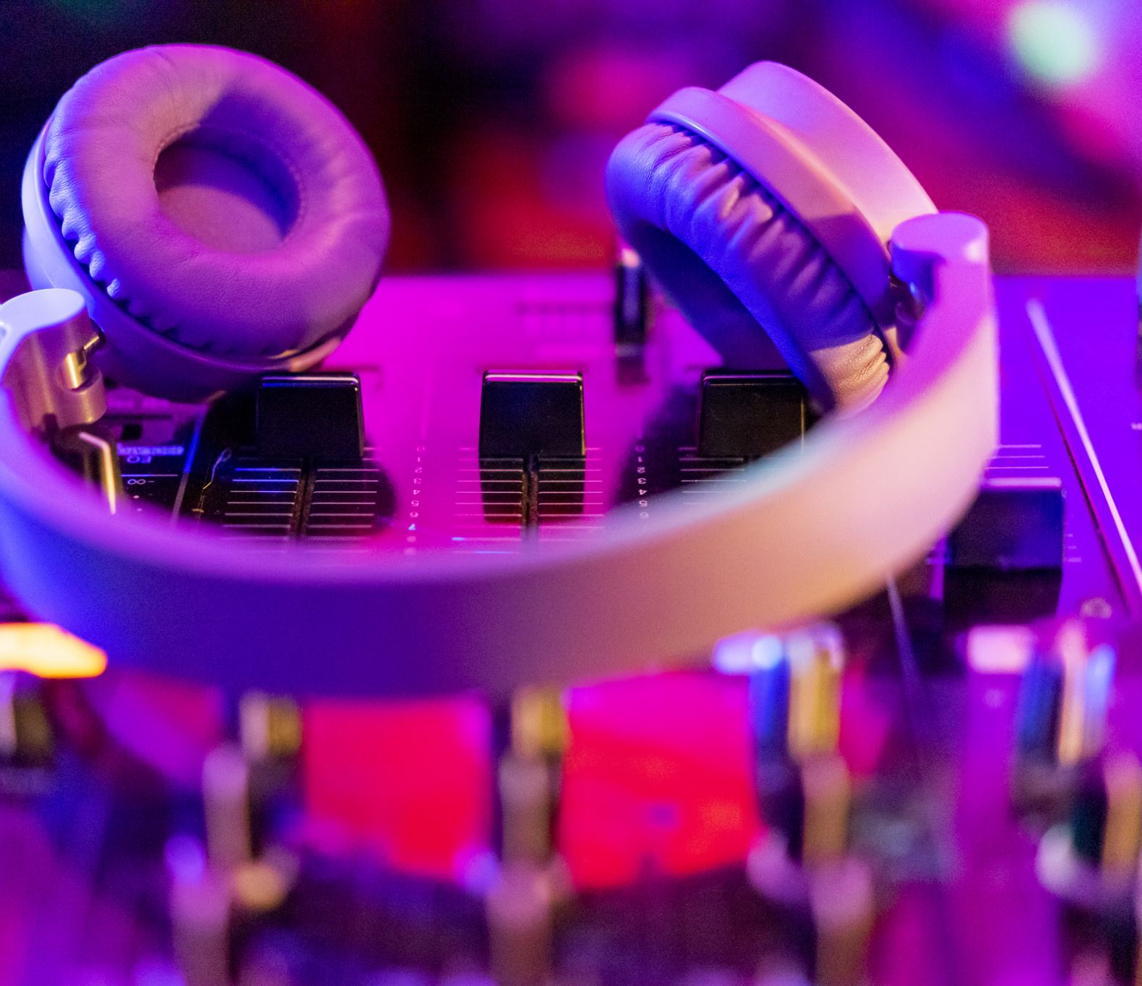
Hands-Free MP3
By:
Matthew Russo

Slide 2
Main Goal
Personal goal: project with wireless feature
MP3 player to Bluetooth speaker
Use a gesture sensor to control a music player
Use Bluetooth
Control volume and playlist

Slide 3
Characterization
In Assingment 2, I looked at timers and GPIO IRQs
Wanted to know how to get them working and react on them
Learned how to use WiringPi (GPIO library)
While useful to learn
Not used in project…
Why is that?

Slide 4
Characteristic Problems
Gesture sensor uses I2C – I knew this
No I2C IRQ in wiringPi– I did not know this
Exists in Pi chip, but not to OS level.
I have experience working with STM32s, but that didn’t fully transfer over to working with Raspberry Pi OS (hence my surprise on the IRQ)

Slide 5
Learned and Learning
Bluetooth control
Bluetoothctl app is how I have my connection
Audio layers
ALSA, PCM, different factors into audio
Ex. Amixer can’t affect BT audio
Used WirePlumber for volume

Slide 6
Learned and Learning
Threads/Pipes
Because I’m using other tools (apps from the Pi), I had to learn how to call them in a C file
Calling those tools and grabbing the info from them
Super important for embedded – but still learning

Slide 7
Future Wishes
Tuning of the gesture sensor
IT WORKS!
Not 100% reliable -_-
About 50 registers to tune
Screen Display
Could add screen to show playing song

