Slide 1
Underdogs
Anita-NCS
Jun Hao-NCS
Warren-NCS
Jaideep-Cognizant
Maggie-Cloudera

Slide 2
https://github.com/mcruz102317/Underdog

Slide 3
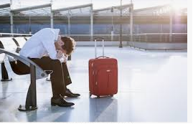
Stuck at airport?

Slide 4
Target Audience
You

Slide 5
Objective
Help you make decision when booking flights.

Slide 6


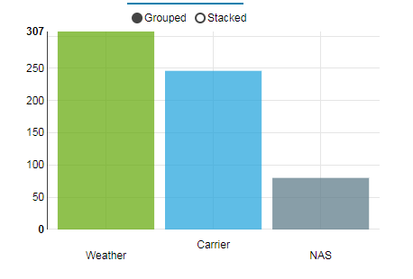
Source
HDFS
DataBase
Visualisation

Slide 7
Objective of this presentation

Slide 8
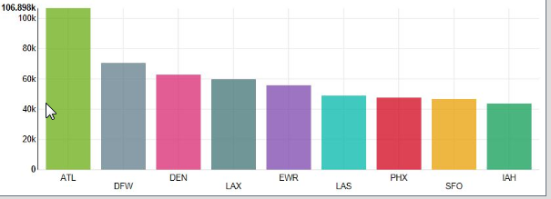
Fun place to go for your next trip
JD

Slide 9
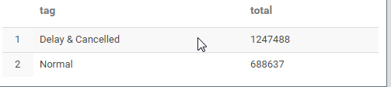
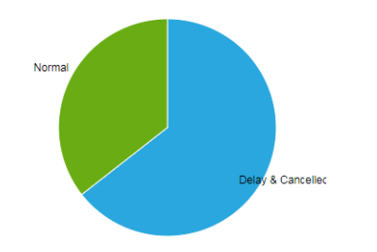
Most flights are delay! Might as well walk
AK

Slide 10
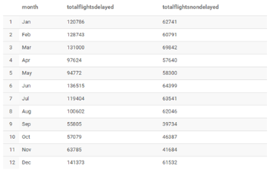
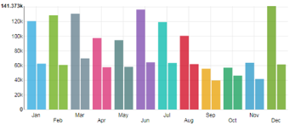
WA
DELAY VS NON-DELAY BY MONTH

Slide 11
Why Cancelled?
JH

Slide 12
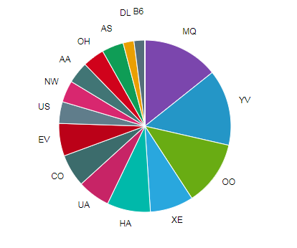
Airlines to avoid at all cost! J.K
JH
Percentage of cancelled flight
*To protect the reputation of the airlines.
I will not say what airline is MQ.
NOT AMERICAN EAGLE

Slide 13
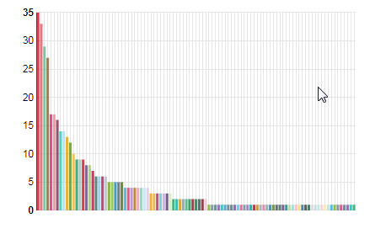
Flight origin vs cancelled places to avoid at all cost!
JH
<< is DENMARK

Slide 14
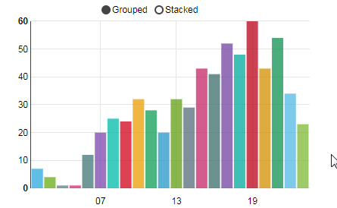
Time vs cancellation
JH

Slide 15
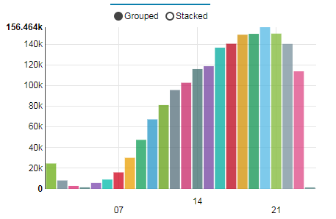
Time VS delayed
JH

Slide 16
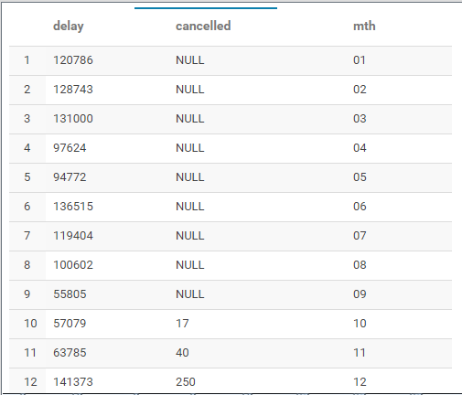
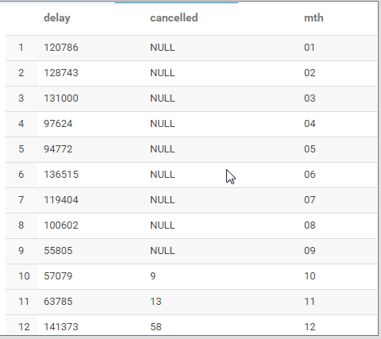
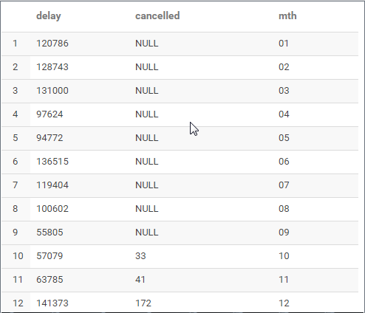
AK
Weather
NAS
Carrier

Slide 17
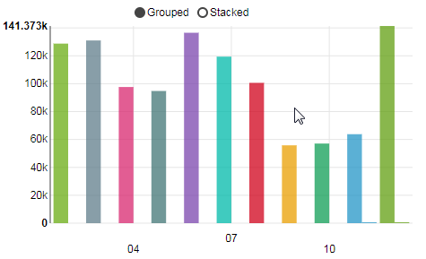
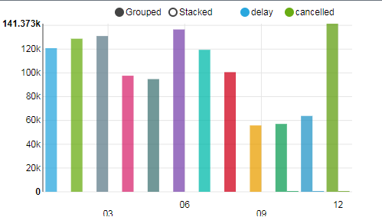
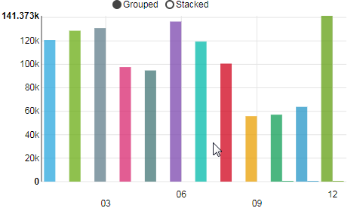
AK
Weather
NAS
Carrier

Slide 18
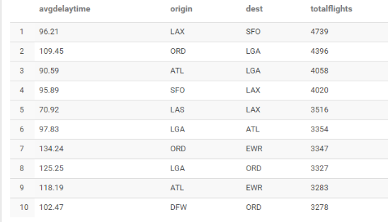
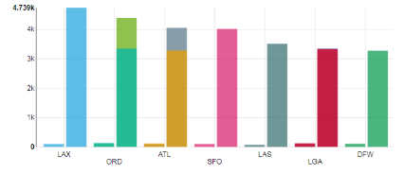
Top 10 routes and their average delay
WA

Slide 19
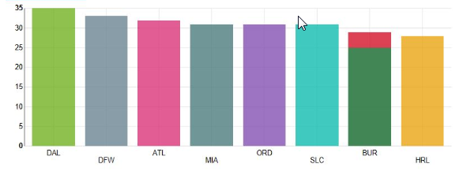
Top 10 airlines with diverted flights
JD

Slide 20
What works
End to end process
Able to process a file from Local to HDFS thru flume
Able to generate report
We learn from each other

Slide 21
What can be done better
KUDU crashed.
Unsolvable within time frame
Bad planning
Bad Kudu skill set
Using of KAFKA on-top of Flume for better data streaming
We should cleanse the data (a bit unclean e.g date and time etc)

Slide 22
I believe you guys have no further question

