Slide 1
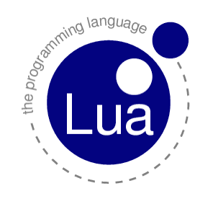
Lua
Prepared by: Erencan Erdoğan
Student Number: 22010107

Slide 2
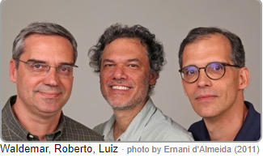
history
"Lua" means "Moon" in Portuguese.
First appeared in 1993
Created by Roberto Ierusalimschy, Luiz Henrique de Figueiredo, and Waldemar Celes at Pontifical Catholic University of Rio de Janeiro in Brazil
It was first created in 1993 as a fusion of two other languages, a scientific language and a language made for geological surveys.

Slide 3
history
Lua was born and raised in Tecgraf, formerly the Computer Graphics Technology Group of PUC-Rio.
Lua is now housed at LabLua, a laboratory of the Department of Computer Science of PUC-Rio.

Slide 4
What is the lua
Lua is a powerful, efficient, lightweight, embeddable scripting language.
It supports procedural programming, object-oriented programming, functional programming, data-driven programming, and data description.
Lua combines simple procedural syntax with powerful data description constructs based on associative arrays and extensible semantics.

Slide 5
What is the lua
Lua is dynamically typed, runs by interpreting bytecode with a register-based virtual machine, and has automatic memory management with incremental garbage collection, making it ideal for configuration, scripting, and rapid prototyping.
Influenced by C++, Modula, Scheme, SNOBOL
Influenced Javascript, Julia, Ruby

Slide 6
Features of lUa
Light, multi-paradigm language
Highly portable: can be compiled to run on Linux, Windows, Macintosh
Lua is a dynamically typed language,
Variables do not possess data types, only their values. The eight basic types it supports for its values are: nil, Boolean, number, string, function, userdata, thread, and table.
Also has automatic garbage collection

Slide 7
Features of lua
Can call functions written in C or Lua
C API
The API is divided into two parts: the Lua core and the Lua auxiliary library.
Assignments in Lua can be done singularly, or in multiplies.
Lua has no static binding, and is completely dynamically bound based on the data fed into the variable.
Variables are global unless otherwise declared
Scopes in Lua are scoped lexically.

Slide 8
Features of lua
Lua provides the following control structures: While, Repeat, If, For, Break, and Return.
Abstract data in Lua is possible in Lua through the tables and metatables, based on implementation on the part of the programmer
A name in Lua can be string of letters, digits, or underscores, but a name may never begin with a digit. Additionally, a name cannot be one of Lua’s reserved words

Slide 9
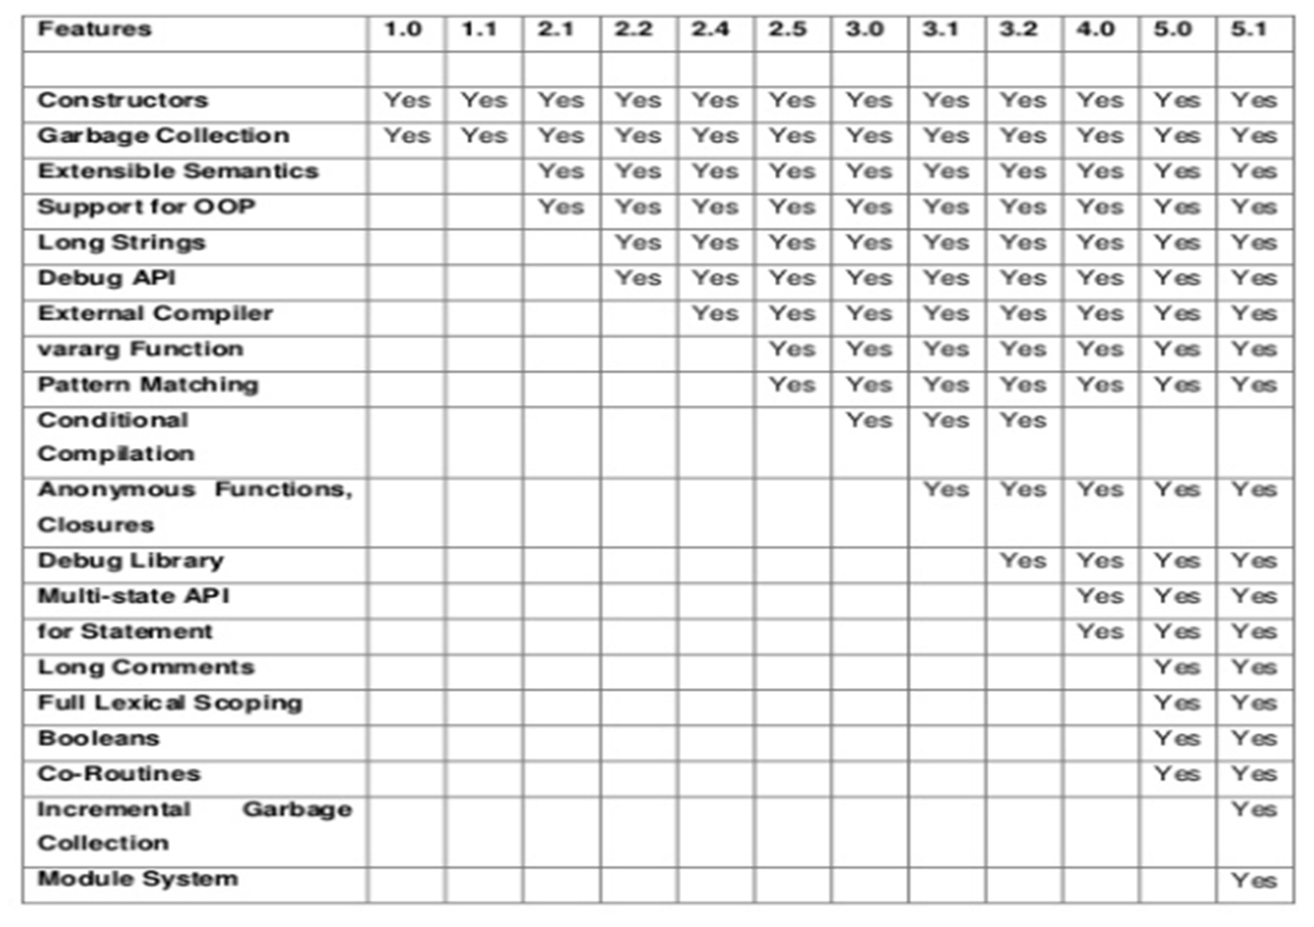
Versıons and evolutıon of lua
1.0
1.1
2.1
2.2
2.3
2.4
2.5
3
3.1
3.2
4.0
5
5.1
5.2
5.3
5.4

Slide 10
Language Evaluatıon Crıterıa
Readability: the ease with which programs can be read and understood
Writability: the ease with which a language can be used to create programs
Reliability: conformance to specifications (i.e., performs to its specifications)
Cost: the ultimate total cost

Slide 11
Readabılıty of lua
Lua is fairly readable, given that the writer puts forth some effort into it’s formatting.
Lua works in blocks that look for a signification of an ending, and such, thus can be put onto all one line, or spread out across multiple lines.
The reserved words in Lua are logical, and case sensitivity on variables ensures that all variable names will be the same.
Semi-colons are not necessary to indicate the ending of one assignment or expression and the start of another. This can result in some difficulty of readability if the code is not formatted correctly manually, due to lack of understanding where one expression ends, and another begins.
Variables don’t have declared types, only their values do(Negative)
No spaces between terminals and nonterminals(Negative)
Very little parentheses or brackets(positive)

Slide 12
Wrıtabılıty of lua
Lua is highly writable, for both those who have not learned, and for those who already know, a C based language.
It shares many of the syntaxes from C based language, aside from that it does not require each line to end in a semicolon.
This reduces the probability of missed semicolon errors, and won’t throw any errors if they are placed, for those used to C.
The program enforces case sensitivity, which can increase the probability of errors from typing the wrong variable, if the programmer uses inconsistent casing or makes errors.
Few keyword(positive)
All blocks of code end with ‘end’(positive/negative)

Slide 13
Relıabılıty of lua
Lua’s reliability depends quite heavily on what language it is extending.
It’s exception handling is dependent on the language being extended, and a language with robust exception handling will be extension assist Lua.
The type checking in Lua is performed only within assignment statements, which allows it to assist in finding errors in that way, but there is no type checking for the returning of functions and their parameters.
This can potentially cause misuse of functions by those unfamiliar with the program, or absent minded programmers.

Slide 14
Cost of lua
Resources for Lua are readily available as free resources
The cost of Lua lies solely in the amount of money it would take to train a programmer, or acquired a trained programmer.
Compilers for Lua are free, and are available as modules for many of the popular IDEs for other languages (upon which Lua expands).

Slide 15
Portabılıty of lua
Lua is distributed in a small package and builds out-of-the-box in all platforms that have a standard C compiler.
Lua runs on all flavors of Unix and Windows, on mobile devices (running Android, iOS, BREW, Symbian, Windows Phone), on embedded microprocessors (such as ARM and Rabbit, for applications like Lego MindStorms), on IBM mainframes, etc.

Slide 16
Some uses of lua
Game Programming
Scripting in Standalone Applications
Scripting in Web
Extensions and add-ons for databases like MySQL Proxy and MySQL WorkBench
Security systems like Intrusion Detection System.

Slide 17
Lua programmıng domaın
Blizzard Entertainment: World of Warcraft scripting
Cisco Systems
Maxis/EA: SimCity 4
Adobe: Adobe Photoshop Lightroom
Many video games use Lua

Slide 18
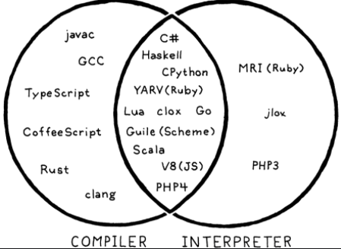
COMPILER OR INTERPRETER OF LUA

Slide 19
Ide of lua
For Windows SciTE, Lua IDE is the default IDE provided by the Lua creator team.
The alternate IDE available is from ZeroBrane Studio, which is available across multiple platforms like Windows, Mac and Linux.
There are also plugins for eclipse that enable the Lua development. Using IDE makes it easier for development with features like code completion and is highly recommended. The IDE also provides interactive mode programming similar to the command line version of Lua.

Slide 20
Ide of lua

Slide 21
Ide of lua
ZeroBrane Studio is a lightweight Lua IDE with code completion, syntax highlighting, live coding, code analyzer, and debugging support for Lua 5.1, Lua 5.2, Lua 5.3, LuaJIT, and other Lua engines.
Unlike Decoda, it runs on Windows, macOS, and Linux and supports various Lua versions with on-device debugging.

Slide 22
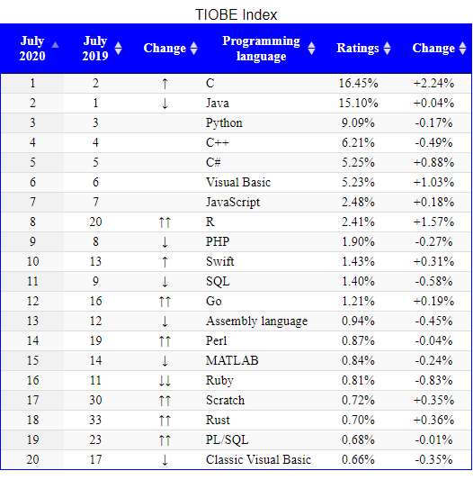
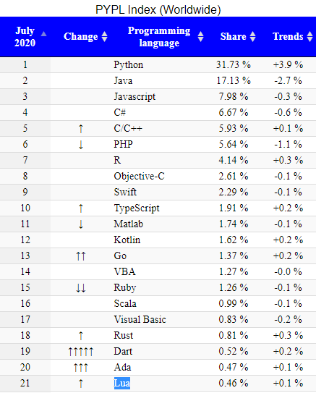
POPULARITY OF LUA

Slide 23

Lua Community Engagement
Lua came in 17th overall for community engagement.
Although we wouldn’t recommend learning Lua as a beginner, its relative popularity on Freenode and Facebook show that people are still interested in Lua.

Slide 24
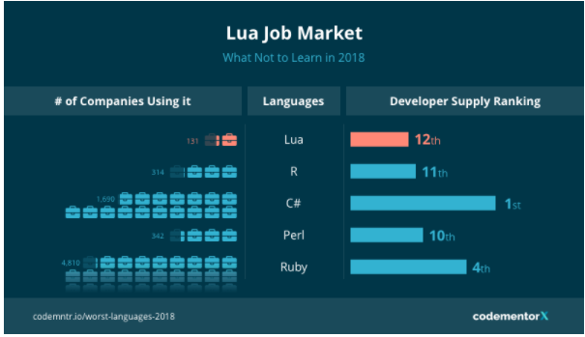
Lua Job Market
Lua ranks 18th place in terms of hiring and 12th in terms of developer supply, giving it an overall job market ranking of 17th place.
There are more Lua developers than there are companies who need Lua developers.
Stackshare.io data shows that Lua isn’t performing as well as other languages that came out around the same time.

Slide 25
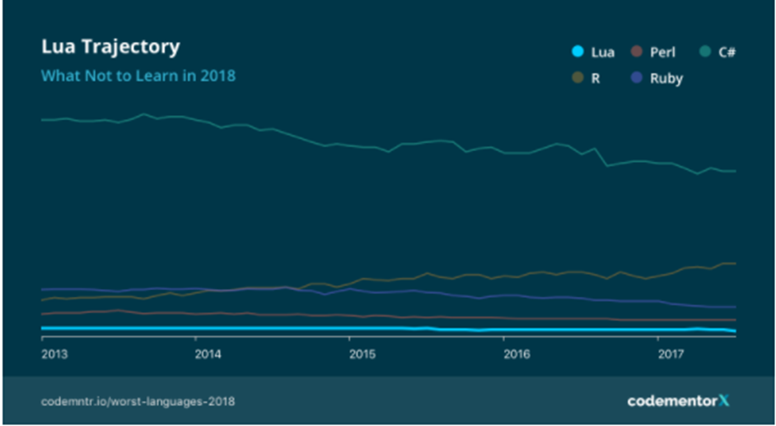
Lua’S GROWTH
As you can see, Lua’s growth has flat-lined. In the last five years, while Lua hasn’t declined, it hasn’t grown either. Like its peers, Perl and Haskell, Lua might be showing its age in terms of developer excitement and usage. That being said, R, which debuted the same year as Lua, is experiencing growth, perhaps because of the rise of data science as a profession, while Lua’s growth remains stagnant.

Slide 26
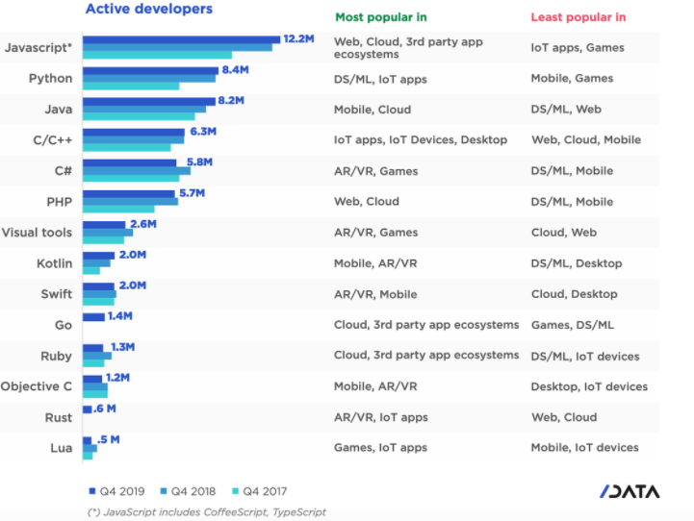
Why is Lua popular?
Lua has an extremely clean simple design and a small API. I think this is the reason that it has the world's fastest JIT implementation for a dynamic scripting language. Lua is extremely popular within the gaming market because of its speed

Slide 27
IS LUA A DEAD LANGUAGE
While Lua is still used fairly often in gaming and web service, it performed poorly in terms of community engagement and job market prospects. That being said, in spite of its age, Lua's growth has flat-lined rather than declined, which means that although it's not popular, it's not dying either

Slide 28
ADVANTAGES OF LUA
Lua is a proven, robust language
Lua is fast
Lua is portable
Lua is embeddable
Lua is powerful (but simple)
Lua is small
Lua is free

Slide 29
Dısadvantages of lua
Not all codes are easily available, some of them need to coded manually
It has a very small community of users

Slide 30
LUA VARIABLES
A variable is nothing but a name given to a storage area that our programs can manipulate.
The name of a variable can be composed of letters, digits, and the underscore character.
Upper and lowercase letters are distinct because Lua is case-sensitive.
In Lua, though we don't have variable data types, we have three types based on the scope of the variable.
Global variables
Local variables
Table fields

Slide 31
Code samples(varıables)

Slide 32
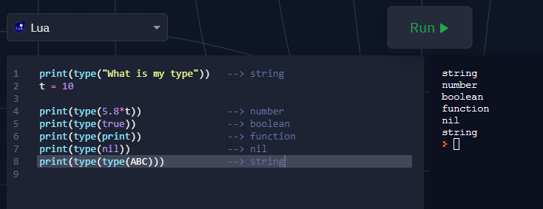
Code samples(data types)

Slide 33
Lua operator
An operator is a symbol that tells the interpreter to perform specific mathematical or logical manipulations.
1.Arithmetic Operators
2.Relational Operators
3.Logical Operators
4.Misc Operators

Slide 34
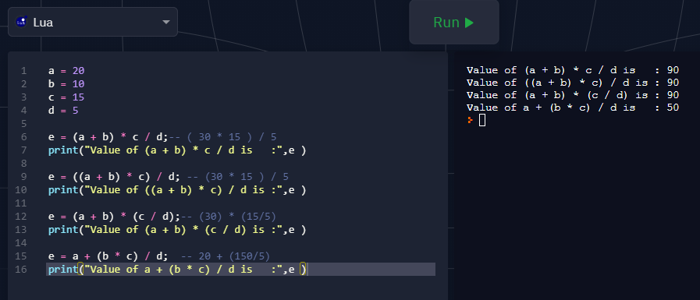
Operators Precedence in Lua

Slide 35
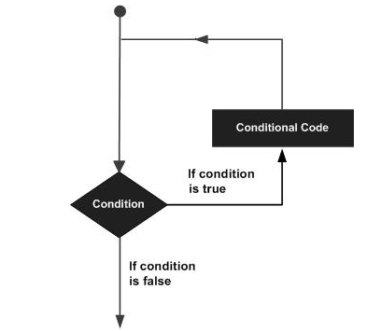
Loop ın lua
A loop statement allows us to execute a statement or group of statements multiple times. Following is the general form of a loop statement in most of the programming languages −

Slide 36
Loop ın lua
Whıle loop
For loop
Repeat untıl loop
Nested loop

Slide 37
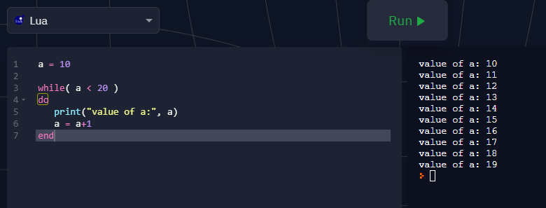
Whıle loop

Slide 38
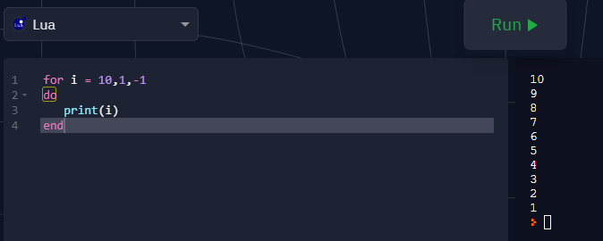
For loop

Slide 39
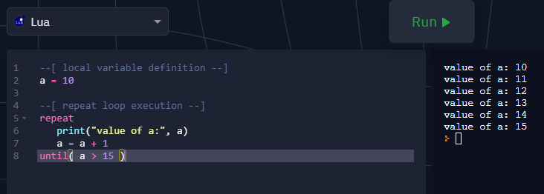
Repeat untıl loop

Slide 40
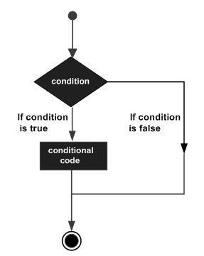
Decısıon makıng ın lua
Following is the general form of a typical decision making structure found in most of the programming languages −

Slide 41
Decısıon makıng ın lua
Lua programming language assumes any combination of Boolean true and non-nil values as true, and if it is either boolean false or nil, then it is assumed as false value. It is to be noted that in Lua, zero will be considered as true.
Lua programming language provides the following types of decision making statements.
If statement-if… else statement-nested if statement

Slide 42
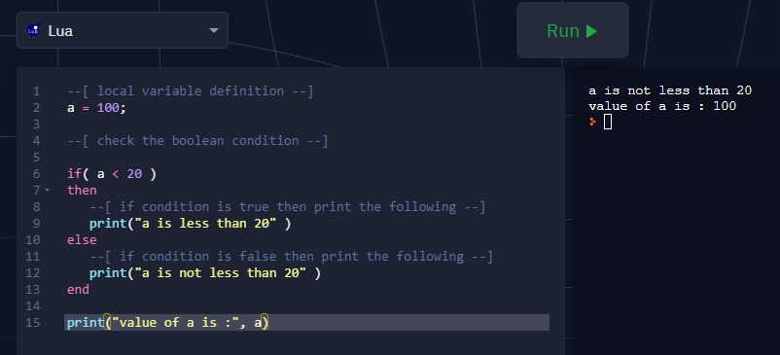
Code samples(decısıon makıng)

Slide 43
OTHERS
Lua's treatment of functions as first-class values
Lua also supports closures
Tables are the most important data structures (and, by design, the only built-in composite data type) in Lua and are the foundation of all user-created types. They are associative arrays with addition of automatic numeric key and special syntax.
A table is a collection of key and data pairs, where the data is referenced by key; in other words, it is a hashed heterogeneous associative array.

Slide 44
OTHERS
Tables are created using the {} constructor syntax.
Tables are automatically assigned a numerical key, enabling them to be used as an array data type. The first automatic index is 1 rather than 0 as it is for many other programming languages
Extensible semantics is a key feature of Lua, and the metatable concept allows Lua's tables to be customized in powerful ways.
C API

Slide 45
Error handlıng
In any programming, there is always a requirement for error handling. Errors can be of two types which includes,
1.Syntax errors
EX: a == 2
2.Run time errors
In case of runtime errors, the program executes successfully, but it can result in runtime errors due to mistakes in input or mishandled functions

Slide 46
Useful Links on Lua
Lua Programming − Official Site for Lua
Editions of Lua − Know about different versions of Lua
Details of Lua Programming − This guide will tell about history and other details of the Lua programming

Slide 47
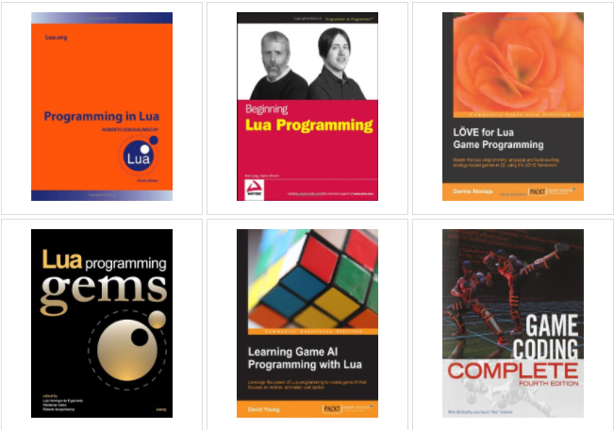
Useful Books on Lua

Slide 48
references
https://www.tutorialspoint.com/lua/lua_environment.htm
https://www.moys.gov.iq/upload/common/Programming_in_Lua%2C_4th_ed._%282017%29_.pdf
http://campus.murraystate.edu/academic/faculty/wlyle/415/2013/AClark.pdf
https://www.lua.org/about.html
https://en.wikipedia.org/wiki/Lua_(programming_language)
https://www.codementor.io/blog/worst-languages-to-learn-3phycr98zk

Slide 49
references
https://www.lua.org/ftp/refman-5.0.pdf
http://index-of.es/Varios-2/Lua%20Tutorial.pdf
https://www.tiobe.com/tiobe-index/
https://pypl.github.io/PYPL.html

Slide 50
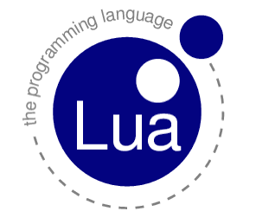
THANKS

