Slide 1
IBM Applied Data Science Space-X
Miklos Csepi 04.02.2023

Slide 2
Outline
Executive summary
Introduction
Methodology
Results
Conclusions
Appendix

Slide 3
Executive summary

Slide 4

Executive Summary
Used methodologies to analyze data:
Data collection about lunch data using SpaceX API
Data wrangling to find patterns
Visualizing data to get relations between data
Used Machine Learning for prediction
Summary of all results
Collecting valuable data from public sources
Interactive dashboard
Crate model for prediction

Slide 5
Introduction

Slide 6

Introduction
Background and context:
In this capstone, it will predict if the Falcon 9 first stage will land successfully. It can determine if the first stage will land, it can determine the cost of a launch. This information can be used if Space Y company wants to bid against SpaceX for a rocket launch.
Deliverables
To estimate, by what factors can have successful landings
Where is the best place to make space launch

Slide 7
Methodology

Slide 8

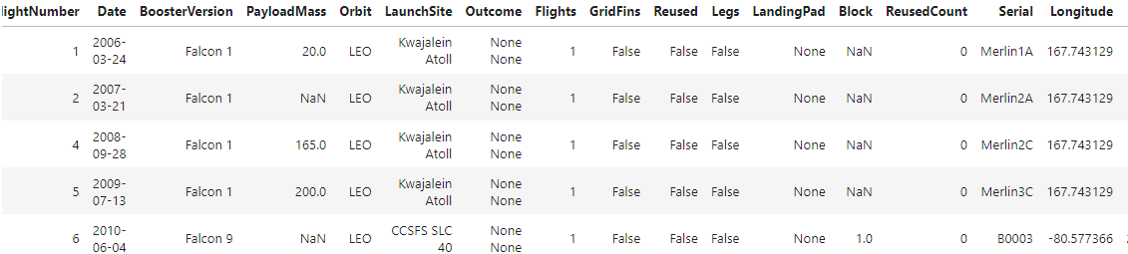

Collecting the data
Collecting the data
use the RESTfulAPI to extract information using identification numbers in the launch data
Request and parse SpaceX launch data using GET request

Slide 9

Collecting the data
Filter the dataframe to only include Falcon 9 launches
Data wrangling
Dealing with Missing Values

Slide 10
Collecting the data
Data wrangling
Loading SpaceX dataset
Identify and calculate the percentage of the missing values in each attribute
Identify which columns are numerical and categorical
Calculate the number of launches on each site
Calculate the number and occurrence of each orbit
Calculate the number and occurence of mission outcome per orbit type

Slide 11
Collecting the data
Data wrangling https://en.wikipedia.org/wiki/List_of_Falcon\_9\_and_Falcon_Heavy_launches
Request the Falcon9 Launch Wiki page from its URL
Extract all column/variable names from the HTML table header
Create a data frame by parsing the launch HTML tables

Slide 12

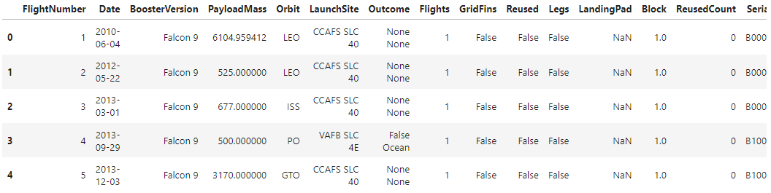
Collecting the data
Data wrangling
Create a landing outcome label from Outcome column

Slide 13
Collecting the data
Understanding SpaceX dataset through executing SQL queries
Connect to the database : %load_ext sql
Display the names of the unique launch sites in the space mission
Display 5 records where launch sites begin with the string 'CCA‘
Display the total payload mass carried by boosters launched by NASA (CRS)

Slide 14
Collecting the data
Display average payload mass carried by booster version F9 v1.1
List the date when the first successful landing outcome in ground pad was acheived
List the names of the boosters which have success in drone ship and have payload mass greater than 4000 but less than 6000

Slide 15
Collecting the data
List the total number of successful and failure mission outcomes
List the names of the booster_versions which have carried the maximum payload mass. Use a subquery
List the failed landing_outcomes in drone ship, their booster versions, and launch site names for in year 2015

Slide 16
Collecting the data
Rank the count of landing outcomes (such as Failure (drone ship) or Success (ground pad)) between the date 2010-06-04 and 2017-03-20, in descending order

Slide 17


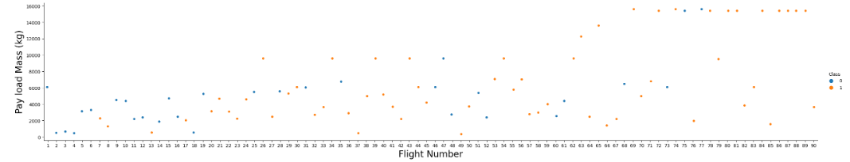
Data Visualization
Exploratory Data Analysis

Slide 18
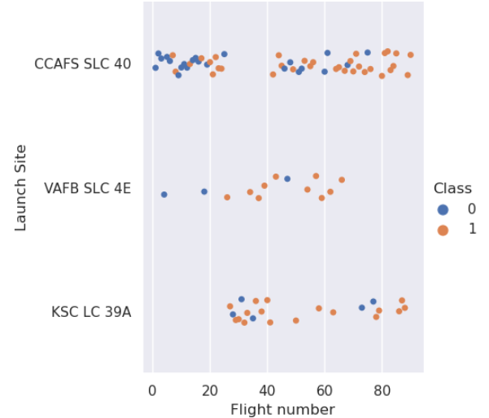
Data Visualization
Visualize the relationship between Flight Number and Launch Site

Slide 19
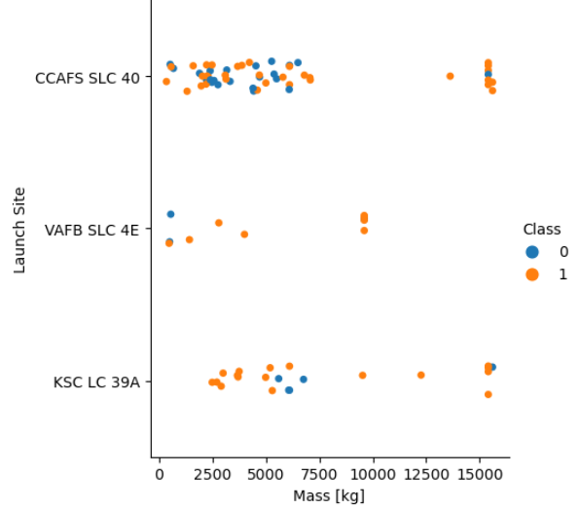
Data Visualization
Visualize the relationship between Payload and Launch Site

Slide 20
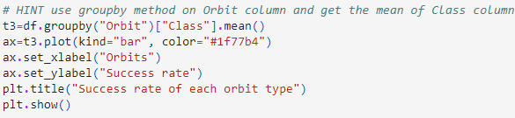
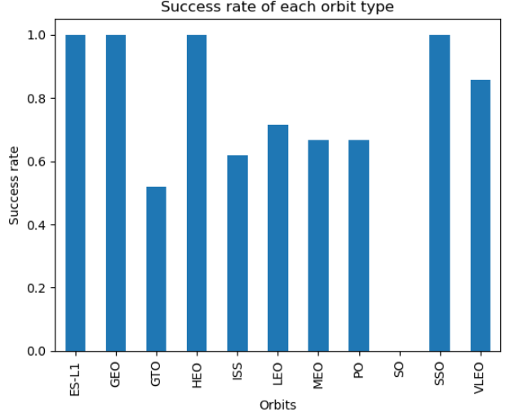
Data Visualization
Visualize the relationship between success rate of each orbit type

Slide 21
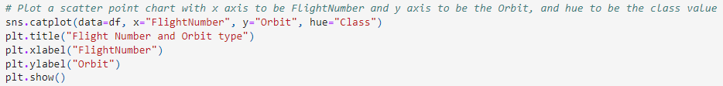
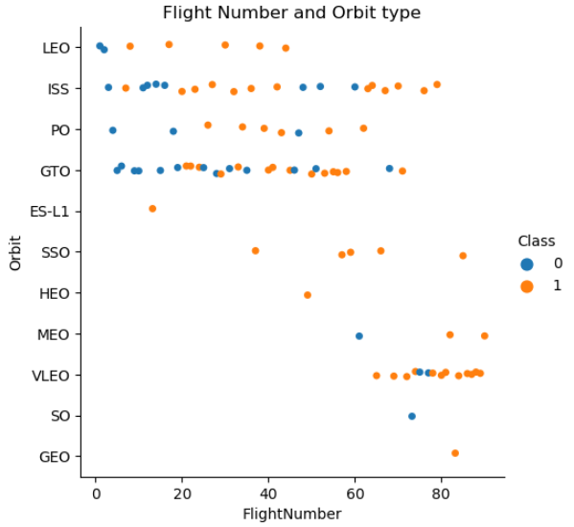
Data Visualization
Visualize the relationship between FlightNumber and Orbit type

Slide 22
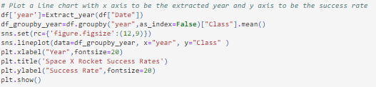
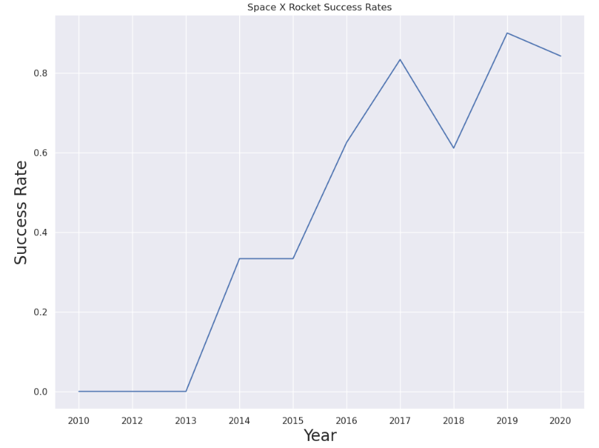
Data Visualization
Visualize the launch success yearly trend

Slide 23

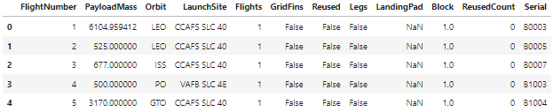
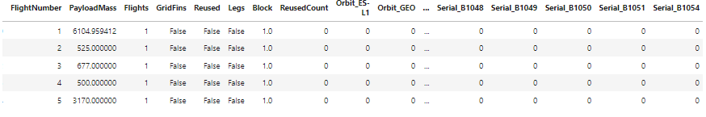
Features Engineering
Select the features that will be used in success prediction in the future module.
Create dummy variables to categorical column

Slide 24
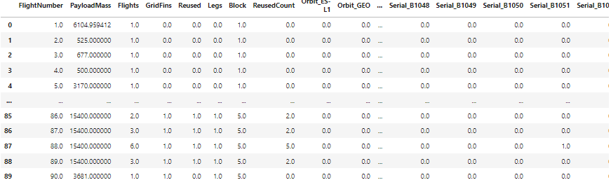
Features Engineering
Cast all numeric columns to float64

Slide 25

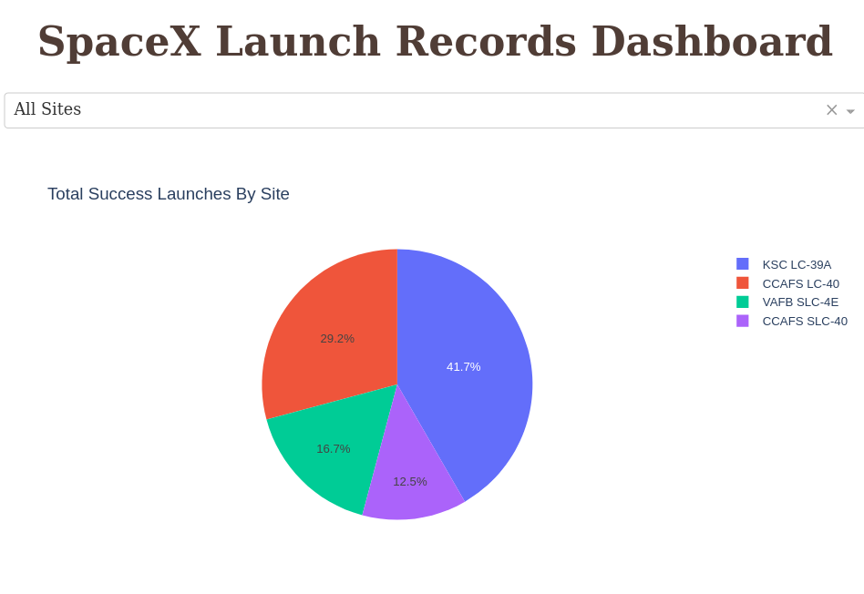
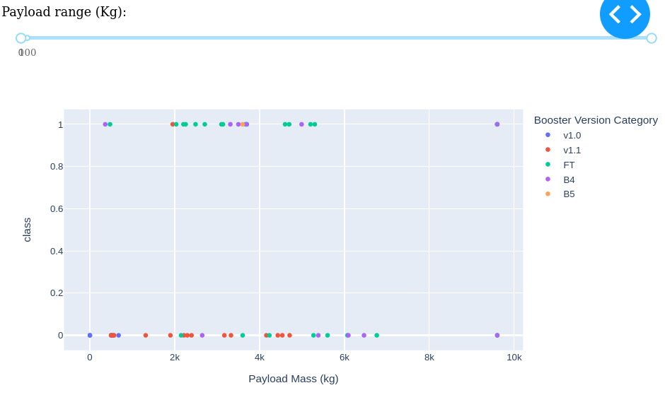
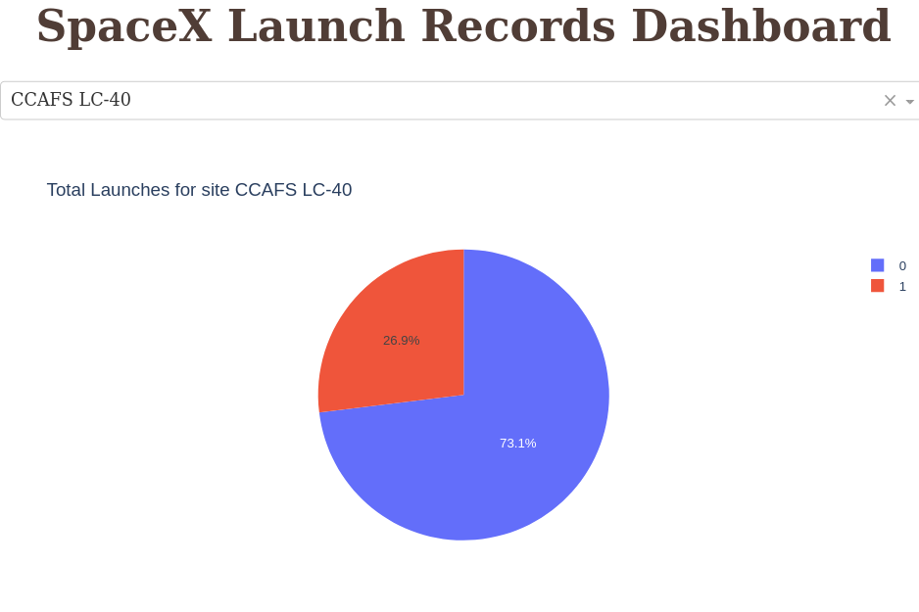
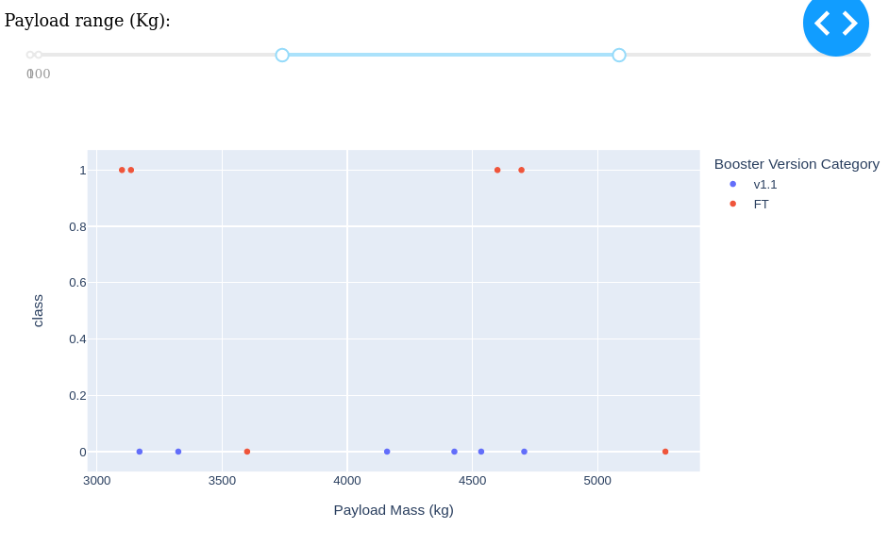
Dashboard with Plotly Dash

Slide 26
Results

Slide 27

Results
Results out of data analysis
Different launch sites have different success rate:
CCAS LC-40 – 60%
KSC LC-39A & VAFB SLC 4E – 77%
Success rate become over 60% from 2016
Success rate 100%: ES-L1, GEO, HEO, SSO
VLEO orbit type has the most success flights, over 80
Most payloads with successful launches are from CCAFS SLC 40 & KSC LC39A

Slide 28
Results
AVG Payloads,2.928 kg by booster version F9
99 Success launches have been made
Total Payload Mass by NASA: 45596 kg
First successful landing outcame in Ground Pad: 22-12-2015

Slide 29

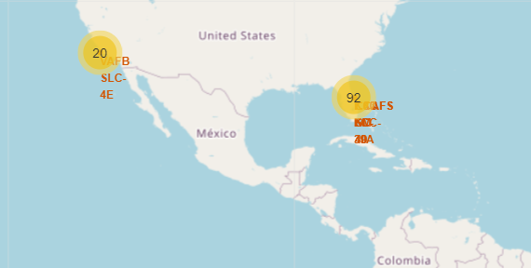
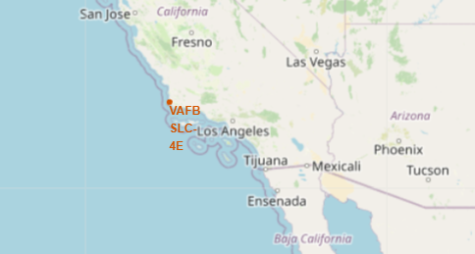
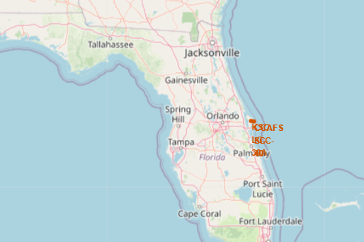
Maps

Slide 30
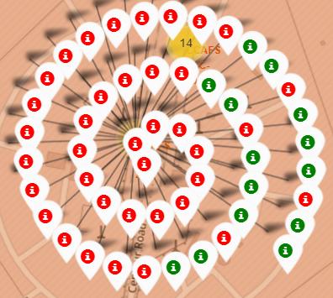
Maps

Slide 31

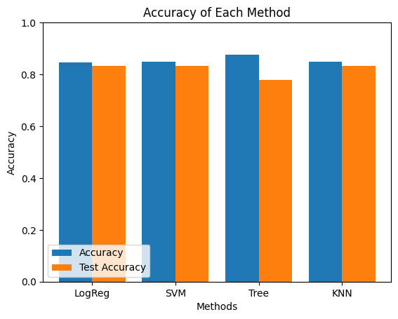
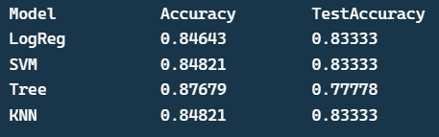
Prediction
Four classifications models were tested
Tree model has the highest accuracy however, its test accuracy was the lowest

Slide 32
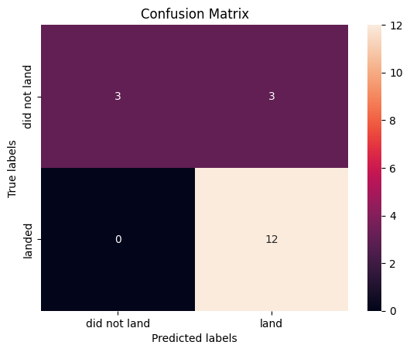
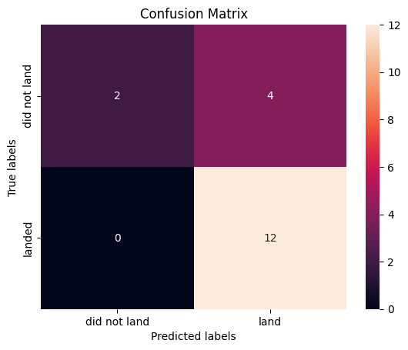
Prediction
Logreg
SVM
KNN
Tree

Slide 33
Conclusions

Slide 34

Conclusions
SpaceX success rates are increasing over the years
Best launch site is KSC LC-39A
Launches become risky with Payloads above 7000 kg
To predict successful landings Decision Tree Classifier worth being used

Slide 35

Appendix
Applied Data Science Capstone
GitHub repository

Slide 36
Thank You!

