Slide 1

Spice up Your Forms and Views
with Client Side Rendering (CSR)
Joe McShea
Owner/Consultant
IntelliPoint Solutions LLC
1/21/2017

Slide 2

Who Am I?
Joe McShea
IntelliPoint Solutions LLC
Owner/Software Architect
Over 20 years as a software developer/architect
Focused on the Microsoft stack and SharePoint/Office 365 since 2007
Author of SPEasyForms, an open source forms solution for SharePoint 2010, 2013, 2016, and Online available for download on CodePlex
Contact
joe@intellipointsol.com
@Joe_McShea (twitter)
http://speasyforms.com (blog)

Slide 3
Target Audience & Objectives
Show practical examples of CSR to customize forms (and possibly Views)
Talk about gotchas MDS, deployment, JSLink limitations
Demonstrate building components that can be easily reused by power users
Who? Developers
(including Citizen Developers)

Slide 4
What is JSLink?
A mechanism to inject JavaScript into various pages
A property that can be set on various SharePoint objects
- Form, Field, Content Type, View, List View Web Part (XLSTListViewWebPart)
CSR depends on a mechanism to inject JavaScript
- It does NOT depend on JSLink
- There are other alternatives (Custom Actions, CEWP, etc.)
- In some cases, JSLink works quite well with CSR, in others it does not play well with CSR at all

Slide 5
What is Client Side Rendering?
In general, it just means pushing much of the presentation logic from the server (XSLT) to the client (JavaScript)
In SharePoint, it is a framework for overriding the built-in presentation logic of new, edit, and display forms, views, and search results using HTML, CSS, and JavaScript
- Depends on a mechanism for injecting JavaScript into one or more SharePoint
pages

Slide 6
What is Client Side Rendering?
An API implemented in SPClientTemplates, which is defined in clienttemplates.js
Override parts of the rendering by calling:
SPClientTemplates.TemplateManager.RegisterTemplateOverrides(obj)
The object input to this function describes the parts of the rendering process that we would like to take over

Slide 7
What can we override? (forms)
var overrides = {
OnPreRender: /* function or array of functions */,
Templates: {
Fields: {
'Field1 Internal Name': {
View: /* function or string */,
EditForm: /* function or string */,
DisplayForm: /* function or string */,
NewForm: /* function or string */
},
'Field2 Internal Name': {
View: /* function or string */,
EditForm: /* function or string */,
DisplayForm: /* function or string */,
NewForm: /* function or string */
},
},
},
OnPostRender: /* function or array of functions */
};

Slide 8
Demo – OOB CSR
Show the basic structure of CSR for a field
Briefly look at form context
Show how to look at some OOB rendering to see how MS does it
If installed on fields, should be on all fields altered
window[ctx.FormUniqueId + "FormCtx"].ListSchema

Slide 9
Demo – Type Ahead Fields
How to handle Minimal Download Strategy
Use of an OnPostRender handler to wire events (and how many times is it called)
Generalizing CSR to be more reusable (AutoComplete2CSR.js)

Slide 10
Demo – Cascading Lookups
Modifying fields without overriding fields
Use of OnPostRender to work with multiple fields (and gotcha’s)

Slide 11
Demo – Entity Editor
Demonstrate CSR for fields on display forms and views
registerGetValueCallback
registerClientValidators and registerValidationErrorCallback

Slide 12
What can we override? (views)
var overrides = {
BaseViewID: /* ID specified in Schema.xml */,
ListTemplateType: /* List Template ID to target */,
ViewStyle: /* classic View Style: Boxed, no labels (12), Boxed (13), Newsletter (15), etc. */,
OnPreRender: /* function or array of functions */,
Templates: {
View: /* function or string */,
Body: /* function or string */,
Header: /* function or string */,
Footer: /* function or string */,
Group: /* function or string */,
Item: /* function or string */,
Fields: { /* same as forms but override View */ },
},
OnPostRender: /* function or array of functions */
};

Slide 13
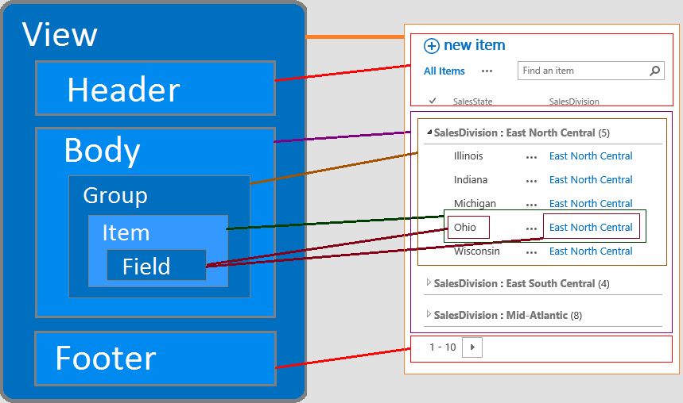

Slide 14
Demo – Accordion View Display Template
Demonstrates overriding an entire list view instead of a single field
Demonstrates installing CSR as a display template.

Slide 15
References
Martin Hatch, 7 part blog series on CSR
www.martinhatch.com/2013/08/jslink-and-display-templates-part-1.html
Andrew Markeev, has several good CSR posts on Code Project
www.codeproject.com/search.aspx?q=markeev&doctypeid=1%3b2%3b3%3b13%3b14&authorid=7585543
Wictor Wilén, great write-up on CSR and MDS
www.wictorwilen.se/the-correct-way-to-execute-javascript-functions-in-sharepoint-2013-mds-enabled-sites
Office365 Developer Patterns and Practices
github.com/OfficeDev/PnP
Slides and Code from this presentation
github.com/mcsheaj/CSRDemos
Jose Quinto, SharePoint 2013 Client Side Rendering: Register Templates Overrides in Detail
https://blog.josequinto.com/2016/01/14/sharepoint-2013-client-side-rendering-register-templates-overrides-in-detail/

