Slide 1


Spice up Your Forms and Views
Deep Dive into Client Side Rendering (CSR)
Joe McShea
Owner/Consultant
IntelliPoint Solutions LLC

Slide 2

Who Am I?
Joe McShea
IntelliPoint Solutions LLC
Owner/Software Architect
Over 20 years as a software developer/architect
Focused on the Microsoft stack and SharePoint/Office 365 since 2007
Author of SPEasyForms, an open source forms solution for SharePoint 2010, 2013, and Online available for download on CodePlex
Contact
joe@intellipointsol.com
@Joe_McShea (twitter)
http://speasyforms.com (blog)

Slide 3
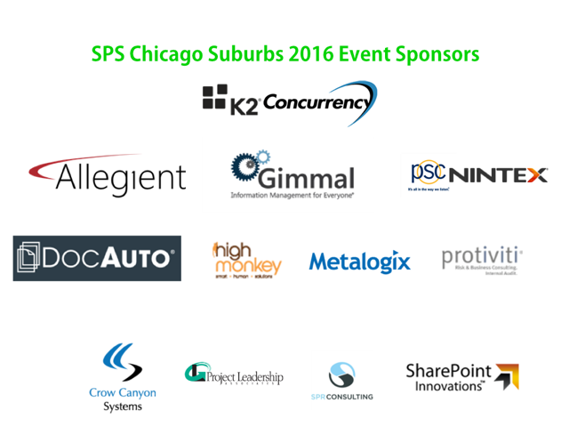

Slide 4
Abstract
I could have called this presentation ‘In Search of the Elusive Custom Field Type’, because they afford some functionality that is not easy to replicate with Client Side Rendering. This has more to do deployment issues, lack of documentation, and JSLink limitations than with the implementation of Client Side Rendering, so we’re going to be spending a bit of time talking about deployment.

Slide 5
Target Audience & Objectives
Show practical examples of CSR to customize forms (and possibly Views)
Talk about gotchas MDS, deployment, JSLink limitations
Demonstrate building components that can be easily reused by power users
Who? Developers
(including Citizen Developers)

Slide 6
What is Client Side Rendering
In general, it just means pushing much of the presentation logic from the server (XSLT) to the client (JavaScript)
In SharePoint, it is a framework for overriding the built-in presentation logic of new, edit, and display forms, views, and search results using HTML, CSS, and JavaScript
- Depends on a mechanism for injecting JavaScript into one or more SharePoint
pages

Slide 7
Advantages of CSR
Performance
Rendering logic is pushed from the server
Development Ease
Few people like XSLT
Many people are comfortable with HTML, CSS, and JavaScript
Flexibility
Only override parts of the view
For instance, let SharePoint render most of the form, you just override methods for a single field
In SharePoint (XSLT) to the client (browser)
Still need a fair amount of SharePoint domain knowledge

Slide 8
Disadvantages of CSR
Performance…Um, Déjà vu
The advantage should really have said Server Performance
If the Browser sucks, or the client machine sucks, or the JavaScript code sucks, the performance is still going to suck from the user perspective
Browser Compatibility
If you’re in a closed environment where all users only have access to a single version of a single browser … Congratulations!
Otherwise, there is a testing burden
Third party libraries like jQuery can normalize this some, but go overboard and you can jump back to the second performance bullet

Slide 9
What is JSLink?
A mechanism to inject JavaScript into various pages
A property that can be set on various SharePoint objects
- Form, Field, Content Type, View, List View Web Part (XLSTListViewWebPart)
CSR depends on a mechanism to inject JavaScript
- It does NOT depend on JSLink
- There are other alternatives
- In some cases, JSLink works quite well with CSR, in others it does not play well with CSR at all

Slide 10

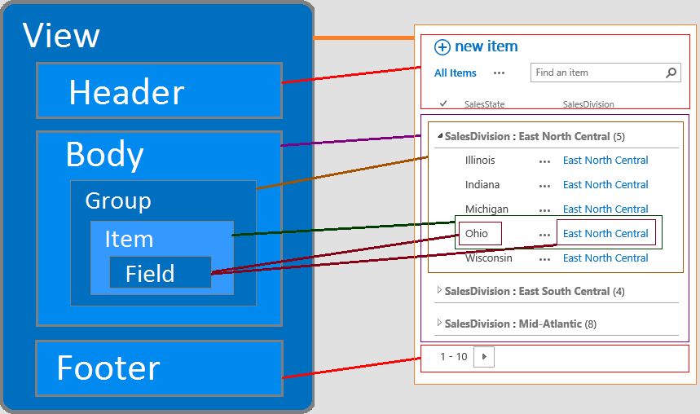

Slide 11
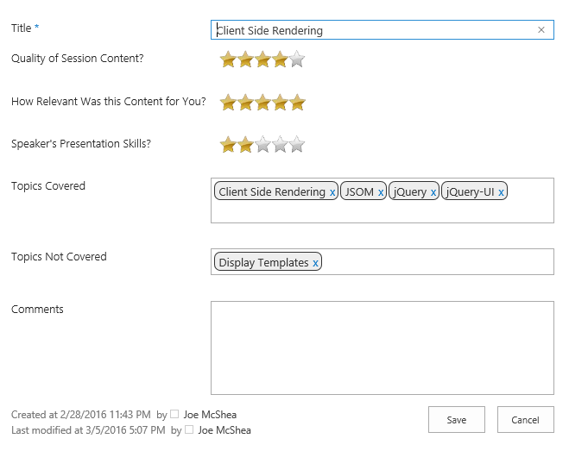
What are we building?

Slide 12
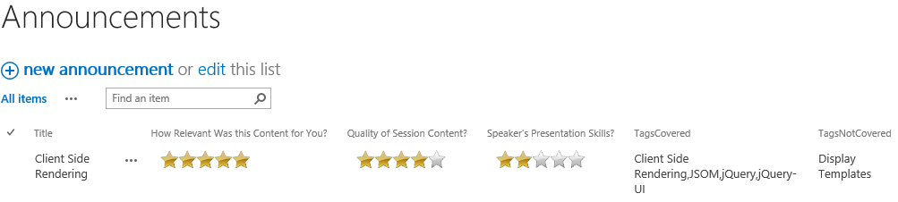
And just as importantly

Slide 13
Demo Star Rating CSR

Slide 14
Deployment Options
Set the JSLink property of a web part
Deploy as a sandbox solution and declaratively set the JSLink on a Field or Content Type in the solution
Set the JSLink property of a content type programmatically
Set the JSLink property of a site column programmatically
Add user custom actions to the web or site so the JavaScript is loaded on every page
Place as stand-lone Display Templates in the Master Page Gallery

Slide 15
Set the JSLink property of a web part
Pros
Very easy.
Doesn’t require any additional code or packaging (i.e. it can be done OOB by a non-developer)
Cons
It’s really a one-off solution (i.e. not enterprise)
Needs to be applied separately to the new, edit, and display forms
Needs to be applied separately to each view in which your field is displayed (or might be displayed)
If somebody adds a view later, or modifies a view later, it may need to be applied again
If you want to use it in another list, start the whole process over again

Slide 16
Deploy as a Sandbox Solution
Pros
Somewhat self documenting
Can be deployed by an admin through the browser
Cons
It is a messy solution (i.e. does not uninstall cleanly)
It leaves behind any instances like site columns
Those columns still have their JSLink pointing the JavaScript
Because it’s messy, it is almost impossible to upgrade
Module files cannot be overwritten through upgrade
Site Column instances need to be deleted before they can be upgraded, and therefore need to be deleted form any list using them (loss of data)

Slide 17
Set Content Type JSLink Programmatically
Pros
It’s easier to manage than individually setting the JSLink on all columns
Not exactly the same functionality as a custom field, but you do at least end up with a reusable component
Cons
JSLink on Content Types does not get called at all for Views; new, edit, and display forms only
Again it cannot be set on some content types…including Event (i.e. no calendars) and Survey
The fact that JSLink is not supported doesn’t necessarily mean that CSR is not supported
List Content Types do NOT get updated when you set the JSLink on site content types, even if you say push changes down

Slide 18
Set Site Column JSLink Programmatically
Pros
It seems like the right granularity, if you want to modify a field, modify it’s JSLink and you’ve modified it everywhere
If you apply the same JS file as JSLink on two different fields, SharePoint is smart enough to only load it once
Cons
Some column types have a read-only JSLink property
The fact that JSLink is not supported doesn’t necessarily mean that CSR is not supported
It can be difficult to manage if you have a lot of columns with a lot of templates applies through JSLink, a well thought out utility page could help overcome this

Slide 19
Add User Custom Actions
Pros
This is kind of the nuclear option, your code gets loaded everywhere (obviously, that can also be a con)
Cons
You need to make your code bullet-proof enough to run everywhere
i.e. Site Settings -> Solutions -> Add Solution dialog loads your code; guess what…SPClientTemplates isn’t loaded
It is pretty easy to do for CSR code, if SPClientTemplates is undefined, get out of Dodge; that’s probably all you need to do to make sure you don’t run on any non-form page, but you need to do it every time

Slide 20
Display Templates in Master Page Gallery
Pros
Easy to deploy
Even easier to reuse
Cons
I got nothin’, this is pure goodness

Slide 21
Random Thoughts: What is the difference between JSLINK and Client Side Rendering?
CSR is a framework for modifing SharePoint fields, views, forms, and search results in the browser.
JSLink is nothing more than one of several mechanisms for injecting JavaScript into SharePoint pages.
Using CSR depends on a method of getting JavaScript injected into the page, but not necessarily on JSLink.

Slide 22
Random Thoughts: How can I run an external Script before CSR code is executed?
If you're setting JSLink, the easiest way is that you can set it to multiple scripts separated by a pipe (|). Those scripts are executed synchronously in the order you specify them. CSR is smart enough to only load each script once, even if it is configured in the JSLink for multiple fields in the same form.
If you're using a Display Template to customize a view for instance, you can load the external dependencies by setting ScriptLink user custom actions at the Web or Site level. ScriptLinks are always loaded before JSLink.

Slide 23
Random Thoughts: Is CSR PostRender supposed to fire more than once?
Yes. At least on forms, CSR PreRender fires once before each field override, then the override occurs, and the CSR Post Render fires. So it looks like:
OnPreRender
RenderTitle -> return HTML for the title field
OnPostRender
OnPreRender
RenderBody -> return HTML for the body field
OnPostRender
Also, in your render callback you can call ctx.registerInitCallback passing in the field internal name and a callback function. These methods get called in the same order as the render methods, but none are called until ALL fields have been rendered.

Slide 24
Random Thoughts: Will I overwrite or append to existing validators with registerClientValidators?
Once you call registerClientValidators, OOB validators will not fire automatically
Required Field Validator
You must add it to your validator set if you want it to fire
Do not add it to the validator set if the current field is not required, check the field schema
SharePoint forms will not let you save with an empty required field, but if you override validators and do not add the required field validator, no error message is displayed either

Slide 25
References
Martin Hatch, 7 part blog series on CSR
www.martinhatch.com/2013/08/jslink-and-display-templates-part-1.html
Andrew Markeev, has several good CSR posts on Code Project
www.codeproject.com/search.aspx?q=markeev&doctypeid=1%3b2%3b3%3b13%3b14&authorid=7585543
Wictor Wilén, great write-up on CSR and MDS
www.wictorwilen.se/the-correct-way-to-execute-javascript-functions-in-sharepoint-2013-mds-enabled-sites
Office365 Developer Patterns and Practices
github.com/OfficeDev/PnP
Slides and Code from this presentation
github.com/mcsheaj/CSRDemos

