Slide 1



Spice up Your Forms and Views
with Client Side Rendering (CSR)
Joe McShea
Owner/Software Architect
IntelliPoint Solutions LLC
1/21/2017

Slide 2

Who Am I?
Joe McShea
IntelliPoint Solutions LLC
Owner/Software Architect
Over 20 years as a software developer/architect
Focused on the Microsoft stack and SharePoint/Office 365 since 2007
Author of SPEasyForms, the free/open source for SharePoint 2010, 2013, 2016, and Online available for download on CodePlex
Contact
joe@intellipointsol.com
@Joe_McShea (twitter)
http://speasyforms.com (blog)

Slide 3









Thank You Sponsors for participating in SPS St. Louis 2017!
You can use the hashtag #SPSSTL & follow us @SPSStlouis
Gold Sponsors
Silver Sponsors

Slide 4
References
Martin Hatch, 7 part blog series on CSR
www.martinhatch.com/2013/08/jslink-and-display-templates-part-1.html
Andrei Markeev, has several good CSR posts on Code Project
www.codeproject.com/search.aspx?q=markeev&doctypeid=1%3b2%3b3%3b13%3b14&authorid=7585543
Wictor Wilén, great write-up on CSR and MDS
www.wictorwilen.se/the-correct-way-to-execute-javascript-functions-in-sharepoint-2013-mds-enabled-sites
Office365 Developer Patterns and Practices
github.com/OfficeDev/PnP
Jose Quinto, SharePoint 2013 Client Side Rendering: Register Templates Overrides in Detail
https://blog.josequinto.com/2016/01/14/sharepoint-2013-client-side-rendering-register-templates-overrides-in-detail/
Slides and Code from this presentation
github.com/mcsheaj/CSRDemos

Slide 5
Target Audience & Objectives
Show practical examples of CSR to customize forms (and possibly Views)
Talk about gotchas MDS, deployment, JSLink limitations
Demonstrate building components that can be easily reused by power users
Who? Developers
(including Citizen Developers)

Slide 6
What is JSLink?
A mechanism to inject JavaScript into various pages
A property that can be set on various SharePoint objects
- Form, Field, Content Type, View, List View Web Part (XLSTListViewWebPart)
CSR depends on a mechanism to inject JavaScript
- It does NOT depend on JSLink
- There are other alternatives (Custom Actions, CEWP, etc.)
- In some cases, JSLink works quite well with CSR, in others it does not play well with CSR at all

Slide 7
What is Client Side Rendering?
In general, it just means pushing much of the presentation logic from the server (XSLT) to the client (JavaScript)
In SharePoint, it is a framework for overriding the built-in presentation logic of new, edit, and display forms, views, and search results using HTML, CSS, and JavaScript
- Depends on a mechanism for injecting JavaScript into one or more SharePoint
pages

Slide 8
What is Client Side Rendering?
An API implemented in SPClientTemplates, which is defined in clienttemplates.js
Override parts of the rendering by calling:
SPClientTemplates.TemplateManager.RegisterTemplateOverrides(obj)
The object input to this function describes the parts of the rendering process that we would like to take over

Slide 9
What can we override? (forms)
var overrides = {
OnPreRender: /* function or array of functions */,
Templates: {
Fields: {
'Field1 Internal Name': {
View: /* single function or string */,
EditForm: /* single function or string */,
DisplayForm: /* single function or string */,
NewForm: /* single function or string */
},
'Field2 Internal Name': {
View: /* single function or string */,
EditForm: /* single function or string */,
DisplayForm: /* single function or string */,
NewForm: /* single function or string */
},
},
},
OnPostRender: /* function or array of functions */
};

Slide 10
Demo #1 – CSR Spy
Show the basic structure of CSR for a field
Briefly look at form context
Show how to look at some OOB rendering to see how MS does it
window[ctx.FormUniqueId + "FormCtx"].ListSchema
CISAR – Chrome Developer Tools extensions by Andrei Markeev

Slide 11
Demo #2 – Type Ahead Fields
How to handle Minimal Download Strategy
Use of an OnPostRender handler to wire events (when and how many times is it called)
If installed on fields, should be on all fields altered

Slide 12
Demo #2 – Cascading Lookups
Modifying fields without overriding rendering
registerInitCallback (only one)
Setting jsLink on multiple fields (with dependencies)
OnPostRender vs. registerInitCallback when working with multiple fields (and gotcha’s)

Slide 13
Register Methods Other than Template Overrides
var render = function (ctx) {
var formCtx = SPClientTemplates.Utility.GetFormContextForCurrentField(ctx);
formCtx.registerInitCallback(formCtx.fieldName, function () {
// single function, called once after all fields have been rendered
});
formCtx.registerFocusCallback(formCtx.fieldName, function () {
// single function, called each time your field is focused
});
formCtx.registerGetValueCallback(formCtx.fieldName, function () {
// single function, called before validation and save at least!
});
formCtx.registerHasValueChangedCallback(formCtx.fieldName, function () {
// single function, called before save i assume!
});
}

Slide 14
Demo #4 - Tabbed Form
Note: JSLink on content types is quirky
They don’t get loaded on views, only on forms
If a content type is already in use on a list, the list content type does not get updated when you set the jsLink property of the site content type
You can update the jslink directly on each list content type that inherits
Use ctx.formUniqueId to find the web part div, then manipulate the DOM
Load CSS into the page inline

Slide 15
Register Validation Handlers
var render = function (ctx) {
var formCtx = SPClientTemplates.Utility.GetFormContextForCurrentField(ctx);
// create a validator set
var fieldValidators = new SPClientForms.ClientValidation.ValidatorSet();
// create a custom validator with an object literal
fieldValidators.RegisterValidator({
Validate: function (value) {
return new SPClientForms.ClientValidation.ValidationResult(false, '');
}
});
// create a custom validator with an object literal
fieldValidators.RegisterValidator({
Validate: function (value) { // do some validation
return new SPClientForms.ClientValidation.ValidationResult(false, '');
}
});
// if required, add a required field validator
if (formCtx.fieldSchema.Required) {
fieldValidators.RegisterValidator(new SPClientForms.ClientValidation.RequiredValidator());
}
// register the validators
formCtx.registerClientValidator(formCtx.fieldName, fieldValidators);
// register a callback method for the validators
formCtx.registerValidationErrorCallback(formCtx.fieldName, function (error) {
$('#' + formCtx.fieldName + 'EntityEditorError').attr('role', 'alert').html(error.errorMessage);
});
}

Slide 16
Demo #5 – Entity Editor
Demonstrate CSR for fields on display forms and views
registerGetValueCallback
registerClientValidators and registerValidationErrorCallback
Deferred event handlers

Slide 17
What can we override? (views)
var overrides = {
BaseViewID: /* ID specified in Schema.xml */,
ListTemplateType: /* List Template ID to target */,
ViewStyle: /* classic View Style: Boxed, no labels (12), Boxed (13), Newsletter (15), etc. */,
OnPreRender: /* function or array of functions */,
Templates: {
View: /* single function or string */,
Body: /* single function or string */,
Header: /* single function or string */,
Footer: /* single function or string */,
Group: /* single function or string */,
Item: /* single function or string */,
Fields: { /* same as forms but override view */ },
},
OnPostRender: /* function or array of functions */
};

Slide 18
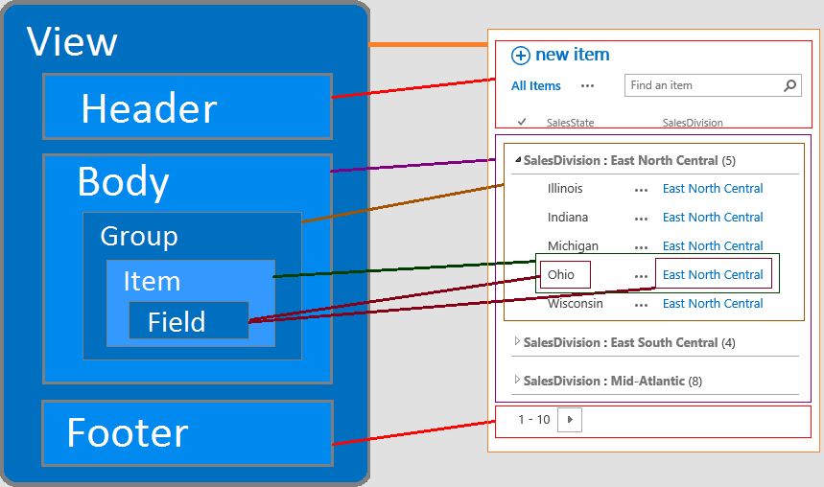

Slide 19
Demo #6 – Accordion View Display Template
Demonstrates overriding an entire list view instead of a single field
Demonstrates installing CSR as a display template.

Slide 20
References
Martin Hatch, 7 part blog series on CSR
www.martinhatch.com/2013/08/jslink-and-display-templates-part-1.html
Andrei Markeev, has several good CSR posts on Code Project
www.codeproject.com/search.aspx?q=markeev&doctypeid=1%3b2%3b3%3b13%3b14&authorid=7585543
Wictor Wilén, great write-up on CSR and MDS
www.wictorwilen.se/the-correct-way-to-execute-javascript-functions-in-sharepoint-2013-mds-enabled-sites
Office365 Developer Patterns and Practices
github.com/OfficeDev/PnP
Jose Quinto, SharePoint 2013 Client Side Rendering: Register Templates Overrides in Detail
https://blog.josequinto.com/2016/01/14/sharepoint-2013-client-side-rendering-register-templates-overrides-in-detail/
Slides and Code from this presentation
github.com/mcsheaj/CSRDemos

