Slide 1


Customizing SharePoint with TypeScript and Knockout
Joe McShea
SharePoint Saturday Charlotte
8/26/2017

Slide 2









Thank our Sponsors!
#SPSCLT17

Slide 3
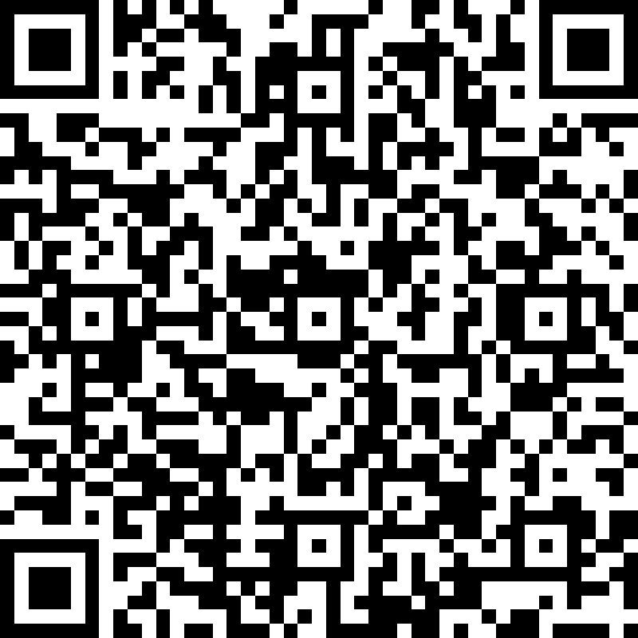
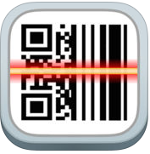
Speaker Surveys!
Session #3 survey
** You can download and use the QR Reader app **
** available for both iOS and Android **
#SPSCLT17

Slide 4
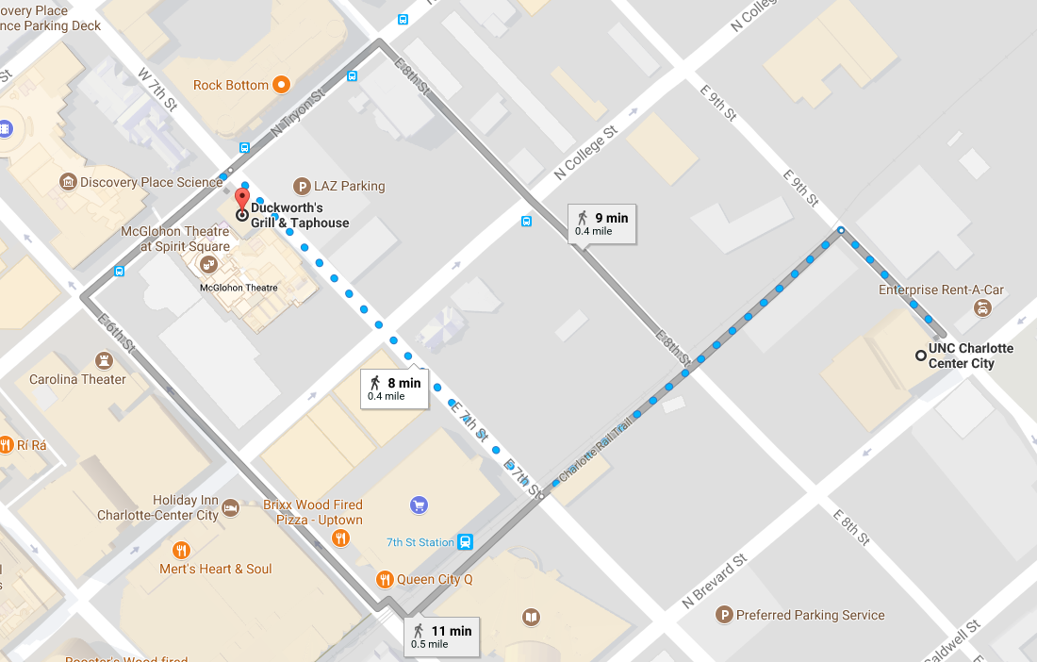
SharePint!
There will be a Happy Hour event held after SPSCLT. SharePint will be held at Duckworth’s in uptown. Duckworth’s is within walking distance of UNCC Center City campus and the 7th street light rail stop.
#SPSCLT17

Slide 5
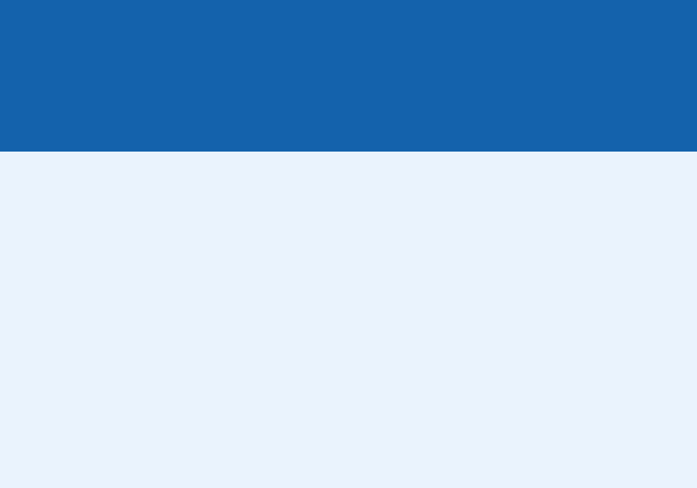

Who am I?
Joe McShea
IntelliPoint Solutions LLC
Owner/Software Architect
Over 20 years as a software developer/architect
Focused on the Microsoft stack and SharePoint/Office 365 since 2007
Author of SPEasyForms, the free/open source for SharePoint 2010, 2013, 2016, and Online available for download on CodePlex/GitHub
Contact
joe@intellipointsol.com
@Joe_McShea (twitter)
http://speasyforms.com (blog)

Slide 6
Agenda
Talk a little about Typescript
Talk a little about Knockout
Demo using them in SharePoint

Slide 7
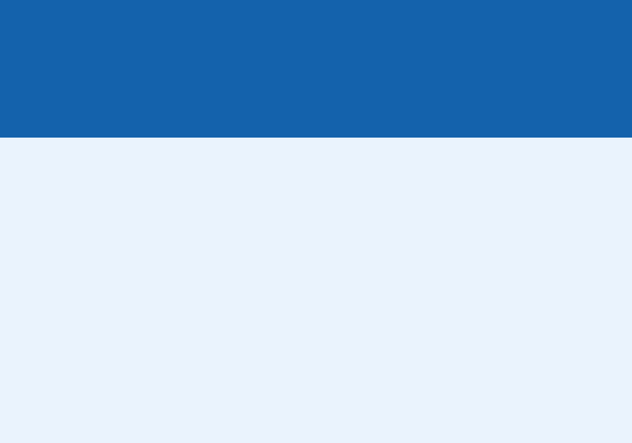
What is Typescript?
Strongly typed JavaScript
Adds Classes, Interfaces, Modules
Superset of JavaScript

Slide 8
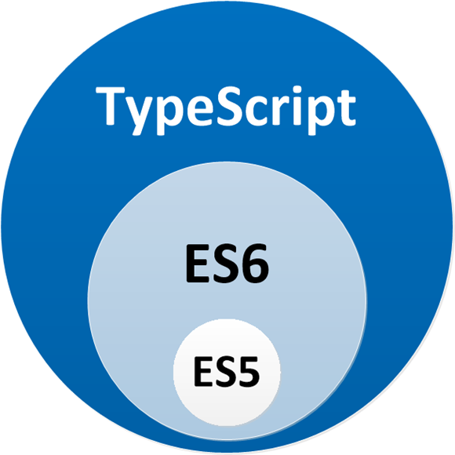
Typescript is a Superset of JavaScript

Slide 9
Why Typescript?
Easier transition for server-side developers
Early detection of errors
Better tool support
Because Microsoft says so

Slide 10
Modules
import * as ko from "knockout";
export const numberRegexp = /^[0-9]+$/;
// exports from external modules
export * from "./StringValidator";
export * from "./LettersOnlyValidator";
export * from "./ZipCodeValidator";

Slide 11
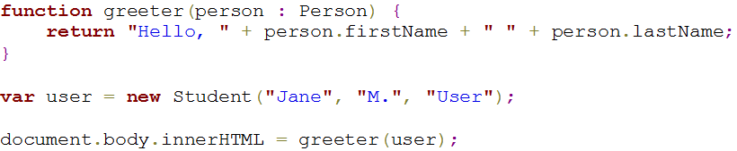
Classes and Interfaces

Slide 12
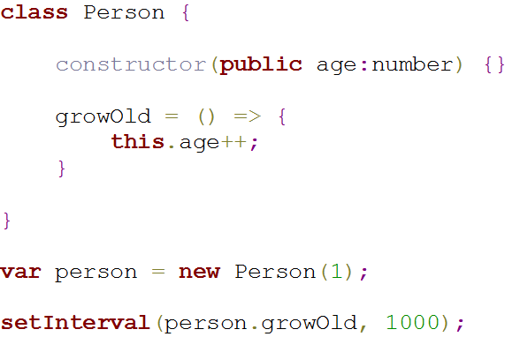
Arrow Functions

Slide 13
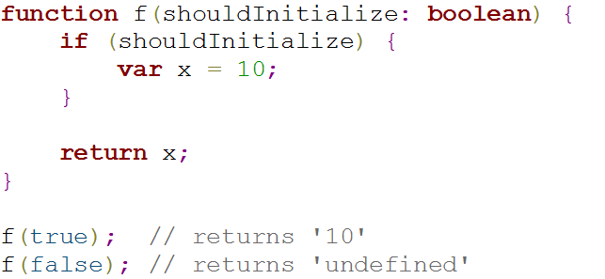
Don’t use var

Slide 14
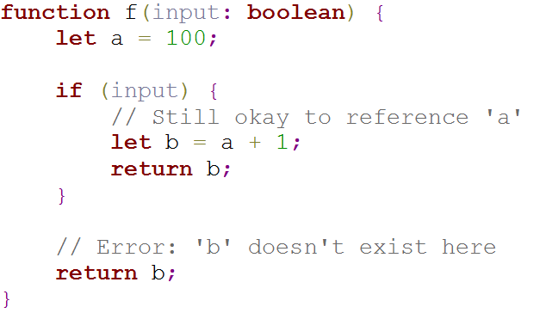
Use let instead

Slide 15
What is Knockout?
JavaScript library to simplify CRUD applications
Eases the creation of rich and responsive web sites
Provides 2 way databinding between the data and it’s presentation
Based on the Model View ViewModel (MVVM) pattern

Slide 16
Why Knockout?
Um…really?
Most SharePoint Customizations are CRUD applications
CRUD is mostly boiler plate HTML and JavaScript
Knockout helps separate concerns and minimizes boiler plate code and markup

Slide 17
So what can we bind to in HTML?
POJO
Observable
Observable Array
Event

Slide 18
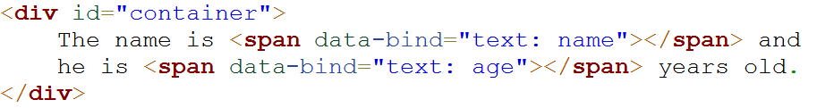
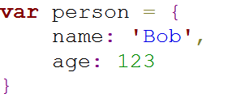
POJO

Slide 19
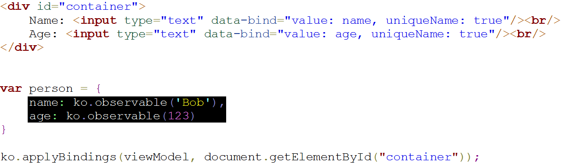
Observable

Slide 20
Observable Array

Slide 21
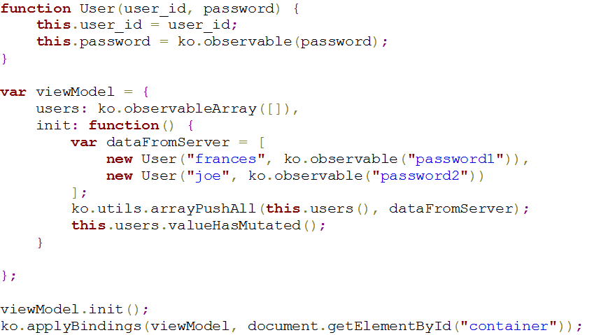
Observable Array

Slide 22
Event

Slide 23
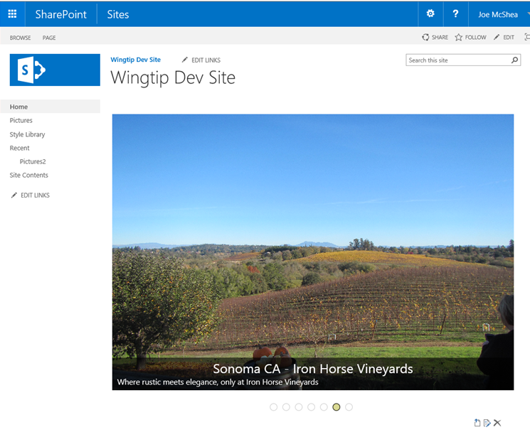
Demo…

Slide 24
References
Typescript quick Start: http://www.typescriptlang.org/docs/tutorial.html
Knockout documentation: http://knockoutjs.com/documentation/introduction.html
Widget-Wrangler by Bob German and Julie Turner: https://github.com/Widget-Wrangler/ww
Source code for tkoWebPart demo: https://github.com/mcsheaj/tkoWebPart
Set up your SharePoint client-side web part development environment: https://dev.office.com/sharepoint/docs/spfx/set-up-your-development-environment

Slide 25
References Continued
Pure JavaScript Slider with Animations by Gabriele Romanato: https://codepen.io/gabrieleromanato/pen/pIfoD
Drag and Drop File Upload jQuery Example, Ravishanker Kusuma: http://hayageek.com/drag-and-drop-file-upload-jquery/
Export any web part from a SharePoint page, Anatoly Mironov: https://chuvash.eu/2014/09/19/export-any-web-part-from-a-sharepoint-page/
Build Custom Web Part Properties with JSOM, Rachid Bouzalmat https://www.werkenbijvxcompany.nl/build-custom-web-part-properties-jsom/

Slide 26
Backup

Slide 27
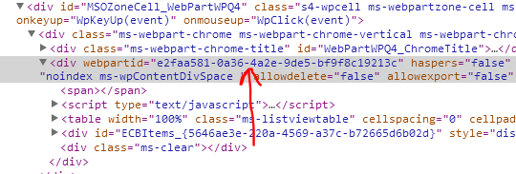
Making it reusable
Get the web part id:
Go to:
<site>/_vti_bin/exportwp.aspx? pageurl=<pageurl>&guidstring=<webPartId>
<site> = your site
<pageurl> = the full path to the web part page
<webPartId> = the id of the web part you want to export
Save the resulting .webpart file, change title, description, etc, upload to the web part gallery

