Slide 1


Customizing SharePoint with TypeScript and Knockout
Joe McShea
SharePoint Saturday Atlanta
6/17/2017

Slide 2





Thank Our Sponsors
Platinum Sponsors

Slide 3




Thank Our Sponsors
Platinum Sponsors

Slide 4


Attendee Shirts
Thank Our Sponsors

Slide 5

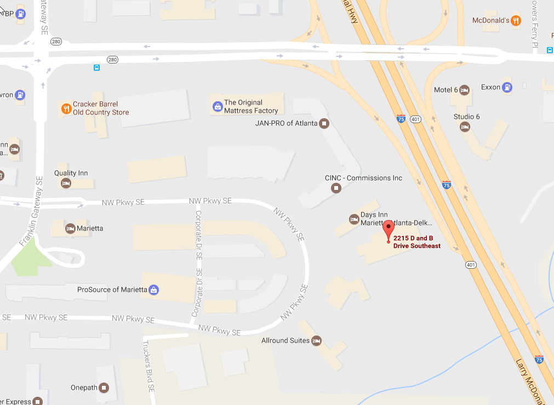
Join us for SharePint!
Thank Our Sponsors
Immediately after the event!
Dave & Busters 2215 D and B Drive SE Marietta, GA 30067

Slide 6


Thank Our Sponsors
Gold Sponsors

Slide 7
Please Provide Feedback
Feedback is a lottery ticket
Session Feedback (x5)
Event Feedback
The Booth Game

Slide 8
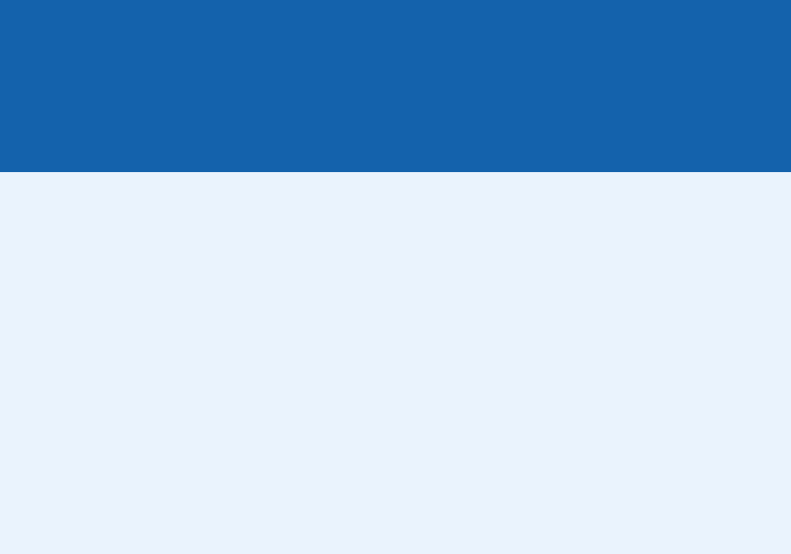

Who am I?
Joe McShea
IntelliPoint Solutions LLC
Owner/Software Architect
Over 20 years as a software developer/architect
Focused on the Microsoft stack and SharePoint/Office 365 since 2007
Author of SPEasyForms, the free/open source for SharePoint 2010, 2013, 2016, and Online available for download on CodePlex/GitHub
Contact
joe@intellipointsol.com
@Joe_McShea (twitter)
http://speasyforms.com (blog)

Slide 9
Agenda
Talk a little about Typescript
Talk a little about Knockout
Demo using them in SharePoint

Slide 10
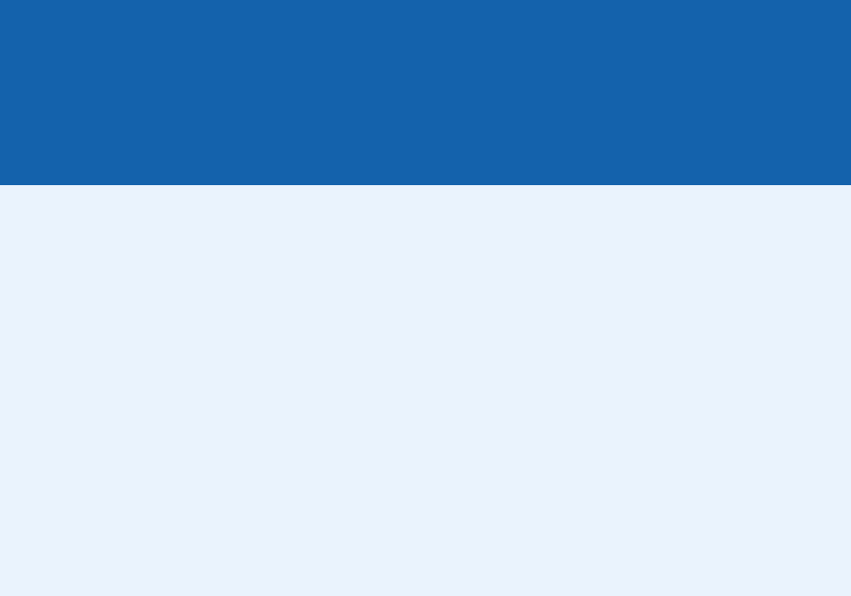
What is Typescript?
Strongly typed JavaScript
Adds Classes, Interfaces, Modules
Superset of JavaScript

Slide 11
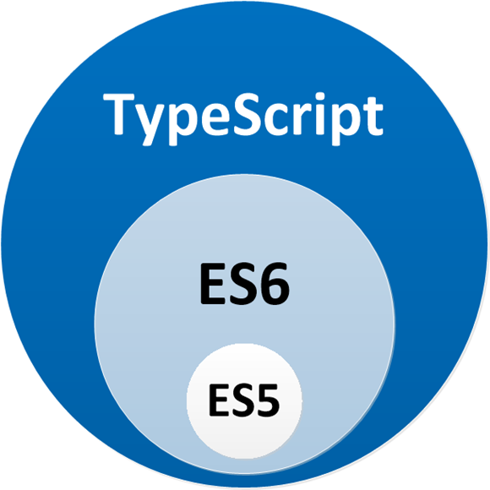
Typescript is a Superset of JavaScript

Slide 12
Why Typescript?
Easier transition for server-side developers
Early detection of errors
Better tool support
Because Microsoft says so

Slide 13
Modules
import * as ko from "knockout";
export const numberRegexp = /^[0-9]+$/;
// exports from external modules
export * from "./StringValidator";
export * from "./LettersOnlyValidator";
export * from "./ZipCodeValidator";

Slide 14
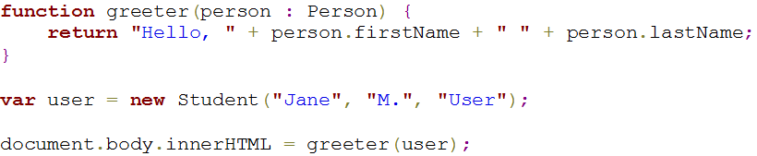
Classes and Interfaces

Slide 15
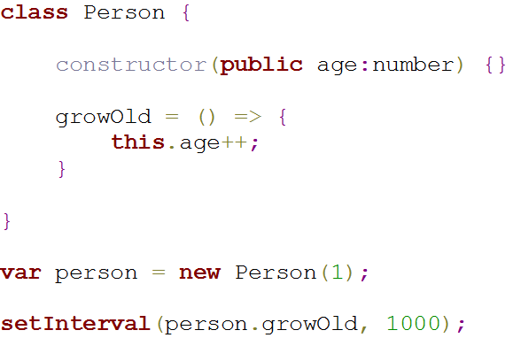
Arrow Functions

Slide 16
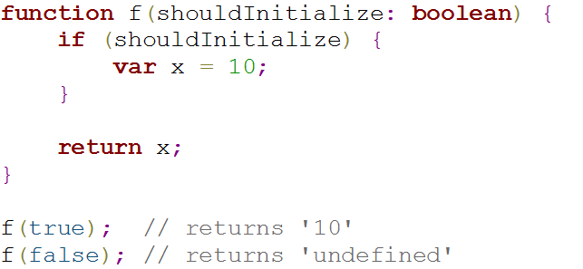
Don’t use var

Slide 17
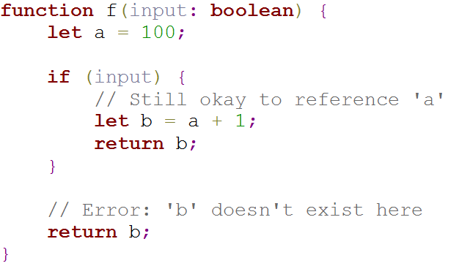
Use let instead

Slide 18
What is Knockout?
JavaScript library to simplify CRUD applications
Eases the creation of rich and responsive web sites
Provides 2 way databinding between the data and it’s presentation
Based on the Model View ViewModel (MVVM) pattern

Slide 19
Why Knockout?
Um…really?
Most SharePoint Customizations are CRUD applications
CRUD is mostly boiler plate HTML and JavaScript
Knockout helps separate concerns and minimizes boiler plate code and markup

Slide 20
So what can we bind to in HTML?
POJO
Observable
Observable Array
Event

Slide 21
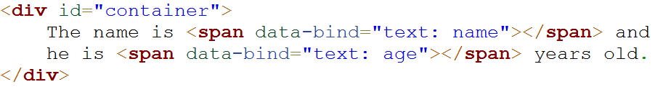
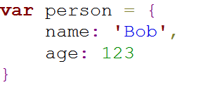
POJO

Slide 22
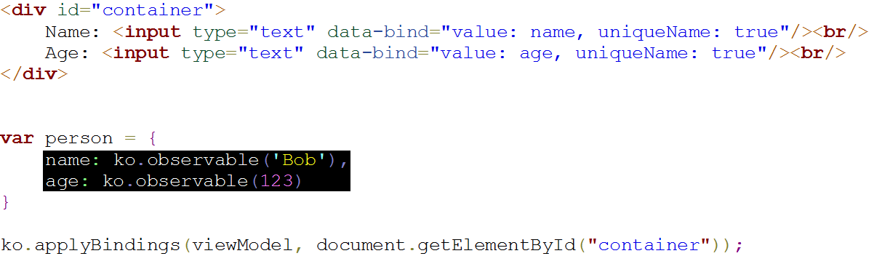
Observable

Slide 23
Observable Array

Slide 24
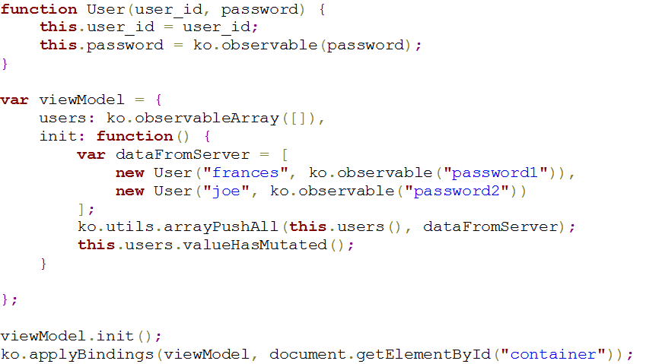
Observable Array

Slide 25
Event

Slide 26
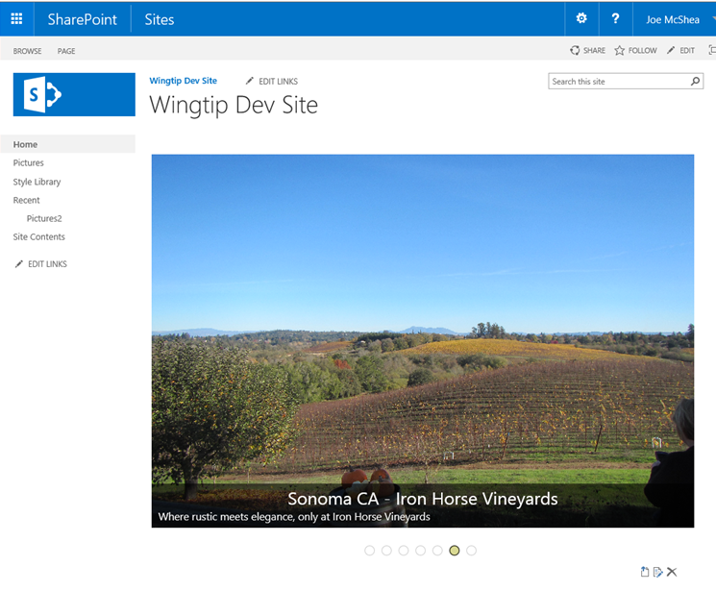
Demo…

Slide 27
References
Typescript quick Start: http://www.typescriptlang.org/docs/tutorial.html
Knockout documentation: http://knockoutjs.com/documentation/introduction.html
Widget-Wrangler by Bob German and Julie Turner: https://github.com/Widget-Wrangler/ww
Source code for tkoWebPart demo: https://github.com/mcsheaj/tkoWebPart
Set up your SharePoint client-side web part development environment: https://dev.office.com/sharepoint/docs/spfx/set-up-your-development-environment

Slide 28
References Continued
Pure JavaScript Slider with Animations by Gabriele Romanato: https://codepen.io/gabrieleromanato/pen/pIfoD
Drag and Drop File Upload jQuery Example, Ravishanker Kusuma: http://hayageek.com/drag-and-drop-file-upload-jquery/
Export any web part from a SharePoint page, Anatoly Mironov: https://chuvash.eu/2014/09/19/export-any-web-part-from-a-sharepoint-page/

Slide 29
Backup

Slide 30
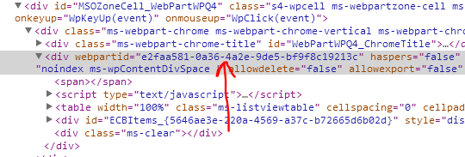
Making it reusable
Get the web part id:
Go to:
<site>/_vti_bin/exportwp.aspx? pageurl=<pageurl>&guidstring=<webPartId>
<site> = your site
<pageurl> = the full path to the web part page
<webPartId> = the id of the web part you want to export
Save the resulting .webpart file, change title, description, etc, upload to the web part gallery

