Slide 1
London – Indian Coffee Shop – Business Viability
Business Idea:
To setup a Indian Coffee shop in suitable location in East London.
Success Criteria:
To find low coffee shop density venues(neighborhoods) and explore feasibility of setting up one for on-time break-even.
Target audience:
ABC Inc. – a consumer beverages company in India – planning to expand into Europe - initially with coffee shops at various location in London – to capture the brand in Young minds before promoting their other products in Europe.
As lead Data scientist – the activity is handed over to me – to explore the venues at various neighbourhoods in East London and find the right venue for their First Coffee shop there.
Data-Sources:
Wikipedia: source for population numbers and density based on Ethnicity, postcodes for each location.
Foursquare: App containing various venue details – for categorizing neighborhood venue wise
PGEOCODE: Python library for getting Lat-Longs for each location to request Foursquare through API.

Slide 2
London – Indian Coffee Shop – Business Viability
Data Collection:
Wikipedia: Wikipedia Python API
Data Collected:
Indian Community percentage of Total Population
Postcodes details for East London (Location of interest)
https://pypi.org/project/wikipedia/
Foursquare: Foursquare developer kit API that can handle requests with ClientID & ClientSecret
Data collected:
Explored venue details from each Lat long location
https://developer.foursquare.com/docs/
PGEOCODE: Python library having postcode and address details for each location.
Data collected:
Lat-Long, address details for each Post code
https://pypi.org/project/pgeocode/

Slide 3
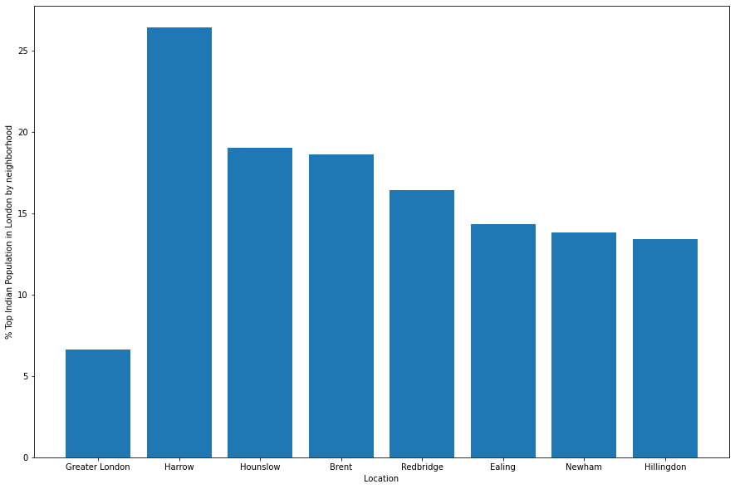
London – Indian Coffee Shop – Business Viability
Indian Ethnicity in London by Demographics:
British Indians form the largest ethno-national group in London with a population of around 542,857 or 6.6% of the population. The majority are concentrated in West London, though populations can be found throughout London. → Harrow has top Indian population followed by Hounslow, Brent, RedBridge

Slide 4
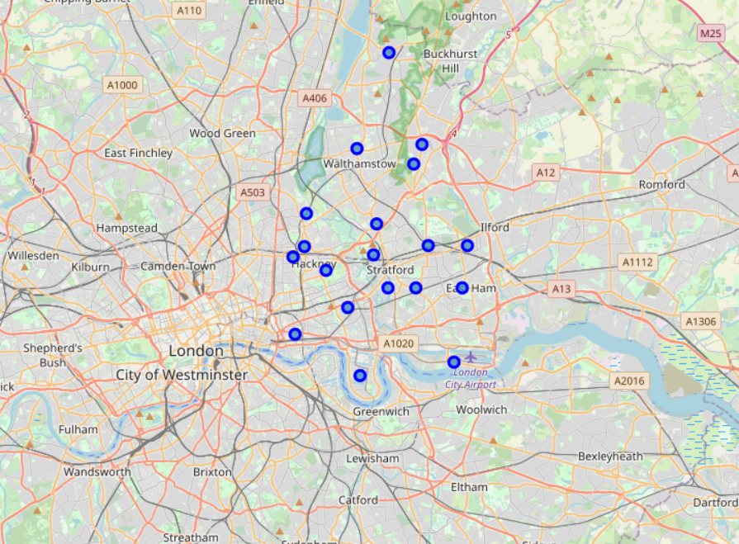
London – Indian Coffee Shop – Business Viability
Exploring venue categories available in each of the neighborhoods in East London (Location of Interest)
Below are neighborhoods in East London to be explored for getting venue categories.

Slide 5
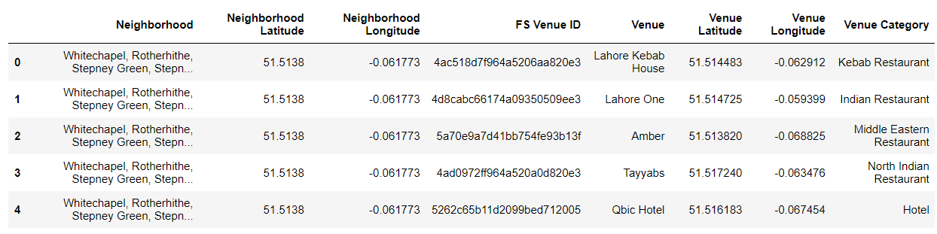
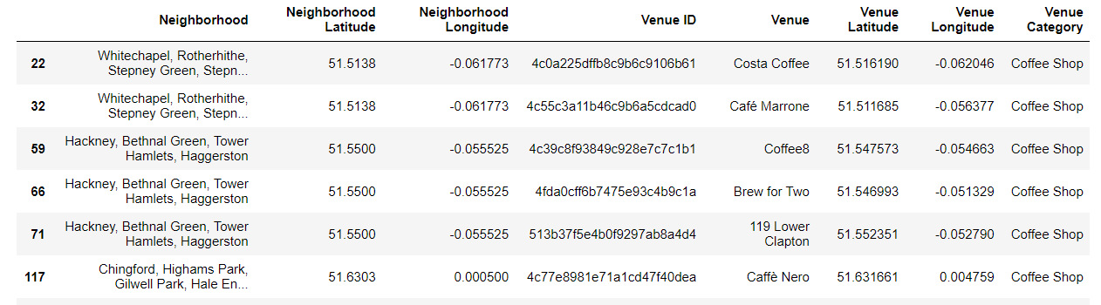
London – Indian Coffee Shop – Business Viability
Different venue locations in East London – list from Foursquare API with Lat Long details.
List of locations having Coffee shops

Slide 6
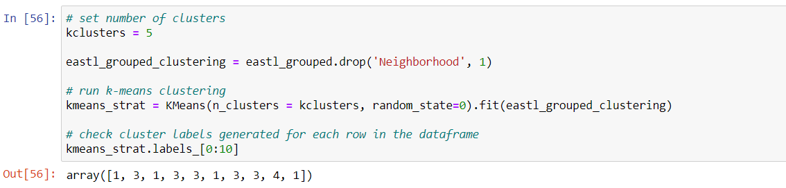
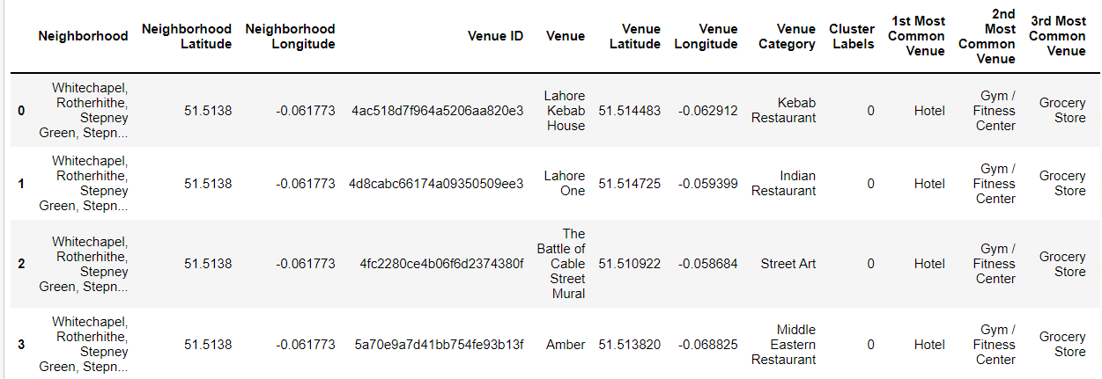
London – Indian Coffee Shop – Business Viability
K-Means Clustering for cluster analysis of the Locations in East London

Slide 7
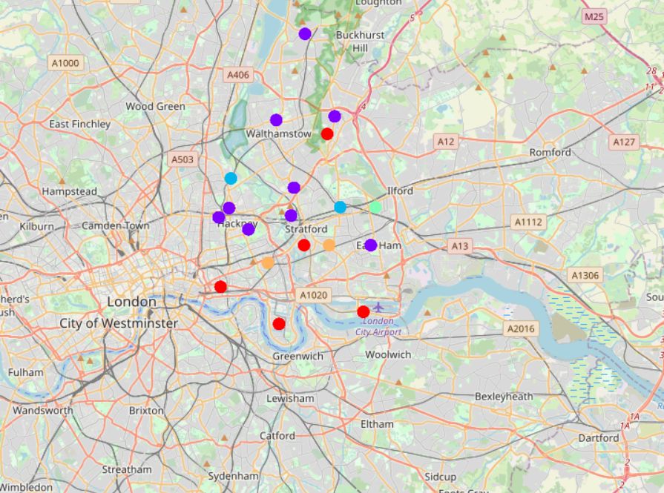
London – Indian Coffee Shop – Business Viability
K-Means Clustering for cluster analysis of the Locations in East London
Clusters Identified by K-Means algorithm:
Cluster – 1
Cluster – 2
Cluster – 3
Cluster – 4
Cluster – 5

Slide 8
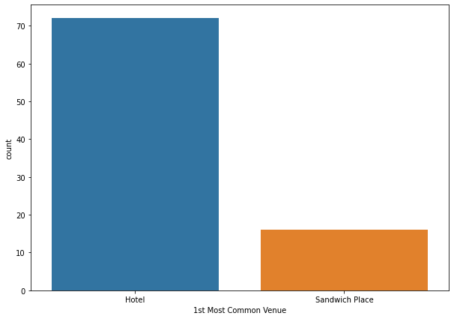
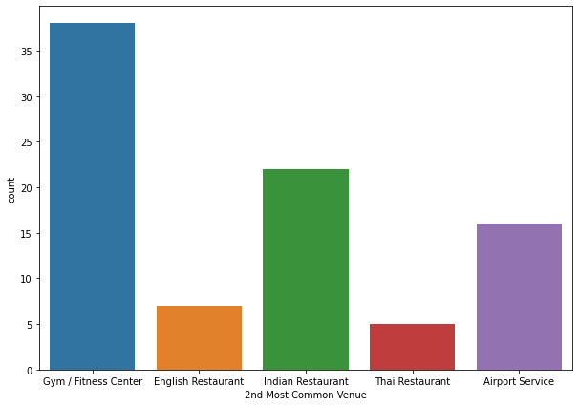
London – Indian Coffee Shop – Business Viability
Cluster 1 Analysis:
The East London neighbourhood include Whitechapel, Rotherhithe, Snaresbrook, Wanstead, Cubitt Town, Canary Wharf, Stratford, Pudding Mill Lane
Further clustering is based on Ranking of Similar Common venues at each of the Neighbourhood:
Top venues being Hotel, Gym, Fitness centre, Grocery store, Indian Restaurant, Pub

Slide 9
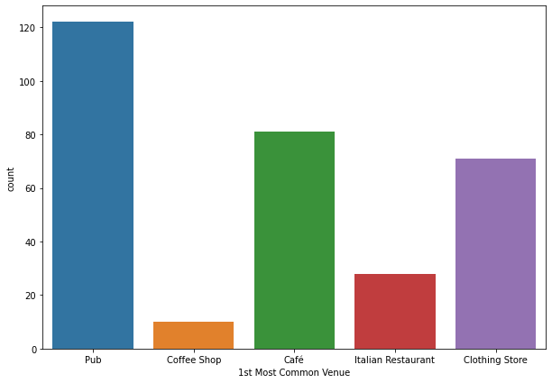
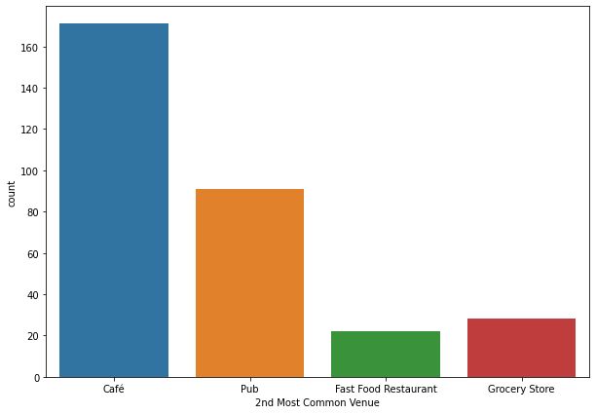
London – Indian Coffee Shop – Business Viability
Cluster 2 Analysis:
The Neighborhoods in this cluster include Hackney, Bethnal Green, Tower Hamlets, Haggerston, East Ham, Beckton, Cyprus
As per above graph and value_counts table Top 5 venues at each of the Neighborhoods include -->
Pub, Brewery, Cafe, Italian Restaurant, Coffee shop

Slide 10
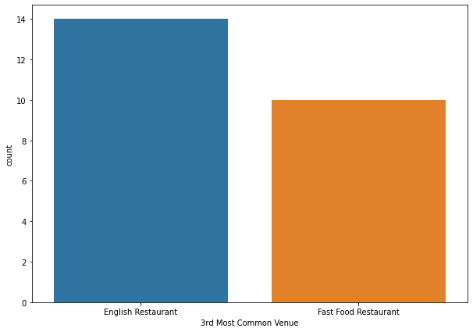
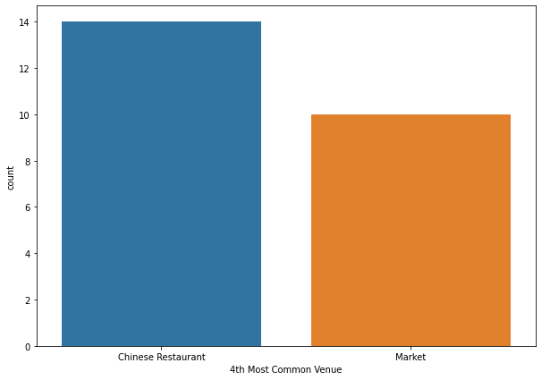
London – Indian Coffee Shop – Business Viability
Cluster 3 Analysis:
The Boroughs include Upperclapton, Clapton park, Hackney Marshes
Further clustering is based on Ranking of Similar Common venues this Burough -->
places include Pub, English Restaurant, Chinese Restaurant, Breakfast Spot, Fast Food Restaurant

Slide 11
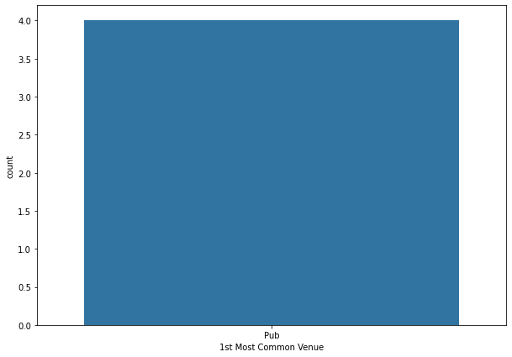

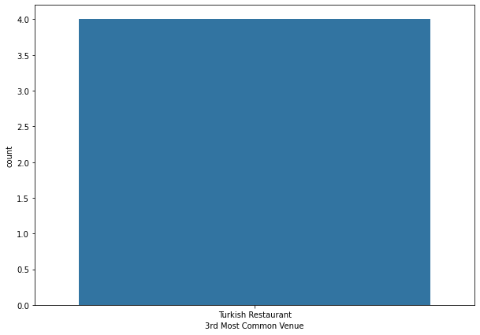
London – Indian Coffee Shop – Business Viability
Cluster 4 Analysis:
The cluster 4 neighborhood includes Manorpark, Little Ilford, Alders Brook
This neighborhood has these venues in :
Top 5: Pub, Restaurant, Turkish, Asian restaurant, Dive bar

Slide 12
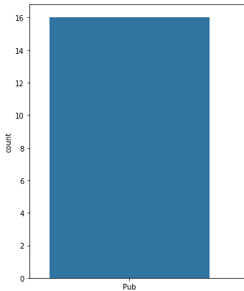
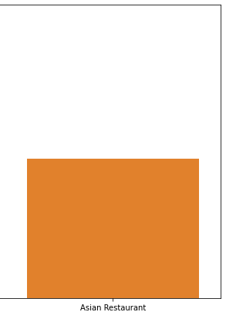
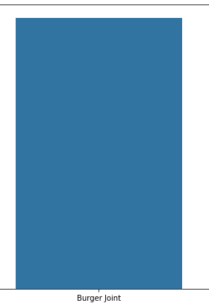
London – Indian Coffee Shop – Business Viability
Cluster 5 Analysis:
The cluster 5 neighborhood includes Mile End, Old Ford, Devons Road, Bow Road
This neighborhood has these venues:
Top 5: Pub, Burger Joint, Breakfast Spot, Bar, Chinese Restaurant

Slide 13
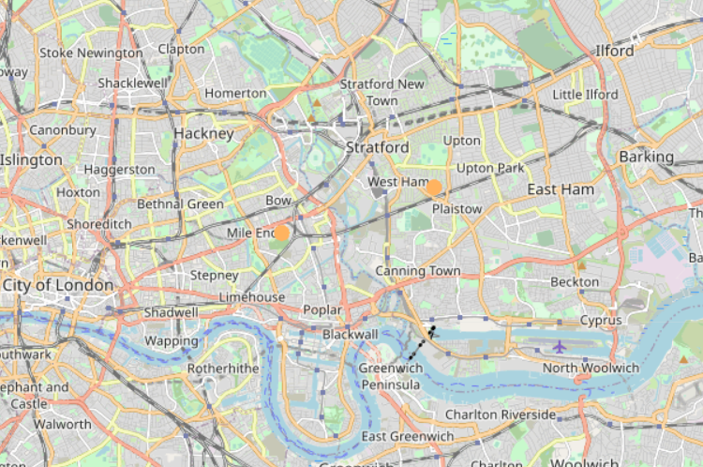
London – Indian Coffee Shop – Business Viability
Conclusion: Location of Indian Coffee Shop Business details:
From previous analysis on each cluster data
We infer that except for cluster 5, all other cluster have at-least few num of Coffee shops & Indian/Asian restaurants
From the list of Top coffee shops in the neighborhood –
we find that none of those shops have Indian food items, Chai (Indian tea) in menu.
The Indian coffee shop could include other chat items in the menu based on continuous customer feedback.
From previous analysis, we can conclude on the Location of New Indian Coffee shop as Cluster 5 in one of the neighbourhoods below:
Mile End
Old Ford
Devons Road
Bow Road

