Slide 1
Analyzing amazon reviews to predict fake reviews
By:
Aravind Krishnan
Ashwin Valiyappan,
Vighneshbalaji SA
Git: https://github.com/mcsoverlavdan/SparkProject

Slide 2
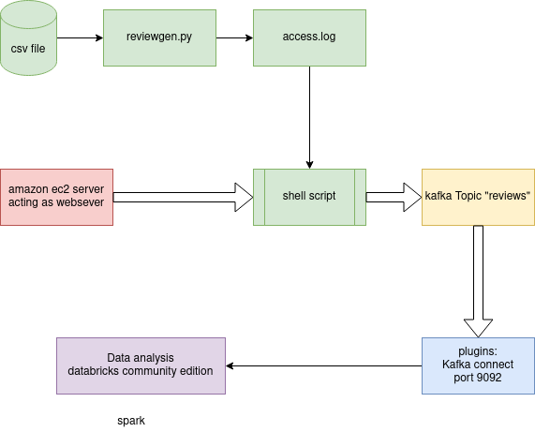

Slide 3
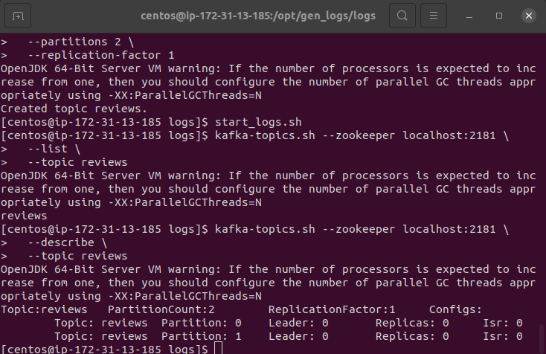

Slide 4
LOCAL MACHINE SETUP
Apache Zookeeper , Kafka, Spark setup in the local machine
Run Zookeeper Server [zookeeper-server-start.bat C:\kafka_2.13-2.8.0\config\zookeeper.properties]
Run Kafka Server [kafka-server-start.bat C:\kafka_2.13-2.8.0\config\server.properties]
Run Broker(Pipelining to spark and kafka)[kafka-console-producer.bat --broker-list localhost:9092 --topic testtopic]
Run Spark Server [spark-submit --packages org.apache.spark:spark-streaming-kafka_2.12-2.8.0 pyspark_test.ipynb]

Slide 5
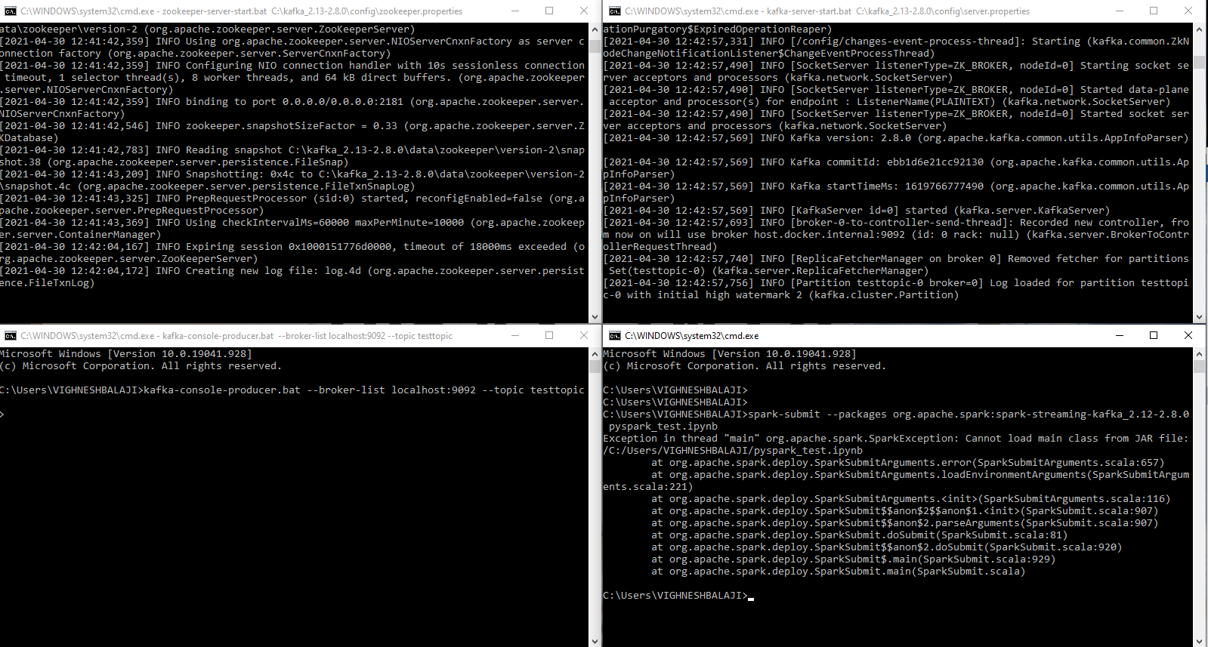

Slide 6
CODE BASE
Data Pre Processing
Data Visualization
Web Scrapping
Packages Used:
Numpy, pandas, matplotlib, string, math, spacy, wordcloud, wrap, Textblob, BeautifullSoup.

