Slide 1
Analyzing amazon reviews to predict fake reviews
By,
Aravind Krishnan,Ashwin Valiyappan, VigneshBalaji SA

Slide 3
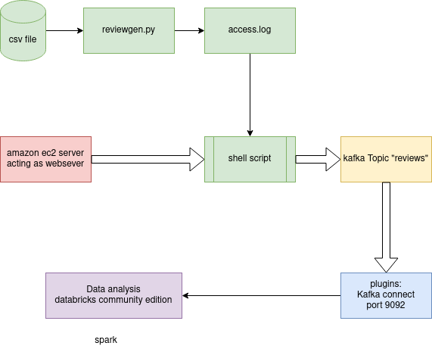

Slide 4
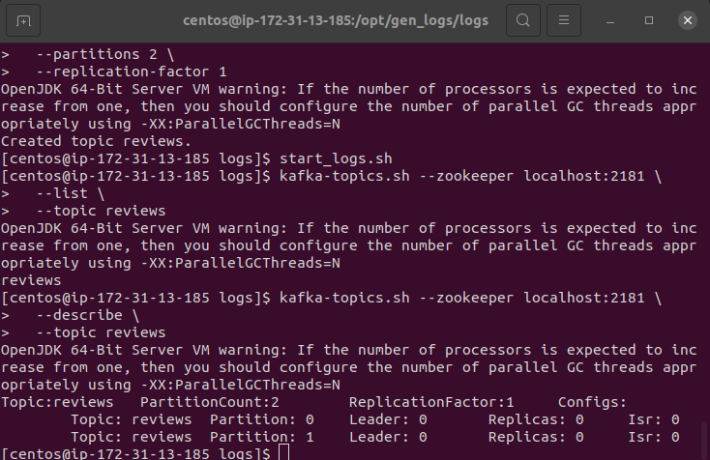

Slide 5
task | details | status

