Slide 1
NYC Green Taxi Trips 2015
CurrencyFair Data Challenge
Andy McSweeney

Slide 2
Challenge
The objective is to find a few recommendations that you would give to a green taxi driver in NYC.
This exercise will help demonstrate some of the following analytics skills:
Data acquisition & wrangling
Data visualisation
Predictive modelling

Slide 3
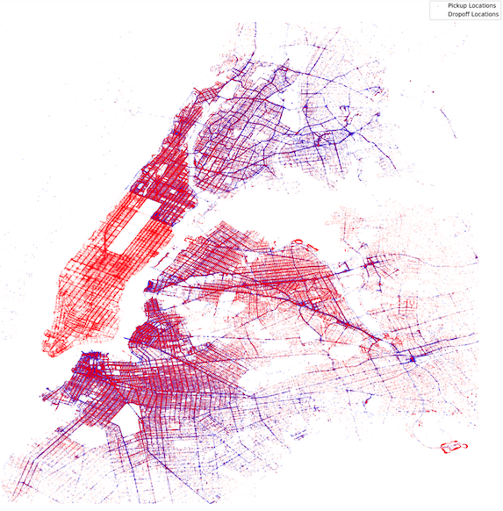
Idea
Originally planned to try and predict fares/tips
But this had already been completed many times
Imagined myself as being a consultant for a NYC Green Taxi Driver who enjoys his current neighbourhoods working hours but would like a change in scenery

Slide 4
Scenario
Tom is a NYC Green Taxi Driver
Tom current lives in Westchester Village/Unionport (BX59) but want’s a change of scenery
He likes his current work schedule and would like to move to a neighbourhood with similar working hours and if possible, a more profitable neighbourhood
Question: Can I build a unsupervised machine learning model to identify similar neighbourhoods to suggest to Tom?

Slide 5
Solution – Data Pre-processing
Reduced the dataset to focus on August instead of the whole year
Over 19 million lines of data, reduced to a more manageable 1.5 million
Mapped latitude and longitude values for pick-up locations and drop-off locations to their respective NYC neighbourhood
Converted pick-up time and drop-off time to date-time datatype and captured the pick-up hour as it’s own specific feature

Slide 6
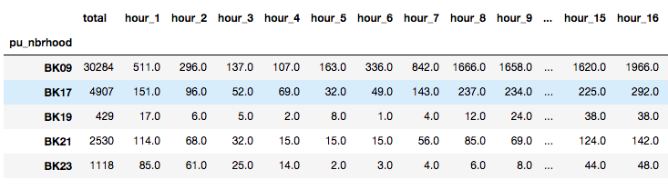
Solution – Model Preparation
Group pickup locations together and split dataset into number of pickups per hour

Slide 7
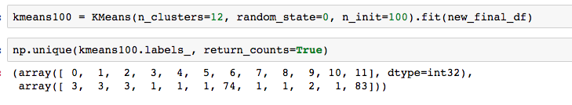
Solution – K-Means Model
Use these columns as input arrays for Sci-Kit Learn’s K-Means clustering algorithm
Final used parameters
12 clusters
Algorithm ran 100 times with different seed centroids

Slide 8
Results
Westchester Village/Unionport
2100 pick-ups in August 2015
Mean distance travelled was 3.17 miles
Mean total fare was 13.64 dollars
Using these as minimum criteria, the cluster Westchester Village/Unionport was in, reduced from an initial 82 suggested neighbourhoods to a final 9

Slide 9
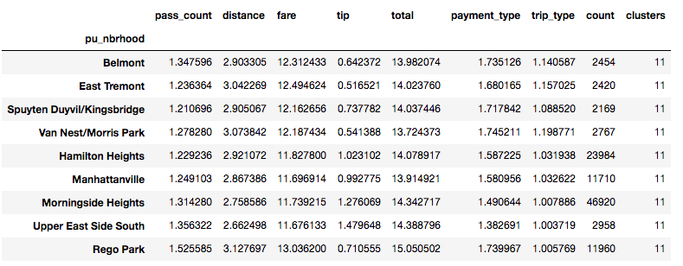
Results

Slide 10
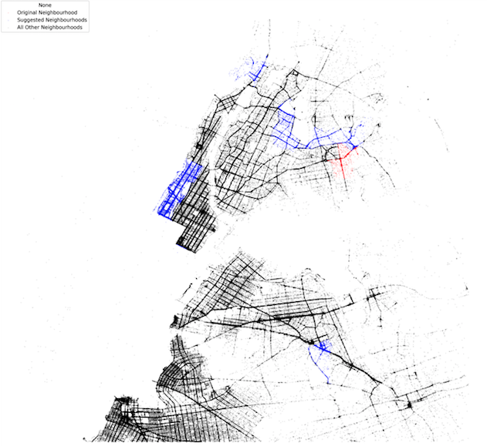

Slide 11
Recommendation
Based on the final 9 suggested neighbourhood, my recommendations would be as follows:
If Tom wanted to move to a neighbourhood far from his current neighbourhood, I’d suggest moving to Rego Park in Queens.
If higher tips is what is more important to him however, I’d suggest he move to either Morningside Heights or the Upper East Side South

