Slide 1

Virgo📍
Latin: WIR-go; or Where-Go?
A Fast, Private, User Location Library
Notes:
Virgo is a fast, private, roughly accurate, user location library for quickly guesstimating where a browser client is in the world.
I make games, and recently I’ve recently scaled out my backend services globally.
The primary motivation for developing this was to seamlessly connect players to the closest server to improve their gameplay experience.

Slide 2
Search for your Suburb or Postcode 🔎
Select Country 🔽
~10 Interactions
~2x Improvement
GPS 📍
~4x Improvement
🇦🇺
Zero Touch = Infinite Improvement
Notes:
There are few common methods that websites use to get your location:
Asking you explicitly. It takes a lot of keystrokes and clicks, but it’s guaranteed to align with the user’s expectations
Letting you pick. Using a dropdown list is faster, but less accurate. Countries can be large, and scrolling through a long list can be annoying
Using GPS. This is super precise, but requires the user, browser app, and operating system’s consent to send your exact coordinates.
Autonomous IP or DNS Geolocation. Seamless, yet not perfect, and the user has hardly any control.

Slide 3
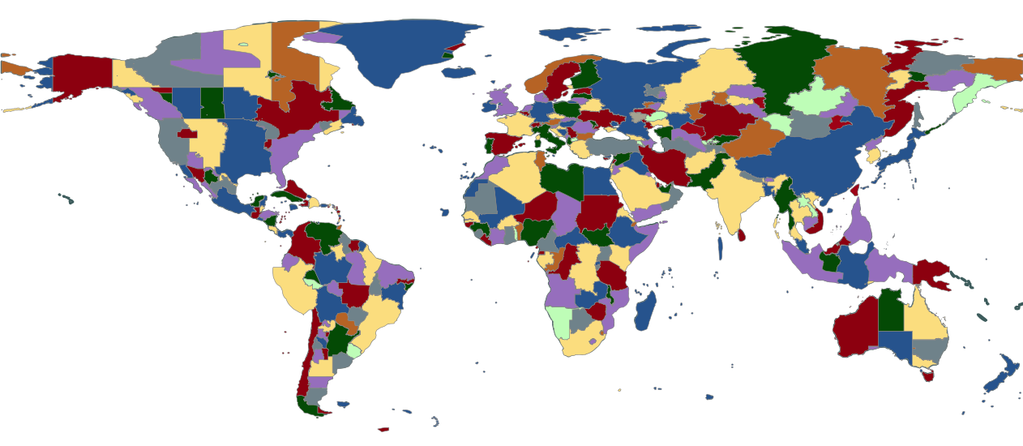
IANA Time Zones
https://pganssle-talks.github.io/pycon-us-2019-language-summit-tz/#/3
Notes:
Virgo works by looking up the user’s device time zone and returning that zone’s precomputed centroid.
This happens entirely synchronously on the client device without the need for any network calls, so the result is immediately available.
It’s a solid enough assumption that people have their time zones set correctly; and can this be more accurate than DNS or IP geolocation services which sometimes return the city of your ISP (often in another city or country).
There are also helpers for calculating distances – and an extension of Virgo for finding the nearest AWS Region: Virgo2AWS.

Slide 4
0.05s First Impression
3s Stay or Leave
Notes:
Why does any of this matter?
It takes only about 50 milliseconds for a user to form their first impression of a website, and within 3 seconds they know whether to abandon or continue.
In my use case, I want players to be able to connect to the right server, (optionally set a player name), and join a game.
50ms is generally not fast enough to ping an IP geolocation service before deciding which server to connect to, switching servers takes time, and connecting to all servers is wasteful and does not scale.
Connecting to the right server during the initial page render really counts!

Slide 5


npm i @mcteamster/virgo
Tony Zhang Games & Things
https://mcteamster.com
https://github.com/mcteamster/virgo
Notes:
I built this library because I couldn’t find something that did this already. There are plenty of libraries that do the opposite of what Virgo does (i.e. Location to Timezone).
I found it useful, and it’s a nice bonus if this solves a problem that someone else faces in the future too.
If you’ve enjoyed my presentation, please like and star my project on GitHub and check out my games.

