Slide 1

Virgo📍
Latin: WIR-go; or Where-Go?
A Fast, Private, User Location Library
Notes:
I’ve created Virgo, a fast, private, roughly accurate, user location library for quickly guesstimating where a browser client is in the world.
I’m a Principal DevOps engineer here at Versent, and some of you might know I make games in my spare time. Recently I’ve recently scaled out my backend services globally, and the primary driver behind developing this was to seamlessly connect players to the closest server for the best gaming experience.

Slide 2
Search for your Suburb or Postcode 🔎
Select Country 🔽
~10 Interactions
~2x Improvement
GPS 📍
~4x Improvement
🇦🇺
Zero Touch = Infinite Improvement
Notes:
There’s a few common ways that websites can get your location:
1. Asking you to type it in / look it up – lots of keystrokes and clicks but it’s guaranteed to align with the user’s expectations
2. Letting you pick from a list – faster, but less accurate, countries can be large, and scrolling through a long list can be annoying
3. Asking for your GPS location – super precise, but requires user, browser, and OS consent to send your coordinates
4. Trying to figure it out autonomously (IP tracking or DNS geolocation routing) – seamless, but also the user has less control

Slide 3
0.05s First Impression
3s Stay or Leave
Notes:
Why does any of this matter?
It takes only about 50 milliseconds for a user to form their first impression of a website, and within 3 seconds they know whether to abandon or continue.
In my use case, I want players to be able to connect to the right server, (optionally set a player name), and join a game.
50ms is generally not fast enough to ping an IP geolocation service before deciding which server to connect to, switching servers takes time, and connecting to all servers is wasteful and does not scale.
So, connecting to the right server during the initial page render really counts.

Slide 4
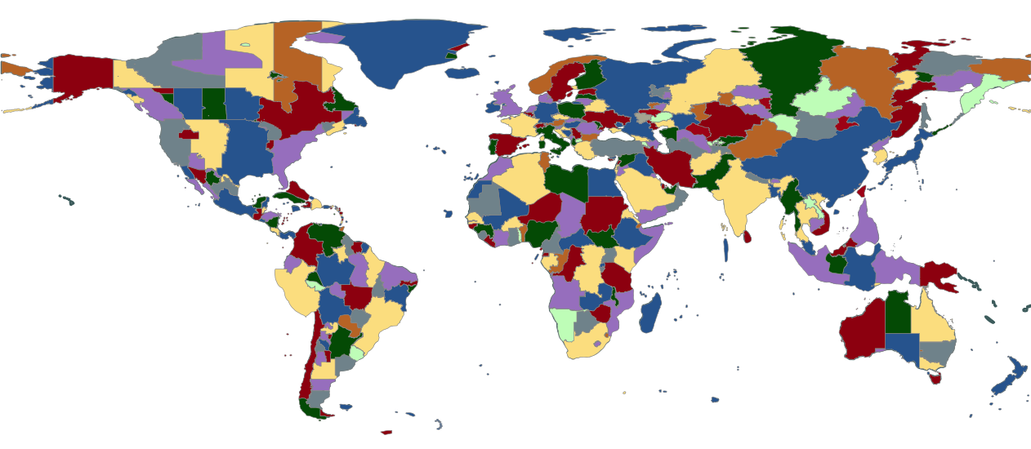
IANA Time Zones
https://pganssle-talks.github.io/pycon-us-2019-language-summit-tz/#/3
Notes:
Virgo works by looking up the user’s device time zone and returning that zone’s precomputed centroid.
This happens entirely synchronously on the client device without the need for any network calls, so the result is immediately available.
It’s a solid enough assumption that people have their time zones set correctly; and can be more accurate than DNS or IP geolocation services which sometimes return the city of your ISP (in another state or country).
There’s also helpers for calculating distances – and an extension of Virgo for finding the nearest AWS Region: Virgo2AWS.
DEMO

Slide 5


npm i @mcteamster/virgo
Tony Zhang Games & Things
https://mcteamster.com
https://github.com/mcteamster/virgo
Notes:
I built this library because I couldn’t find something that did this already. There’s plenty of libraries that do the opposite of what Virgo does (i.e. Location to Timezone).
I find it useful, and it’s a nice bonus if this solves a problem that someone else faces in the future too.
If you’ve enjoyed my talk, please like and star my project on GitHub and check out my games.

