Slide 1
PV243 Team project
Machine Reservation

Slide 2
Project
system for machine reservation in computer labs
based on JSF 2 + RichFaces 4, CDI, JPA/Hibernate, EJB, Seam 3, JBoss AS 7
deployed on OpenShift, documented via UML, source code hosted on GitHub
features planned for version 2.0:
  integration with labs in Red Hat (vs. OpenShift)
  improved user & rights management
  improved webdesign
  Arquillian

Slide 3
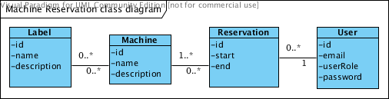
Project

Slide 4
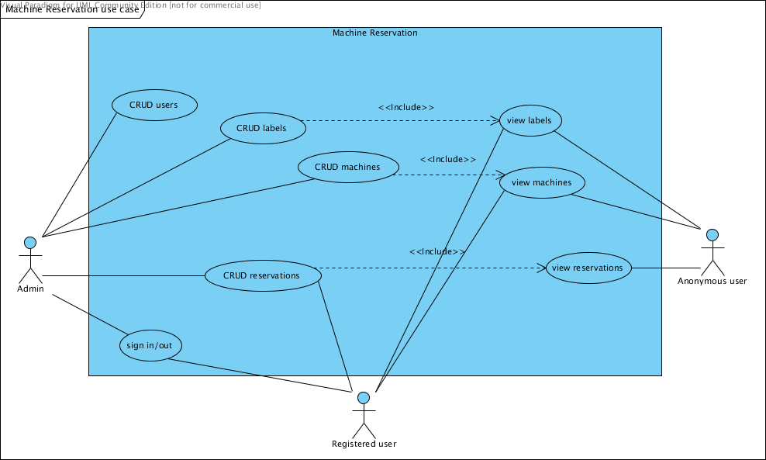
Project

Slide 5
Team
Jan Papoušek
  created basic functionality of the application
  did most of the work on frontend (reservations)
  CDI
  work on EJBs
Oliver Kišš
  frontend development (admin functionality)

Slide 6
Team
Radim Hatlapatka
  most of the development of business layer (EJBs)
  JPA
  bean validation
  logging
Miroslav Cupák
  helping with development where needed, bug fixing
  OpenShift deployment
  documentation, UML

Slide 7
DEMO !

Slide 8
Links
sources on GitHub
  https://github.com/mcupak/machine-reservation.git
deployment on OpenShift
  http://machinereservation-mcupak.rhcloud.com/
more info
  https://github.com/mcupak/machine-reservation/blob/master/README.txt

