Slide 1
Graphical instruction language
IA158 Mindstorms project
Cupak Miroslav,
Němeček David,
Nižnan Juraj,
Streck Adam
29.4.2012

Slide 2
Overview
We aimed for robot that can read and then execute given istructions.
Instructions are read using light sensor.
After reading, robot interprets given code, causing it to move or make sounds.

Slide 3

Encoding

Slide 4
Encoding cont'd
Each instruction has 4 bits.
6 movement instructions.
4 sound instructions.
4 delay instructions.
2 repetition instructions.
Movement and sound instructions are executed in parallel.

Slide 5
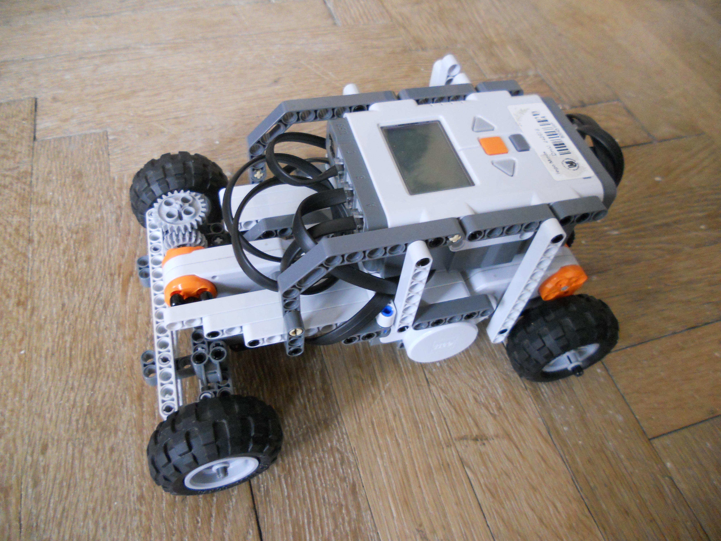
Hardware

Slide 6
Hardware cont'd
Four wheel steering car.
2 light sensors on the sides.
Steering ensures continuous reading.

Slide 7
Calibration
Two-color line is followed.
Car needs to calibrate its light sensor to current light conditions.
Reading ends after timeout.

Slide 8
Thank you for your attention.

