Slide 1
IHCV Project
Block 2
Team 2
Ana, Noa, Lorenzo, Raul

Slide 2
Task 1
Goal: Implement morphological operators
Approach: Analyse the way Dilation, Erosion, Opening, Closing and Top-Hat work on an image and how they modify it. Then write code to simulate it.
Results: show the effects of each operator (possibly on the next slide)

Slide 3
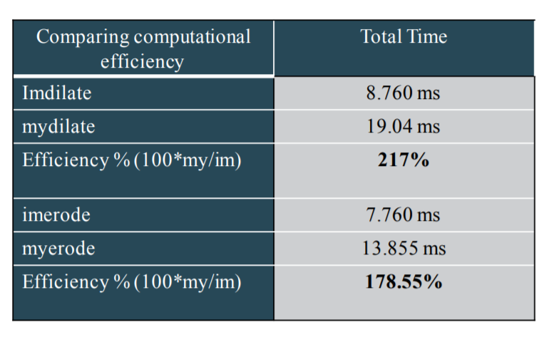
Task 2
Goal: Measure the computational efficiency of your programed operators
Approach: After writing code for the required morphological operators, the resulting image is subtracted to Matlab’s own implementation of the corresponding morphological operator: if the result is a black image (all zeroes) then the two images are the same and our implementation is behaving like it should. Also using tic and toc we can measure the computational efficiency of our code in terms of running time.
Results: show an image subtraction as an example and a this table:
(taken from the slides)

Slide 4
Task 3
Goal: Use morphological operators to improve results on colour segmentation
Approach: Use the images in the dataset to analyse the results obtained by running the morphological operators on the images in order to remove noise and be more precise in the traffic sign detection. Other algorithms will also be used to improve the results (hole filling). Measures of efficiency will be recall, precision and F1-measure.
Results: show tables with recall, precision, etc

Slide 5
Task 4
Goal: Segmentation using histogram back-projection
Approach: Divide the signals into groups according to color (Group1=Red/White/Black, Group2=Blue/White/Black, Group3=Red/Blue), compute a histogram for each group and then use histogram back-projection for each group separately before joining the results in order to get one single mask per image. (talk about the threshold)
Results:

Slide 6
Conclusions
Achievements and findings:
Achievement1 we_will_see
Problems
Problem1 we_will_see

