Slide 1

M4 - Video Analysis
Block 1. Assessment of Foreground Extraction and Optical Flow
Adrià Ciurana
Guim Perarnau
Pau Riba

Slide 2
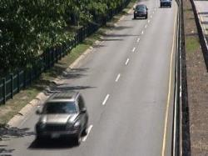

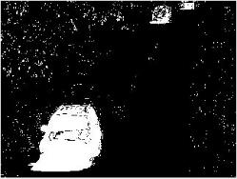
Task 1
Original image
Ground truth
Segmentation
Ground-truth AND Segmentation = TP
Ground-truth AND ¬Segmentation = FP
¬Ground-truth AND ¬Segmentation = TN
¬Ground-truth AND Segmentation = FN
(¬ = negation)

Slide 3
Task 1
 | Test A | Test B
True Positive | 569355 | 312799
True Negative | 14323127 | 14564633
False Positive | 383289 | 141783
False Negative | 84229 | 340785
Precision | 59.76% | 68.81%
Recall | 87.11% | 47.85%
F1 Score | 70.89% | 56.45%

Slide 4
Task 2

Slide 5
Task 3

Slide 6
Task 4 (Optional)

Slide 7
Task 5 (Optional)

