Slide 1

M4 - Video Analysis
Block 1. Assessment of Foreground Extraction and Optical Flow
Adrià Ciurana
Guim Perarnau
Pau Riba

Slide 2
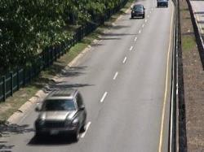

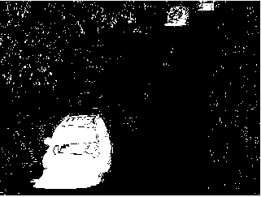
Task 1: calculate global metrics
RGB image
Greyscale image
Binary image
Original image
Ground truth
Segmentation
Ground-truth AND Segmentation = TP
Ground-truth AND ¬Segmentation = FP
¬Ground-truth AND ¬Segmentation = TN
¬Ground-truth AND Segmentation = FN
(¬ = negation)

Slide 3
Task 1: calculate global metrics
 | Test A | Test B
True Positive | 569355 | 312799
True Negative | 14323127 | 14564633
False Positive | 383289 | 141783
False Negative | 84229 | 340785
Precision | 59.76% | 68.81%
Recall | 87.11% | 47.85%
F1 Score | 70.89% | 56.45%

Slide 4

Task 2: precision VS recall
Ground truth
Test A (higher recall)
Test B (higher precision)
Segmentation
Test A segmentation has a higher recall because it misses less foreground pixels (true samples). However, it misclassifies background pixels (false samples) as foreground (FP) and, consequently, the precision lowers.
On the other hand, Test B has a higher precision because most of the positive pixels (TP+FP) are foreground (TP) at a cost of having foreground pixels incorrectly classified as background (FN), which lowers the recall.

Slide 5
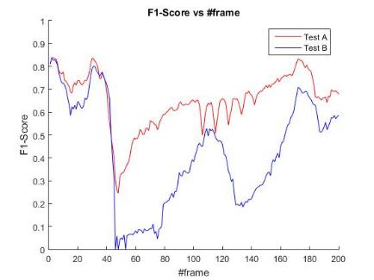
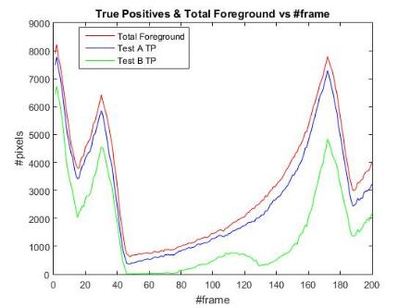
Task 3: frame by frame metrics
Huge F1 Score drop! Why?

Slide 6
Task 4:

Slide 7
Task 5:

Slide 8
Task 6:

Slide 9
Task 7:

