Slide 1
Mitchell Verter : The Face of the Earth. A Black and Indigenously-Inspired Levinasian Conception of Matrisocial Ecological Becoming.

Slide 2
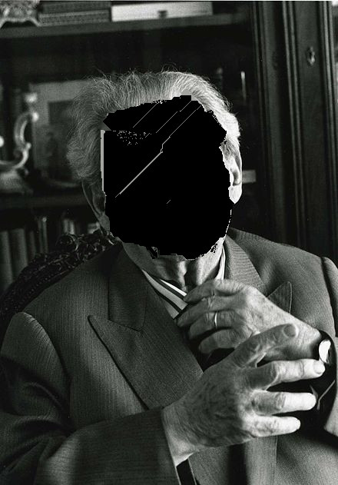
There is no face reification of a thing placeholder subject position as theoria consciousness intentiolity

Slide 3
“Le Visage” = Intentionality
Vision
Visuality
Intentionality The Subject Position
Man-to-Man position
Persectivism in Levinas the visage is not the only important viewpoint

Slide 4
It is in order to reserve the English word ‘face’ to translate ‘visage’ — the countenance of the Other — that we are using the term ‘side’ to translate ‘face’ in this context.
s. Il se déploie dans sa propre dimension la profondeur, inconvertible en largeur et en longueur où s'étend la face de l'élément
The element has no forms containing it ; it is content without form. Or rather it has but a side : the surface of the sea and of the field, the edge of the wind ; the medium upon which this side5 takes form is not composed of things. It unfolds in its own dimension: depth, which is inconvertible into the breadth and length in which the side of the element extends. To be sure, a thing likewise presents itself by but one unique side; but we can circle round it, and the reverse is equivalent to the obverse; all the points of view are equivalent. The depth of the element prolongs it till it is lost in the earth and in the heavens. “Nothing ends, nothing begins.
Il se déploie dans sa propre dimension la profondeur, inconvertible en largeur et en longueur où s'étend la face de l'élément. La chose, certes, elle non plus, ne s'offre que par une face unique; mais nous pouvons en faire le tour, et l'envers en vaut l'endroit. Tous les points de vue se valent. La profondeur de l'élément le prolonge et le perd dans la terre et dans le ciel « Rien ne finit, rien ne commence. »”

