Slide 1
GRANARCHISM
By Mitchell Verter

Slide 2
For Levinas, the Home is precisely the event that terminates engagement, separating the individual from the immediacy of his enjoyment. “Man abides in the world as having come to it from a private domain, from being at home with himself, in which at each moment that he retires”
labour in its possessive grasp suspends the independence of the element… as property the thing is an existent that has lost its being” (158).
For Levinas, the realm of generality is populated not by property or by objects, but by works.
Levinas challenges the authority of these thematic organizing principles by demonstrating that before consciousness can appropriate the ex-ternal, the self is already ex-posed, already open to otherness. From the very beginning, the suum is already directed by its responsibility to other people.

Slide 3
It is utterly impossible to draw a distinction between the work of each of these men. To measure the work by its results leads us to an absurdity; to divide the total work and to measure its fractions by the number of hours spent on the work also leads us to absurdity. One thing remains: to put needs above works, and first of all to recognize the right to live, and later on the right to well-being for all those who took their share in production. (231)
In Introduction to Metaphysics, Heidegger elaborates his characterization of the Greek concept of Being, physis, as the self-blossoming emergence of Being, as something that manifests through the dynamics of violence, power, and struggle.

Slide 4
In contrast, Levinas remarks that “the idea of causa sui … is belied by birth, non-chosen and impossible to choose … which situates the will in an anarchic world, that is, a world without origin.”

Slide 5
The Home in bell hooks
why the interbeing is a separation
. In addition to reconsidering the importance of maternal care, other feminist thinkers have similarly re-evaluated the category of domestic nurturance. For example, bell hooks discusses how black women maintained what she calls ‘home place’ as a site of resistance against rampant racism, a refuge where people could gather and heal themselves from the wounds inflicted by a hostile society (2001, pp. 41–9).

Slide 6
Also a communion of needs, the companion, in aristotle the meal tub fellows.
Birth as different process of generation. A connection to other people as through a family, something volutary and involuntary connection with other people.

Slide 7
Two quotes from Alexis Pauline Gumbs
One from rest about them shedding skin and becoming other
The other about allomothering

Slide 8
Dialogue on Nature of Evolution
Kropotkin
Sarah Blaffer Hrdy

Slide 9
“a feature of the greatest importance for the maintenance of life, the preservation of each species, and its further evolution,

Slide 10

Nuclear Family
“Abolish the nuclear family” Sophie Lewis
Do whatever the fuck you want
Let the baby have his bottle. That’s my motto. – Homer Simpson
Nuclear family.
“Religion is the opium of the people. It is the sigh of the oppressed creature, the heart of a heartless world, and the soul of our soulless conditions.”
Let the poor slobs have religion. Religion as a tying together
The heart of a heartless world, and the soul of soulless conditions

Slide 11
This talk will investigate Kropotkin's description of mutual aid as being critical for the evolution of a species. The idea of "evolution" will be considered as a theory of Becoming, the way that identity and non-identity are persisted and not-persisted over time. We will contrast our theory those that derive from Heraclitus (materialism, empiricism, Hume, Hobbes, Spinoza, Nietzsche, Heidegger, Deleuze, Simondon, Read, Bottici ...)), which posit Becoming as emerging from the dynamic clashes within a field of anonymous forces. My analysis, taken from Emmanuel Levinas, articulates Becoming a mode of relating to other persons through two moments: (1) the *metabolics* of consumption describe the process by which the material being of the other becomes the self, which Levinas explores under the motifs of eating and breathing; (2) the *genetics* of regeneration describe the way in which the material being of my self becomes the other, which Levinas describes under the motif of maternity. I will explore "maternity" through what Sarah Ruddick calls *maternal practice* that preserves the life of the child, nourishes their growth and prepares them for acceptance in wider society. Feminist anthropologist Sarah Blaffer Hrdy clarifies that what is important is not merely the person of the mother, but the community of *allomothering*-- particularly the *grandmother*, the person who takes care both of the child and the mother of the child, as the most fundamental resason for the evolution of human understanding and prosocial behavior. The talk will end by reflecting on thinking across generations, as many native peoples do, about how we can enrich our regenerational thinking and practice as anarchists.

Slide 12
What is Evolution
Becoming through time
Becoming of the species through time.
Persistence, how things stand
Locke self-identity, etc identity through flux

Slide 13
Marx Species Being
The life of the species, both in man and in animals, consists physically in the fact that man (like the animal) lives on organic nature; and the more universal man (or the animal) is, the more universal is the sphere of inorganic nature on which he lives.
For labor, life activity, productive life itself, appears to man in the first place merely as a means of satisfying a need – the need to maintain physical existence. Yet the productive life is the life of the species. It is life-engendering life. The whole character of a species, its species-character, is contained in the character of its life activity; and free, conscious activity is man’s species-character. Life itself appears only as a means to life.
(4) An immediate consequence of the fact that man is estranged from the product of his labor, from his life activity, from his species-being, is the estrangement of man from man. When man confronts himself, he confronts the other man. What applies to a man’s relation to his work, to the product of his labor and to himself, also holds of a man’s relation to the other man, and to the other man’s labor and object of labor.
WHEN MAN CONFRONTS HIMSELF HE CONFRONTS THE OTHER MAN

Slide 14
Heraclitean Becoming
Force
Flux of forces
Powers
Anonymous
He identifies nutrition and
reproduction as more basic than the others. For Aristotle, nutrition is not nutrients
(food) but rather the internal capacity or “power”[dynamis, in ancient Greek] of
an organism to acquire (absorb), process (digest), and use nutrients for biological
ends such as development, growth, maintenance, and repair; tellingly, he uses the
terms “self-nutrition”and “nutrition”interchangeably in his writing
F=ma newton "spontaneous assembly" "emergence"
Affects of collisions
early science question of mechanism, how things work together, how things are produced. what is the singular collisions of atoms and the consistency of consiosuness

Slide 15
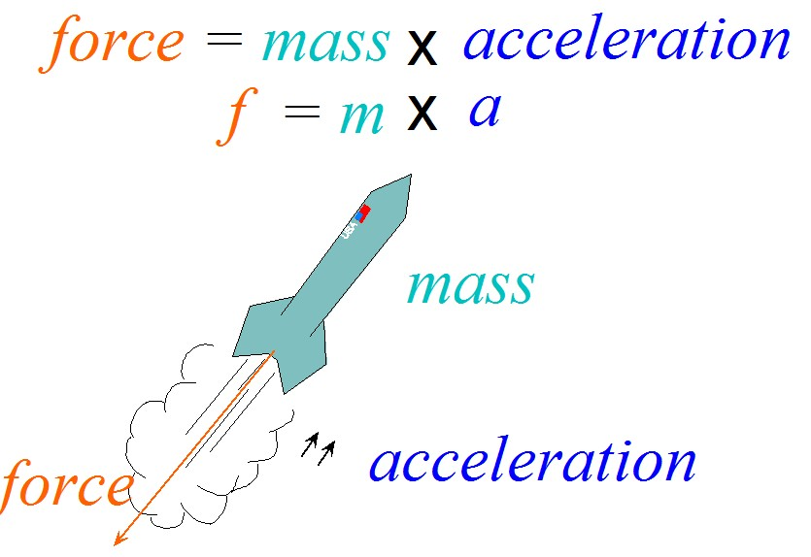

Two types of relation
Heraclitus, governed by laws of physcis, Newtonian or non-newtonian
Force and matter
Familial Relation

Slide 16
Selfhood, Levinas explains, is not a stable identity but a process of self-identification, of appropriating the diversity of otherness and integrating it back into a unitary selfhood.
The ego is neither a particular instance of a universal category nor something that partakes of elemental forces or codes, but rather something that lives a contented life, living from its contents, fulfilling itself by filling itself.
. In contrast, Levinas explains that the self initially relates to the other through a process of incorporation and not externalization, through consumption and not production. process of incorporation and not externalization, through consumption and not production. By emphasizing consumption, Levinas seems to be drawing attention the way in which one begins one’s existence -- not as an agent asserting its sovereign will and projecting its spirit onto things but rather as someone vulnerable who needs to be sustained by the world in order to survive.
Hand to mouth

Slide 17
Becoming as Regeneration
Not anonymous,
Material becoming occurs through the intercession of others

Slide 18
Theory of Becoming

Slide 19
Metabolism

Slide 20
Birth

Slide 21
Maternal Practice

Slide 22
Allomothering

Slide 23
Granarchism

