Slide 1
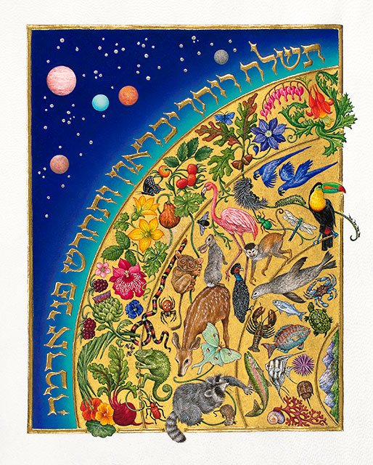
The Face of the Earth פְּנֵ֣י אֲדָמָֽה
A Black and Indigenously-Inspired Levinasian Conception of Matrisocial Ecological Becoming.

Slide 2
“Does X have a face” is always the wrong question
Straightforwardly ontological, predicative
Reification of the face as a thing

Slide 3
“Le Visage” = Intentionality
Vision
Visuality
Intentionality The Subject Position
Man-to-Man position
Persectivism in Levinas the visage is not the only important viewpoint
“Le visage” is a straightforward wordplay, well-known philosophical trops
Vis a vis, vision
Intentionality of the seer, the power of theoria, of consciousness to subsume the external as internal
A seer is a subject, a masculine and virile subjectivity
The face-to-face is a man-to-man faceoff, a reconsideration of Hegel’s struggle for self-consciousness

Slide 4
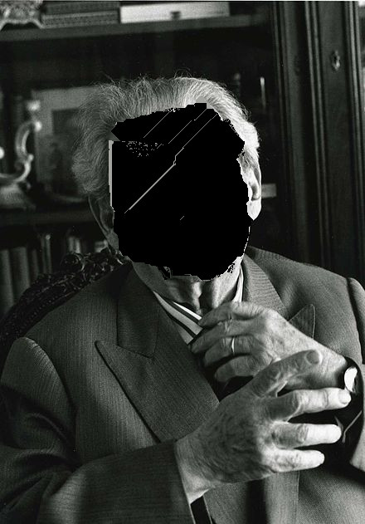
Anarchic, Faceless Levinas
In his later work, Levinas stops using the language of the face
Prevents the ontological error of thinking the face is a thing
His work foregrounds the depths from which subjectivity is given birth by maternity

Slide 5
The face of the element
Il se déploie dans sa propre dimension la profondeur, inconvertible en largeur et en longueur où s'étend la face de l'élément. La chose, certes, elle non plus, ne s'offre que par une face unique; mais nous pouvons en faire le tour, et l'envers en vaut l'endroit. Tous les points de vue se valent. La profondeur de l'élément le prolonge et le perd dans la terre et dans le ciel « Rien ne finit, rien ne commence. »”
It unfolds in its own dimension: depth, which is inconvertible into the breadth and length in which the side of the element extends. To be sure, a thing likewise presents itself by but one unique side; but we can circle round it, and the reverse is equivalent to the obverse; all the points of view are equivalent. The depth of the element prolongs it till it is lost in the earth and in the heavens. “Nothing ends, nothing begins.
Translator’s Note:
It is in order to reserve the English word ‘face’ to translate ‘visage’ — the countenance of the Other — that we are using the term ‘side’ to translate ‘face’ in this context.
The dimension here is *depth* as opposed to *height*
Materiality, The Self attached to the Ego in Time and the Other
Materiality of Maternity in Otherwise than Being
Gravity, Curvature of Space Time, etc

Slide 6
Continuous Creation
Descartes: it does not follow that we shall exist a moment from now, unless there is some cause—the same cause which originally produced us— which continually reproduces us, as it were, that is to say, which keeps us in existence
Bergson: Creation would have appeared not simply as continued, but also as continuous. The universe, regarded as a whole, would really evolve. The future would no longer be determinable by the present
Psalm 104:29-30
30 You will send forth Your spirit and they will be created, and You will renew the face of the earth.
ל תְּשַׁלַּ֣ח ר֖וּֽחֲךָ יִבָּֽרֵא֑וּן וּ֜תְחַדֵּ֗שׁ פְּנֵ֣י אֲדָמָֽה

