Slide 1
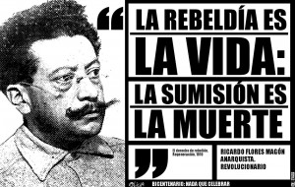
Ricardo Flores Magon

Slide 2
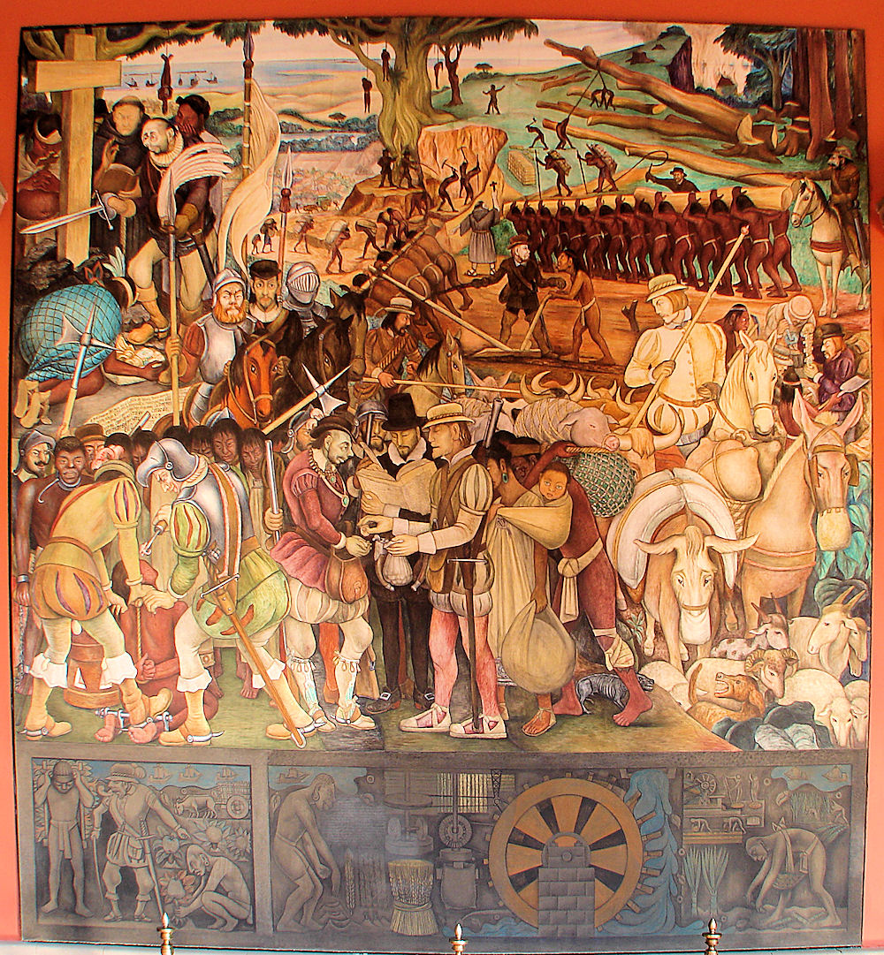
Spanish Conquest 1519
Spain conquers what is now Mexico
Domination
  Spiritual : Catholic
  Political : King
  Economic : Plantations

Slide 3
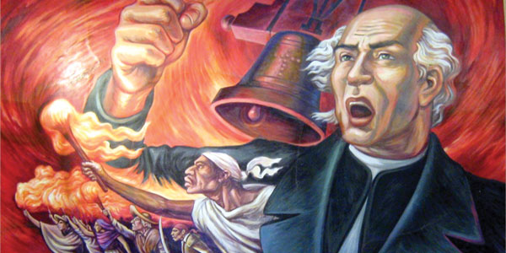
Mexican Independence (1810-21)
September 16, 1810, parish priest Miguel Hidalgo invokes the cry of Dolores “Will you free yourself. will you recover the lands stolen three hundred years ago by the hated Spaniards?”
Struggle for independence continues for 1821
Political: Independent from Spain
Religious: Still Catholic
Race & Class
  Maintained class and racial divisions
  The one improvement was that white Europeans were given the same rights as Spanish descendents

Slide 4
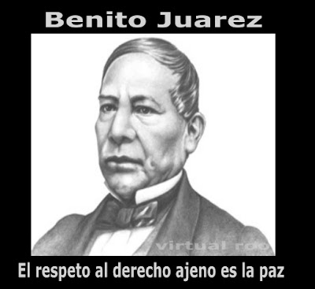
1857-1872: Liberalism, Juarez
“Liberalism” becomes popular in the 1850s
  French freethinkers such as Voltaire and Rousseau
  Also anarchists such as Proudhon
Leader of the Liberal Party was Benito Juarez
  Indigenous Mexican, from a poor family
Liberal Reforms
  Constitution guaranteeing rights of individuals
    Freedom of speech and assembly
    Universal free education
  Rational rule of law: against authoritarian and arbitrary
    Restrict power of church
    Curb power of the military
  Market liberalization
    Law required church to give up much of its property
    Many indigenous tribes had to similarly forfeit communal lands
More radical movements
  Anarcho-syndicalist unions
  Anarchist/Socialist Peasant uprisings (Chavez Lopez)

Slide 5
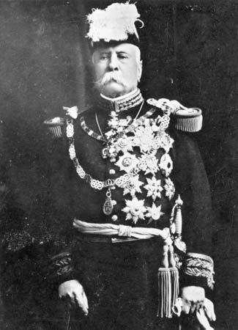
Porfirio Diaz
Military General.
Hero after he leads campaign against attempted French invasion of Mexico
Runs for president against Juarez
Loses election
Attempts a coup. Fails
Juarez suddenly dies
Leads another coup.
Even though he campaigned on a pledge of limiting presidential terms, he rules from 1880-1910

Slide 6
Dictatorship of Diaz
Combines political authoritarianism and economic exploitation
  Political
    Diaz Governs by “Pano o Palo”: Bread or the Club. (Gifts or Punishment)
    Corruption and patronage throughout
    State governors, district political bosses, village mayors freely abuse power, even rape and murder
    Courts protect rich Mexicans and foreigners
    Free speech is repressed. Journalists and other dissidents go to jail
    Increase the army and the paramilitaries
    “Fugitive Law” gives authorities right to shoot someone who is fleeing from the law
  Economic
    Exploitation of natural resources – coffee, timber, tobacco, petroleum, copper, iron
    Monopoly over industries – railroad, mining
  Ideology
    Catholicism: supports the church, rescinds liberal reforms
    “Scientific” Darwinism legitimizes racism against indigenous people
  People suffer
    Globalism: Lands seized from the natives and sold to foreign investors and (white) Mexican aristocrats
    War against tribes who resist this exploitation (Maya in Southern Mexico, Yaqui in Northern)
    Half the rural population works on plantation, enslaved by debt contracts

Slide 7
Ricardo Flores Magon born in village
Born in 1874 in a small village in Southern Mexico
According to his first biographer, his father taught him about the importance of village communism and mutual aid
  No rich and no poor existed in their communities:
  Each person produced what she or he could and each took what she or he needed for survival.
  The villagers did not need judges, jails, or policemen to govern them:
  “We live with peace, respect, and love towards one another as friends and brothers.”

Slide 8
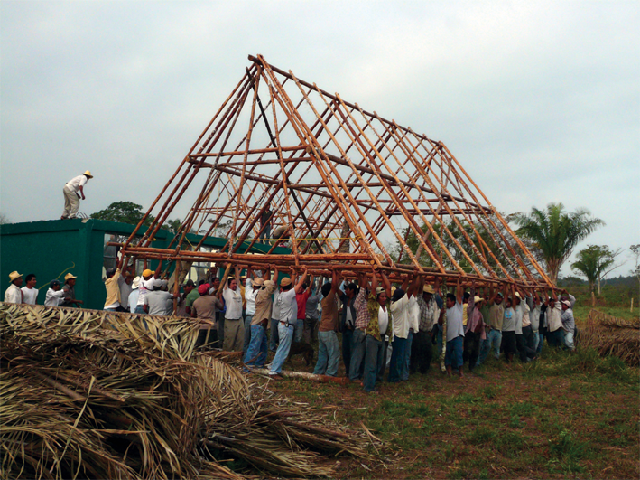
Tequio
From before the Spanish invasion up to the current day, Mexican villagers practice “tequio”
The entire community shares responsibility for everybody's well beings
Collaborate on communal projects

Slide 9
RFM in Mexico City
Family moved to Mexico City
As a teenager, in demonstrations against Diaz
In law school, works for school newspaper
Founds the paper Regeneracion
  Motto is “Independent Legal Journal”
  Changes motto to “Independent Journal of Combat”
Wide ranging criticism of Diaz’s regime
  Focuses on the wrongs of the legal system
  Also criticizes injustices of political bosses
  Also criticizes the plantation system that oppresses the peasants as well as unfair working conditions in factories
Paper is shut down and RFM is imprisoned several times

Slide 10
Liberal Party (1901)
While visiting the Vatican, Diaz brags that he has given the Catholic church free reign in Mexico
Camilo Arriaga, a wealthy engineer and sometimes politician, calls for a return to the legacy of Benito Juarez and the Liberal Constitution
February 1901 the Liberal Party has its first convention.
Military police patrol outside
Most speeches critique the regime indirectly, focusing on the illegitimate power of the church
In contrast, Flores Magon details the evils of the government, ending with the pronouncement: “The administration of Porfirio Diaz is a den of thieves.”
  People are shocked. He repeats the statement . The crowd applauds
Regeneration continues publishing articles against political injustice and economic exploitation. It is shut down
The police arrest the leaders of the Liberal Party to prevent a second meeting of the Liberal Party

Slide 11
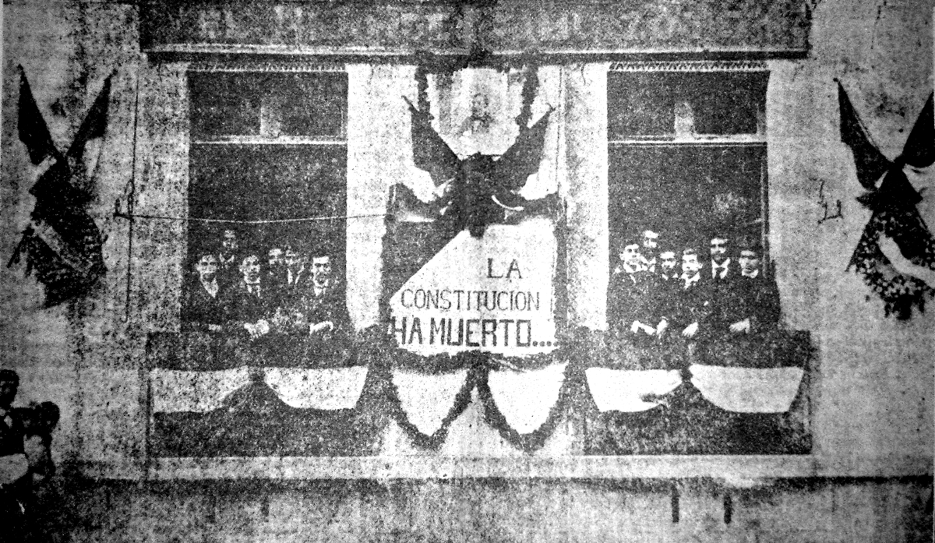
El Hijo del Ahuizote
Continue publishing papers (El Hijo del Ahuizote)
Staff of newspaper hangs a banner that reads: The Constitution is dead

Slide 12
RFM chased out of Mexico
The papers get shut down and RFM is again arrested
Finally, the government decrees that it is illegal for any newspaper to publish anything by Flores Magon
RFM is told that he will be murdered if he stays in Mexico

Slide 13
Arrive in USA
1904: Cross the border to Texas
Restart the newspaper
  Discuss persecution of press and liberal party
  Discuss Injustice of the dictationship
  Discuss Social and economic justice, exploitation of workers, etc.
A Mexican agent breaks into his home and tries to murder him
Moves up to Saint Louis Missouri

Slide 14

JOPLM
Junta Organizadora (Organizing Committee) of Mexican Liberal Party
In Saint Louis, Flores Magon restarts the newspaper and founds the radical wing of the Liberal Party
They call for a formation of cells throughout Mexico and the United States border dedicated to overthrowing the dictator, who will communicate with the coordinating committee in Saint Louis
Impressive network of around 50 cells
In addition to being a platform to discuss the overthrow of the dictator, it was a platform to
  Discuss unjust labor conditions on farms and mines and factories
  Discuss political corruption
  Discuss Racism in United States
The governments of the US and Mexico were spying on them throughout
RFM arrested for alleged violations of the postal code, but fled to Canada after getting out on bail

Slide 15
1906 Manifesto
Even during their exile, RFM released the 1906 Manifesto
  One of the most important documents of the Mexican revolution. The same language in Zapata’s declarations and also in the current Mexican Constitution
  Intensely collaborative.
    A product of the communication between the coordinating committee and the members of cells throughout Mexico and the US border
  Propositions
    Political and Legal
      No prisons. No death penalty
      Equal rights for women
      Freedom of speech. Freedom of the press
      Women’s rights
    Economic
      Limit the work week.
      Minimum wage
      Promote union
      Restore land to peasants
  Circulated throughout Mexico and the US Border

Slide 16
Labor Uprisings 1906-1907
Cananea Copper Mine – Northern Mexico
  Economic Misery: Paid low wages and had to buy from company store
  Racism: Managers are from the United States. Paid better. Treated better.
  JOPLM had many supporters in this region
  Strike demanding better pay and shorter hours
  After a few battles between protestors and management, strike ended when the Mexican army came to town
Rio Blanco Textile Factory – Southern Mexico
  Economic Misery: wages too low, rents and commodities too expensive
  Strikes all over the region
  Rio Blanco riots against the owners after company store refuses to sell food to a starving mother
  Federal forces massacred the civilians. People are jailed and drafted into the army
Mexican populace notices the brutality
  US soldiers crossed into Cananea, demonstrating the influence of US capitalism
  Murder of innocents in Rio Blanco demonstrates brutality of regime

Slide 17
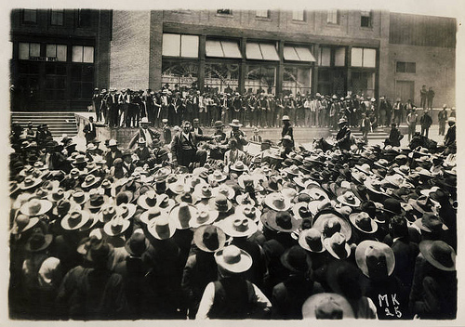

Slide 18
1906 and 1908 PLM Revolutions
In 1906 and 1908, the JOPLM launched revolutionary attempts against the dictator
Aims
  Collected weapons and made battle plans
  They hoped for coordinated uprisings throughout Mexico and the border
  The 1906 Plan of the JOPLM would be instituted
Limited Success
  In a few towns, the insurgents met with some success, seizing the civic treasury and deposing the civil authorities
  However, the US and Mexican governments were spying on the PLM and were both prepared for these uprising
  Many leaders were arrested before any of their plans could be enacted
  Uprisings squashed by the military

Slide 19
Repression of PLM
Brutal repression of the PLM in reaction to these uprisings
Also targeted indigenous tribes who had supported these efforts
RFM was arrested in 1907.
  Sent to jail for “resisting arrest” because they didn’t know the charges
  Held in jail for many months
  Finally charged with violating neutrality laws between Mexico and US
  Prosecutor focuses on the general threat of political radicalism.

Slide 20
International Left Solidarity
The PLM undergoing much persecution
Anarchists and Socialists such as Emma Goldman, Eugene Debs, and Petr Kropotkin raised money for the PLM and spoke about their repression
At this time, the US left was also being persecuted
  “War on Anarchists” declared by President Roosevelt
  Illegal to advocate expropriation
Change in Flores Magon’s thinking
  Before: For the national liberation of the Mexican People
  After: Realized that an international struggle was necessary to defeat the exploitation of capitalism, tyranny of government and brainwashing of religion

Slide 21
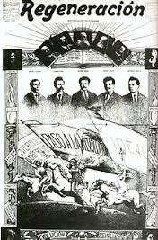
Mexican revolution
Got out of jail in August, 1910
Wealthy landowner Francisco Madero calls for revolution in November 1910
Publishes Regeneracion again

Slide 22
Exhortation to Revolution
“The revolution is going to break out at any moment.
“We libertarians ought to strive that the orientation of this movement is that indicated by science. If we don’t do this, the revolution which is rising will serve no other purpose than to replace one president with another, or that which is the same, one boss with another. We ought to keep in mind that what is needed is that the people have bread, shelter, and land to cultivate; we ought to keep in mind that no government, no matter how good its intents, can declare the abolition of misery. It is the people itself, the hungry, the dispossessed who must abolish misery, taking, in the first place, possession of the earth which, by natural right, cannot be monopolized by a few, but is the property of every human being.
“It is necessary, then, proletarians, it is necessary then, you dispossessed, you don’t confuse yourselves. The conservative and bourgeois parties speak to you of liberty, of justice, of law, of honest government, and they tell you that if the people exchange the men in power now for others, that you will have liberty, justice, law, honest government. Don’t let yourselves be swindled. What you need is that which will ensure the well-being of your families and your daily bread; and no government can provide the well-being of families. It is you yourselves who must conquer these things, taking immediately the possession of the earth, which is the primordial wellspring of riches; and no government can give you the land. Understand this well! The law defends the “right” of those who hold the wealth. You have to take it yourselves despite the law, despite the supposed right of private property; you have to take it yourselves in the name of natural justice, in the name of the right of every human being to live and develop his body and mind.

Slide 23
PLM uprisings
By the time the revolution started, the party was severely wounded
Wealthy landowner Madero chased the dictator out of the country
PLM did have some success in one Mexican state, but they were defeated by Madero’s troops in the end
Lots of international fighters supported PLM, including many from the IWW (International Workers of the World)

Slide 24
Manifesto of September 23, 1911
The Organizing Junta of the Partido Liberal Mexicano views with sympathy your efforts to put into practice the lofty ideals of political, economic, and social emancipation, whose reign upon the earth will finally put an end to the long battle of man against man, which has its origin in the inequality of wealth born of the principle of private property.
Without the principle of private property there would be no reason for government, which is necessary solely for the purpose of keeping the disinherited within bounds in their quarrels or in their rebellions against those who hold the social wealth; neither would there be reason for the church, whose only object is to strangle the innate human rebellion against oppression and exploitation through the preaching of patience, resignation, and humility, and through quieting the call of the most powerful and fertile of instincts through immoral, cruel, and unhealthy penances; and so that the poor will not aspire to enjoying the good things of the earth and thus constitute a danger to the privileges of the rich, the church promises to the humble, to the most resigned, to the most patient, a heaven extending to infinity, beyond the stars one can see . . .
The Partido Liberal Mexicano recognizes that the so-called right of individual property is an iniquitous right, because it subjects the larger number of human beings to work and to suffer to satisfy and keep in idleness a small number of capitalists.
The Partido Liberal Mexicano recognizes that Authority and the Clergy are the support for the iniquity of capital, and therefore the Organizing Junta of the Partido Liberal Mexicano has declared solemn war upon Authority, Capital, and the Clergy.

Slide 25
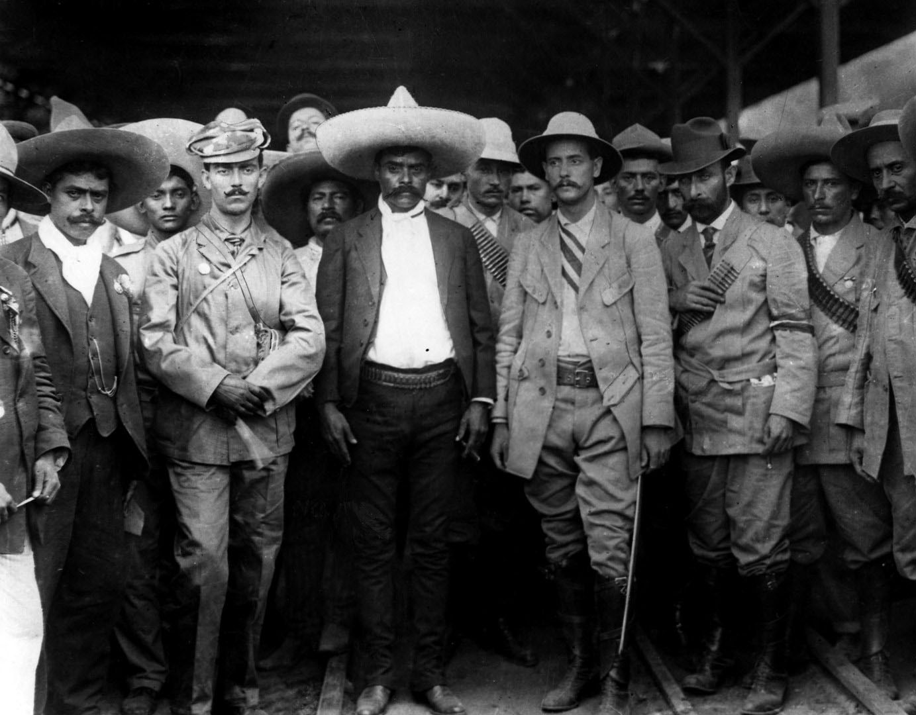
Zapata
Emiliano Zapata broke with the wealthy landowner Madero in November 1911 because he was doing nothing to help the poor indigenous peasants
Probably was exposed to the Regeneracion newspaper in 1905
Many of his advisors were associated with the PLM and much of his rhetoric came from their documents
Invited Flores Magon to come to stay with them in Mexico, but Flores Magon was already in trouble with the law and heading to jail

Slide 26
The Mexican People Are Apt For Communism (1911)
The inhabitants of the state of Morelos [Zapata’s home], and other states have solved the problem of hunger.
To arrive at this result they took possession of the earth and the instruments of production in Mexico. They didn't need “leaders,” nor “friends of the working class,” nor “paternal decrees,” nor “wise laws”—they didn't need any of this. Their actions did it all and continue doing it all.
This in itself is enough for a social revolution which is economic in nature and anti-authoritarian, but there is more. Four million Indians live in Mexico who. until twenty or twenty-five years ago, lived in communities possessing the lands, the waters, and the forests in common. Mutual aid was the rule in these communities, In these communities there were no judges, mayors, jailers, in fact no bothersome people at all of this type. Everyone had the right to the land, to the water to irrigate it, to the forests for firewood, and to the wood from the forests for the construction of small houses. The plows passed from hand to hand, as did yokes of oxen. Each family worked as much land as they thought was sufficient to produce what was necessary, and the work of weeding and harvesting was done in common by the entire community—today. Pedro s harvest, tomorrow Juan's, and so on. Everyone in the community put their hands to the work when a house was to be raised.

Slide 27
Revolution Continues
Flores Magon was in and out of jail through much of the Mexican Revolution
Didn’t have the military force to participate
In Mexico, a series of leaders took control of the Revolution
  Flores Magon wrote articles repeating warning of *personalismo*, the belief that a single person or a political party could liberate the Mexican people. The people must take possession of the land and industries themselves.

Slide 28
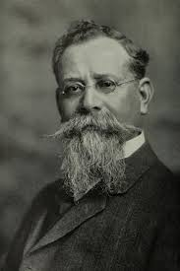
Carranza
The ultimate victor of the revolution was Venustiano Carranza
Like Madero, came from a wealthy family
Clever politician
  Adopted the rhetoric of the left
    Promised labor and land reforms
    Struck deals with US Labor and Socialist Organizations
  Does not implement land reform
    Leaders such as Zapata and Villa break with him because he refuses to return land to the peasants
  Casa del Obrero Mundial (House of the Worker of the World)
    Anarcho-syndicalist union
    Carranza promises to pass progressive labor reforms and support union in exchange for their support
    Peasant revolutionaries are called “counter-revolutionary” and primitive
    Casa organizes Red Battalions to fight Zapata and Villa
    Afterwards, Carranza disbands the Red Battalions
    Then he breaks two general strikes, threatening strikers with the death penalty
    Shuts down the offices of the Casa

Slide 29
“To the Soldiers of Carranza”
Flores Magon addressed Carranza’s supporters, warning them again of the danger of following a leader
He tells them that “the rebels who continue to stand are your brothers; they’re poor like you”
See then, brother who follows Carranza, that the problem that the rebels are trying to resolve with arms in hand will remain when Carranza is president, and it's that same problem that you have to resolve, because it affects you in the same manner that it affects them. Your duty is to aid them, and in order to do that do not give up your arms when you're ordered to do so when Carranza s troops are discharged. What you ought to do in that moment, or sooner if possible, is to rebel, turning your gun upon your leaders and their officials, without trembling as you shoot your weapon, because they are your enemies, because they have an interest in the persistence of the institutions that enable them to live a life of privilege

Slide 30
World War I
During this period, US Left was in trouble
  Series of direct actions led to repression by the state
  Emma Goldman and other foreign leftists were deported
  Attacks on the International Workers of the World after Free Speech demonstrations
World War 1
  Espionage Act: President of the United States makes it illegal to do anything that would interfere with the war effort
Flores Magon speaks boldly against the war
  Insisted that the war between nations was simply a battle between competing groups of rich people
  A poor person from one country has no desire to die in order to become the murderer a poor person from another country, all for the satisfaction of a rich person
  Wage slavery does not recognize national borders
  Instead of war between nations, he insisted there be international struggle between classes.

Slide 31
Trials of 1916 and 1918
Flores Magon’s statements landed him in a great deal of trouble
In general, anarchists were being targeted
In 1916, he was arrested for sending the newspaper through the mail
While out on bail for this arrest, he was again indicted.
This time it was for the speeches and articles he had written against American participation in the War
In both trials he was directly attacked for being as an anarchist, whose anarchism was a direct threat to the nation
The judge in 1918 proclaimed the paramount importance of national security and sentenced him to 20 years in prison

Slide 32
Death of Flores Magon
Flores Magon was already very sick and knew that he would not last the 20 year prison sentence
In Leavenworth Prison, he was widely respected by other prisoners as the highest type of idealist.
Many people petitioned for his freedom, but he was too much of a danger to both the Mexican and US governments
He died in prison in 1922
But his supporters refused to have him buried in the prison graveyard
Transported his corpse back to Los Angeles
The Mexican Railroad Union then transported him back to Mexico City for a proper burial. They stopped at towns along the way, to crowds that welcomed and honored him
After his death, Flores Magon still remains influential
  Writers during the Spanish Revolution quoted his work
  Inspired Cesar Sandino, leader of the Nicaraguan Revolution
  Discussed during the 1968 student protests in Mexico City
  Still an inspiration to indigenous movements in Mexico

Slide 33
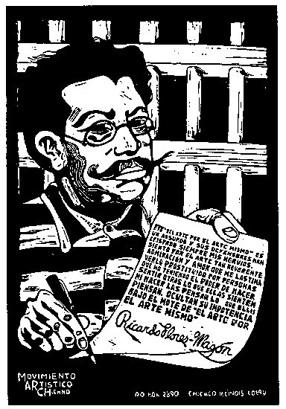
Letter from Prison
How quickly time passes and how much changes the luck of men, except for mine! My comrades of that epoch are now generals, governors, secretaries of State, and some of them have even become presidents of Mexico. They are rich, famous, and powerful, while I am poor, obscure, sick, nearly blind, with a number for a name, branded as a felon, rotting in this human herd, whose crime was to have been so ignorant and so stupid to have robbed a piece of bread, when it is a virtue to rob millions. But my former comrades are practical men, while I am only a dreamer, and this, therefore, is my own fault. They have been the ant and I the cicada; while they have counted dollars, I have spent time counting the stars. I would like to make a man out of each human animal; they, more practical,
have made an animal out of each man and have made themselves pastors of the flock. Nevertheless, I prefer to be a dreamer than a practical man.

