Slide 1
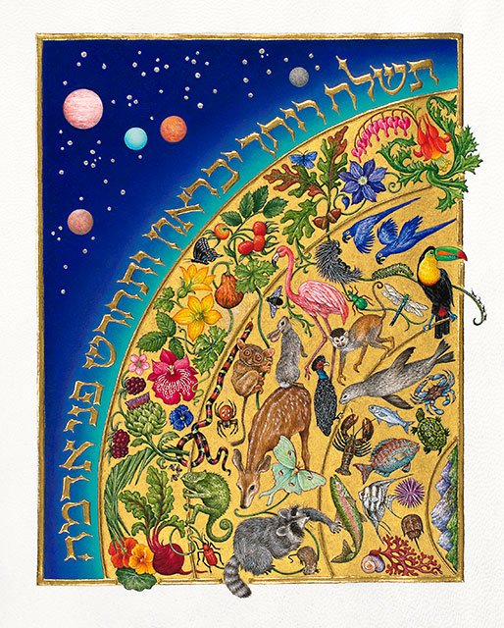
The Face of the Earth פְּנֵ֣י אֲדָמָֽה
A Black and Indigenously-Inspired Levinasian Conception of Matrisocial Ecological Becoming.

Slide 2
Sol QUotes
n a 2016 paper, Sol Neely, our great friend, asked us to allow the writings of Emmanuel Levinas to become inspired by indigenous thought so that we could learn to take ethical responsibility through "the social relation—the irreducible kinship relation expressed by 'all my relations' — the utterance itself of ancestry and place by which the noise and sounds of nature are at last heard through an inspired eco-phenomenology."1. The question of our ethical relationship to nature seems especially pertinent now, both for us right here right now at this conference where we are considering the relationship between humanism and otherness, and for us as humans responsible for the exploitation and decimation of the natural world.

Slide 3
“Does X have a face” is always the wrong question
Straightforwardly ontological, predicative
Reification of the face as a thing

Slide 4
“Le Visage” = Intentionality
Vision
Visuality
Intentionality The Subject Position
Man-to-Man position
Persectivism in Levinas the visage is not the only important viewpoint
“Le visage” is a straightforward wordplay, well-known philosophical trops
Vis a vis, vision
Intentionality of the seer, the power of theoria, of consciousness to subsume the external as internal
A seer is a subject, a masculine and virile subjectivity
The face-to-face is a man-to-man faceoff, a reconsideration of Hegel’s struggle for self-consciousness

Slide 5
Face is idolatry. You never look at the face of God
The problem begins in the book of Exodus, when the prophet Moses, speaking with God on Mount Sinai, asks God to show Moses his glory. God warns that: "…You cannot see my face, for no one may see me and live." (Exodus 33:20, NIV)
The face isn't a thing. The mistake of reification, predication, ontological attribution is all over the scholarship. "The Face" is a mode of relating, one that is fundamentally ambiguous as you point out. This is an obvious truth: I see everything Gad presents as himself, as his Face, on his Facebook for example as a mode of self-presentation, but is that presentation of Face really who Gad is? Yes and no. The Face is a fundamentally ambiguous presentation. Moreover, "le visage" is a sort of a metonym for "intentionality" in general and sort of a wordplay on vision, vis-a-vis, videre (to see). It's an inquiry into the positionality of the one who sees, the one who looks, an inquiry into the position of the masculine, virile Subject. The face-to-face is a reconsideration of Hegel's struggle between self-consciousnesses, but this absolutely not the only nor the most important dynamic in Levinas. It's his undermining of all that macho bullshit of virile subjectivity. In his later works, he makes it more clear that the face is not the most important concept.
Really: worship of the Face in Levinas is flat out idolatry
I haven't read this article and I probably won't any time soon. In general, the idea of the "Face" is widely misunderstood. You get scholars asking dumb questions like "What is the face" and "Does X have a face". This is very clearly an ontological question, one of predicaton, of the Being of Face. Clearly the wrong question, reifying question.

Slide 6
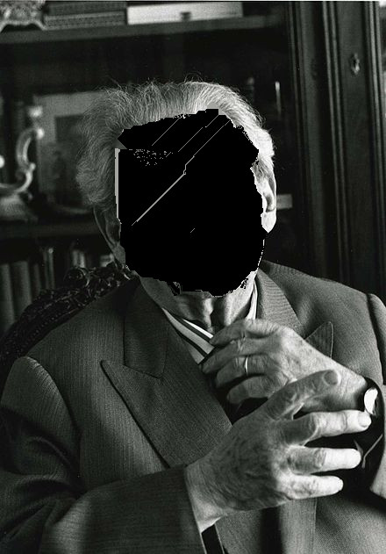
Iconoclasm Anarchic, Faceless Levinas
In his later work, Levinas stops using the language of the face
Prevents the ontological error of thinking the face is a thing
His work foregrounds the depths from which subjectivity is given birth by maternity
Faceless becoming

Slide 7
The face of the element
Il se déploie dans sa propre dimension la profondeur, inconvertible en largeur et en longueur où s'étend la face de l'élément. La chose, certes, elle non plus, ne s'offre que par une face unique; mais nous pouvons en faire le tour, et l'envers en vaut l'endroit. Tous les points de vue se valent. La profondeur de l'élément le prolonge et le perd dans la terre et dans le ciel « Rien ne finit, rien ne commence. »”
It unfolds in its own dimension: depth, which is inconvertible into the breadth and length in which the side of the element extends. To be sure, a thing likewise presents itself by but one unique side; but we can circle round it, and the reverse is equivalent to the obverse; all the points of view are equivalent. The depth of the element prolongs it till it is lost in the earth and in the heavens. “Nothing ends, nothing begins.
Translator’s Note:
It is in order to reserve the English word ‘face’ to translate ‘visage’ — the countenance of the Other — that we are using the term ‘side’ to translate ‘face’ in this context.
The dimension here is *depth* as opposed to *height*
Materiality, The Self attached to the Ego in Time and the Other
Materiality of Maternity in Otherwise than Being
Gravity, Curvature of Space Time, etc

Slide 8
Continuous Creation
Descartes: it does not follow that we shall exist a moment from now, unless there is some cause—the same cause which originally produced us— which continually reproduces us, as it were, that is to say, which keeps us in existence
Bergson: Creation would have appeared not simply as continued, but also as continuous. The universe, regarded as a whole, would really evolve. The future would no longer be determinable by the present
Psalm 104:29-30
30 You will send forth Your spirit and they will be created, and You will renew the face of the earth.
ל תְּשַׁלַּ֣ח ר֖וּֽחֲךָ יִבָּֽרֵא֑וּן וּ֜תְחַדֵּ֗שׁ פְּנֵ֣י אֲדָמָֽה

Slide 9
Regeneration precedes πόλεμος
Levinas’s doctrine of non-Heraclitean Becoming
On n'a pas besoin de prouver par d'obscurs fragments d'Héraclite que l'être se révèle comme guerre,
Levinas famously starts Totality and Infinity declaring that “We do not need obscure fragments of Heraclitus to prove that being reveals itself as war.”
Heraclitus whose dictum Πάντα ῥεῖ1, everything flows, is complemented by his assertion that war is the master-father of all beings2
War (πόλεμος) is the father-master (πατήρ) of all beings; and some he has made gods and some men, some slaves and some free.
This conception of the master-father as the source of Becoming is paradigmatic of the male barracks warrior-hero, as Nancy Hartsock explains, finds its correspondence in the patriarchal political model found in Aristotle's politics, but an alternative for that koinon or commoning is the matrisocial sphere of take care of the needs sphere of the oikos. the needs that from birth as we are birthed as a needy being into the world, breathed into the wold
This idea of becoming as force inspires the entire genealogy descended from Heraclitus, opposition of forces runs through Locke's billiard ball empiricism4 and Hobbes's mechanistic5 and Hume6, Newton's forces, Spinoza's conatus, Hegel's dialectic, Nietzsche's will to power, Heidegger's ecstatic Being, Deleuze, Foucault, as so on.7
Deleuze and Spinoza are widely influential in contemporary ecological thought in for example in for example post-humanist philosopher Ross Bradiotti’s conception of a “Politics of Life as Bios/Zoe”. Heidegger in deep ecology, anarchoprimitivism, and eco-phenomenology

Slide 10
Elemental Force as Polemos
But the primitive powers that burn within it burst open its wretched phraseology under the pressure of an elementary force. They awaken the secret nostalgia within the German soul. Hitlerism is more than a contagion or a madness; it is an awakening of elementary feelings. But from this point on, this frighteningly dangerous phenomenon becomes philosophically interesting. For these elementary feelings harbor a philosophy.
The mysterious urgings of the blood, the appeals of heredity and the past for which the body serves as an enigmatic vehicle, lose the character of being problems that are subject to a solution put forward by a sovereignly free Self. Not only does the Self bring in the unknown elements of these problems in order to resolve them; the Self is also constituted by these elements.
But force is characterized by another type of propagation. The person who exerts force does not abandon it. Force does not disappear among those who submit to it. It is attached to the personality or society exerting it, enlarging that person or society while subordinating the rest. Here the universal order is not established as a consequence of ideological expansion; it is that very expansion that constitutes the unity of a world of masters and slaves. Nietzsche's will to power, which modern Germany is rediscovering and glorifying, is not only a new ideal; it is an ideal that simultaneously brings with it its own form of universalization: war and conquest.

Slide 11
Regeneration of generations
For Levinas, the generative family demonstrates that, rather than merely issuing from an origin, existence is a continuous creation
Time as continuous creation, as the genesis of gendered generations, time as continuous regeneration
There is a sense in which Totality and Infinity may be read as if were the first Book of Moses, Genesis or בְּרֵאשִׁית, { There is a footnote here } the story of the regenerating engendering of generations. It tells a story of life stage development, from the newborn nursing on the element through job and mature home ownership, through old age, through sex and sacrifice and murder, to the rebirth of a new subjectivity who begins the story at the start in naissance an . At the end you realize that the sacrifice and murder of the self is what constituted the infant at the beginning.

Slide 12
Continuous Rebirthing at Every moment
This is emphasized not just as the family scheme but showing how it is at every moment this reorientation
The expression "in one's skin" is not a metaphor for the in-itself; it refers to a recurrence in the dead time or the meanwhile which separates inspiration and expiration, the diastole and systole of the heart beating dully against the walls of one's skin. The body is not only an image or figure here; it is the distinctive in-oneself of the contraction of ipseity and its breakup.12 This contraction is not an impossibility to forget oneself, to detach oneself from oneself, in the concern for oneself. It is a recurrence to oneself out of an irrecusable exigency of the other, a duty overflowing my being, a duty becoming a debt and an extreme passivity prior to the tranquillity, still quite relative, in the inertia and materiality of things at rest. It is a restlessness and patience that support prior to action and passion. Here what is due goes beyond having, but makes giving possible. This recurrence is incarnation. In it the body which makes giving possible makes one other without alienating. For this other is the heart, and the goodness, of the same, the inspiration or the very psyche in the soul.
The temporalization of time-the openness by which sensation manifests itself, is felt, modifies itself without altering its identity, doubling itself up by a sort of diastasis of the punctual, putting itself out of phase with itself-is neither an attribute nor a predicate expressing a causality "sensed" as a sensation.
The ego is in itself like a sound that would resound in its own echo, the node of a wave which is not once again consciousness.
the trope of the body animated by the soul, psyche in the form of a hand that gives even the bread taken from its own mouth. Here the psyche is the maternal body.
deBroglie matter waves

Slide 13
Maternal Body
Indeed in the transcendence of intentionality diachrony is reflected, that is, the psyche itself, in which the inspiration of the same by the other is articulated as a responsibility for another, in proximity. Sensibility is in this way situated back in the human exception. But one has to go back from this reflection to the diachrony itself, which is the-one-for-the-other in proximity. It is then not a particular signification. The-one-for-another has the form of sensibility or vulnerability, pure passivity or susceptibility, passive to the point of becoming an inspiration, that is, alterity in the same, the trope of the body animated by the soul, psyche in the form of a hand that gives even the bread taken from its own mouth. Here the psyche is the maternal body.
Again the question of body, of gravity, of weight that he was working on, the curvature of space-time in Totality nd Infinity
Or do the being encumbered with oneself and the suffering of constriction in one's skin, better than metaphors, follow the exact trope of an alteration of essence, which inverts, or would invert, into a recurrence in which the expulsion of self outside of itself is its substitution for the other?

Slide 16
Anarchic Materiality, the Matrisocial
Also bring in Kropotkin

