Slide 1

Cirrius
An evolution in integrated weather services

Slide 2





Existing Solutions
Weather channel
Mobile widgets
Check Online
Small Talk

Slide 3
Product Demo

Slide 4
Product Roadmap
Integrate more widgets and build custom widgets
User customizations (e.g. drag and drop, scale, forecast settings)
Expand to more platforms (e.g. iOS, mobile homescreen)
Fully functioning dashboard
Monetizing opportunity

Slide 5
Dashboard Preview

Slide 6
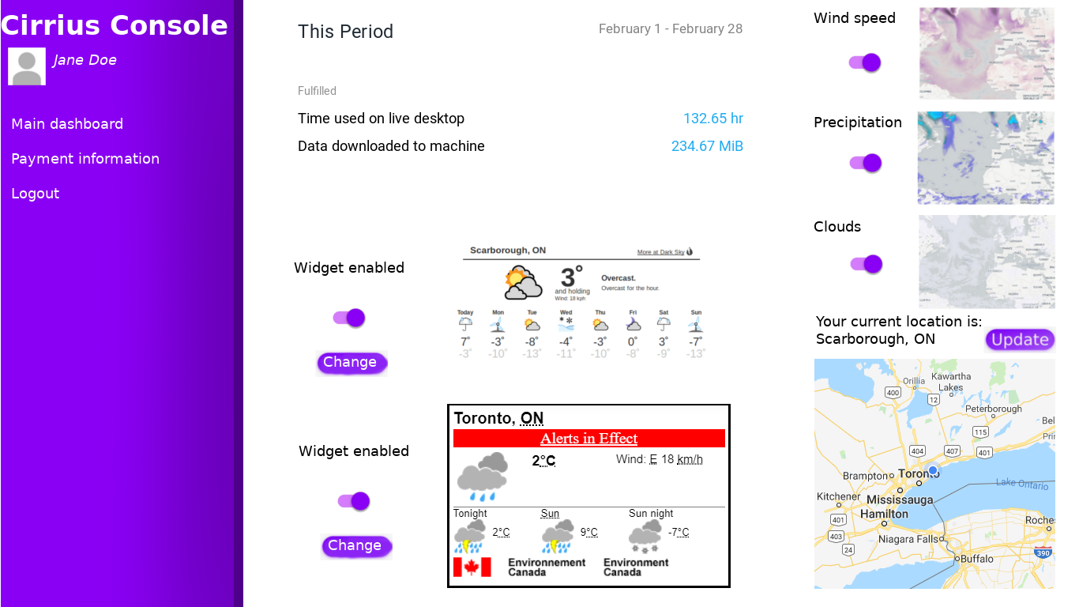

Slide 7
Thank you for listening!

