Slide 1

Plankton
An Introduction to the Drifters

Slide 2
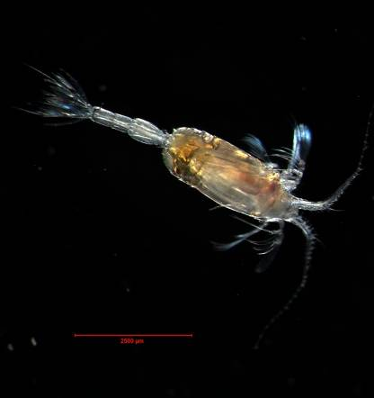
What are plankton?
Planktos – Greek meaning “to wander”
Weakly swimming or drifting organisms
Microscopic or macroscopic in size
Plant (phytoplankton) or animal (zooplankton)

Slide 3
Why are plankton important?
Food source (basis of the food web)
Producer of oxygen (photosynthesis)
Cause of toxic “blooms” (resulting in fish kills and shellfish poisoning)
Means for dispersal of organisms by transport in currents
Major players in the global carbon cycle

Slide 4
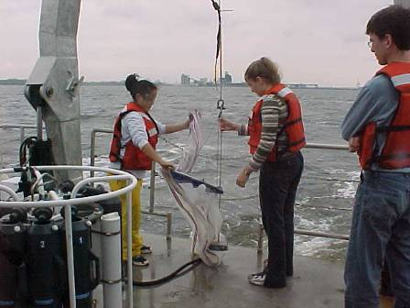
How are plankton studied?
Collected with sampling bottles
Special nets
Microscopes
Cultured in labs
Photo by: Lisa Wu
Students aboard the R/V Slover in the southern Chesapeake Bay

Slide 5
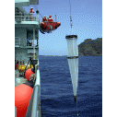
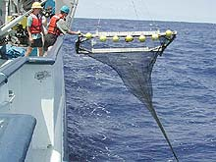
Collection Methods
Fish and invertebrate larvae (net plankton) are collected during plankton tows
Depth, distance towed, and the volume of water sampled must be calculated
Mesh sizes of nets vary depending upon what is being researched
This plankton net is being deployed to collect near-surface plankton in Maug caldera. The net is about 2 m (6.5 ft) long and has a mesh size of 236 microns (0.25 mm or 0.01 in).
The large aluminum frame of the neuston net is 1 meter high and 3 meters long. Here the net is being deployed off the starboard side of the R/V Seward Johnson

Slide 6
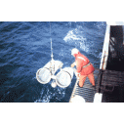
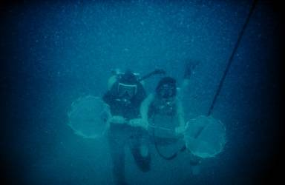
Collecting Plankton
Bongo nets are towed
over the side of the
ship or carried by divers to
collect drifting organisms
Image ID: fish1014, NOAA's Fisheries Collection
Photo Date: 1987
Photographer: Captain Robert A. Pawlowski, NOAA Corps
Image ID: nur05536, Voyage To Inner Space - Exploring the Seas With NOAA Collect
Photographer: J. Morin
Credit: OAR/National Undersea Research Program (NURP)
Deploying Bongo nets for sampling plankton

Slide 7
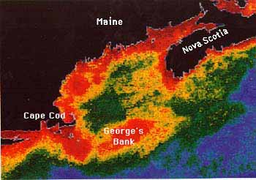
Can plankton be studied from space?
Satellites equipped with color scanners measure the concentration of chlorophyll in the ocean
Red = high concentration of chlorophyll
Chlorophyll is the major pigment for photosynthesis in phytoplankton
Data provides information concerning biomass, productivity, and changes in plant populations
Satellite Image of the Gulf of Maine

Slide 8
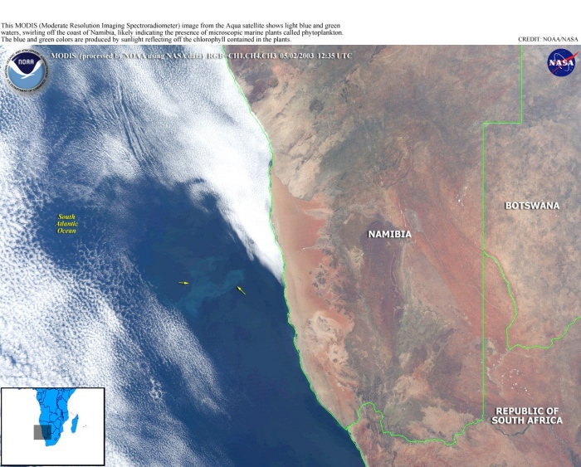
Phytoplankton blooms observed in the Atlantic Ocean off Africa
Image ID: spac0361, NOAA In Space Collection 2003 May 2

Slide 9
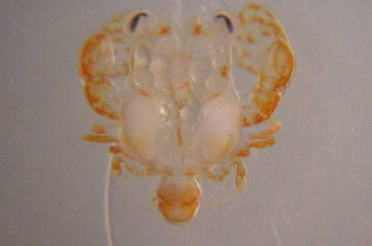
Do organisms spend their entire lives as plankton?
Holoplankton spend their entire life cycle as plankton. Examples include: dinoflagellates, diatoms and krill
Meroplankton spend only a part of their life cycle drifting. As they mature they become nekton (free swimmers) or benthic (crawlers)
Examples include: fish and crab larvae.
Charleston Bump Expedition. Zooplankton, crab larva.
Image ID: expl0172, Voyage To Inner Space - Exploring the Seas With NOAA Collect
Location: Southeast of Charleston, South Carolina
Photo Date: 2003 August 7
Photographer: Jerry Mclelland
Credit: Charleston Bump Expedition 2003. NOAA Office of Ocean Exploration; Dr. George Sedberry, South Carolina DNR, Principal Investigator

Slide 10
How are phytoplankton different from zooplankton?
Phytoplankton
Producers
Single cells or chains of cells
Include the smallest plankton – picoplankton (0.2 -2 microns)
Remain near the surface
Zooplankton
Consumers (including herbivores and carnivores)
Include microscopic and macroscopic organisms
May vertically migrate (to a depth of 200m) during the day for protection but resurface at night to feed

Slide 11
Investigating Plankton
Scientists carefully observe characteristics and communicate these observations with sketches and photographs.
Ten slides depict specimens you might find in plankton samples. Note: They are from different tows representing different oceans and different depths.
Each slide will be visible for 2 minutes.
As the slides are shown, observe and, using a pencil, sketch each sample on your worksheet. If there is more than one specimen on the slide, choose one to draw. Note body shape, projections, sensory organs, appendages, type of covering and degree of transparency.

Slide 12
Investigating and Observing Plankton continued
Try to hypothesize as to whether the organism is phytoplankton or zooplankton,
holoplankton or meroplankton.
Following the drawing section, use your sketches and resources to identify the specimens.

Slide 13
Plankton Identification Resources
The following sites have excellent resources for studying plankton. Information includes labs, instructions for making plankton nets, diagrams, photographs, and scientific research related to plankton.
www.njmsc.org/Education/Lesson_Plans/Plankton.pdf
http://www.biosci.ohiou.edu/faculty/currie/ocean/
http://www.mos.org/sln/sem/mic_life.html
http://oceancolor.gsfc.nasa.gov/SeaWiFS/TEACHERS/sanctuary_4.html
http://www.indiana.edu/~diatom/diatom.html
http://www.nmnh.si.edu/botany/projects/algae/
http://www.calacademy.org/research/diatoms/
http://earthobservatory.nasa.gov/Library/Phytoplankton/

Slide 14
Plankton Observation Worksheet
sketch
Specimen # ___________
Characteristics: Description
Body shape/Tail/flagella/appendages/eyes
Transparency/gills/other features
______________________
______________________
______________________
Circle one from each category:
Phytoplankton or Zooplankton
Holoplankton or Meroplankton

Slide 15
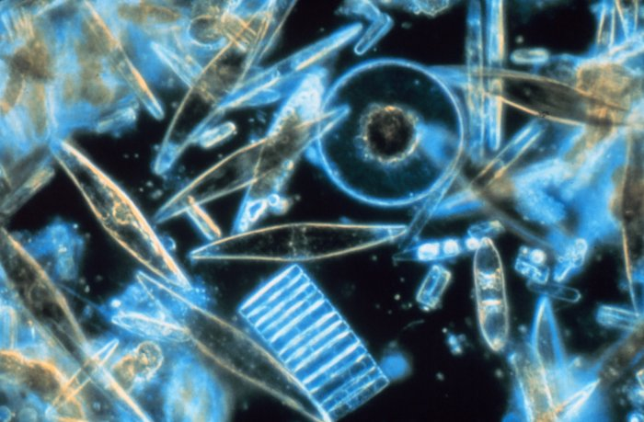
Examples of Plankton
Specimen #1

Slide 16
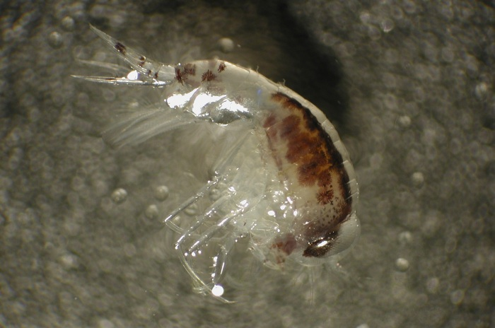
Specimen #2

Slide 17
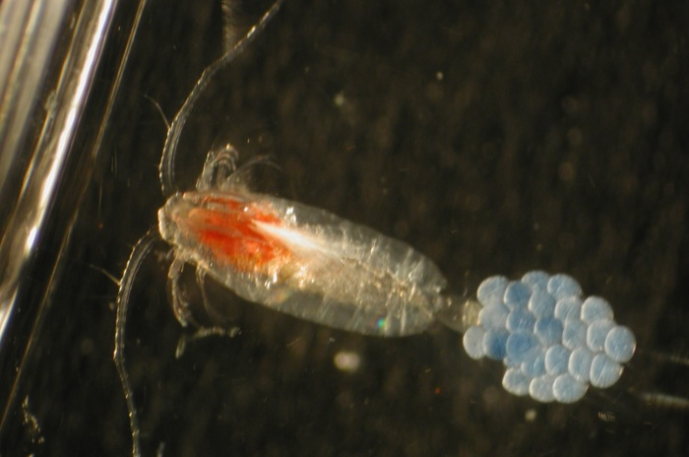
Specimen #3

Slide 18
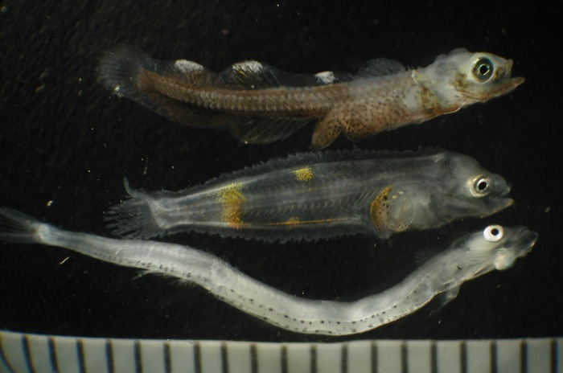
Specimen #4

Slide 19
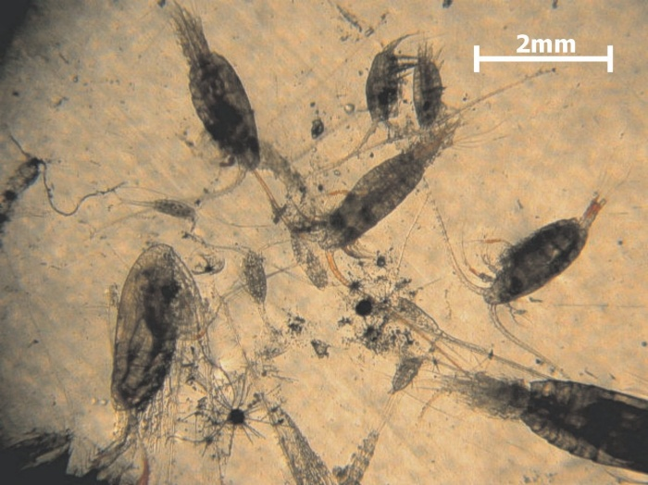
Specimen #5

Slide 20
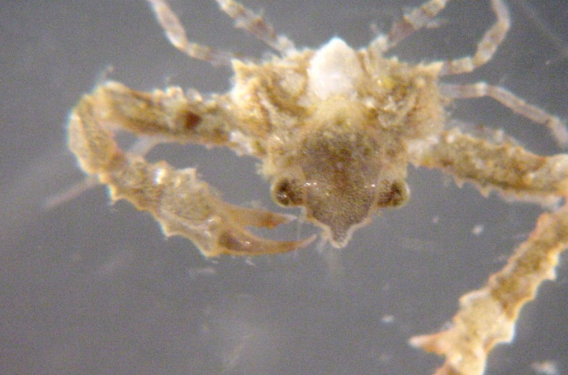
Specimen #6

Slide 21
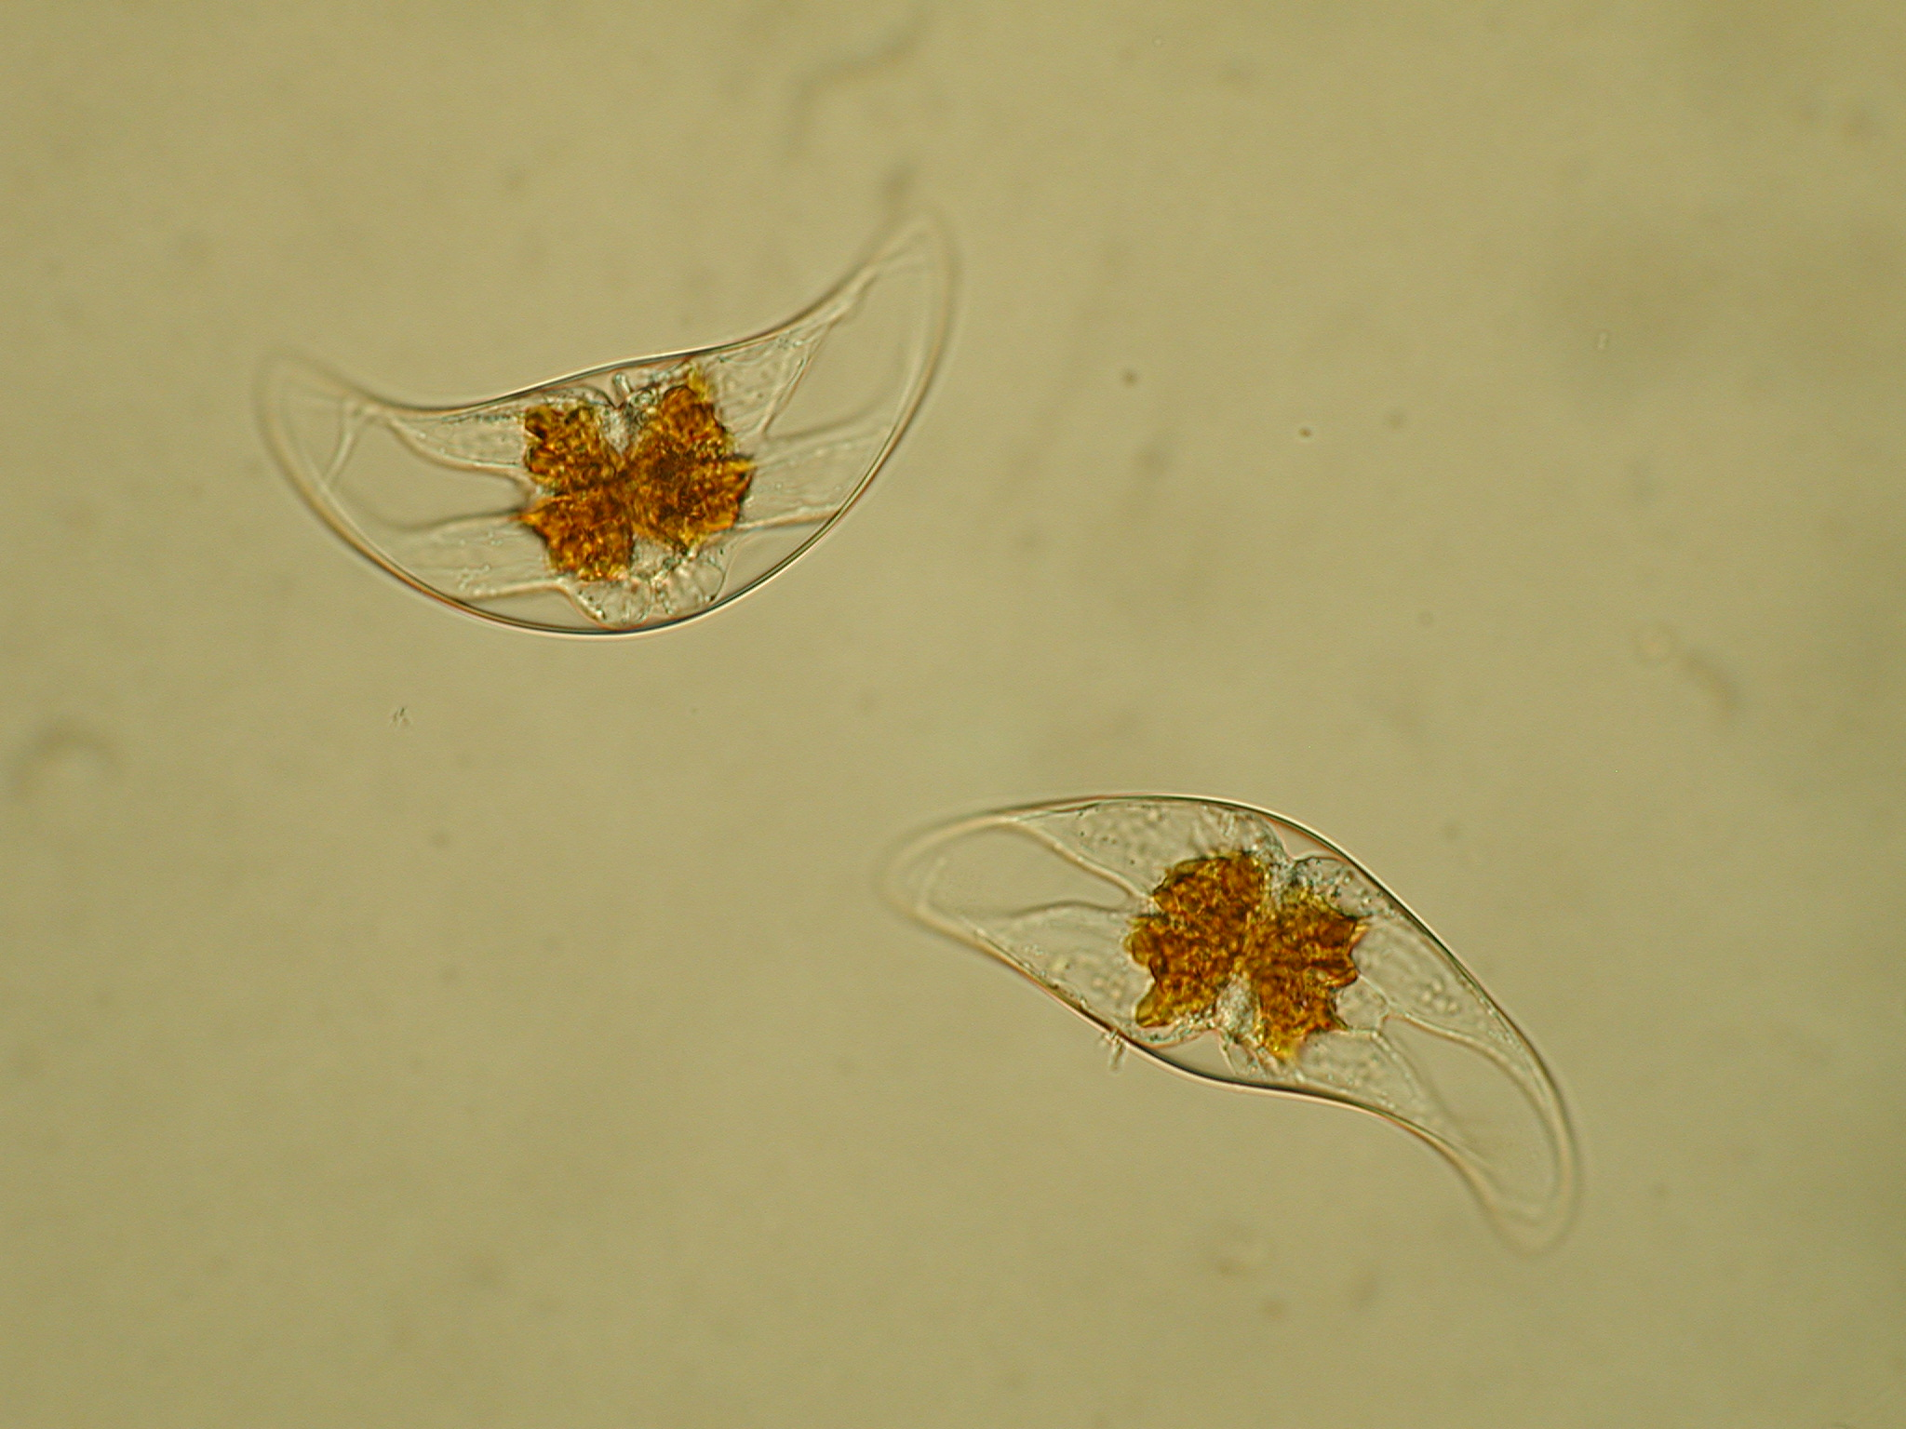
Specimen # 7

Slide 22
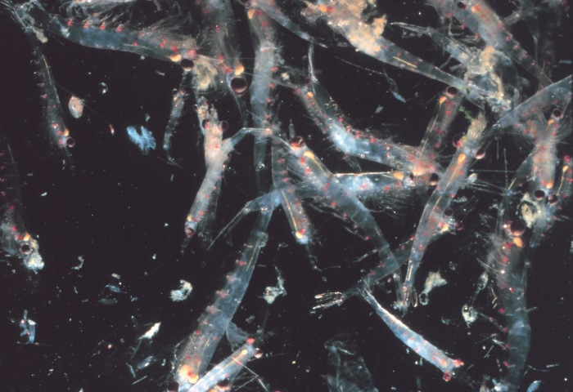
Specimen #8

Slide 23
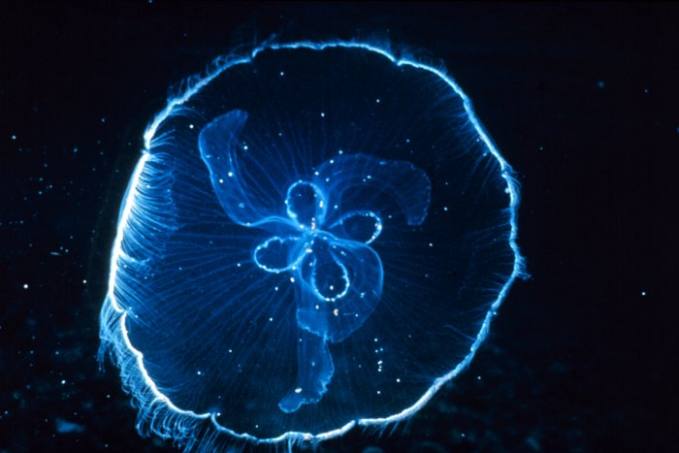
Specimen #9

Slide 24
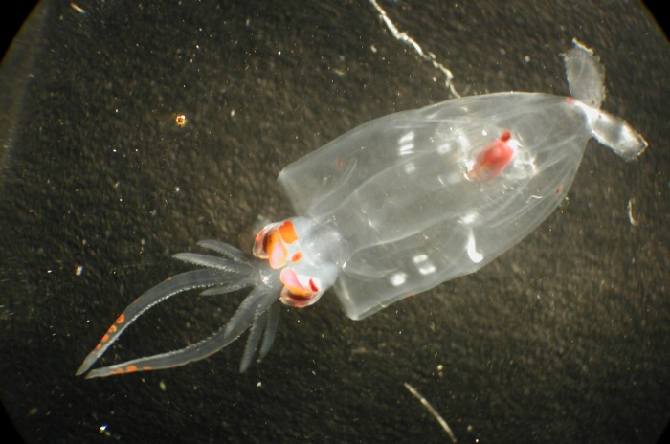
Specimen #10

Slide 25
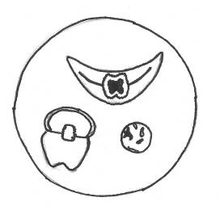
End of Drawing Section
Now use your drawings to identify your specimens. Use any resources you have available or view the rest of the slides to discuss the specific organisms used.
Sketch by T.A. Arsala

Slide 26
Plankton Identified
Specimen #1 Mixed Diatoms
Common in nutrient rich temperate, polar, coast and open ocean
Important oxygen producer
Occur as a single cell or in chains
Covered in shells or frustules made of silica
Siliceous shells used in industry as filters for breweries and swimming pools, as match heads, in car and jewelry polish, toothpaste whitener, and diatomaceous earth for gardens
Beautiful marine diatoms as seen through a microscope.
Image ID: corp2365, NOAA At The Ends of the Earth Collection
Photographer: Dr. Neil Sullivan, University of Southern Calif.

Slide 27
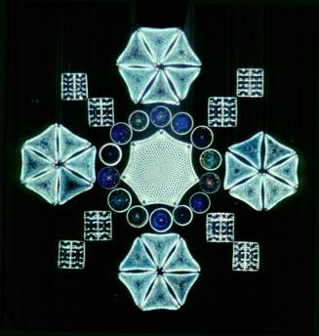
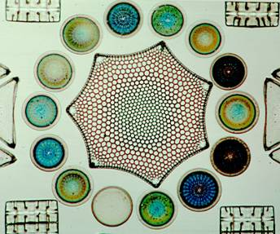
The Art of Science
Did you know that in Victorian times the geometry of diatom frustules was appreciated by hobbyists as well as scientists?
On microscope slides, diatom skeletons were arranged in artistic designs. In these arranged slides, the microscopic pictures are only a mm or two across and demonstrate the intricate structure and beauty of diatom anatomy.
Slides from the collection of the Academy of Natural Sciences of Philadelphia - photo by Jan Rines

Slide 28
Specimen #2 Copepod
Simple crustacean with jointed exoskeleton
Use enlarged first antenna to swim
Among the most common animals on Earth (most abundant of the net zooplankton)
Zooplankton. Copepod.
Image ID: fish3229, NOAA's Fisheries Collection
Photographer: Matt Wilson/Jay Clark, NOAA NMFS AFSC

Slide 29
Specimen #3 – Copepod with Eggs
Bristly appendages act as paddles and create water currents that draw individual phytoplankton cells close to feed on
Many feed on zooplankton using claw like appendages to grab prey
Eggs are attached to the tail
Zooplankton. Copepod with eggs.
Image ID: fish3261, NOAA's Fisheries Collection
Photographer: Matt Wilson/Jay Clark, NOAA NMFS AFSC

Slide 30
Specimen #4 – Fish Larvae
Coastal waters are rich in meroplankton
(temporary members of the plankton)
Nearly all marine fish have planktonic larvae
Fish larvae may change from herbivores to carnivores as they grow
Zooplankton. Fish larvae.
Image ID: fish3363, NOAA's Fisheries Collection
Photographer: Matt Wilson/Jay Clark, NOAA NMFS AFSC

Slide 31
Specimen #5 Copepods
Although usually found near the surface plankton may also be collected at all depths even over hydrothermal vents in the deep sea
Pacific Ring of Fire Expedition. Some common zooplankton (mostly copepods) collected near the surface over East Diamante volcano.
Image ID: expl0102, Voyage To Inner Space - Exploring the Seas With NOAA Collect
Location: Mariana Arc region, Western Pacific Ocean
Photo Date: 2004 April
Credit: Pacific Ring of Fire 2004 Expedition. NOAA Office of Ocean Exploration; Dr. Bob Embley, NOAA PMEL, Chief Scientist

Slide 32
Specimen #6 Crab Larva
Some invertebrates have a whole series of different larval stages
Charleston Bump Expedition. Zooplankton. Crab larva.
Image ID: expl0215, Voyage To Inner Space - Exploring the Seas With NOAA Collect
Location: Southeast of Charleston, South Carolina
Photo Date: 2003 August 10
Photographer: Jerry Mclelland
Credit: Charleston Bump Expedition 2003. NOAA Office of Ocean Exploration; Dr. George Sedberry, South Carolina DNR, Principal Investigator

Slide 33
Specimen # 7 Dinoflagellates
Unicellular, mostly autotrophic protists with two flagella
Most have a cell wall (theca) with plates of cellulose with spines and pores
May form blooms that color the water “Red Tides” or Harmful Algal Blooms (HABs)
Produce bioluminescence (light) often seen on the sea surface at night
Some dinoflagellates live in symbiotic relationships with corals, giant clams, sea anemones.
Some are parasitic – Pfiesteria – living as a cyst in sediments until triggered to bloom. Causes fish and invertebrate disease and even memory loss in humans
Photo by: Karen Bullen and F. Lampazzi in the Ocean ography Lab at
The Thomas Jefferson High School for Science and Technology

Slide 34
Specimen #8 Krill
Not as abundant as copepods they aggregate into huge, dense schools
Prefer colder polar waters
Filter feeders (on diatoms) and detritivores feeding on fecal pellets and solid wastes of other zooplankton
Small zooplankton are also eaten
Important food for whales
Tread water to stay afloat
Have been researched as food for humans
Krill
Image ID: sanc0126, NOAA's Sanctuaries Collection
Location: Gulf of the Farallones National Marine Sanctuary
Photographer: Jamie Hall

Slide 35
Specimen #9 Moon Jelly
One of 200 species of jellyfish (gelatinous zooplankton)
Common in temperate and tropical waters
Transparent umbrella shaped bodies may grow up to 1 foot wide
Stinging cells are not toxic and don’t sting like other jellyfish
95% water but serve as food for many animals including turtles (NOTE: many animals die each year swallowing plastic that looks like the jellies)
Feed by producing a sticky mucus on the bell. Planktonic organisms get stuck in the mucus and slide into the jelly’s mouth
Reproduce sexually and asexually
Reproductive organs are the 4 horseshoe shaped structures in the center
Image ID: reef2547, NOAA's Coral Kingdom Collection
Photographer: Florida Keys National Marine Sanctuary Staff
Credit: Florida Keys National Marine Sanctuary
(moon jelly)

Slide 36
Specimen #10 Octopus Larva
Temporary members of the plankton, octopus and squid become nektonic (free swimming) and benthic (crawling)
Giant squid are the largest invertebrates in the ocean
Zooplankton. Octopus larva.
Image ID: fish3612, NOAA's Fisheries Collection
Photographer: Matt Wilson/Jay Clark, NOAA NMFS AFSC

