Slide 1
A Basic Classifier to Prospectively Identify Dissatisfied Patients at the Time of Admission
McWelling Todman
CS613 Machine Learning
Drexel University

Slide 2
Agenda
What is the problem you are tackling?
What related work is out there (which papers are you basing your approach off of)?
What is the basic approach?
Where are you getting your data from and what does it look like?
What are your results and observations?
What could be future extensions of your work

Slide 3
Problem Statement
I work for a large health system that operates in PA and NJ. A major source of hospital revenue is reimbursement from insurers. The largest insurer in the country is the US government through Medicare/Medicaid.
The center for Medicare and Medicaid services (CMS) runs a program call Value Based Purchasing, through which 2% of all Medicare reimbursements to each hospital are withheld and can be earned back through performance assessments. The program incentivizes hospital systems to reduce costs and increase the quality of care delivered.
2% is small, sure. With $5b in revenue, the number becomes non-trivial.

Slide 4
Problem Statement Cont.
CMS uses several different outcome measures to assess performance, one of which is the HCAHPS survey (Hospital Consumer Assessment of Healthcare Providers and Systems).
Performance on the HCAHPS survey accounts for a quarter of the 2% of revenue withheld—so 0.5%.
We need a reliable way to predict whether a patient will be unsatisfied with the care they received so that we can devote resources to performing service recovery before they are surveyed.

Slide 5
What related work is out there (which papers are you basing your approach off of)?
There is a dearth of studies in which the PIs attempt to prospectively estimate satisfaction on the HCAHPS survey based on demographics...
HOWEVER previous work in the field provides valuable insight into which sorts of demographic factors should be considered during the feature selection process.
For instance:
A 2011 Hopkins study was able to show that a composite feature, composed of race, gender, age, and education can be used to explain variation in patient perception of care. The authors were able to show that patient-provider social discordance (large differences in the composite measure) was associated with lower patient perceptions of care: lower overall rating of office visit, lower likelihood to recommend the practice to a friend.
A 2015 study by McFarland, Ornstein, and Holcombe showed that at the hospital level, bed count and percent of patient population with a primary language other than English negatively correlate with HCAHPS scores, whereas education level and percentage of patient population to identify as white were positively correlated with HCAHPS scores.
A 2016 study by Li, Lee, Glicksberg, Radbill, and Dudley surfaced a number risk factors to satisfaction as reported by HCAHPS among surgical inpatients, such as self-evaluation of health, education level, Asian, White, treatment by oncology division, and being prescribed a new medication.
A 2008 study by Jha, Orav, Zheng, and Epstein published in NEJM found that a high ratio of nurses to patient-days was predictor of top quartile performance on the HCAHPS survey (P<0.001).

Slide 6
What is your basic approach?
I implemented a logistic regression classifier P(Y=1|X,θ) = [0,1]
The model is optimized through batch gradient ascent
Cost function = sum of log likelihood
I do not have a mechanism to pick an ideal classification threshold, largely because the decision would be determined by resource constraints, which puts a hard cap on positive classifications
you can only perform service recovery on so many patients per day!

Slide 7
Where are you getting your data from and what does it look like?
My Dataset:
I use one of the questions on the HCAHPS survey as my classification target. There is a binary conversion where 0 indicates satisfied, and 1 indicates dissatisfied (what we are try to detect).
The survey is composed of 32 questions that assess the quality of care the patient received. Most questions have a response scale of "Never, Sometimes, Usually, Always." CMS assesses performance by calculating the percentage of respondents to give the best possible response (e.g. Always)--this is called the "Top Box" methodology.
I pulled 43 demographic fields from the EHR system. They can be grouped into the following buckets: language, marriage, race, age, gender, payor (proxy for SES), admit disposition, and clinical service
These selections were made based upon my literature review and intuition

Slide 8
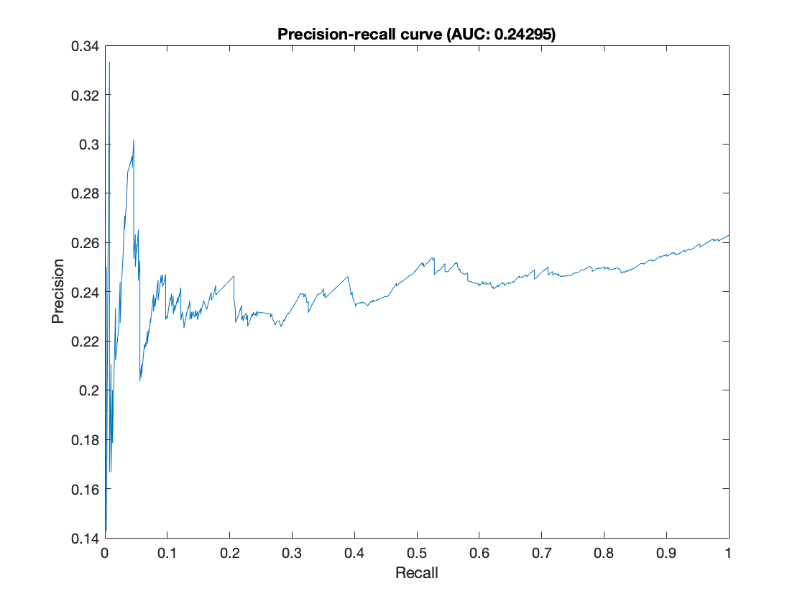
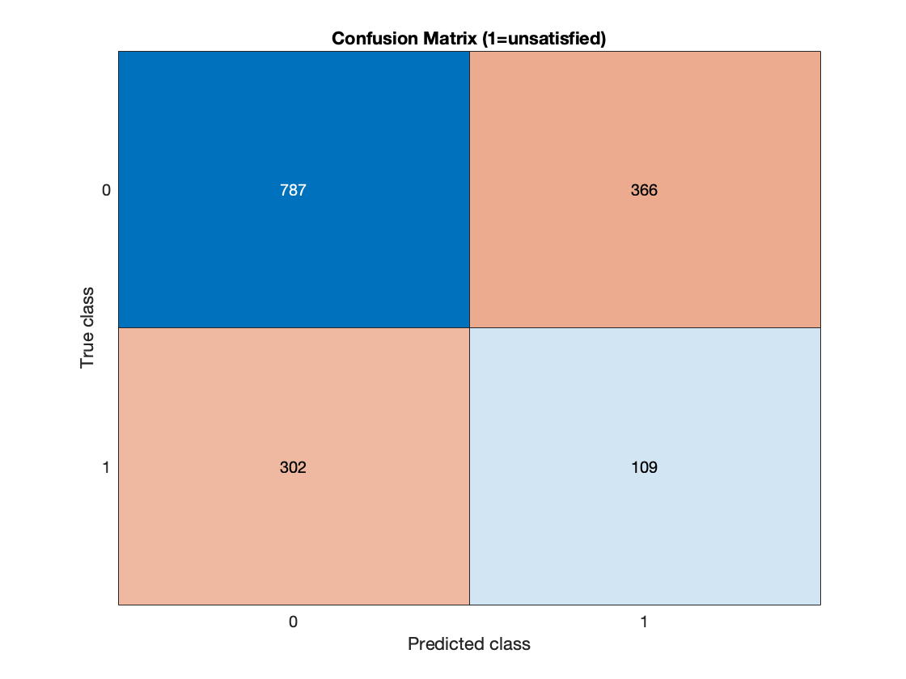
What are your results and observations? Sample Classification Threshold = 0.75

Slide 9
What could be future extensions of your work?
As I see it, there are two options for future work in this area:
build a rigorous causal model using all relevant data and iteratively refine the feature set with a group of expert clinical/administrative stakeholders
rather than predicting with the intent to intervene, calculate an Observed/Expected ratio to be used in a performance management context. Tuning the model to get the correct ratio of dissatisfied patients might prove far easier than predicting exactly which patients are likely to be dissatisfied.
Another more practical alternative could be to circumvent the prediction process altogether by collecting real-time patient feedback during the hospitalization.

