Slide 1
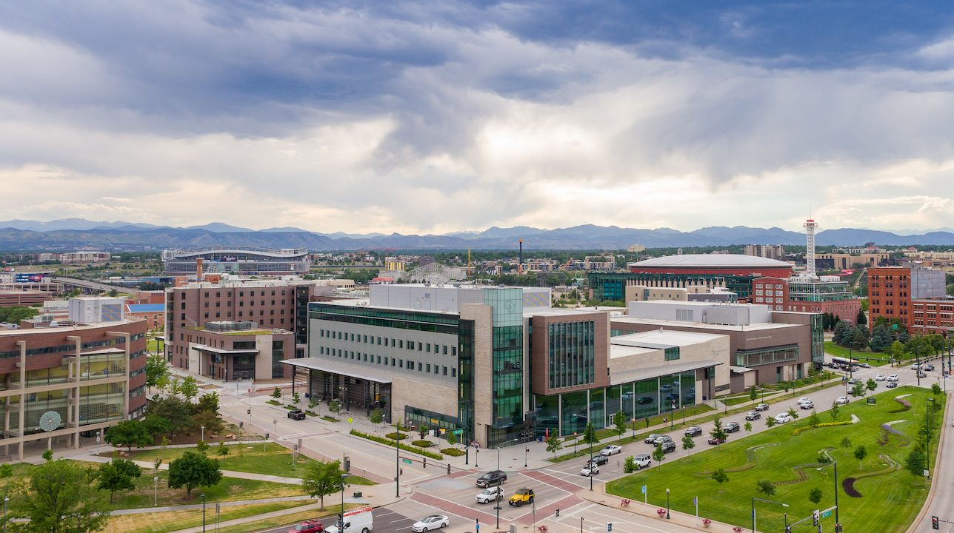

Data Science in Undergraduate Mathematics Classrooms
Adam Spiegler
University of Colorado Denver
adam.spiegler@ucdenver.edu

Slide 2
Background
Working at CU Denver since 2018
Serving as Director of Undergraduate Programs since 2019
Work on undergraduate texts as member of Calculus Consortium
No prior data science background
Focus on developing teaching materials and curriculum development

Slide 3
My Data Science Journey
Minimal coding experience
Undergraduate background in statistics
No research experience in data science
Starting
Point
Teach statistics and data science courses
Support undergraduate research
Take online data science courses
Learn from colleagues
Data science workshops
Professional Development

Slide 4
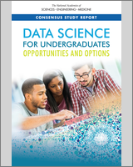
Why? Broadening Our Audience
Finding 4.1: The nature of data science is such that it offers multiple pathways for students of different backgrounds to engage at levels ranging from basic to expert.
Finding 4.2: Data science would particularly benefit from broad participation by underrepresented minorities because of the many applications to problems of interest to diverse populations.
Recommendation 4.1: As data science programs develop, they should focus on attracting students with varied backgrounds and degrees of preparation and preparing them for success in a variety of careers.
National Academies of Sciences, Engineering, and Medicine. 2018. Data Science for Undergraduates: Opportunities and Options.
Washington, DC: The National Academies Press. https://doi.org/10.17226/25104.

Slide 5
“What would you like to see improved in our program?”
“The improvement that the mathematics major desperately needs is a heavier focus on coding in python and R. … There absolutely needs to be a required in department coding course that goes over the fundamentals of python and R.”
“Maybe an intro to Python class or something. My only exposure to Python in the math department was through Math Clinic and that goes 0-60 faster than a sports car.”
“Integrate coding into earlier courses. I hadn't learned python from any course and was expected to use it in Math Clinic for an extremely challenging project. The best course experiences I had were courses in which coding played a large role.”
“All I can think of is possibly a intro to computer science class geared towards math students?”

Slide 6
How Data Science? At CU Denver
In 2019, the Math/Stat Department created three new data science programs:
An Undergraduate Certificate in Data Science Essentials (4 courses)
A Minor in Data Science (6 courses)
A Data Science Concentration to our Mathematics BS.
To support these new programs, we began designing two new core courses:
Introduction to Programming for Data Science (Freshman level using Python)
Data Wrangling and Visualization (Junior level using R)

Slide 7
How Data Science? At CU Denver
In 2019, CU Denver solicited proposals to fund a new online BS program:
The program would be fully online.
Structured into 8-week blocks of classes.
Students pay a total of $15,000 tuition to earn the BS online.
Department of Math/Stat, Computer Science and the Business School jointly proposed a new interdisciplinary BS in Data Science that was approved in Fall 2019 for development.

Slide 8
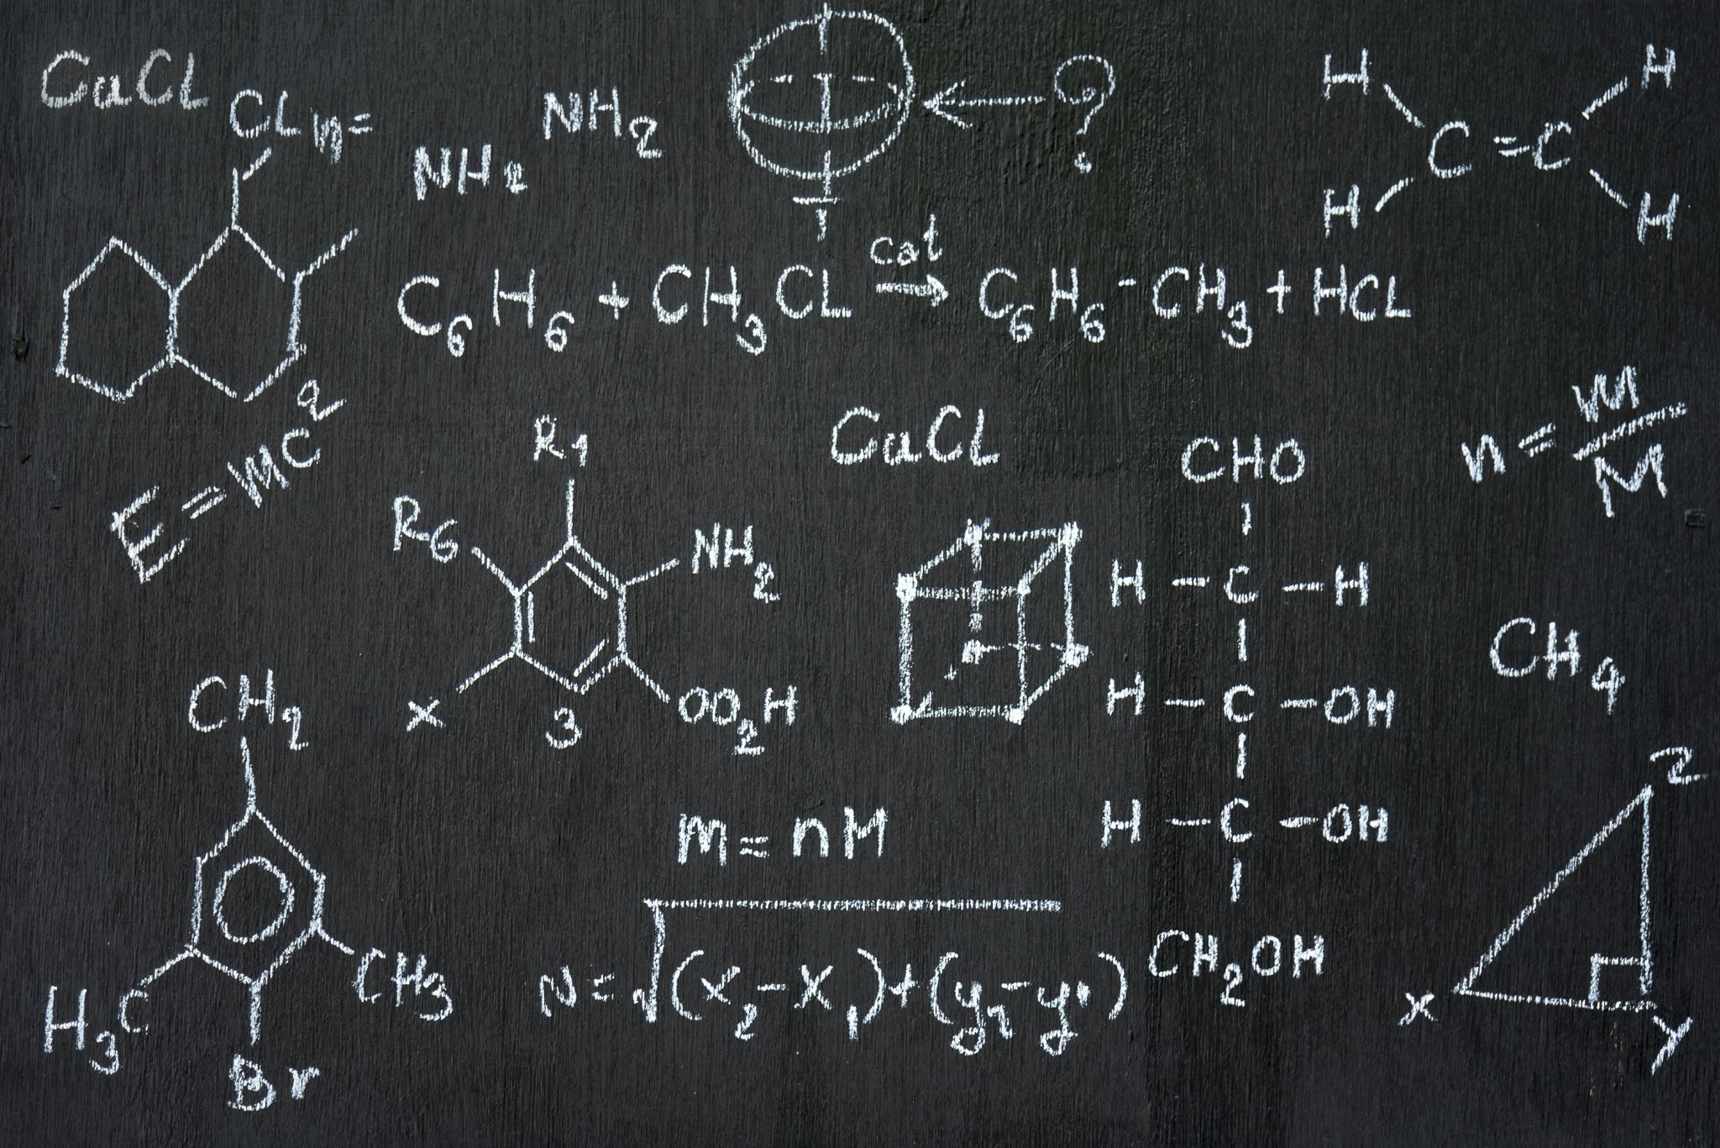
Experimenting with Mathematics
The objectives of experimental mathematics are generally to make mathematics more tangible, lively and fun.
Discover patterns and relationships.
Using graphical displays to investigate mathematical concepts.
Developing and testing conjectures.
Exploring results to help construct proofs.
Confirm analytically derived results.
Gain insight and intuition.
Bridge the divide between theory and practice.

Slide 9
Project Motivation and Vision
Equip students with knowledge & skills necessary to compete in the job market.
Train students as “mathematical experimentalists” across multiple levels of math, data science and statistics curricula.
Utilize “virtual laboratories” to enable an active computational learning environment.
Minimize costs to students.
Our Team
Troy Butler
Joshua French, Director Data Science
Stephen Hartke, Associate Chair
Yaning Liu, Director Statistical Programs
Adam Spiegler, Director Undergrad
In February 2022, our department was awarded a 2-year OER grant from the Colorado Department of Higher Education (CDHE).

Slide 10
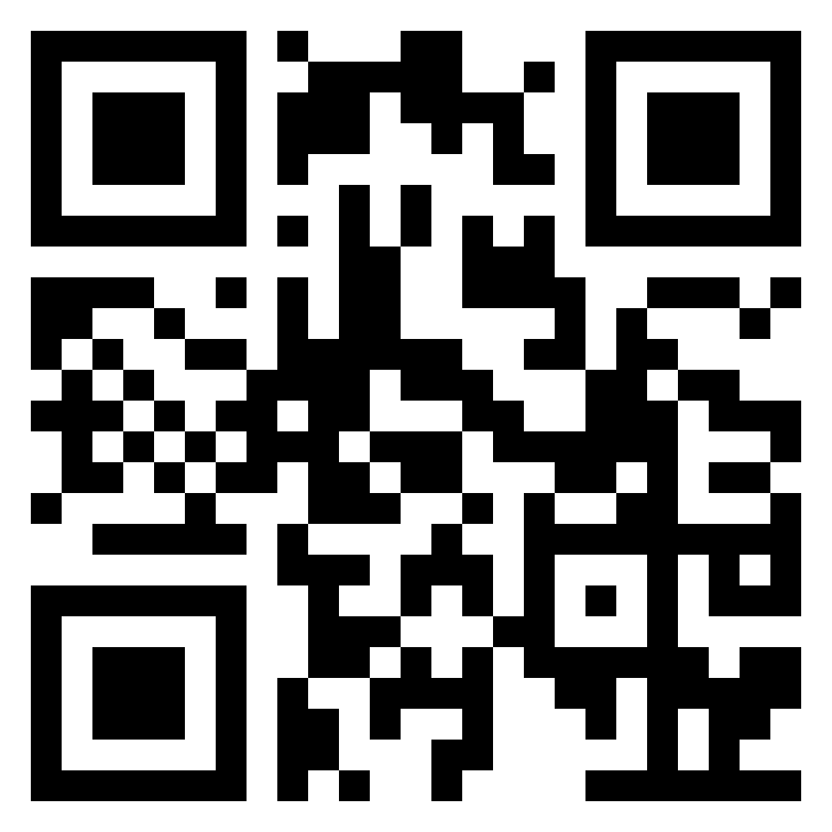
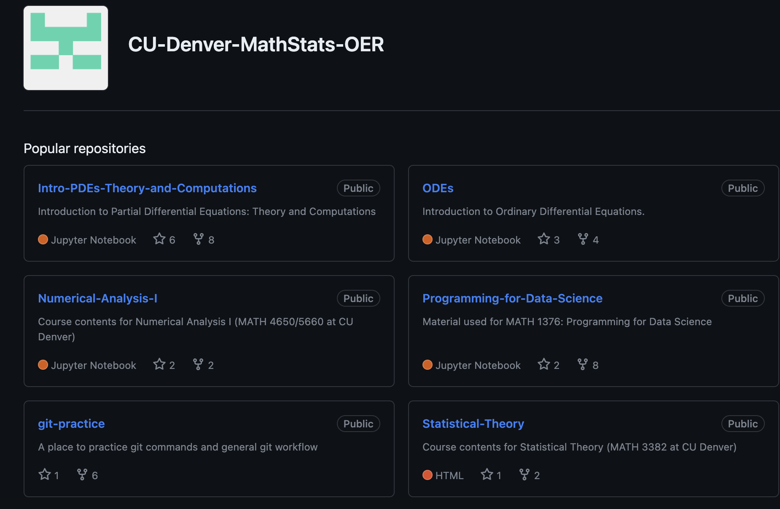
Initial Courses Targeted
4000/5000 levels
Applied Regression Analysis (Year 1, R)
Machine Learning Methods (Year 2, Python)
Partial Differential Equations (Year 1, Python)
Numerical Analysis I (Year 1, Python)
3000 level
Linear Algebra (Year 2, Python)
Data Wrangling and Visualization (Year 0, R)
Elementary Differential Equations (Year 1, Python)
Statistical Theory (Year 2, R)
1000/2000 level
Intro to Prog for Data Science (Year 0, Python)
https://github.com/CU-Denver-MathStats-OER

Slide 11
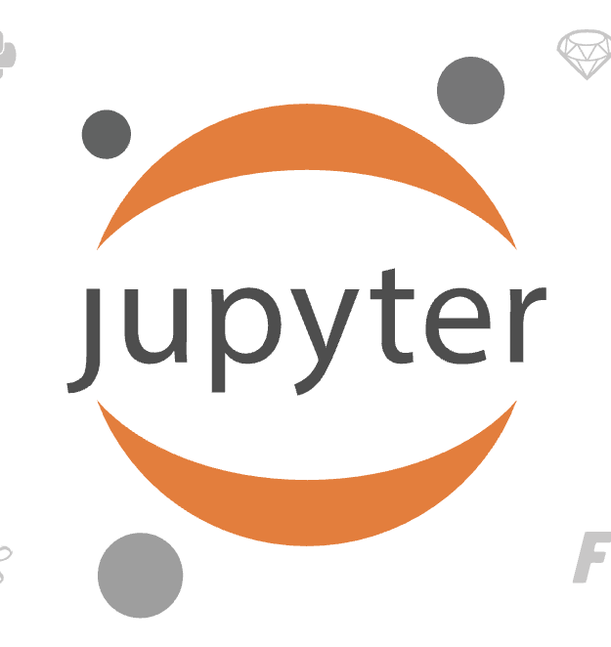

Equity in Computing: Jupyter and Colab
Equity in Computing
We want to ensure the computing technology and educational resources we develop are accessible and usable no matter the socioeconomic circumstances of the user or institution.
Jupyter
is free software for interactive computing.
supports over 40 programming languages including Python, R, and Julia.
Google Colaboratory (Colab)
is a free cloud-based version of Jupyter that any institution or user can utilize
https://jupyter.org/
https://colab.research.google.com/

Slide 12
Why Jupyter and Colab?
Provides instructors and students an environment to weave together narrative text, executable code, interactive visualizations, and/or videos all in one document.
Materials are FREE! No additional technology required. Course materials are delivered in Google Colaboratory, a free, cloud-based application.
The flexibility to design materials for a variety of course formats.
Create a dynamic learning environment for students to experiment with mathematics.

Slide 13
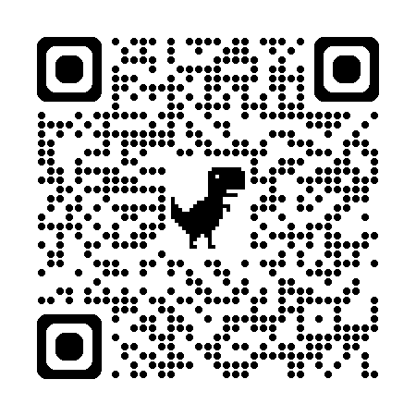
Approval of Data Science BS!
In 2019, CU Denver solicited proposals to fun a new BS program:
The program would be fully online.
Structured into 8-week blocks of classes.
Students pay a total of $15,000 tuition to earn the BS online.
Department of Math/Stat, Computer Science and the Business School jointly proposed a new interdisciplinary BS in Data Science that was approved in 2020 for development.
In April 2022, we were notified that a final proposal had been submitted and approved!
https://datascience.ucdenver.edu/

Slide 14

Approval of Data Science BS!
In 2019, CU Denver solicited proposals to fun a new BS program:
The program would be fully online.
Structured into 8-week blocks of classes.
Students pay a total of $15,000 tuition to earn the BS online.
Department of Math/Stat, Computer Science and the Business School jointly proposed a new interdisciplinary BS in Data Science that was approved in 2020 for development.
In April 2022, we were notified that a final proposal had been submitted and approved!
https://datascience.ucdenver.edu/

Slide 15
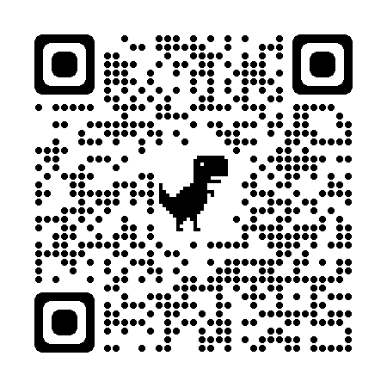
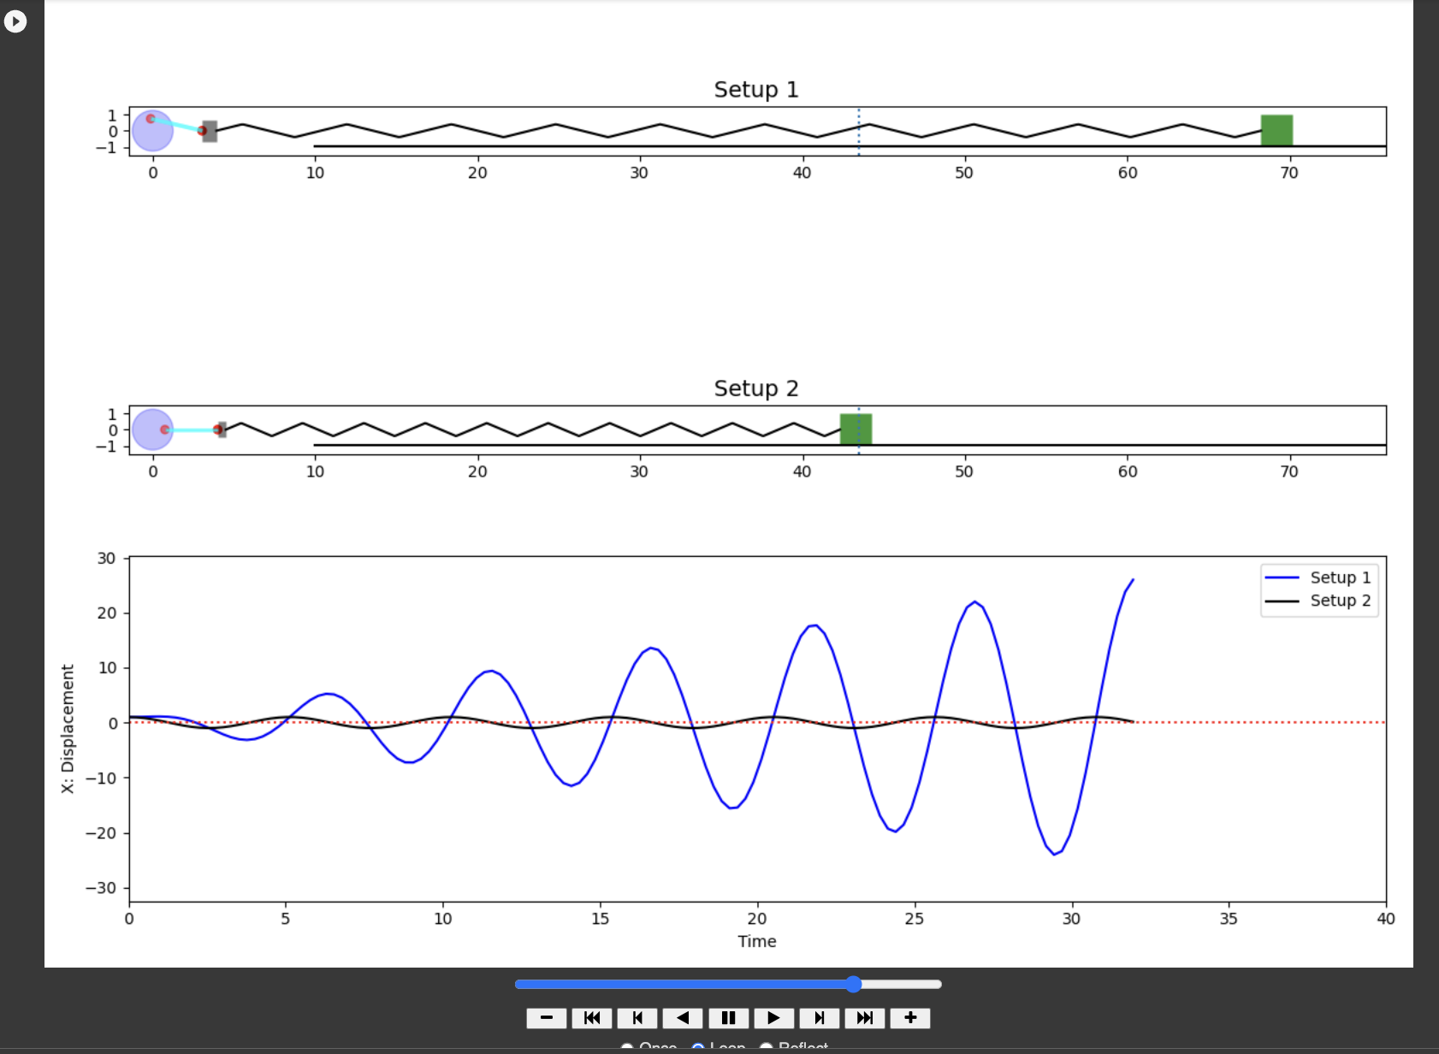
Accessing Differential Equations Materials
HTML text:
https://aspiegler.github.io/Exploring-Differential-Equations/
GitHub:
https://github.com/CU-Denver-MathStats-OER/ODEs

Slide 16
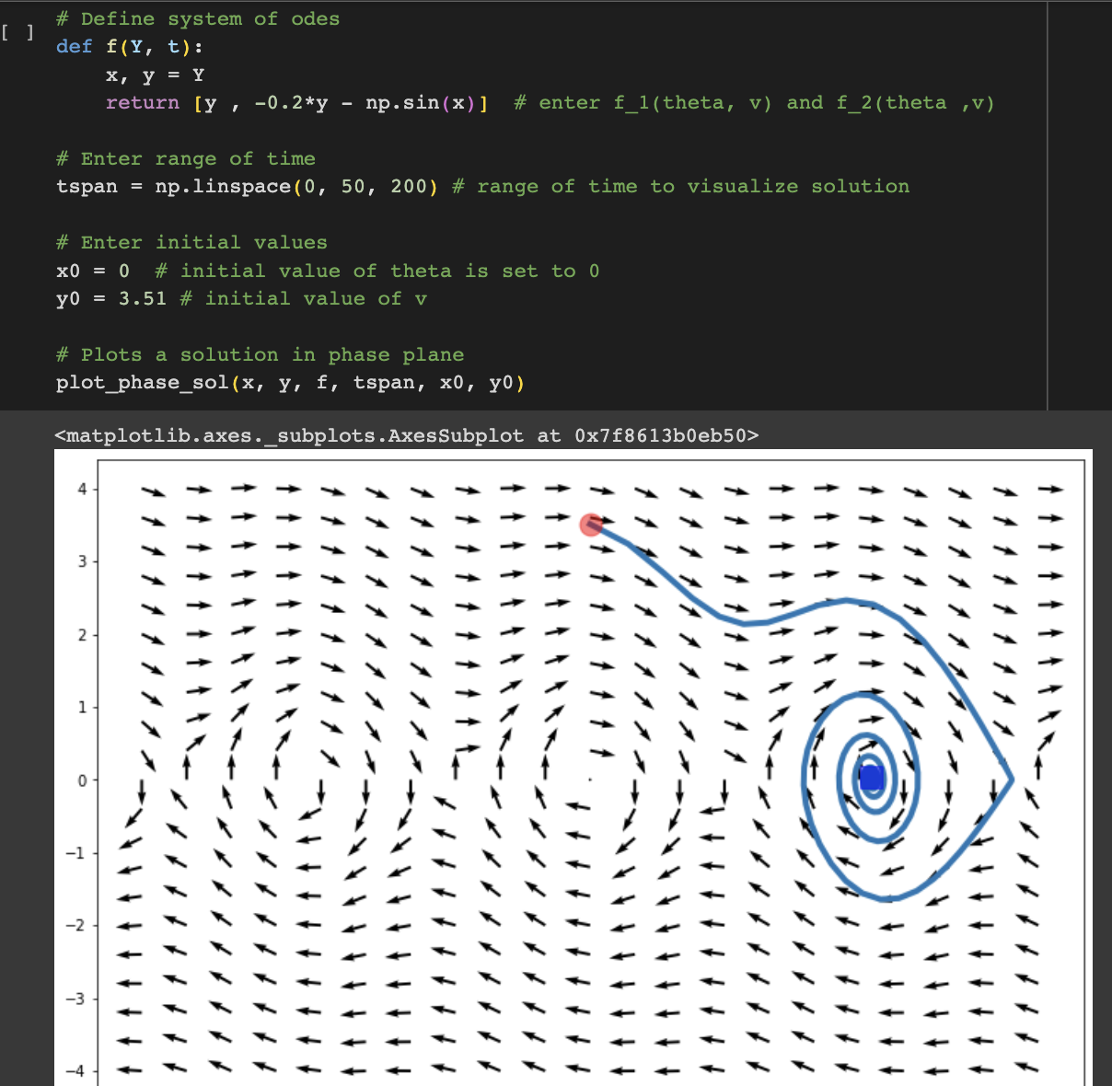
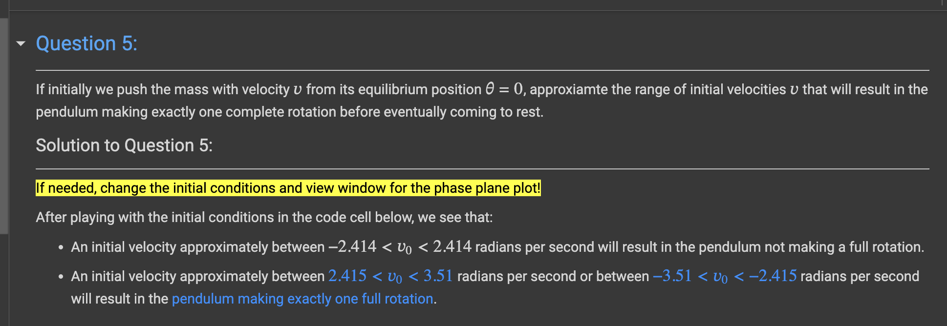
Python Modules for Experimenting with Differential Equations
Phase Plane Plots in Colab

Slide 17
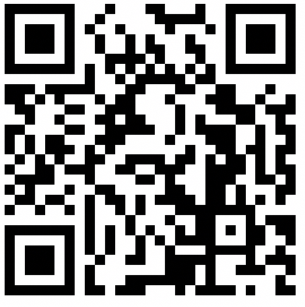
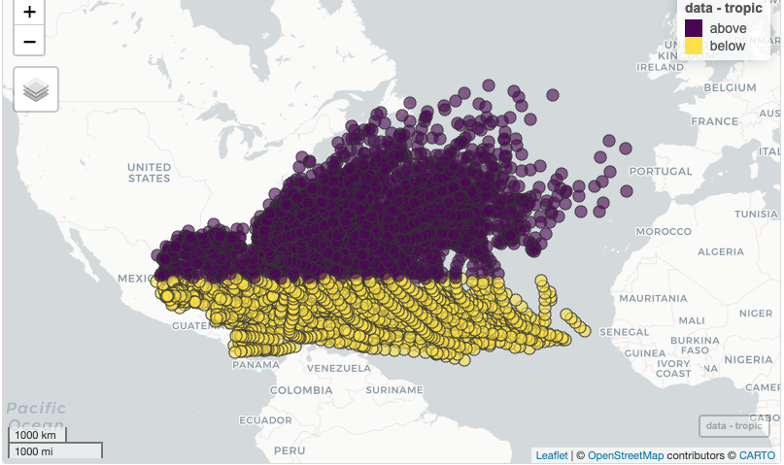
Accessing Statistical Theory Materials
HTML text:
https://aspiegler.github.io/Statistical-Theory/
GitHub:
https://github.com/CU-Denver-MathStats-OER/Statistical-Theory

Slide 18
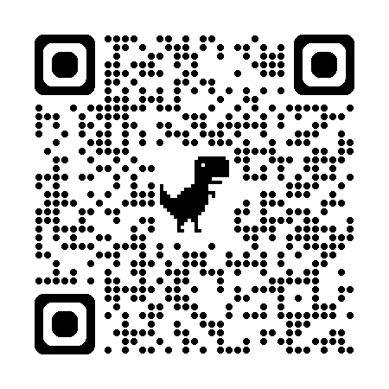
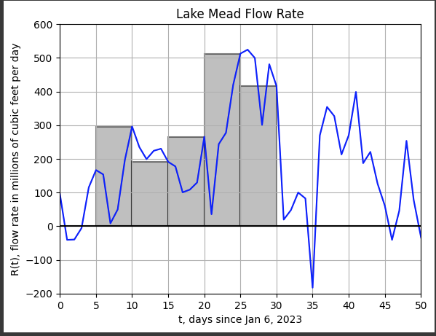
Accessing Python Labs For Calculus
Lab1-Getting-Started-with-Colab-Python.ipynb
Lab2-Plotting-and-Solving-Equations.ipynb
Lab3-Linear-Regression.ipynb
Lab4-Derivatives-with-Water-Level.ipynb
Lab5-Symbolic-Differentiation-Marginal-Cost.ipynb
Lab6-Optimization.ipynb
Lab7-Definite-Integrals-and-Accumulated-Change.ipynb
Lab8-Symbolic-Integration.ipynb
GitHub Repo: https://github.com/mcwg/calc-python-labs

Slide 19
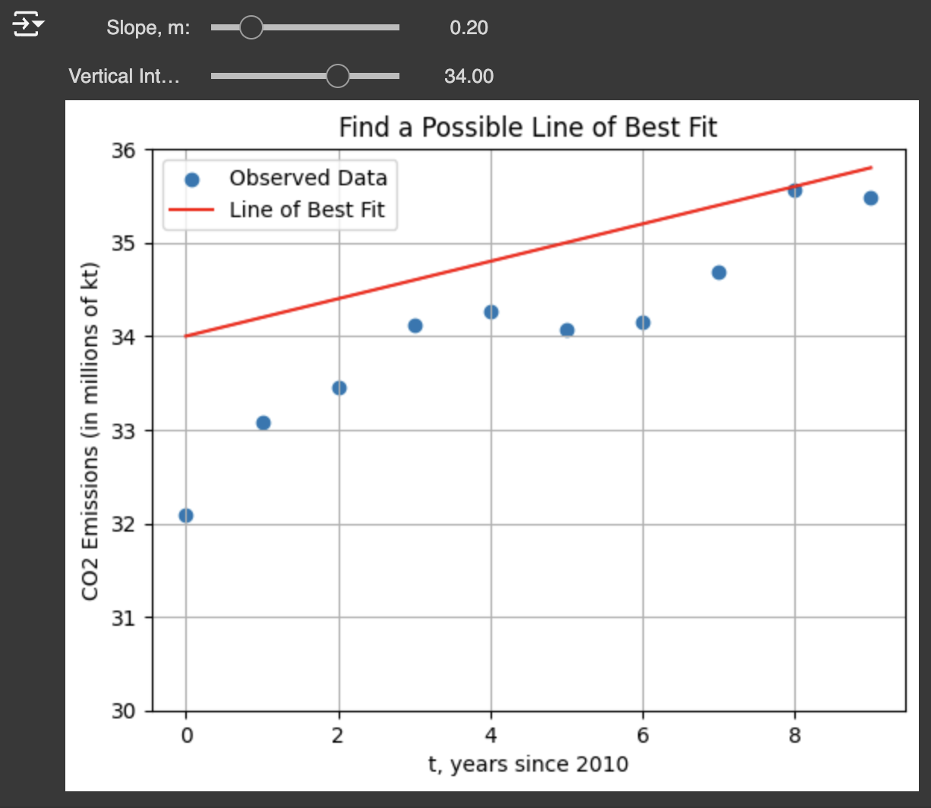
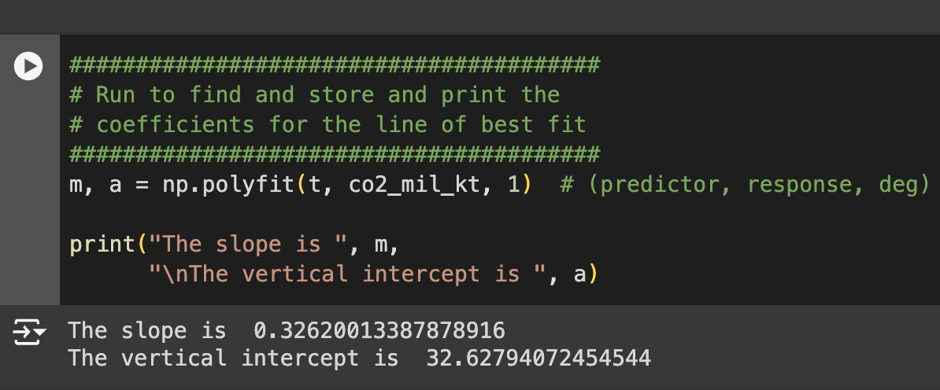
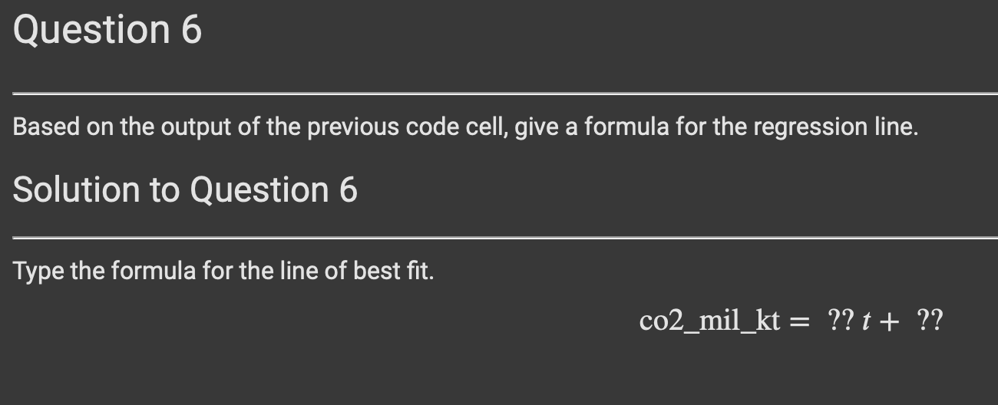
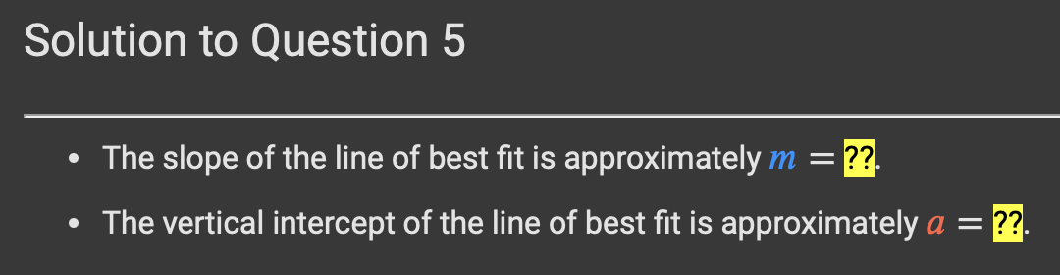

Slide 20
Challenges and/or Opportunities
Connecting course content cohesively
Provide multiple paths through course for different majors
Avoid repeating content
“Attract students with varied backgrounds and degrees of preparation”
Instructor capacity
Grading
Calculus requirements for Data Science BS
Build larger community
Engagement with high schools and community colleges

Slide 21
Resources
Adam Spiegler at CU Denver: adam.spiegler@ucdenver.edu
CU Denver OER Repo: https://github.com/CU-Denver-MathStats-OER
Python Labs for Calculus Repo: https://github.com/mcwg/calc-python-labs
ODE’s Text: https://aspiegler.github.io/Exploring-Differential-Equations/
Statistics Text: https://aspiegler.github.io/Statistical-Theory/
CU Denver Data Science: https://datascience.ucdenver.edu

