Slide 1
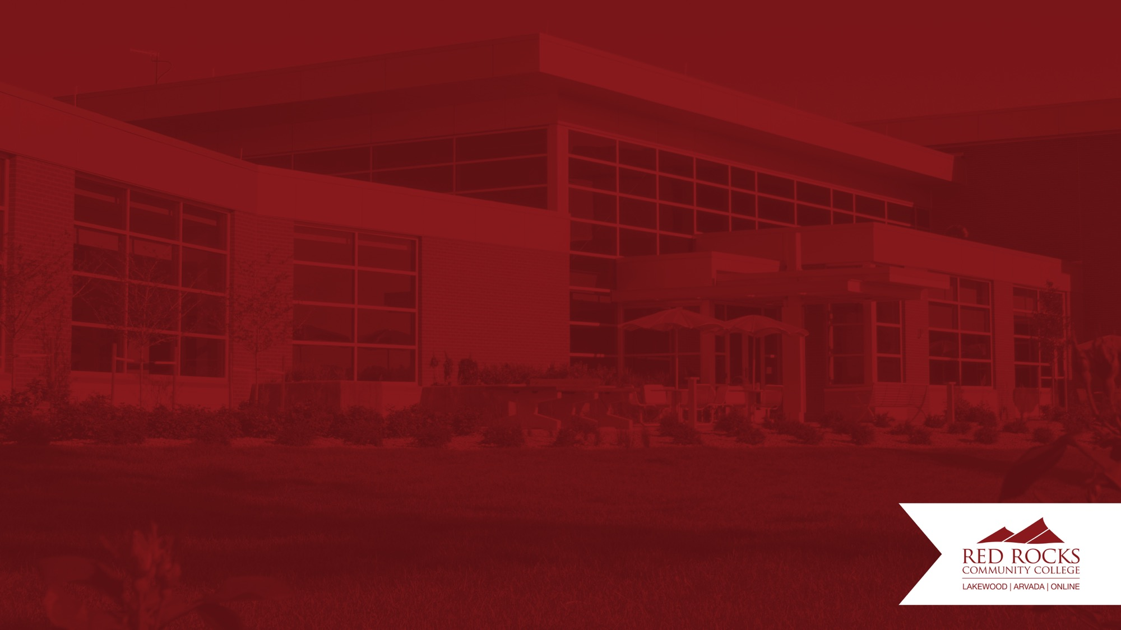
Data Science Red Rocks Community College
Development and Progress
Notes:
Introductions

Slide 2

Philosophy and Idea
Why data science at Red Rocks?
Students were interested to learn more about the field.
Industry partners were asking for students with data science skills.
Transfer schools expressed a need for more computer and data foundations for students.
Data science and related fields are growing industries in our area.
By offering introductory classes with limited to no pre-requisites, students can gain exposure and skills early in their educational pathway and determine if data science or statistics is something they are interested in pursuing.

Slide 3

How did it start?
Quick overview of the timeline
Students and faculty research teams worked collaboratively on data projects.
A special topics class in mathematics focusing on machine learning was offered.
The discipline in data science was developed and 5 course were created.
Introduction to Data, Machine Learning, and Data Visualization were offered face to face.
Introduction to data class to be taught online and at other Colorado Community College campuses.
Notes:
Simple Syllabus is a centralized electronic syllabus software tool designed to streamline the process of creating and managing course syllabi.
Provides a consistent experience for students.
Simple Syllabus integrates directly to D2L course pages
Integrates w Banner; automatically pulls relevant course information from the institution's systems, such as course descriptions, meeting times, and instructor details.
Offers customization for college, departments, and administrators. Interactive features: You can include interactive elements like embedded videos, links, and quizzes to enhance student engagement.
Saves time, Template-based: It offers pre-designed templates that you can customize to fit your specific course needs.
Centralized access; can be updated in real-time. Students can easily access the syllabus directly within their learning management system (LMS), like Canvas or Blackboard.
Provides an intuitive user experience.
Enables instructors to see student engagement with course syllabi.
Serves as repository.
By automating many of the tedious tasks involved in syllabus creation, Simple Syllabus allows instructors to focus on more important aspects of their teaching, such as developing engaging course content and supporting student learning.

Slide 4
What all was built?
Course objectives and Topical Outlines were created for:
Introduction to Data Science (DAT 1001)
Data Visualization (DAT 2002)
Statistics and Modeling (DAT 2001)
Introduction to Machine Learning (DAT 2025)
Data Ethics (DAT 1002)
These foundational materials allow all the schools in the Colorado Community College System to teach the Data Science (DAT) classes.

Slide 5

Introduction to Data Science
Our introduction class offers students a chance to explore different topics in data science and develop a foundational understanding of many of the aspects of a data science project. Over the semester, each student utilizes the topics from class to work on a personal data project that they present at the end of the semester at our campus research expo.
Topics for the class include:
Collecting, Storing, and Accessing Data.
Working with Data.
Analyzing Data for Insights using Python.
Presenting Findings and Proposing Actions.

Slide 6
Collaboration with Math
Math and Data working together:
Initial Machine Learning class was developed as a math special topics class.
The mathematics faculty developed and teach the data science classes.
The technology used in the data program is also utilized in the calculus sequence.
Some lectures have been developed for both data science and math classes.
Concepts from the introduction to data class are now included in our introduction statistics class.
By building the data science program as math faculty we have been able to integrate and collaborate seamlessly with the math pathway, allowing us to utilize course content in both programs and share technology throughout all the classes.

Slide 7

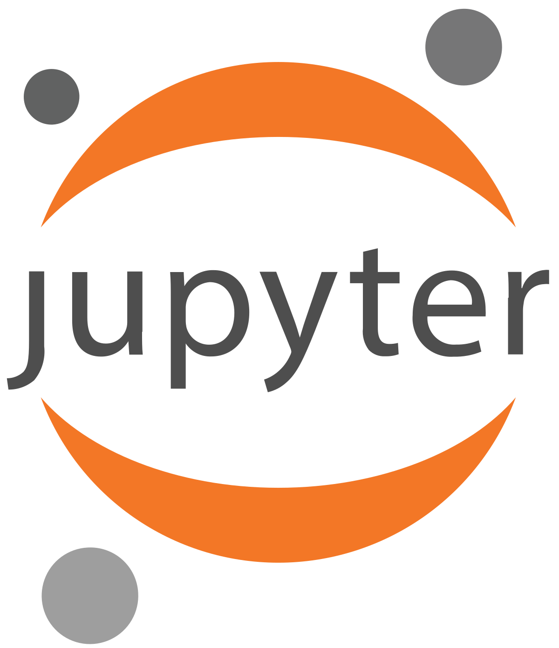
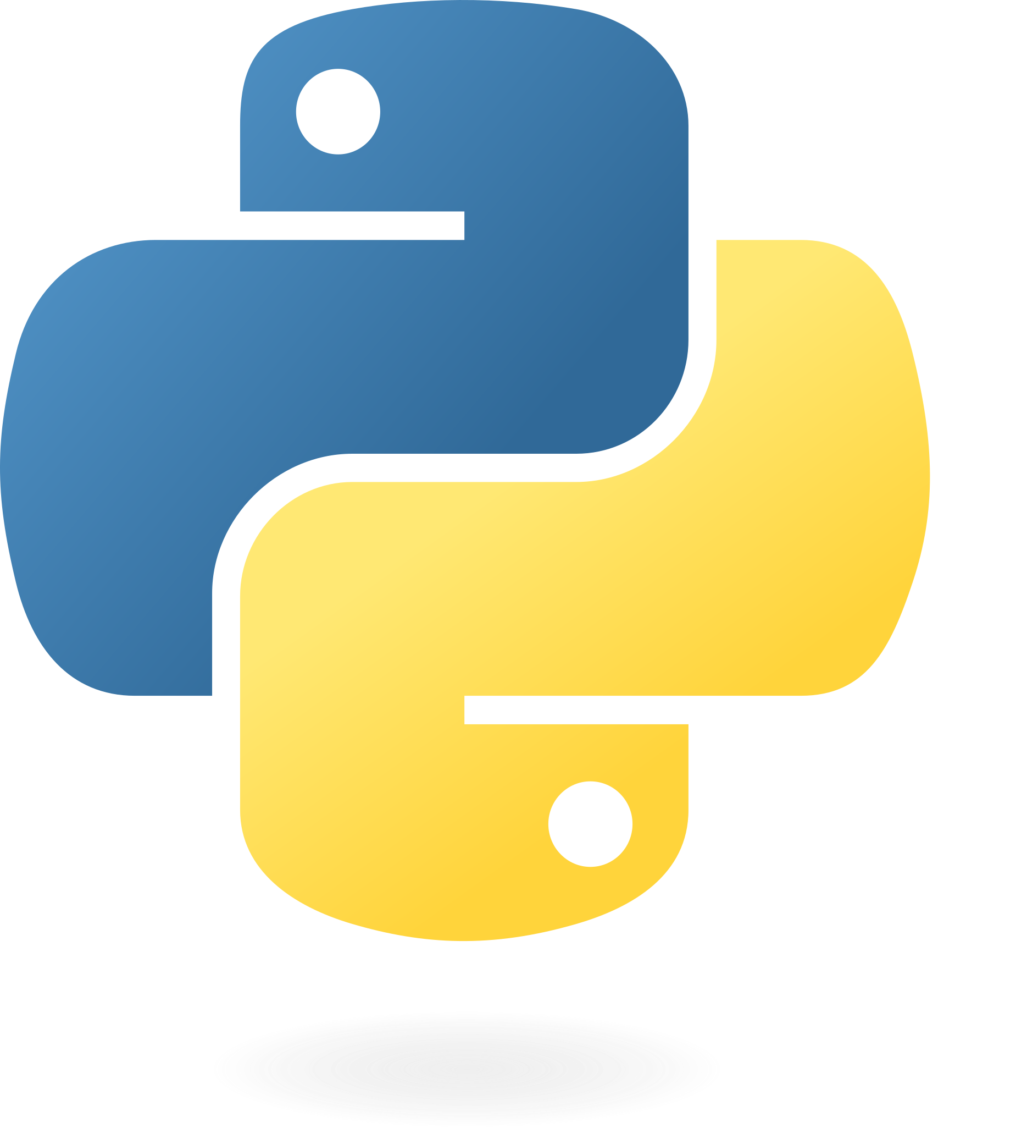

The Technology
All the data classes share a remote server.
Each student gets a Jupyter environment.
Allows for equitable access.
Classes can work with shared data sets.
Faculty can share lecture notebooks.
Students can collaborate.
This platform is utilized in our calculus classes for application projects.
In-house physical servers allow us to keep costs down and establish a setup that works for our students and classes.
In addition to the Jupyter environment, students get some exposure to Linux and working with file systems.
All software is open source so that students can install on a local system to continue beyond the class.
Notes:
Elaborate how to make content visible to students; the following conditions must be met:
Sections MUST contain content (not empty!)
Sections MUST be marked visible (most are, by default)
Syllabus MUST be shared appropriately (more on this later)
Sections have attributes of being either Required, Optional, or Locked; cascades to all child syllabi (college-wide, or department-wide);
Required: the section is required and title cannot be changed, but CONTENT can be changed/modified by user/department.
Optional: the section is optional per the instructor/department. Optional sections an be hidden.
Locked: section is locked at the system-level; CONTENT cannot be changed/modified/removed by anyone at the college
Sections can contain pre-filled sample content to adopt, and contain helpful hints including suggested content.
Much like syllabus templates have provided in the past.
Reordering sections
Existing sections cannot be reordered.
Custom sections can be ordered among the existing sections at department level
Custom sections CANNOT be ordered among the existing sections at the instructor level; show at the bottom of the syllabi
Adding custom sections
Different types of components are available to add to Department templates (more about this in the department training).
Instructors can only add new Content components
Required & Optional sections must contain content to be visible, otherwise the section missing content will be omitted.

Slide 8
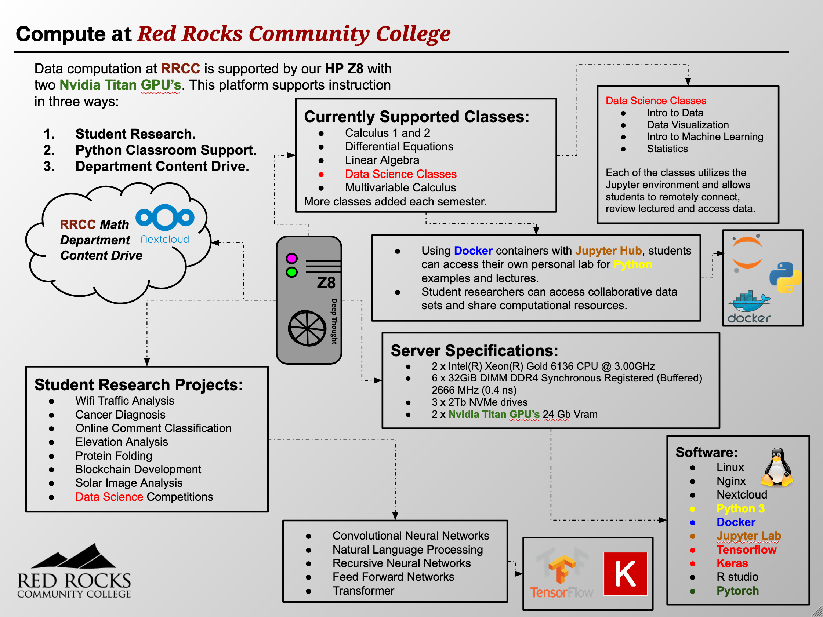

Slide 9

Going Forward
Collaborations with other departments within the college.
Working on formal pathways with our transfer partners.
Continuing to develop connections with industry.
Growing the program and refining the pathway for our students.
Finalize the associates degree in data science at RRCC.

