Slide 1
Japanese Cherry Blossoms
Deb Hughes Hallett
University of Arizona/Harvard Kennedy School
Mathematics Consortium Working Group
https://mcwg.github.io/
https://mcwg.github.io/climate
© 2022 Mathematics Consortium Working Group, Hughes Hallett et al.

Slide 2
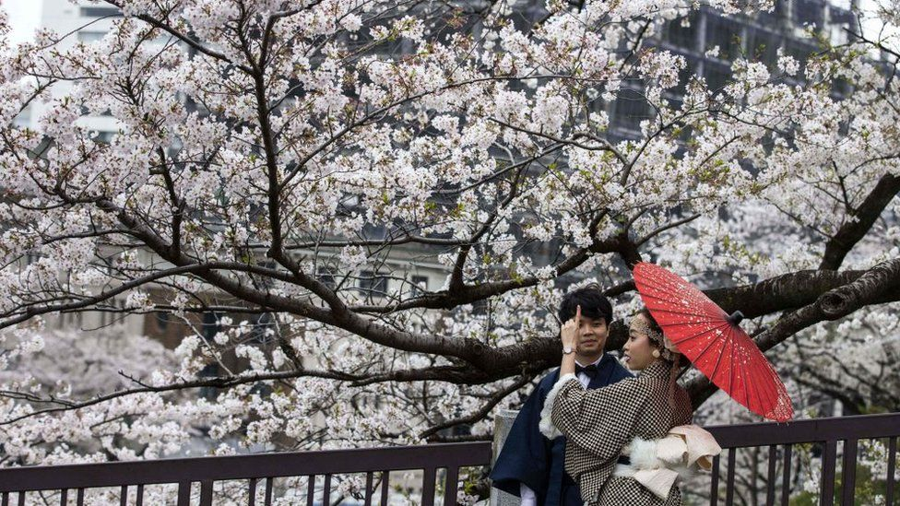
Japanese Cherry Blossoms
http://atmenv.envi.osakafu-u.ac.jp/aono/kyophenotemp4/
AD | Full-flowering date (DOY)
1800 | 103
1801 | 105
1802 | 96
1803 | 110
1804 | 104
1805 | 93
1806 | 114
1807 | 116
1808 | 98
1809 | 107
1810 | 100
1811 | 110
“The cherry blossom season, Japan's traditional sign of spring, has peaked at the earliest date since records began 1,200 years ago, research shows.” March 2021
https://www.bbc.com/news/world-asia-56574142

Slide 3
Peak Flowering Date against Year
Interpreting Linear Model
Slope:
is the number of days the peak flowering date moved back each year
Just over half a day every decade
About 4 days in a lifetime (70 years)
Units are days/year
Intercept:
214.94 is the predicted number of days since start of year if this model was projected backward to AD 0
This time is in July not reasonable
Trend is not evident pre-1800
Extrapolation is dangerous!

Slide 4
More climate change resources at
https://mcwg.github.io/climate
https://mcwg.github.io/climate
© 2022 Mathematics Consortium Working Group, Hughes Hallett et al.

