Slide 1
Mauna Loa: How Do We Know Carbon Dioxide is Increasing?
Deb Hughes Hallett
University of Arizona/Harvard Kennedy School
Mathematics Consortium Working Group
https://mcwg.github.io/
https://mcwg.github.io/climate
© 2022 Mathematics Consortium Working Group, Hughes Hallett et al.

Slide 2
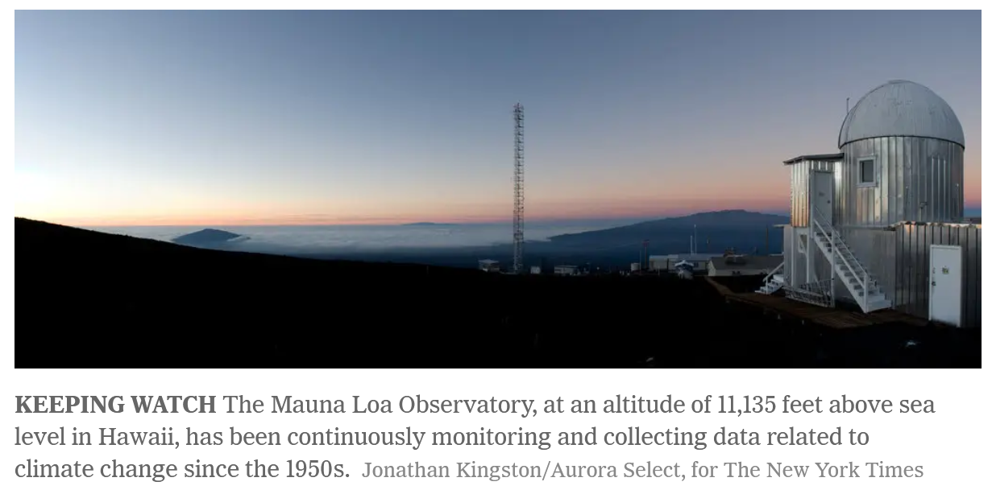
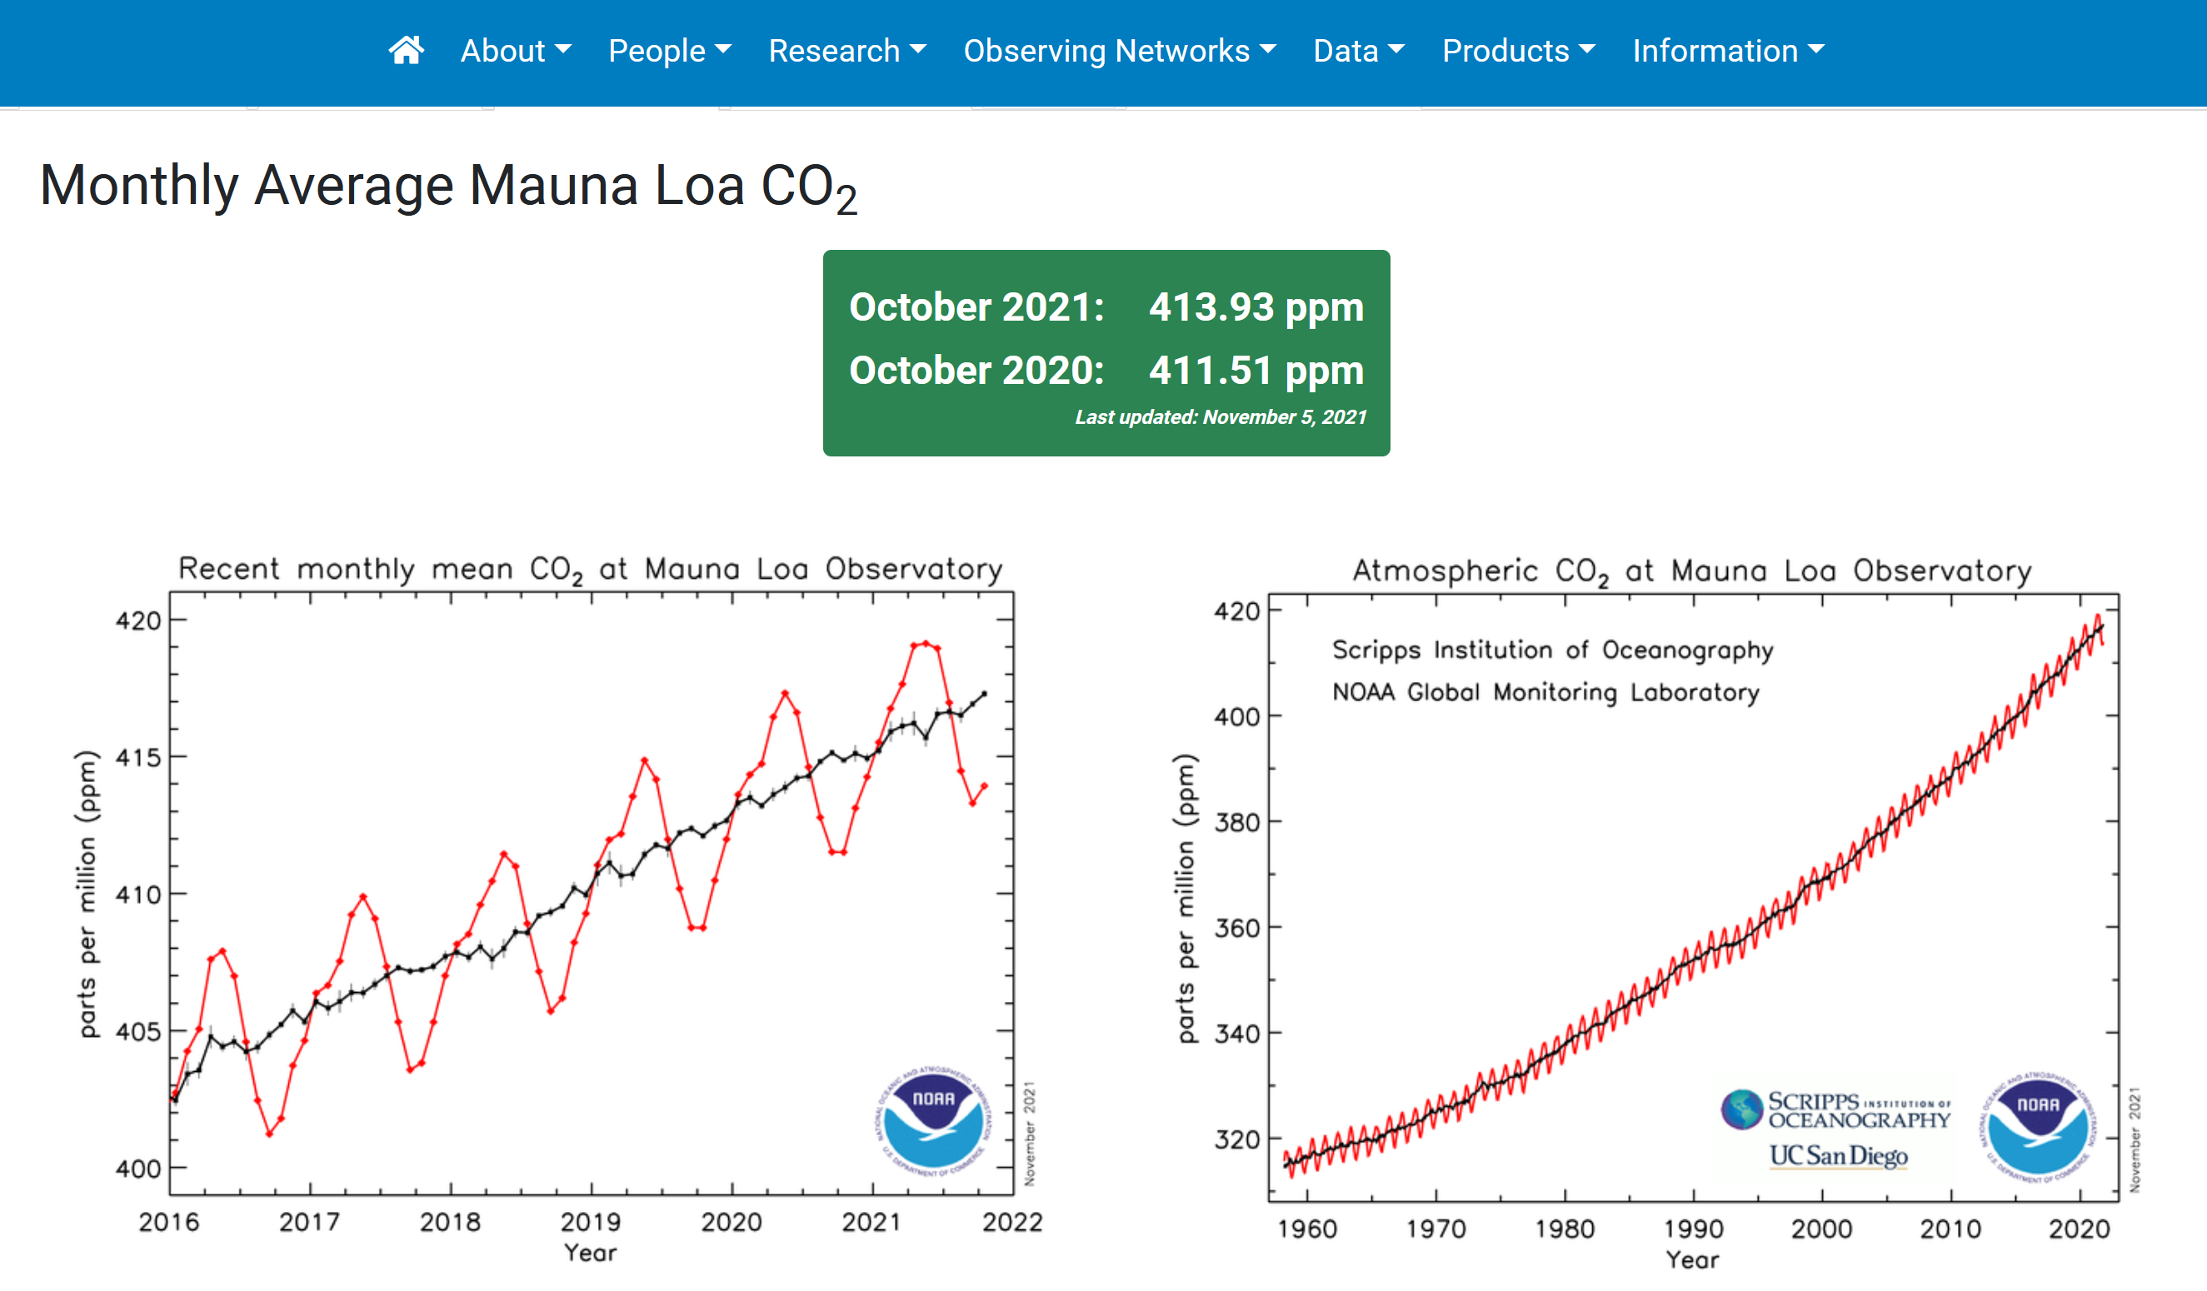
How Do We Know Carbon Dioxide is Increasing?
https://gml.noaa.gov/ccgg/trends/
https://www.nytimes.com/2010/12/22/science/earth/22carbon.html
Keeling Curve: Black Curve
Black yearly average; red is monthly
Right curve: What function is black?
Maybe exponential?
Left curve: What function is black?
Approximately linear?

Slide 3
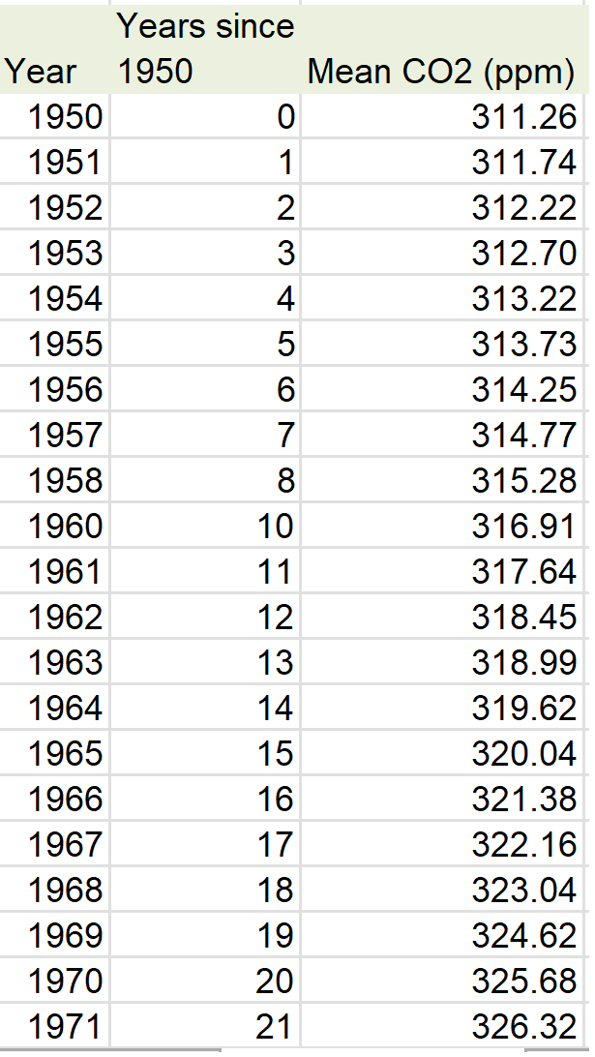
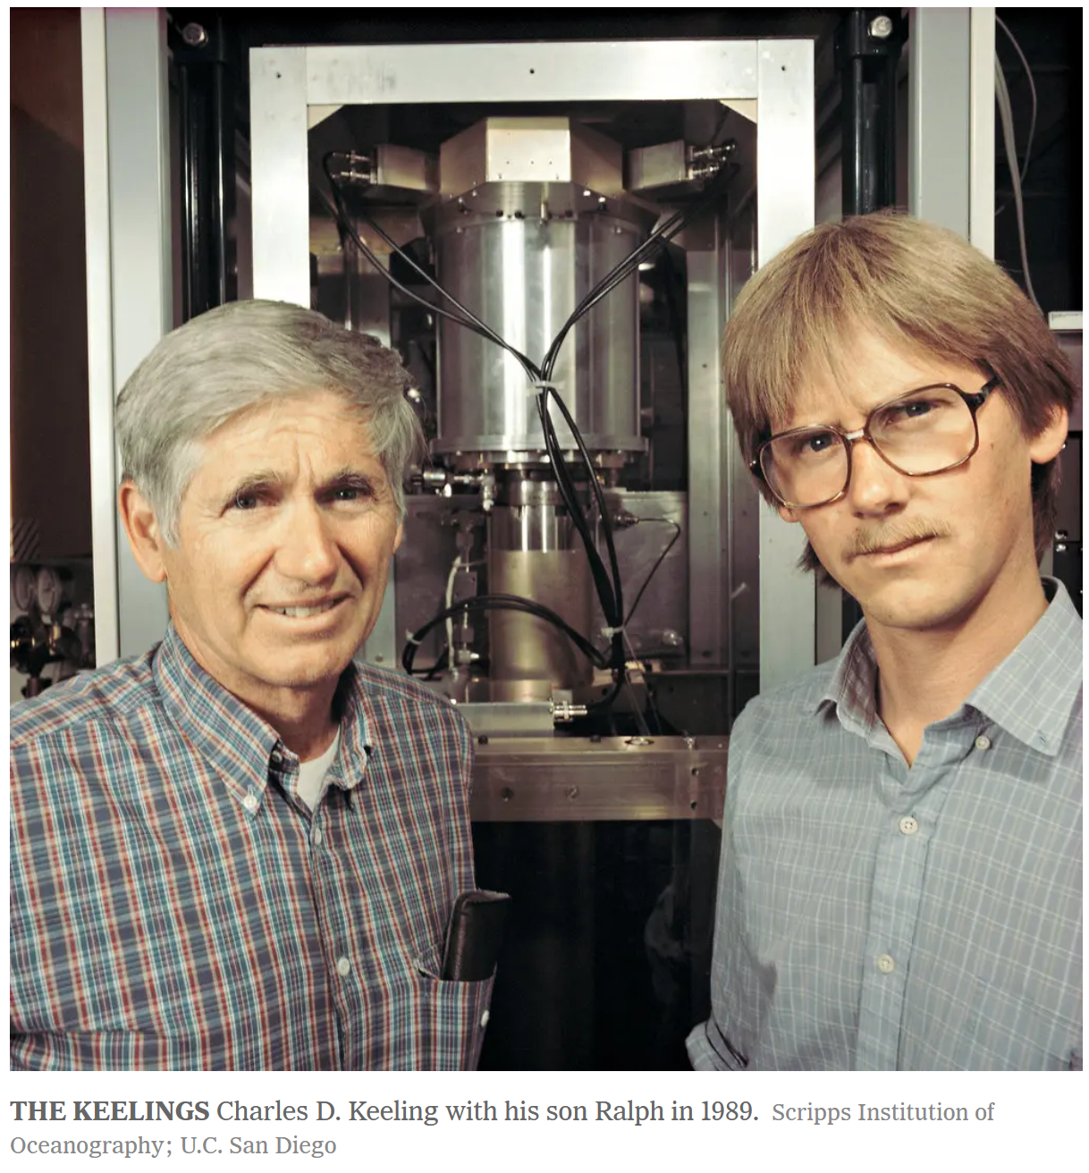
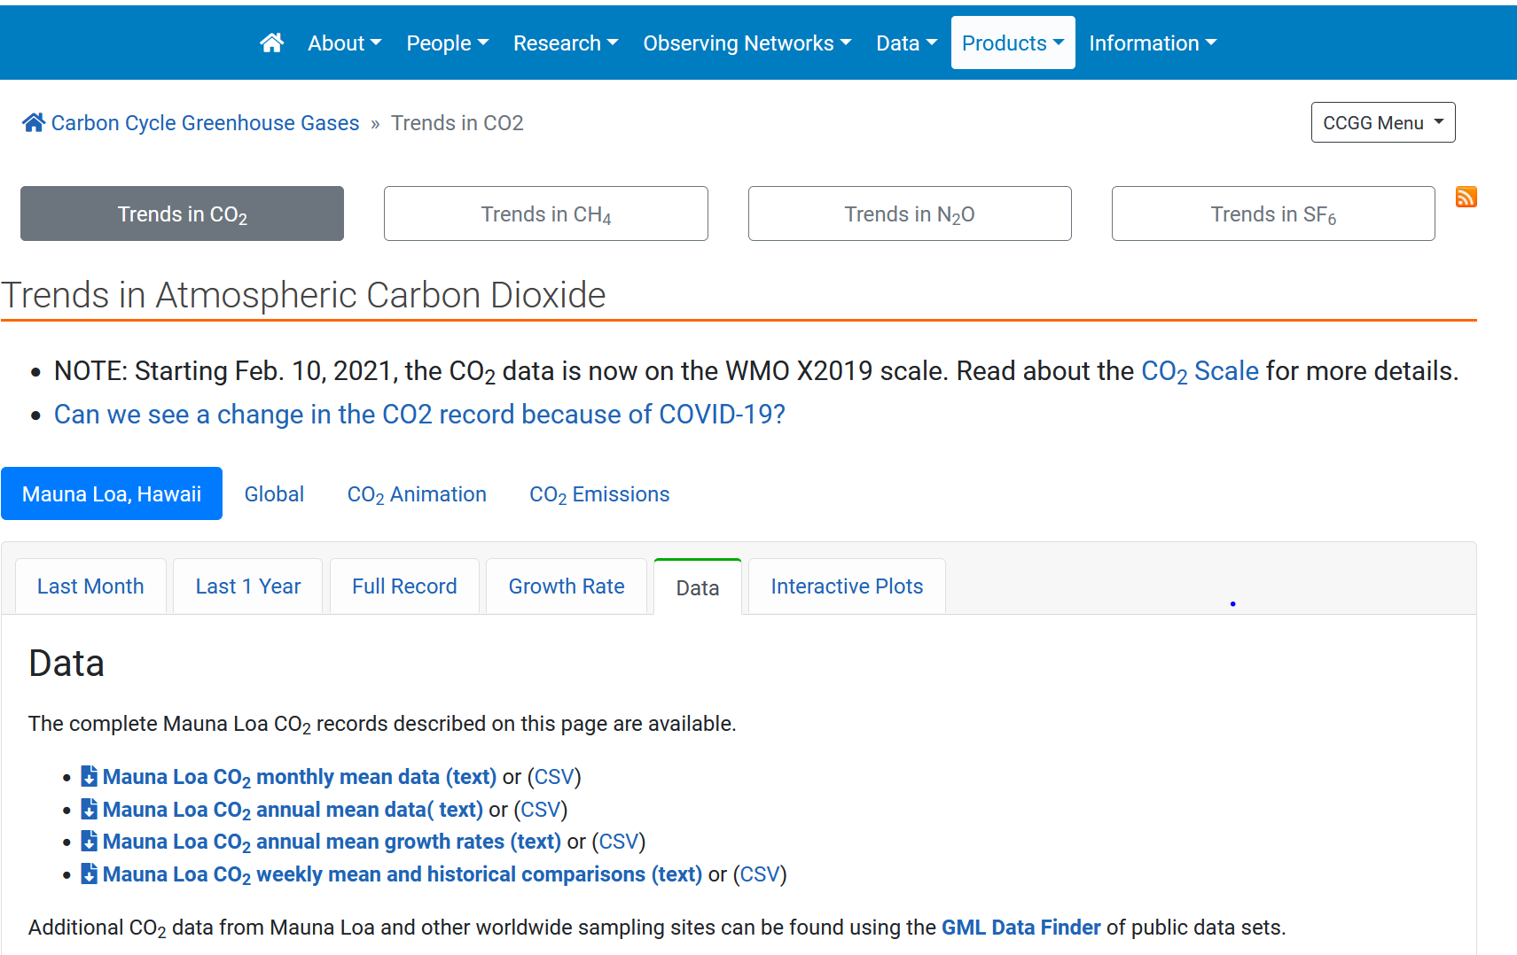
Students Can Get the Data or You Can Give it to Them
https://gml.noaa.gov/ccgg/trends/
Plot on spreadsheet or calculator and fit a curve
https://www.nytimes.com/2010/12/22/science/earth/22carbon.html

Slide 4
Carbon Dioxide: Linear and Exponential Functions
Top graph: Linear Fit
Linear function does not fit well
Slope is too large in 1950 and too small in 2020
Interpret slope: An increase of 1.47 ppm per year
Interpret intercept: Projected CO₂ in 1950 was 299.34 ppm
Bottom graph: Exponential Fit
Exponential function also does not fit well
Climbing slower in 1950 and faster in 2020
Since :
Interpret intercept: Projected CO₂ in 1950 was 297.82 ppm
Interpret growth rate: Increases continuously at 0.45% ppm/yr

Slide 5
Another View of CO₂
Log scale: (bottom graph)
Slope is the continuous growth rate:
0.45% per year
Intercept of log graph is log of intercept:

Slide 6
More climate change resources at
https://mcwg.github.io/climate
https://mcwg.github.io/climate
© 2022 Mathematics Consortium Working Group, Hughes Hallett et al.

