Slide 1
Lake Mead
Deb Hughes Hallett
University of Arizona/Harvard Kennedy School
Mathematics Consortium Working Group
https://mcwg.github.io/
https://mcwg.github.io/climate
© 2022 Mathematics Consortium Working Group, Hughes Hallett et al.

Slide 2
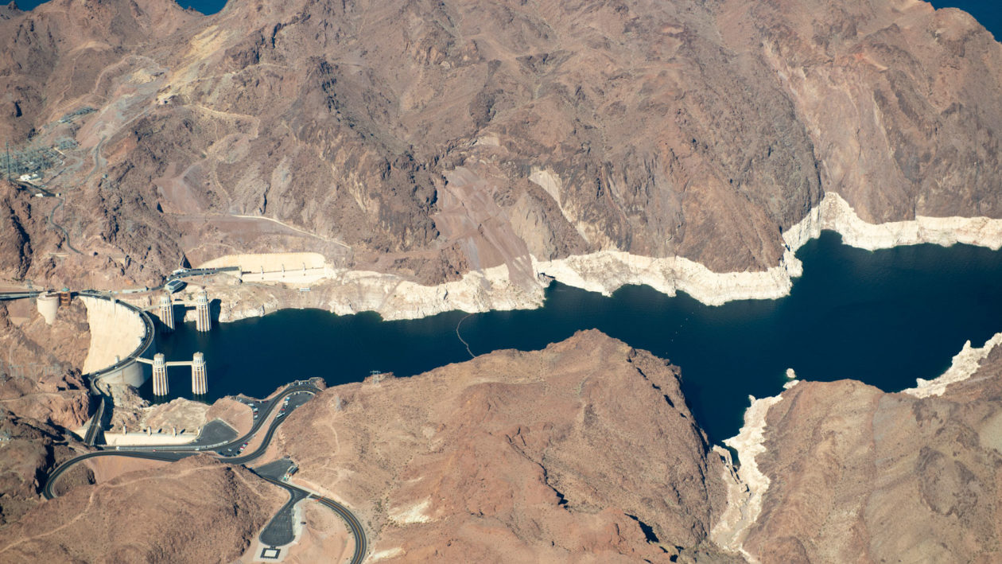
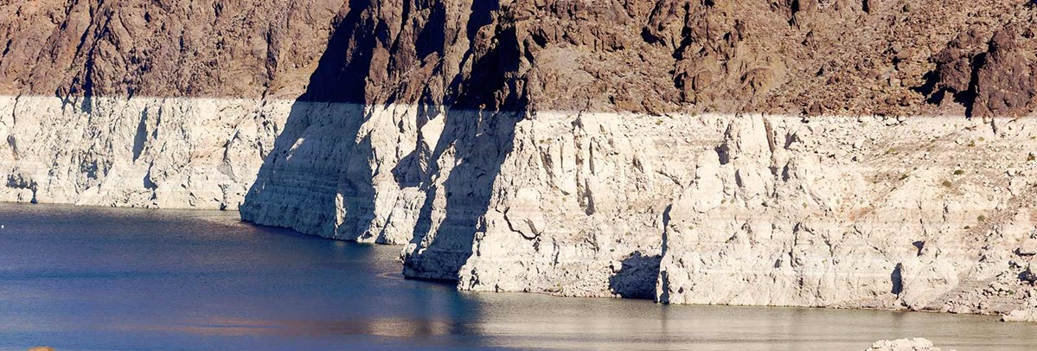
What Does this Mean for Arizona?
https://www.nps.gov/lake/learn/drought.htm
https://e360.yale.edu/series/crisis-on-the-colorado
Lake Mead is about 35% full
with “bathtub ring”
Less Water:
Water comes via Colorado river from Lake Mead
River flow is shrinking; we are in a long drought
Flow is about 12-15 million acre-feet per year (in a good year)
Western states use 20 million acre-feet per year

Slide 3
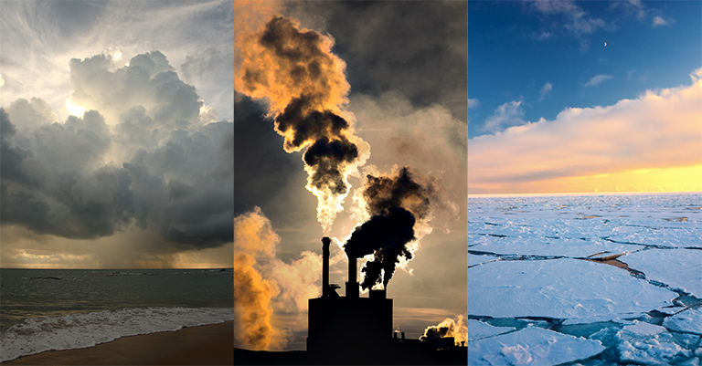
Why is the Climate Change Changing?
https://climate.nasa.gov/resources/global-warming-vs-climate-change/
Carbon dioxide in atmosphere is increasing
This traps heat (the “greenhouse effect”), causing warming
Why is carbon dioxide increasing?
Scientists are almost certain that humans are responsible
Not everyone agrees humans are responsible; some are “climate deniers”

Slide 4
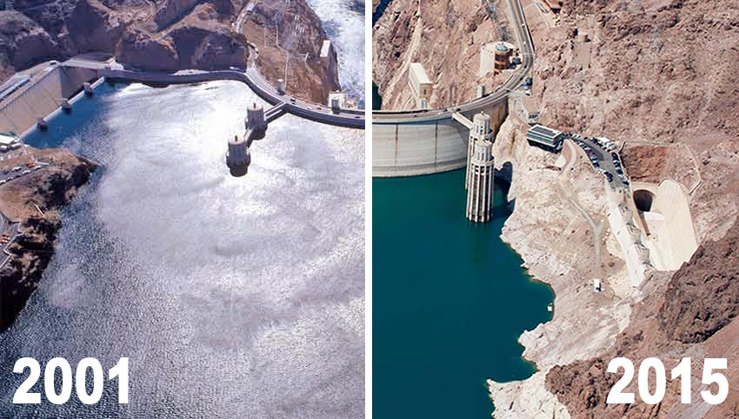
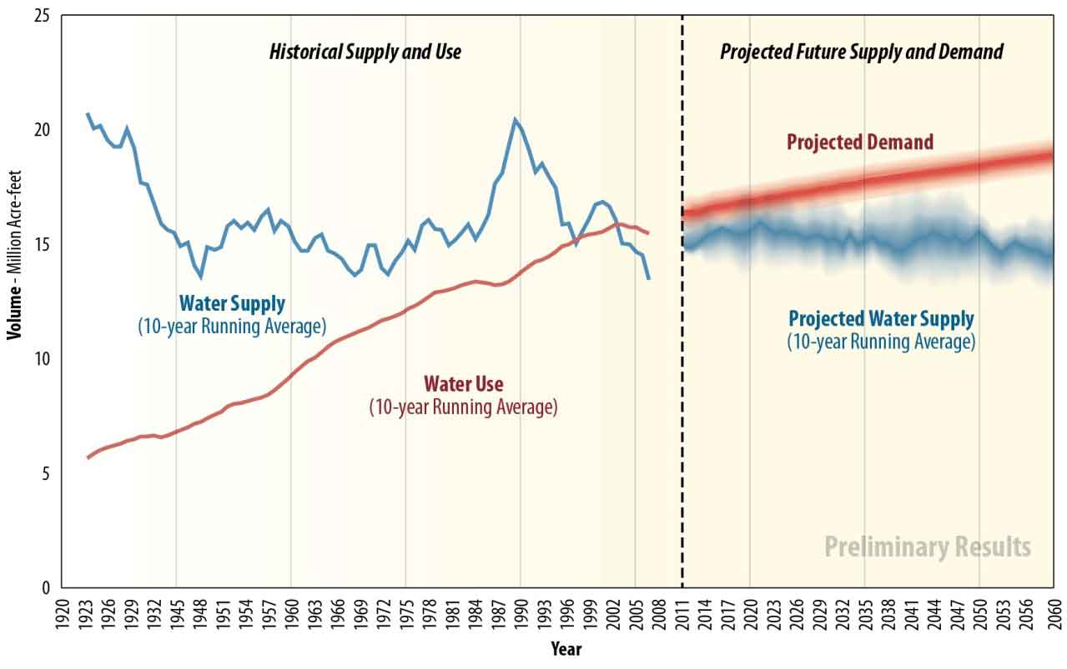
What Does the Future Look Like in Lake Mead?
https://www.nps.gov/lake/learn/drought.htm
Lower rainfall and snow melt
Higher demand

Slide 5
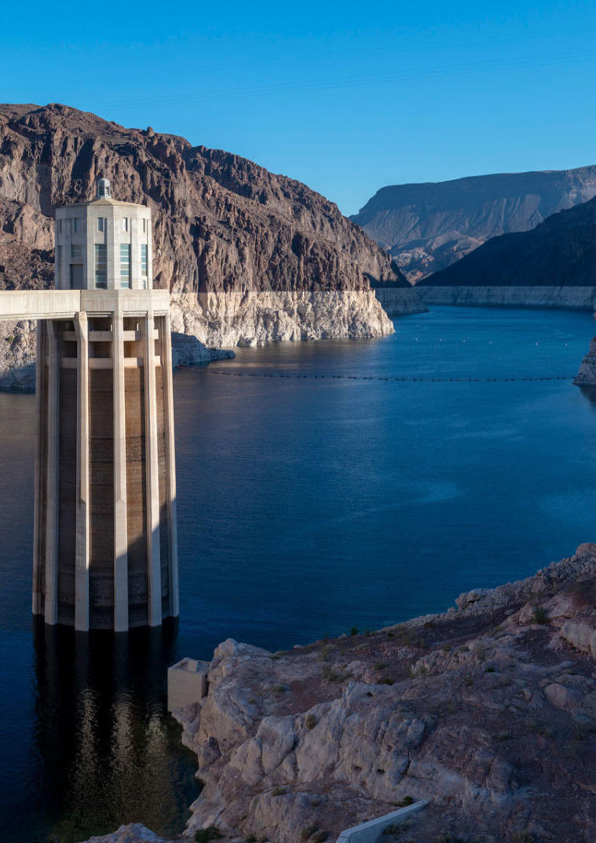
How Certain is the Shortage?
https://e360.yale.edu/features/on-the-water-starved-colorado-river-drought-is-the-new-normal
Lake Mead about 35% full with “bathtub ring”
That it will happen: Essentially Certain
When it will happen: Very Uncertain
Waiting till it happens to plan: Bad Idea!
Your students will be the ones experiencing and voting on this!

Slide 6
More climate change resources at
https://mcwg.github.io/climate
https://mcwg.github.io/climate
© 2022 Mathematics Consortium Working Group, Hughes Hallett et al.

