Slide 1
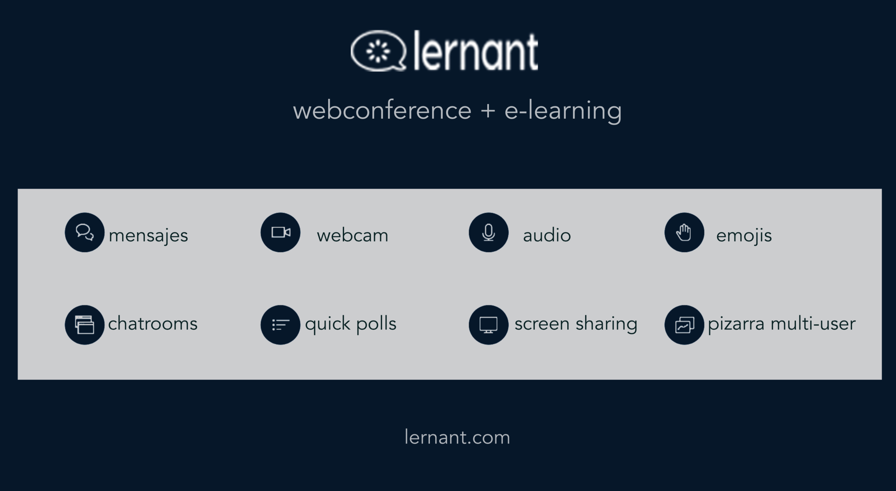

Slide 2
This slide left blank for whiteboard

Slide 3
This slide left blank for whiteboard

Slide 4
This slide left blank for whiteboard

Slide 5
This slide left blank for whiteboard

Slide 6
This slide left blank for whiteboard

