Slide 1

German Renninance
Where is Dürer in the Met?
1.0
Enter your username
Enter your password
Sign In
AndroidUIUX.com
768x1280 | LG Nexus 4

Slide 2
Where is Dürer In The Met?
Want to find your favorite Dürer artwork in the Metropolitan Museum of New York in Manhattan?
Wondering what was happening in Dürer’s life before and after the artwork was produced?
Curious about what else was happening during the German Renninance?
Art enthusiast wanting to learn more about what is in the Metropolitan Museum of New York in Manhattan?
Student looking for inspiration for the perfect project?
Historian trying to research historical events?
Look No Further ….
This Android Application has been created to address the above questions at Parsons School of Design at The New School in Manhattan, New York City, New York.

Slide 3
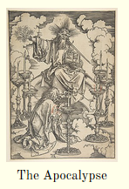
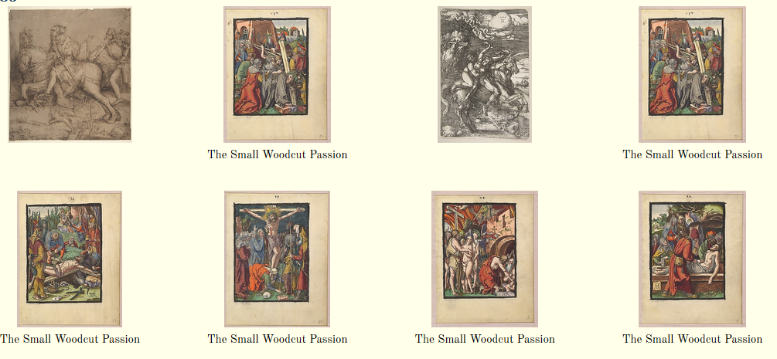
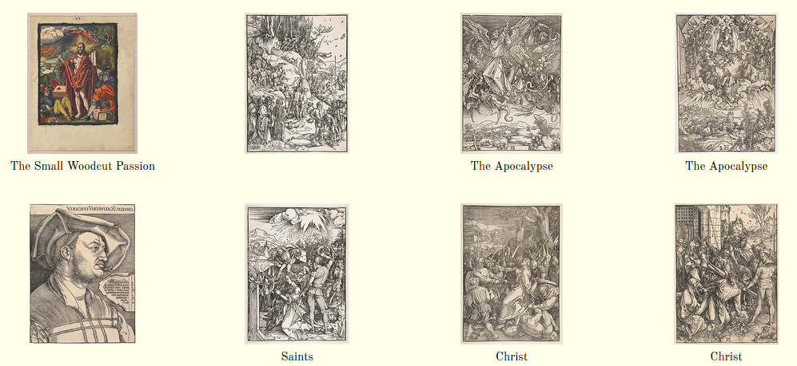
Albrecht Dürer in the Met 1481 - 1528
1481
1485

Slide 4


Where is Dürer in The Met?
Option 1
1481
1485
Option 1: Turn Oveview On/OFf
Option 2
Option 2: Locations in Met
Option 3
Option 3: History
Option 4
Option 5
Option 6

Slide 5
Albrecht Dürer 1471 - 1528
1481

Slide 6
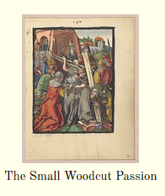
Albrecht Dürer 1471 - 1528
1485

Slide 7
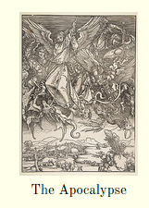
Albrecht Dürer 1471 - 1528
1485

Slide 8
Where is Dürer in The Met?
Option 1
1481
1485
Option 1: Turn Oveview On/OFf
Option 2
Option 2: Locations in Met
Option 3
Option 3: History
Option 4
Option 5
Option 6

Slide 9
Albrecht Dürer 1471 - 1528
Saint John Beholding the Seven Golden Candlesticks, from The Apocalypse
1481
1485
What’s in the Met?
Location: Gallery 4 Room 2
Met Website on Art Piece
Circa Dates
Credit Line
Add to Itinerary
OK

Slide 10
Where is Dürer in The Met?
Option 1
1481
1485
Option 1: Turn Oveview On/OFf
Option 2
Option 2: Locations in Met
Option 3
Option 3: History
Option 4
Option 5
Option 6

Slide 11
Albrecht Dürer 1471 - 1528
1471 - May 21 Born in Nuremberg, Germany
….
1481
The Lighthouse of Alexandria's final remains disappear when Qaitbay, Sultan of Egypt, builds the Citadel of Qaitbay on its site.
1485

