Slide 1
EconoCausal
Dynamic Pricing via Double Machine Learning
Internship project — Data Science & Machine Learning
Objective: estimate the causal effect of price on demand
Method: cross-fitted Double Machine Learning (DML)
Dataset: reproducible synthetic retail pricing data

Slide 2
Business Problem
Observed price and sales correlation is not necessarily causal.
Businesses may change prices when demand, inventory, costs, or competitor prices change.
The project controls for observed confounders before estimating price elasticity.
The final app demonstrates how an estimated elasticity can be used in a controlled scenario analysis.

Slide 3
Data & Features
8,000 daily observations generated with a fixed random seed.
Categorical: category, region.
Calendar / promotion: day_of_week, holiday, promotion.
Business variables: cost, competitor_price, demand_index, inventory.
Treatment: log(price) | Outcome: log1p(units_sold).
The generator uses a known benchmark elasticity of -1.25.

Slide 4
Methodology — Double Machine Learning
1. Split observations into cross-validation folds.
2. Learn E[Y|X] with Random Forest and obtain out-of-fold outcome predictions.
3. Learn E[D|X] with Random Forest and obtain out-of-fold treatment predictions.
4. Residualize outcome and treatment.
5. Estimate the partially-linear coefficient from residualized variables.
6. Use bootstrap resampling for an empirical 95% interval.

Slide 5
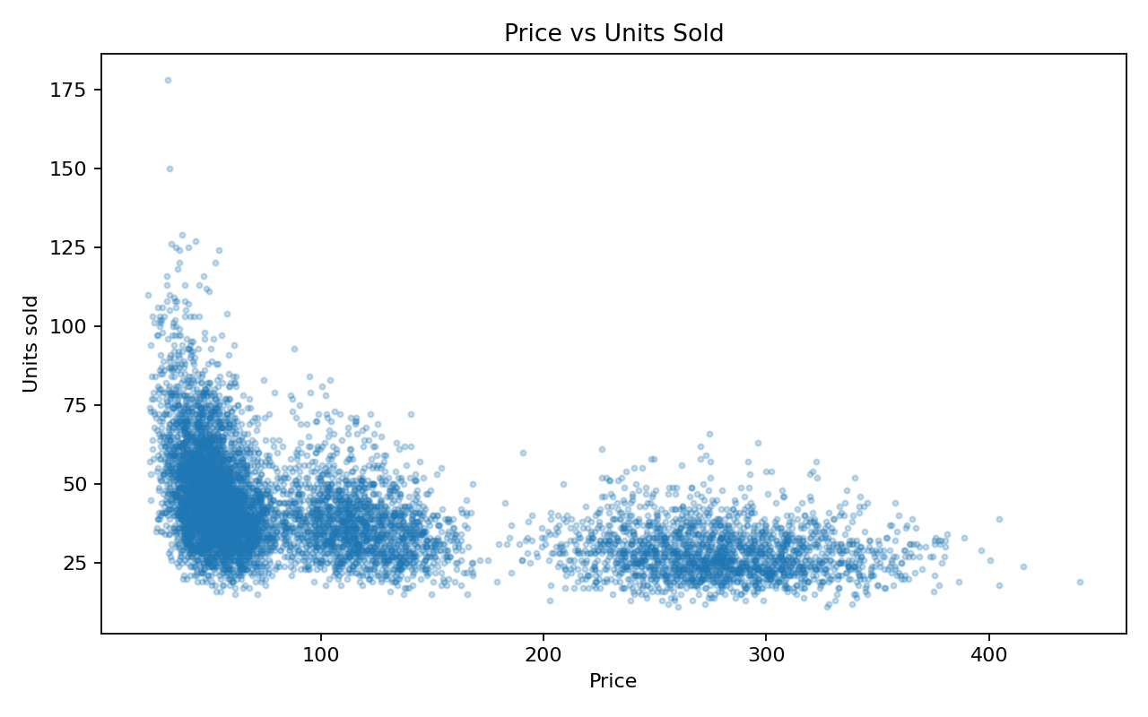
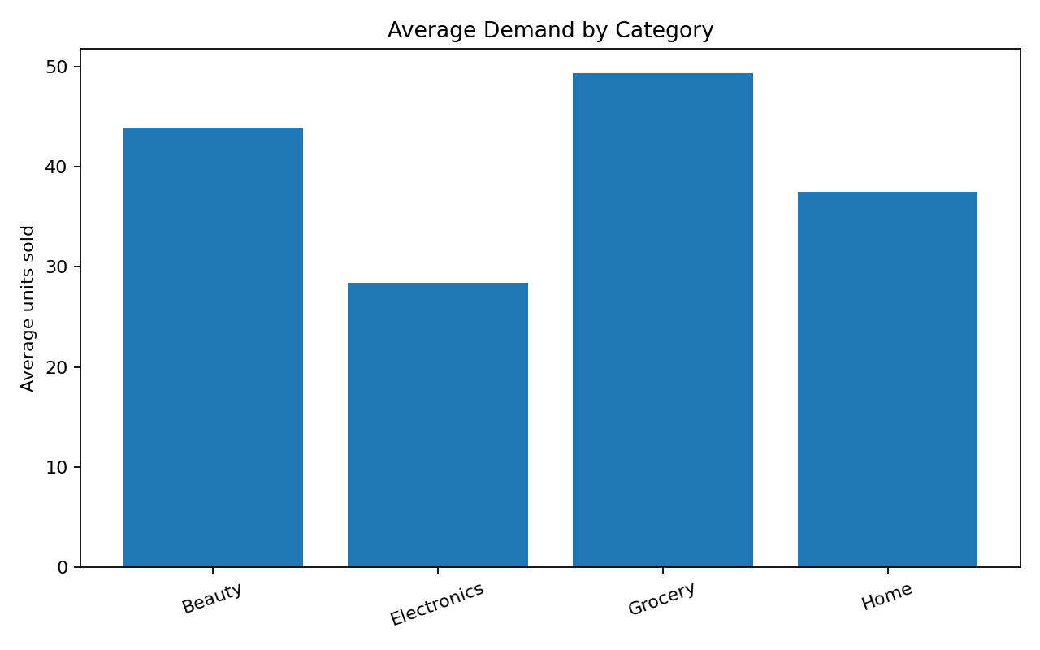
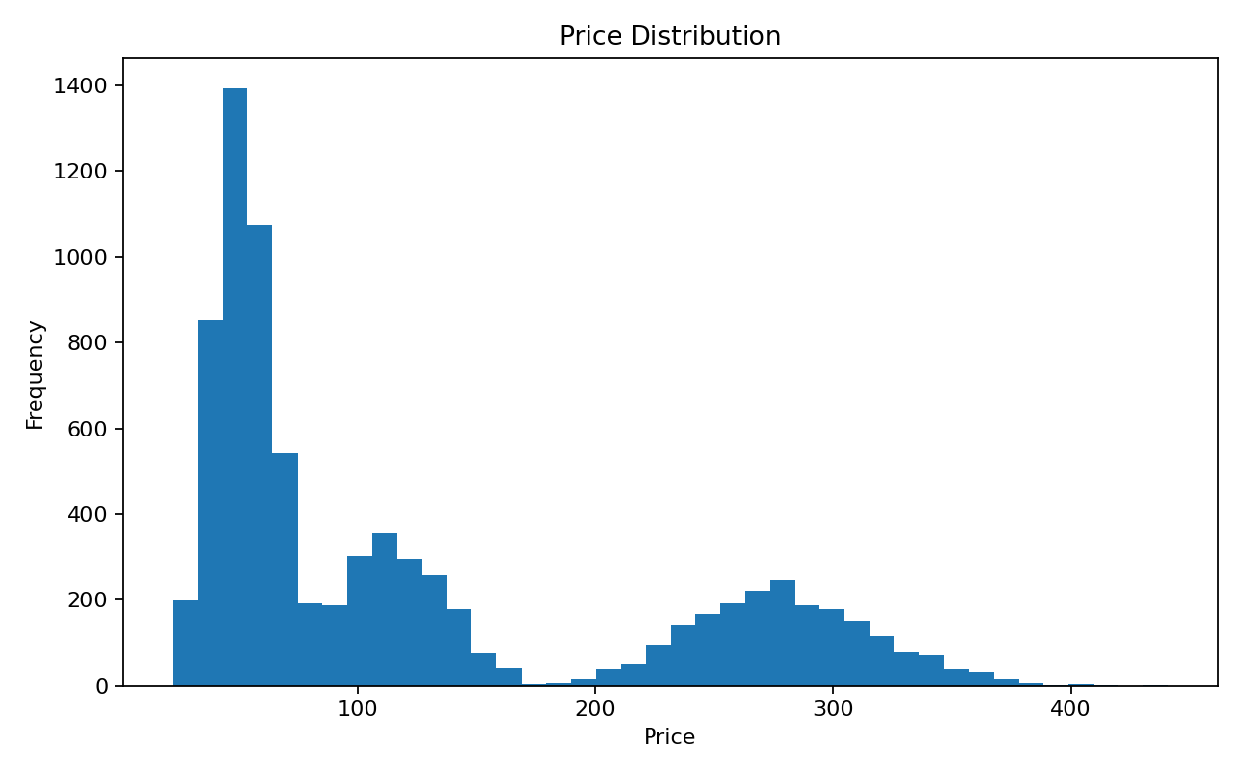
Exploratory Data Analysis

Slide 6
Model Evaluation
Metric | Result
Estimated elasticity | -1.1194
Standard error | 0.0258
95% bootstrap interval | [-1.1650, -1.0714]
Outcome RMSE | 0.2438
Outcome R² | 0.5456
Treatment RMSE | 0.1005
Treatment R² | 0.9817
Observations | 8000

Slide 7
Interactive Demonstration
Streamlit dashboard: app.py
Select category and scenario inputs.
Adjust price change from -20% to +20%.
Estimate demand multiplier from the causal elasticity.
Show scenario price, estimated demand and illustrative gross contribution.
Display model evaluation metrics and confidence interval.

Slide 8
Limitations & Reproducibility
Dataset is synthetic; results are not claims about a real company or market.
Causal interpretation depends on observed-confounding and model assumptions.
Unmeasured confounding may remain.
Main pipeline uses random seed 42 and can be rerun from the terminal.
Validation includes automated unit tests and a full pipeline run.

