Slide 1
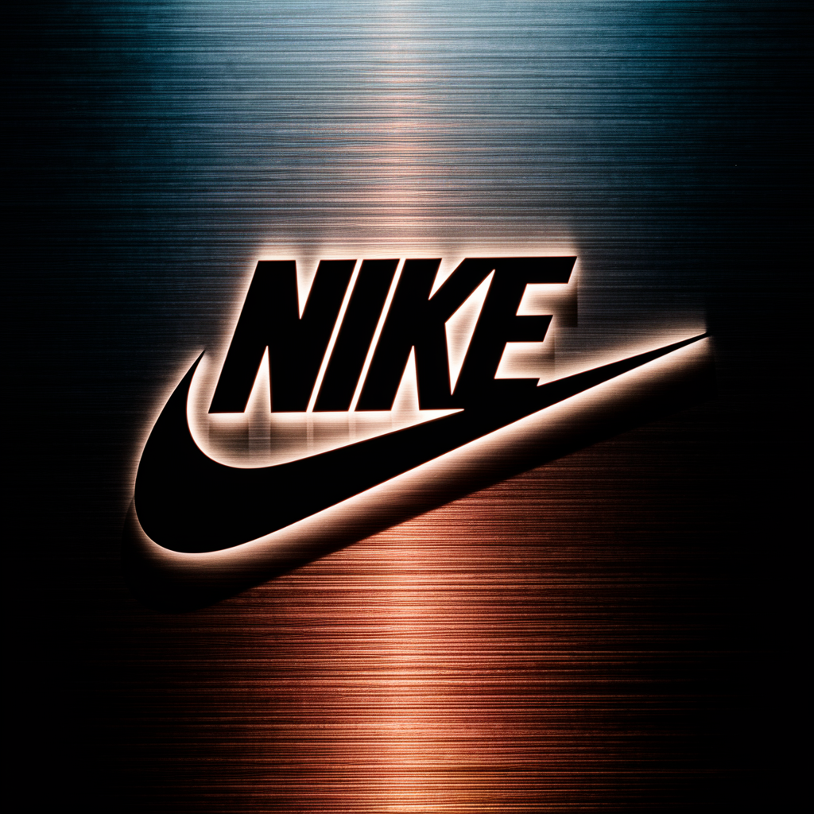
Nike
Brand Book
creative
innovative
Innovation
forward-thinking

Slide 2
Table of Contents
1. Table of Contents
2. Company Profile
3. Market Analysis & Insights
4. Brand Positioning
5. Logo Variations
6. Color Palette
7. Typography
8. Visual & Photography Guidelines

Slide 3
Table of Contents (2)
9. Brand Story & Mission
10. Brand Voice & Tone
11. Messaging & Value Propositions
12. Marketing Copy
13. Brand Collateral Templates

Slide 4
Company Profile
Company: Nike
Industry: Sportswear, Footwear, Apparel, Lifestyle & Fitness
Target Audience: Athletes, Fitness enthusiasts, Sports teams, Urban youth, Lifestyle-focused consumers, Fashion-conscious individuals, Professional and amateur athletes, People seeking performance-driven and stylish sportswear.
Core Values:
• Innovation
• Performance
• Inspiration
• Empowerment
• Diversity
• Sustainability
• Authenticity
• Excellence
• Community
• Determination

Slide 5
Market Analysis & Insights
Industry Trends:
• Trend 1: Sustainable and Eco-Friendly Fabrics · Trend 2: Smart Activewear with Embedded Technology · Trend 3: Inclusive Sizing and Adaptive Design
• Trendy Activewear Accessory Palette (5 color
• new website for Squash club Clean, modern design.
• Trends Website Design
Key Competitors:
Target Market, DesignRush Home, What Is, Top Sportswear, Top, Custom Fitness
Popular Design Styles: professional, bold, creative, clean

Slide 6
Brand Positioning
Unique Value Proposition:
Distinctive Sportswear, Footwear, Apparel, Lifestyle & Fitness solution focused on Athletes, Fitness enthusiasts, Sports teams, Urban youth, Lifestyle-focused consumers, Fashion-conscious individuals, Professional and amateur athletes, People seeking performance-driven and stylish sportswear.
Brand Promise:
Empowering Athletes, Fitness enthusiasts, Sports teams, Urban youth, Lifestyle-focused consumers, Fashion-conscious individuals, Professional and amateur athletes, People seeking performance-driven and stylish sportswear. through innovative Sportswear, Footwear, Apparel, Lifestyle & Fitness solutions
Brand Personality:
innovative, forward-thinking, creative, responsible, eco-friendly
Competitive Advantage:
User-centric design approach

Slide 7
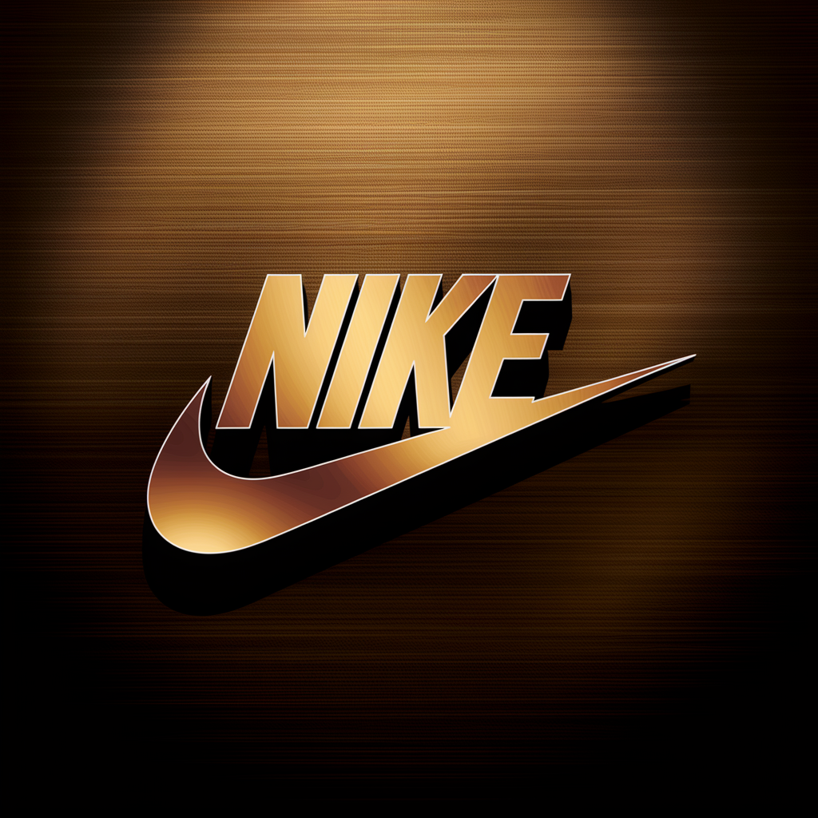
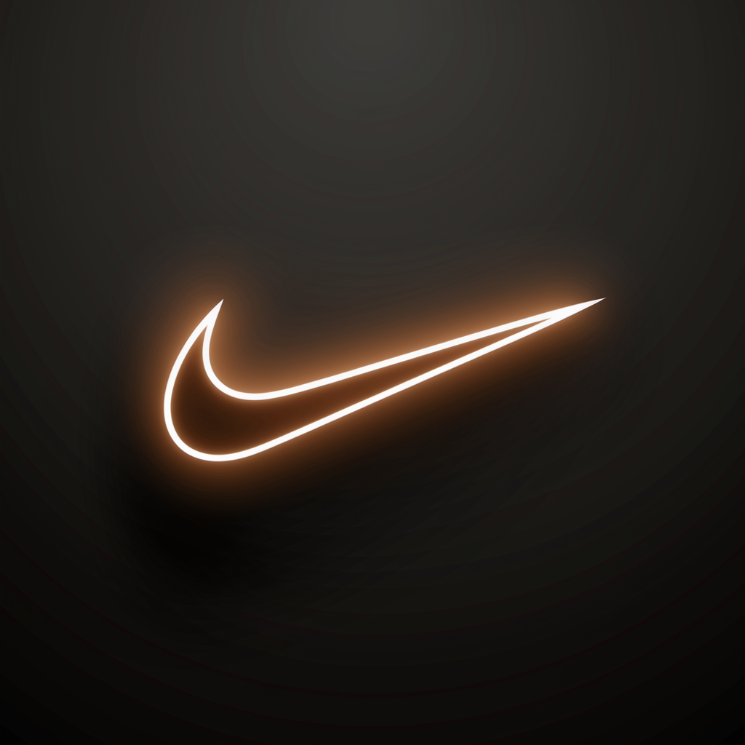
Logo Variations (3 designs)

Slide 8
Color Palette
Primary
#F59E0B
Secondary
#1E40AF
Accent
#374151
Supporting
#D97706
Hex_codes
#F59E0B

Slide 9
Typography
Primary Font: Archivo
Secondary Font: Work Sans

Slide 10
Visual & Photography Guidelines
Visual Style:
Visual style for Nike in Sportswear, Footwear, Apparel, Lifestyle & Fitness: Modern aesthetic, values: Innovation, Performance, Inspiration, Empowerment, Diversity, Sustainability, Authenticity, Excellence, Community, Determination, audience: Athletes, Fitness enthusiasts, Sports teams, Urban youth, Lifestyle-focused consumers, Fashion-conscious individuals, Professional and amateur athletes, People seeking performance-driven and stylish sportswear.. Use whitespace, on-brand accent color, modern design cues.
Photography Style:
Photography style for Nike: Modern and Sportswear, Footwear, Apparel, Lifestyle & Fitness feel. Show diversity, authenticity, and lighting that supports brand values: Innovation, Performance, Inspiration, Empowerment, Diversity, Sustainability, Authenticity, Excellence, Community, Determination. Images should resonate with Athletes, Fitness enthusiasts, Sports teams, Urban youth, Lifestyle-focused consumers, Fashion-conscious individuals, Professional and amateur athletes, People seeking performance-driven and stylish sportswear..

Slide 11
Brand Story & Mission (1)
In the heart of every athlete beats the relentless drive for excellence, the unyielding determination to push boundaries, and the insatiable thirst for victory. At Nike, we understand this burning passion because it runs through our veins too. Our journey began with a simple mission - to empower athletes and fitness enthusiasts to reach their full potential, to inspire them

Slide 12
Brand Story & Mission (2)
to dream bigger, and to provide them with the tools they need to conquer any challenge that comes their way. From the courts to the tracks, from the gyms to the streets, Nike has been there every step of the way, fueling the fire within each and every athlete. Innovation is our cornerstone, driving us to constantly push the boundaries

Slide 13
Brand Story & Mission (3)
of what is possible. Our relentless pursuit of excellence has led us to create groundbreaking technologies that redefine the way athletes perform. From the revolutionary Nike Air cushioning to the game-changing Flyknit material, every product we design is crafted with one goal in mind - to elevate your game to new heights.

Slide 14
Brand Story & Mission (4)
But our commitment goes beyond just performance. We believe in the power of inspiration, in the strength of diversity, and in the importance of sustainability. We strive to create a community where every athlete, regardless of their background or ability, feels empowered to chase their dreams. We stand for authenticity and inclusivity, celebrating the unique talents and voices that make

Slide 15
Brand Story & Mission (5)
our world colorful and vibrant. At Nike, we are more than just a brand - we are a movement. A movement of individuals who refuse to be bound by limitations, who embrace challenges as opportunities, and who believe that with the right mindset and the right gear, anything is possible.

Slide 16
Brand Story & Mission (6)
Whether you're a professional athlete seeking that extra edge, a fitness enthusiast looking to crush your personal best, or a fashion-conscious individual who values style and performance, Nike is here to support you every step of the way. So join us, as we lace up our shoes, stretch our limits, and take on the world with courage and determination.

Slide 17
Brand Story & Mission (7)
Together, let's write

Slide 18
Brand Voice & Tone (1)
Nike's brand voice is dynamic, empowering, and inspiring. It strikes a balance between being authoritative and friendly, reflecting its values of innovation, performance, inspiration, empowerment, diversity, sustainability, authenticity, excellence, community, and determination. The tone is confident, motivating, and inclusive, resonating with athletes, fitness enthusiasts, sports teams, urban youth, lifestyle-focused consumers, fashion-conscious individuals, and professional and amateur athletes alike.

Slide 19
Brand Voice & Tone (2)
It is performance-driven and stylish, appealing to those seeking top-quality sportswear that helps them achieve their goals and express their personal style. Overall, Nike's brand voice

Slide 20
Messaging & Value Propositions (1)
Messaging Architecture for Nike: Key Value Propositions: 1. For Athletes and Fitness Enthusiasts: "Unleash your full potential with Nike's cutting-edge performance technology, designed to elevate your game and push your limits." 2. For Urban Youth and Lifestyle-focused Consumers: "Stay ahead of the trend with Nike's innovative designs that seamlessly blend style and functionality, perfect for the urban jungle." 3.

Slide 21
Messaging & Value Propositions (2)
For Professional and Amateur Athletes: "Dominate the competition with Nike's superior quality and performance-driven gear, trusted by athletes at every level of the game." 4. For People Seeking Performance-Driven Sportswear: "Elevate your workout with Nike's advanced materials and construction, engineered for optimal performance and comfort during every workout." 5. For Fashion-Conscious Individuals: "Make a statement with Nike's trend-setting designs that

Slide 22
Messaging & Value Propositions (3)
effortlessly combine style and performance, keeping you on the cutting

Slide 23
Marketing Copy: Website
"Unleash Your Potential with Nike: Where Innovation, Performance, and Empowerment Meet"
"Elevate Your Game with Nike's Authentic, Sustainable, and Community-Driven Sportswear"

Slide 24
Marketing Copy: Email
Subject: Discover the Future of Performance with Nike's Innovative Sportswear
Preview text: Explore the intersection of excellence, sustainability, and empowerment in Nike's latest collection, designed to inspire and support athletes, fitness enthusiasts, and fashion-conscious individuals alike.

Slide 25
Marketing Copy: Social Media
"Step into the future of fitness and style with Nike! 🏃‍♂️🔥 From the track to the streets, our innovative gear is designed to empower your performance and inspire greatness. Join the diverse community of athletes, enthusiasts, and trendsetters who choose excellence in every step. #JustDoIt #NikeInnovates"

Slide 26
Marketing Copy: Ad Copy
"Gear up like a pro with Nike's cutting-edge sportswear and footwear! Elevate your game, dominate the streets, and conquer every workout in style. Shop now and unleash your full potential with Nike! Just do it. #Nike #JustDoIt"

Slide 27
Collateral: Business Card
Simple, clean business card layout for Nike in Sportswear, Footwear, Apparel, Lifestyle & Fitness. Emphasize clarity, logo, and minimal info.

Slide 28
Collateral: Letterhead
Letterhead with Nike branding, address, and subtle color accent from brand palette.

Slide 29
Collateral: Email Signature
Professional email signature for Nike with logo, name, title, and key contact details.

Slide 30
Collateral: Presentation Template
PPT cover slide and content slide layouts using Nike palette and fonts.

Slide 31
Collateral: Social Templates
Instagram/Facebook post and story templates reflecting Nike's style and values.

