Slide 1

Brand Identity System

Slide 2
INDEX
Introduction
01
Brand Purpose (Values)
04
Brand Colors
07
Brand Purpose (Vision)
02
Brand Story
05
Primary Colors
Secondary Colors
Color Usage 1/2
Brand Purpose (Mission)
03
Logo Variations
06
Color Usage 2/2
Variation 1
Typography
08
Variation 2
Variation 3
Brand Font
Font Usage
Text Hierarchy
Imagery & Visuals
09
Iconography
Illustrations
Merchandise

Slide 3
Welcome to Forbes Media's global brand framework, a sophisticated system crafted to deliver an international, engaging, and consistently recognizable media presence. For over a century, we have shaped the landscape of business journalism through unwavering integrity, pioneering innovation, and entrepreneurial insight. Our brand identity system reflects this rich heritage while embracing digital transformation, ensuring Forbes remains the definitive voice in business media. We invite you to explore how our distinctive approach continues to inspire and empower global leaders, visionary entrepreneurs, and influential professionals across every platform and medium.
INTRODUCTION

Slide 4
Forbes Media envisions a world where every business leader, entrepreneur, investor, professional, high-net-worth individual, and aspiring youth is empowered with knowledge and insights to drive global innovation and progress. Our ultimate goal is to inspire and motivate individuals to reach their full potential and shape a brighter future through our innovative Media & Publishing solutions.
BRAND PURPOSE (VISION)

Slide 5
Forbes Media is dedicated to delivering cutting-edge Media & Publishing (Business Journalism & Digital Media) solutions that provide unparalleled value to business leaders, entrepreneurs, investors, professionals, high-net-worth individuals, and aspiring youth. We aim to be the go-to platform for insightful and forward-thinking content that drives success, fosters entrepreneurship, and shapes the future of global business.
BRAND PURPOSE (MISSION)

Slide 6
At Forbes Media, we are driven by a commitment to innovation, integrity, entrepreneurship, excellence, and a global perspective. We believe in the power of influence and the importance of credibility in all our endeavors. These core values guide us in creating impactful and relevant content for our audience, fostering a culture of trust, growth, and inspiration within the Media & Publishing (Business Journalism & Digital Media) industry.
BRAND PURPOSE (VALUES)

Slide 7
In a world where information is power, Forbes Media stands as a beacon of innovation and integrity, empowering business leaders, entrepreneurs, investors, professionals, high-net-worth individuals, and aspiring youth with cutting-edge Media & Publishing solutions. Our story began with a vision to provide a platform that offers more than just news - a platform that inspires, educates, and elevates. We are driven by the core values of entrepreneurship, excellence, and a global perspective, ensuring that our audience receives the most credible and influential insights to make informed decisions in an ever-evolving business landscape. At Forbes Media, we believe in the power of storytelling to drive change and shape the future.
BRAND STORY (1/2)

Slide 8
Our unique value proposition lies in our distinctive approach to Business Journalism and Digital Media, offering a holistic view of the business world that resonates with our diverse audience. Whether you are a seasoned business leader navigating complex markets or a young professional looking to make your mark, Forbes Media is here to guide and inspire you on your journey to success. Our brand promise is simple yet powerful - to empower individuals with the knowledge and resources they need to thrive in today's competitive environment. Through our innovative and forward-thinking...
BRAND STORY (2/2)

Slide 9
Choose for maximum impact and brand recognition in primary applications.
Logo Variation 1

Slide 10

Perfect for constrained spaces while maintaining professional brand presence and clarity.
Logo Variation 2

Slide 11

Ideal for small sizes, watermarks, and applications requiring simplified brand representation.
Logo Variation 3

Slide 12
Innovation Green
#4CAF50
RGB(76, 175, 80)
CMYK(56, 0, 54, 31)
Use Dark Text
Integrity Gray
#9E9E9E
RGB(158, 158, 158)
CMYK(0, 0, 0, 38)
Use Dark Text
Global Gold
#FFD700
RGB(255, 215, 0)
CMYK(0, 15, 100, 0)
Use Dark Text
Entrepreneurship Teal
#009688
RGB(0, 150, 136)
CMYK(100, 0, 9, 41)
Use Dark Text
Primary Colors

Slide 13
Light Gray
#F8F9FA
Use Dark Text
Ocean Blue
#26C6DA
Use Dark Text
Lemonade
#FFEB3B
Use Dark Text
Sage Green
#8BC34A
Use Dark Text
Charcoal
#424242
Use Light Text
Secondary Colors

Slide 14
Primary Color Usage
Use for brand-critical elements:
• Logos and main brand marks
• Headlines and key text
• CTA buttons and navigation
• Hero sections
Colors: Innovation Green, Integrity Gray, Global Gold, Entrepreneurship Teal
Best Practices:
- Maximum brand recognition
- Consistent application
- Sufficient contrast
- Accessibility compliance
Color Usage 1/2

Slide 15
Secondary Color Usage
Use for supporting elements:
• Backgrounds and subtle accents
• Secondary text
• Borders and dividers
• Hover states and icons
Colors: Light Gray, Ocean Blue, Lemonade, Sage Green, Charcoal
Best Practices:
- Create visual hierarchy
- Support, don't compete
- Maintain readability
- Use sparingly
Color Usage 2/2

Slide 16
Primary Font: Source Sans Pro
Secondary Font: Inter
Font Hierarchy:
• Headlines: Source Sans Pro - Bold, 28-32pt
• Subheadlines: Source Sans Pro - Bold, 20-24pt
• Body Text: Inter - Regular, 16-18pt
• Caption Text: Inter - Regular, 12-14pt
TYPOGRAPHY

Slide 17






Forbes Media - Core Functional Icons Icons
Home Icon
Search Magnifying Glass Icon
Menu Hamburger Lines Icon
Settings Gear Icon
User Profile Person Icon
Notification Bell Icon
ICONOGRAPHY

Slide 18






Forbes Media - Media & Publishing (Business Journalism & Digital Media). Industry Icons Icons
Cloud Computing Icon
Server Database Icon
Programming Code Icon
Network Connection Icon
Artificial Intelligence Icon
Security Lock Icon
ICONOGRAPHY

Slide 19
Style: Minimalist Outline design
Color: #4CAF50 on black background
Size Requirements:
• Minimum: 16px web, 0.5" print
• Recommended: 24px+ web, 0.75"+ print
Spacing:
• Clear space: 50% of icon width
• Consistent grid alignment
USAGE GUIDELINES

Slide 20


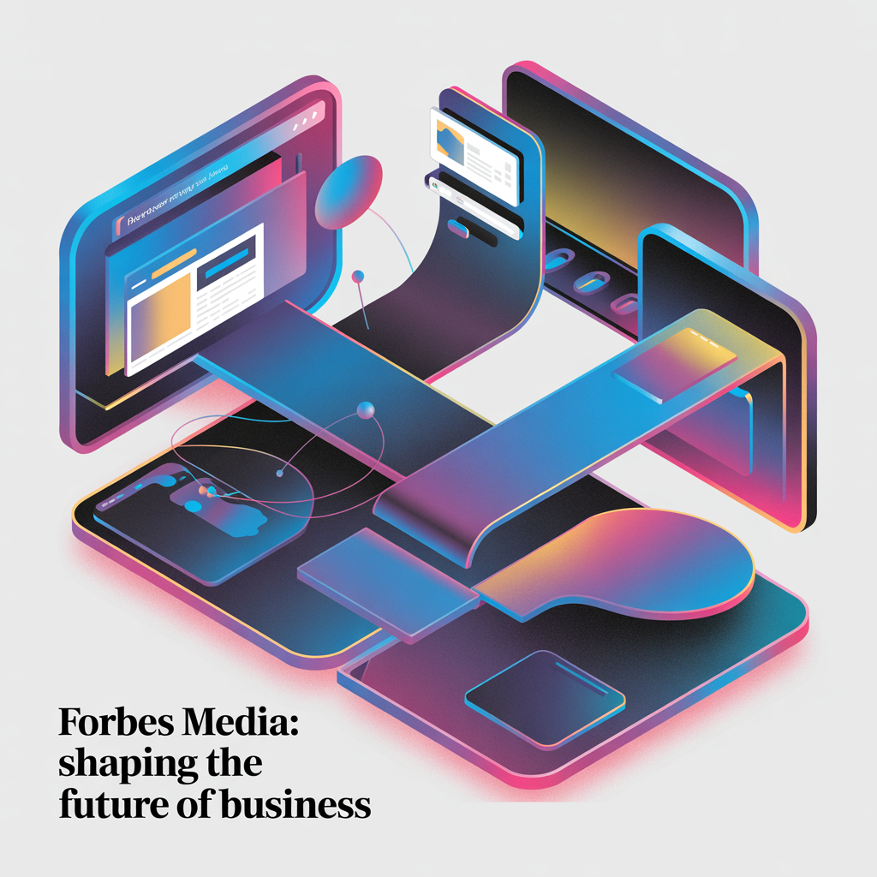
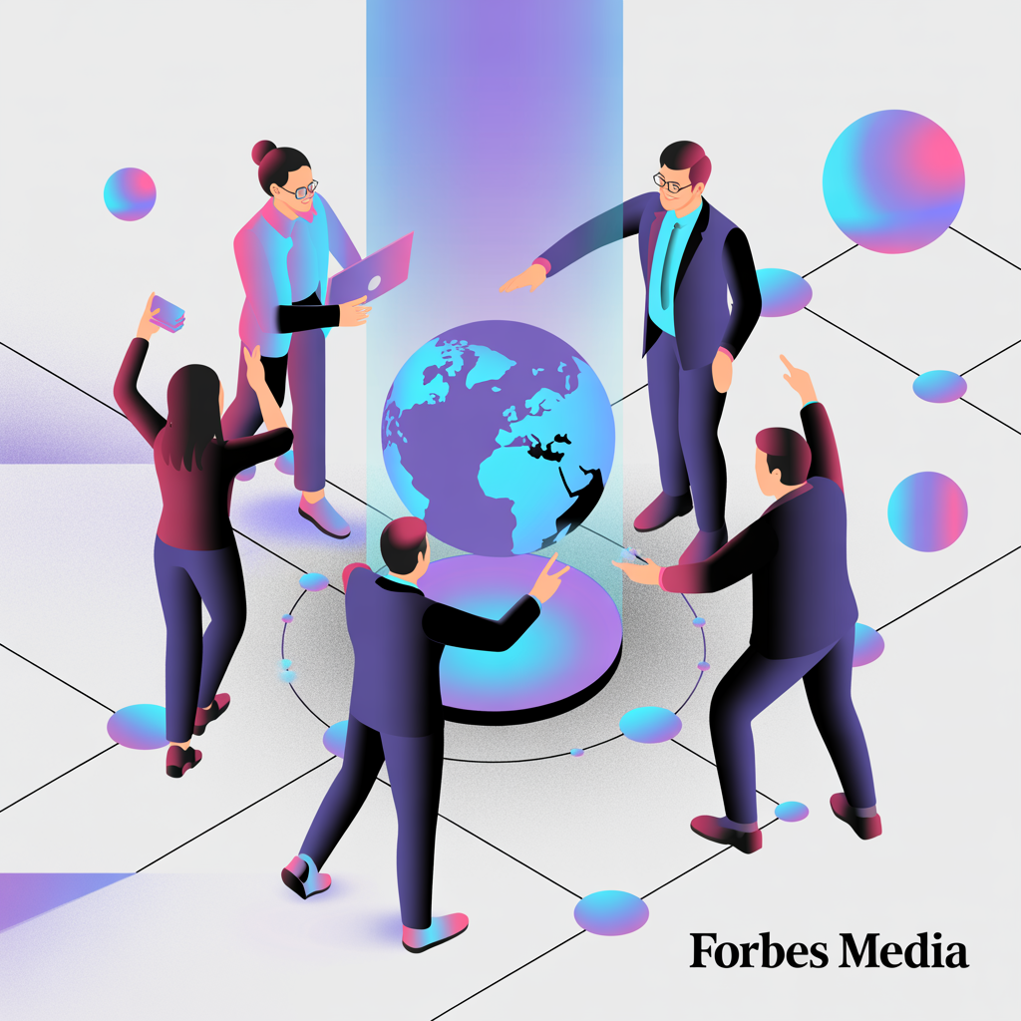


External Focus
External Focus
External Focus
Digital innovation in Media & Publi...
Professional excellence in Media & ...
Innovative solutions for Media & Pu...
Internal Focus
Internal Focus
Internal Focus
Collaborative teamwork and company ...
Strategic growth and development in...
Technology integration and digital ...
USAGE NOTES: These illustrations define the visual storytelling style of the brand. Use them consistently across presentations, reports, and marketing materials to maintain brand coherence.
BRAND ILLUSTRATIONS

