Slide 1

Chaayos
Brand Book
creative
innovative
Innovation
forward-thinking

Slide 2
Table of Contents
1. Table of Contents
2. Company Profile
3. Market Analysis & Insights
4. Brand Positioning
5. Logo Variations
6. Color Palette
7. Typography
8. Visual & Photography Guidelines
9. Brand Story & Mission
10. Brand Voice & Tone
11. Messaging & Value Propositions
12. Marketing Copy
13. Brand Collateral Templates

Slide 3
Company Profile
Company: Chaayos
Industry: Food & Beverage (F&B), Quick Service Restaurants (QSR), Café/Tea Retail
Target Audience: Urban millennials, Young professionals, Office-goers, Students, Tea enthusiasts, Digital-savvy consumers, Health-conscious individuals, People seeking a modern chai café experience.
Core Values:
• Innovation
• Personalization
• Customer Delight
• Quality
• Community
• Convenience
• Warmth
• Authenticity
• Modern Tradition
• Consistency

Slide 4
Market Analysis & Insights
Industry Trends:
• New logo wanted for Veg&More This design
• new sandwich concep Food And Drink logo ideas? We've collected some amazing examples of food and drink design
• New Openings Operations Staffing Product Updates Hospitality Now Stories for the Restaurant Community Subscribe Design
Key Competitors:
The, From, Missing, ERROR The, Restaurants, Dining Trends
Popular Design Styles: modern, bold, professional, creative

Slide 5
Brand Positioning
Unique Value Proposition:
Distinctive Food & Beverage (F&B), Quick Service Restaurants (QSR), Café/Tea Retail solution focused on Urban millennials, Young professionals, Office-goers, Students, Tea enthusiasts, Digital-savvy consumers, Health-conscious individuals, People seeking a modern chai café experience.
Brand Promise:
Empowering Urban millennials, Young professionals, Office-goers, Students, Tea enthusiasts, Digital-savvy consumers, Health-conscious individuals, People seeking a modern chai café experience. through innovative Food & Beverage (F&B), Quick Service Restaurants (QSR), Café/Tea Retail solutions
Brand Personality:
innovative, forward-thinking, creative, reliable, premium
Competitive Advantage:
User-centric design approach

Slide 6

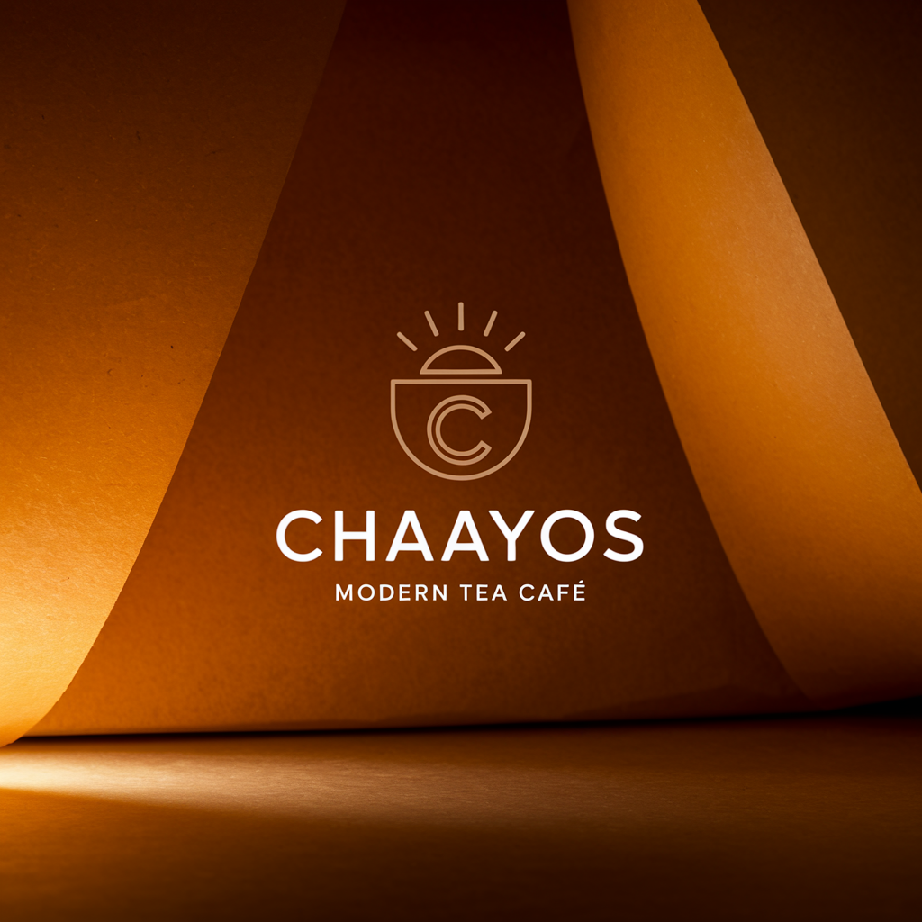
Logo Variations

Slide 7
Color Palette
Primary
#DC2626
Secondary
#059669
Accent
#2563EB
Supporting
#E5E7EB
Hex_codes
#DC2626

Slide 8
Typography
Primary Font: Inter
Secondary Font: Source Sans Pro

Slide 9
Visual & Photography Guidelines
Visual Style:
Visual style for Chaayos in Food & Beverage (F&B), Quick Service Restaurants (QSR), Café/Tea Retail: Elegant aesthetic, values: Innovation, Personalization, Customer Delight, Quality, Community, Convenience, Warmth, Authenticity, Modern Tradition, Consistency, audience: Urban millennials, Young professionals, Office-goers, Students, Tea enthusiasts, Digital-savvy consumers, Health-conscious individuals, People seeking a modern chai café experience.. Use whitespace, on-brand accent color, modern design cues.
Photography Style:
Photography style for Chaayos: Elegant and Food & Beverage (F&B), Quick Service Restaurants (QSR), Café/Tea Retail feel. Show diversity, authenticity, and lighting that supports brand values: Innovation, Personalization, Customer Delight, Quality, Community, Convenience, Warmth, Authenticity, Modern Tradition, Consistency. Images should resonate with Urban millennials, Young professionals, Office-goers, Students, Tea enthusiasts, Digital-savvy consumers, Health-conscious individuals, People seeking a modern chai café experience..

Slide 10
Brand Story & Mission (1)
Once upon a time in the bustling streets of urban India, there existed a place that redefined the traditional chai experience. This place was Chaayos - a modern chai café that catered to the needs and desires of the urban millennials, young professionals, office-goers, and students who craved a contemporary twist on their favorite beverage. At Chaayos, tea wasn't just a drink; it was an experience. It was a blend of innovation and tradition, where each cup was crafted with care and precision to delight the senses.

Slide 11
Brand Story & Mission (2)
The aroma of freshly brewed chai wafted through the air, drawing in tea enthusiasts and digital-savvy consumers alike who sought a taste of something new and exciting. But Chaayos was more than just a café; it was a community hub where people could come together to connect, relax, and recharge. The warm and inviting atmosphere invited guests to linger over their favorite brew, whether it was a classic masala chai or a trendy fusion creation. What set Chaayos apart was its commitment to quality and consistency.

Slide 12
Brand Story & Mission (3)
Each cup of chai was made with the finest ingredients, sourced from trusted suppliers who shared Chaayos' dedication to excellence. Customers could always count on the same great taste, no matter which Chaayos café they visited. But what truly made Chaayos special was its personalized touch. Customers could customize their chai just the way they liked it, whether they preferred it strong or light, sweet or spicy. This attention to detail and commitment to customer delight set Chaayos apart as a brand that truly cared about its patrons.

Slide 13
Brand Story & Mission (4)
As Chaayos continued to grow and expand, it remained true to its core values of innovation, authenticity, and warmth. It was a place where modern tradition met cutting-edge creativity, where premium quality met convenience. Chaayos wasn't just a chai café; it was a lifestyle choice for those who appreciated the finer things in life. And so, the story of Chaayos became a legend in

Slide 14
Brand Voice & Tone (1)
Chaayos' brand voice is friendly, modern, and inviting. The tone is warm, welcoming, and engaging, resonating with urban millennials, young professionals, office-goers, students, tea enthusiasts, digital-savvy consumers, and health-conscious individuals. The brand values of innovation, personalization, customer delight, quality, community, convenience, warmth, authenticity, modern tradition, and consistency are reflected in the communication.

Slide 15
Brand Voice & Tone (2)
The brand voice is innovative, showcasing a unique twist on traditional chai experiences. It is personalized, focusing on catering to individual preferences and creating memorable moments for customers. Customer delight

Slide 16
Messaging & Value Propositions (1)
Messaging Architecture for Chaayos:
Key Value Propositions:
1. Customized Chai Experience: Choose from a wide variety of teas, add-ons, and spices to create a chai that suits your taste preferences, catering to urban millennials and tea enthusiasts seeking a personalized beverage experience. 2.

Slide 17
Messaging & Value Propositions (2)
Convenient and Quick Service: Enjoy a quick and efficient ordering process, perfect for young professionals, office-goers, and students on-the-go looking for a hassle-free dining experience during their busy schedules. 3. Innovative Menu Options: Discover unique and modern chai concoctions, along with healthy food options, appealing to health-conscious individuals seeking a balance between flavor and wellness in their dining choices. 4.

Slide 18
Messaging & Value Propositions (3)
Digital Engagement: Stay connected through our user-friendly app for ordering, loyalty rewards, and updates on new offerings, catering to digital-savvy consumers who appreciate seamless technology integration in their dining experiences.

Slide 19
Marketing Copy: Website
Headline: Experience Innovative Chai Delights at Chaayos - Where Tradition Meets Modernity
Subheadline: Indulge in Personalized Tea Creations, Quality Ingredients, and Warm Community Vibes for a Truly Delightful Chai Experience!

Slide 20
Marketing Copy: Email
Subject: Discover the Modern Chai Café Experience at Chaayos! Preview: Indulge in innovative blends, personalized creations, and warm hospitality at Chaayos - the perfect spot for urban millennials seeking quality chai, convenience, and a sense of community. Join us for a modern twist on tradition!

Slide 21
Marketing Copy: Social Media (1)
Sip, savor, and socialize at Chaayos - where innovation meets tradition for a modern chai café experience! 🍵✨ Indulge in our personalized tea creations, crafted with quality and consistency to delight your taste buds. Join our vibrant community of tea enthusiasts and enjoy the warmth and authenticity of every cup. Convenience meets comfort at Chaayos - the perfect spot for urban millennials, young professionals, students, and health-conscious individuals seeking a flavorful escape.

Slide 22
Marketing Copy: Social Media (2)
Come on in and elevate your tea game! #Chaayos #InnovationInEverySip #TeaL

Slide 23
Marketing Copy: Ad Copy
"Craving a modern chai experience? Look no further than Chaayos! Sip on unique tea blends, indulge in delicious snacks, and unwind in a vibrant café atmosphere. Perfect for urban millennials, young professionals, and tea enthusiasts. Visit us today and elevate your chai game! #ChaayosExperience"

Slide 24
Collateral: Business Card
Simple, clean business card layout for Chaayos in Food & Beverage (F&B), Quick Service Restaurants (QSR), Café/Tea Retail. Emphasize clarity, logo, and minimal info.

Slide 25
Collateral: Letterhead
Letterhead with Chaayos branding, address, and subtle color accent from brand palette.

Slide 26
Collateral: Email Signature
Professional email signature for Chaayos with logo, name, title, and key contact details.

Slide 27
Collateral: Presentation Template
PPT cover slide and content slide layouts using Chaayos palette and fonts.

Slide 28
Collateral: Social Templates
Instagram/Facebook post and story templates reflecting Chaayos's style and values.

