Slide 1

Brand Identity System

Slide 2
INDEX
Introduction
01
Brand Purpose (Values)
04
Brand Colors
07
Brand Purpose (Vision)
02
Brand Story
05
Primary Colors
Secondary Colors
Color Usage 1/2
Brand Purpose (Mission)
03
Logo Variations
06
Color Usage 2/2
Variation 1
Typography
08
Variation 2
Variation 3
Brand Font
Font Usage
Text Hierarchy
Imagery & Visuals
09
Iconography
Illustrations
Merchandise

Slide 3
Welcome to Uber's global brand identity system. Built on the pillars of innovation, safety, and reliability, this comprehensive framework delivers a consistent and instantly recognizable brand experience across our mobility and delivery ecosystem. Our system reflects Uber's pioneering spirit in transforming transportation while ensuring a cohesive presentation that resonates with riders, drivers, merchants, and delivery partners worldwide. Through thoughtful design and strategic implementation, we've created a proprietary language that embodies our commitment to moving the world forward, connecting communities, and empowering economic opportunities across cities and cultures.
INTRODUCTION

Slide 4
At Uber, our vision is to revolutionize urban mobility and transform the way people and goods move in cities worldwide. We aspire to create a future where transportation is not only efficient and accessible but also sustainable, safe, and innovative. Our ultimate goal is to empower urban commuters, travelers, professionals, students, businesses, and delivery consumers with seamless and cutting-edge technology solutions that enhance their daily lives.
BRAND PURPOSE (VISION)

Slide 5
Uber is dedicated to providing technology-driven mobility solutions tailored to the diverse needs of urban communities. By leveraging our innovative ride-hailing, delivery, and transportation services, we aim to simplify and elevate the way people and goods travel within cities. Our mission is to connect urban commuters, travelers, professionals, students, businesses, and delivery consumers with safe, reliable, and efficient transportation options that enhance their overall mobility experience.
BRAND PURPOSE (MISSION)

Slide 6
At Uber, we uphold a set of core values that guide our every decision and action. Safety is our top priority, ensuring the well-being of both passengers and drivers. We prioritize reliability, delivering consistent and dependable services to our users. Innovation drives us forward, constantly pushing boundaries to enhance the urban mobility landscape. Accessibility is key, making our services available to all individuals regardless of their background or location. We operate with efficiency, optimizing resources to provide seamless and timely transportation solutions. Sustainability is at the heart of our operations, committed to reducing our environmental impact. Above all, we are customer-centric, always putting the needs and experiences of urban commuters, travelers, professionals, students, businesses, and delivery consumers at the forefront of everything we do.
BRAND PURPOSE (VALUES)

Slide 7
In the bustling heart of the city, where the rhythm of life beats fast and the streets are alive with energy, there is a brand that stands out among the crowd. Uber, a beacon of innovation and efficiency in the world of Technology & Mobility, is not just a ride-hailing or delivery service – it is a game-changer for urban commuters, travelers, professionals, students, businesses, and delivery consumers alike. At Uber, safety is non-negotiable, reliability is a given, and accessibility is key. We understand the needs of our diverse clientele and have built our brand around serving them with the utmost care and attention to detail.
BRAND STORY (1/2)

Slide 8
Our commitment to sustainability echoes our core values, as we strive to reduce emissions and promote eco-friendly transportation options. Step into an Uber and you step into a world of possibilities. Our cutting-edge technology is at the forefront of the industry, constantly evolving to meet the ever-changing demands of our customers. From the seamless app interface to the GPS tracking system, every aspect of your Uber experience is designed with your convenience in mind. Whether you're a student rushing to class, a professional heading to a meeting, or a traveler exploring a new city,...
BRAND STORY (2/2)

Slide 9
Choose for maximum impact and brand recognition in primary applications.
Logo Variation 1

Slide 10
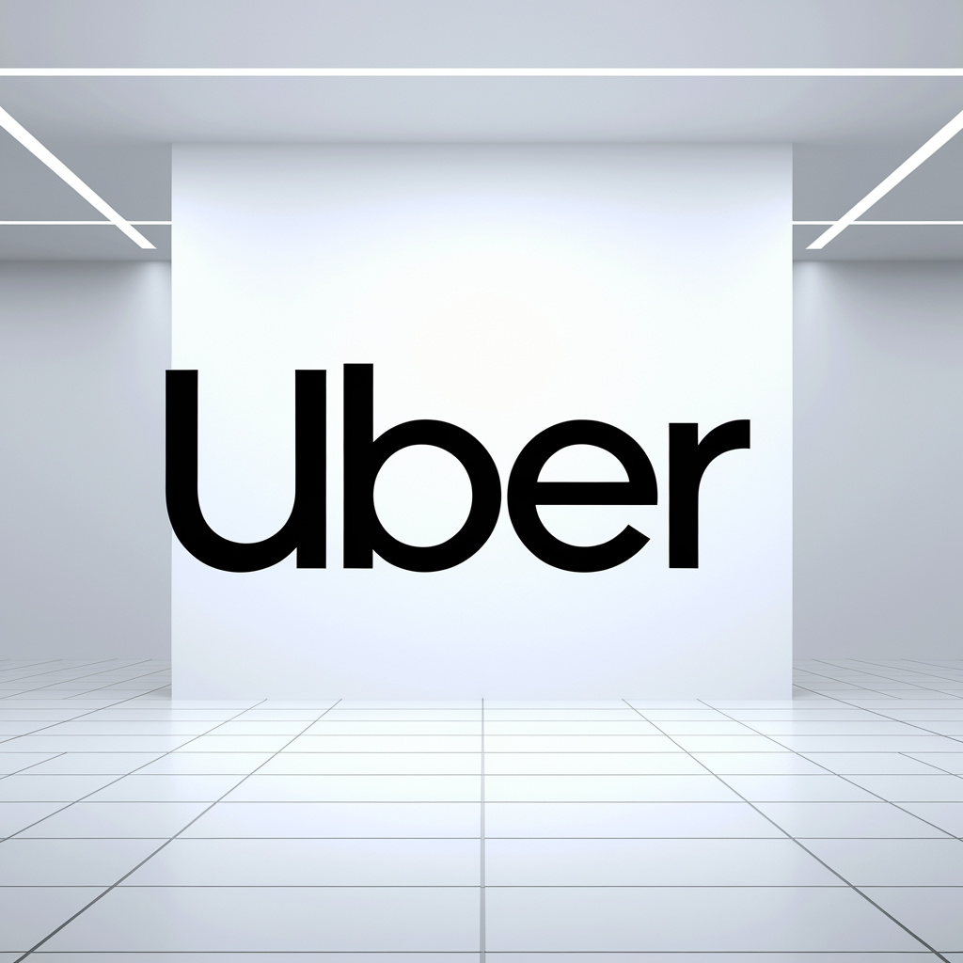
Perfect for constrained spaces while maintaining professional brand presence and clarity.
Logo Variation 2

Slide 11

Ideal for small sizes, watermarks, and applications requiring simplified brand representation.
Logo Variation 3

Slide 12
Deep Ocean Blue
#1F2937
RGB(31, 41, 55)
CMYK(43, 25, 0, 78)
Use Light Text
Innovation Red
#E74C3C
RGB(231, 76, 60)
CMYK(0, 67, 74, 9)
Use Dark Text
Efficiency Green
#27AE60
RGB(39, 174, 96)
CMYK(77, 0, 44, 31)
Use Dark Text
Urban Silver
#7F8FA4
RGB(127, 143, 164)
CMYK(22, 12, 0, 35)
Use Dark Text
Primary Colors

Slide 13
Light Gray
#F8F9FA
Use Dark Text
Mint Green
#55D8A6
Use Dark Text
Dusty Pink
#D68AA7
Use Dark Text
Slate Blue
#5D6D7E
Use Light Text
Mustard Yellow
#E6AF2E
Use Dark Text
Secondary Colors

Slide 14
Primary Color Usage
Use for brand-critical elements:
• Logos and main brand marks
• Headlines and key text
• CTA buttons and navigation
• Hero sections
Colors: Deep Ocean Blue, Innovation Red, Efficiency Green, Urban Silver
Best Practices:
- Maximum brand recognition
- Consistent application
- Sufficient contrast
- Accessibility compliance
Color Usage 1/2

Slide 15
Secondary Color Usage
Use for supporting elements:
• Backgrounds and subtle accents
• Secondary text
• Borders and dividers
• Hover states and icons
Colors: Light Gray, Mint Green, Dusty Pink, Slate Blue, Mustard Yellow
Best Practices:
- Create visual hierarchy
- Support, don't compete
- Maintain readability
- Use sparingly
Color Usage 2/2

Slide 16
Primary Font: Inter
Secondary Font: Source Sans Pro
Font Hierarchy:
• Headlines: Inter - Bold, 28-32pt
• Subheadlines: Inter - Bold, 20-24pt
• Body Text: Source Sans Pro - Regular, 16-18pt
• Caption Text: Source Sans Pro - Regular, 12-14pt
TYPOGRAPHY

Slide 17















Uber - Core Functional Icons
ICONOGRAPHY

Slide 18
Uber - Technology & Mobility (Ride-Hailing, Delivery, Transportation) Industry Icons
ICONOGRAPHY

Slide 19
Style: Minimalist design
Color: #1F2937 on black background
Size Requirements:
• Minimum: 16px web, 0.5" print
• Recommended: 24px+ web, 0.75"+ print
Spacing:
• Clear space: 50% of icon width
• Consistent grid alignment
USAGE GUIDELINES

Slide 20
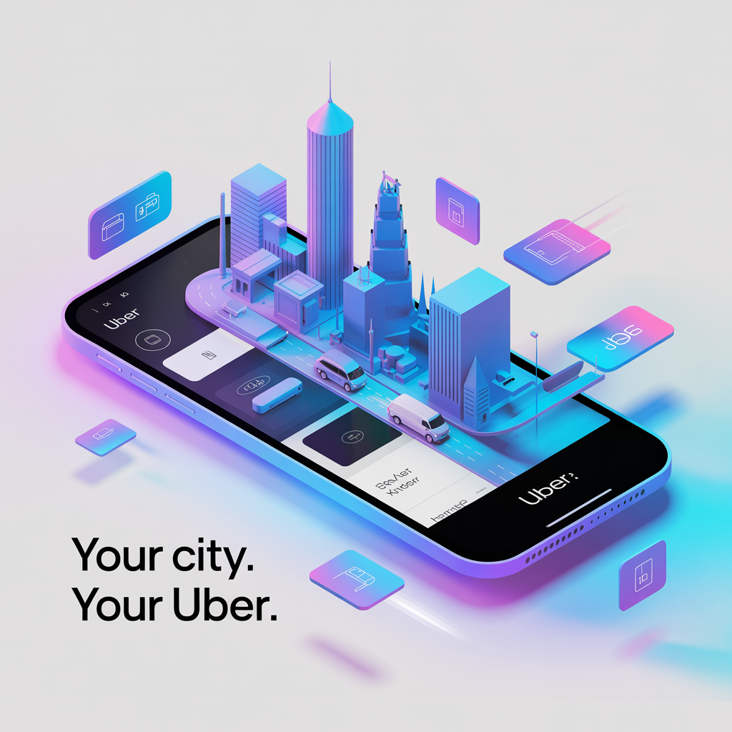
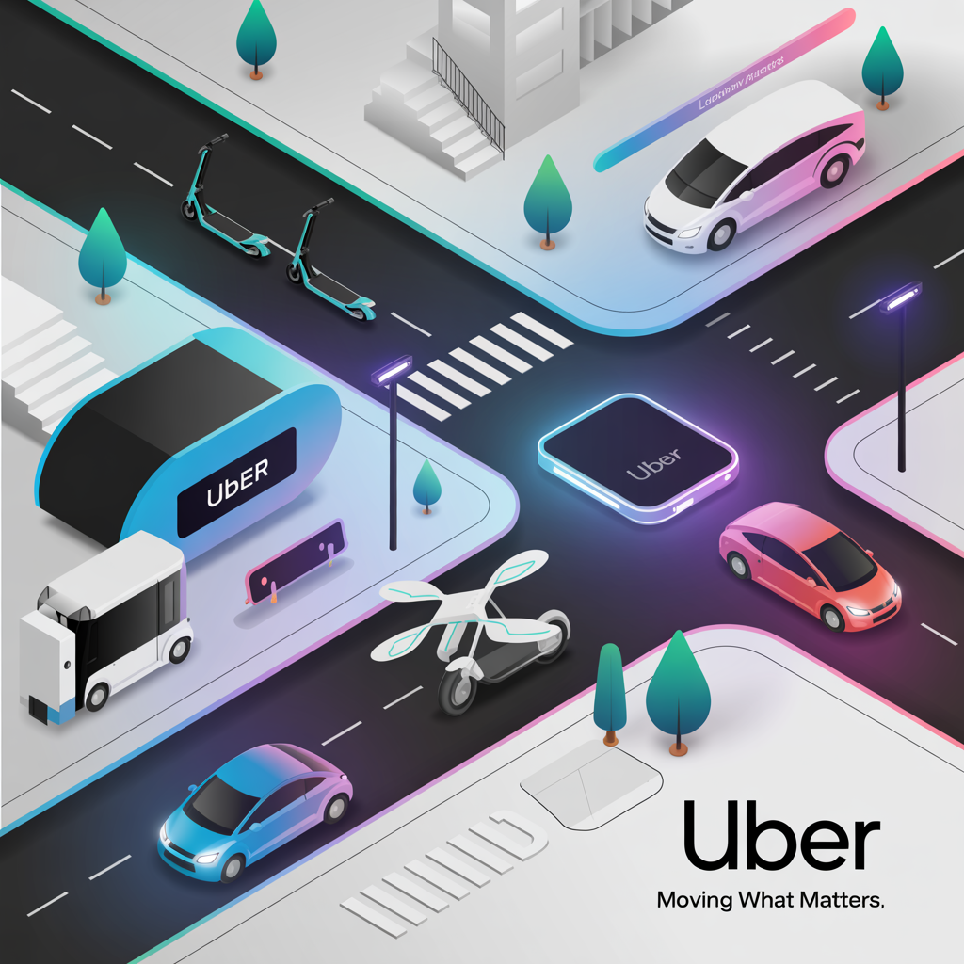
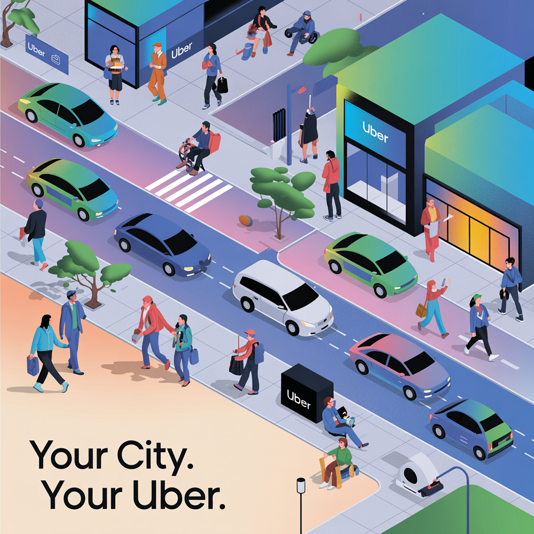
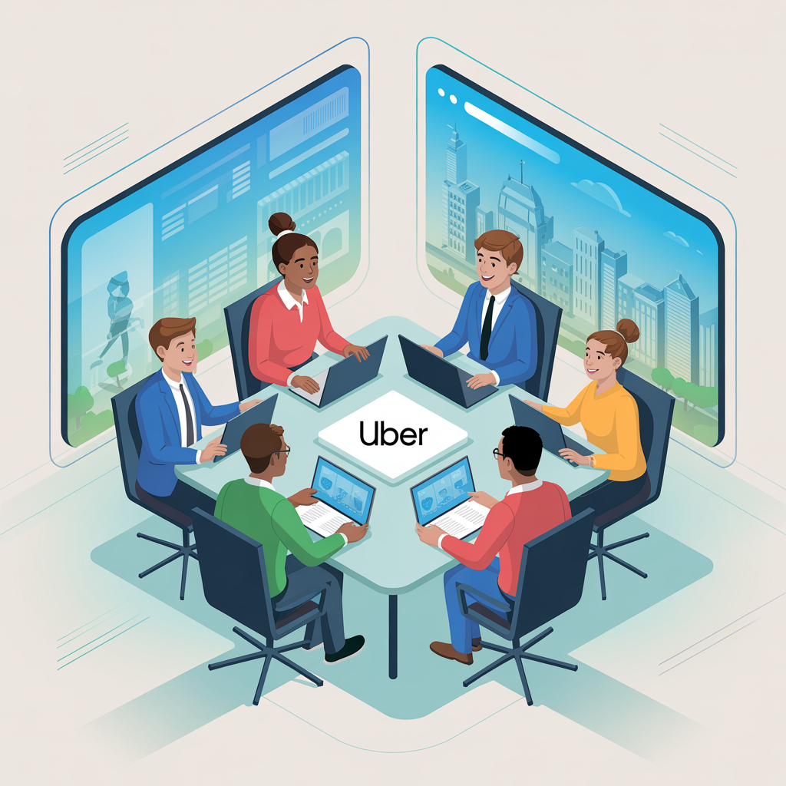
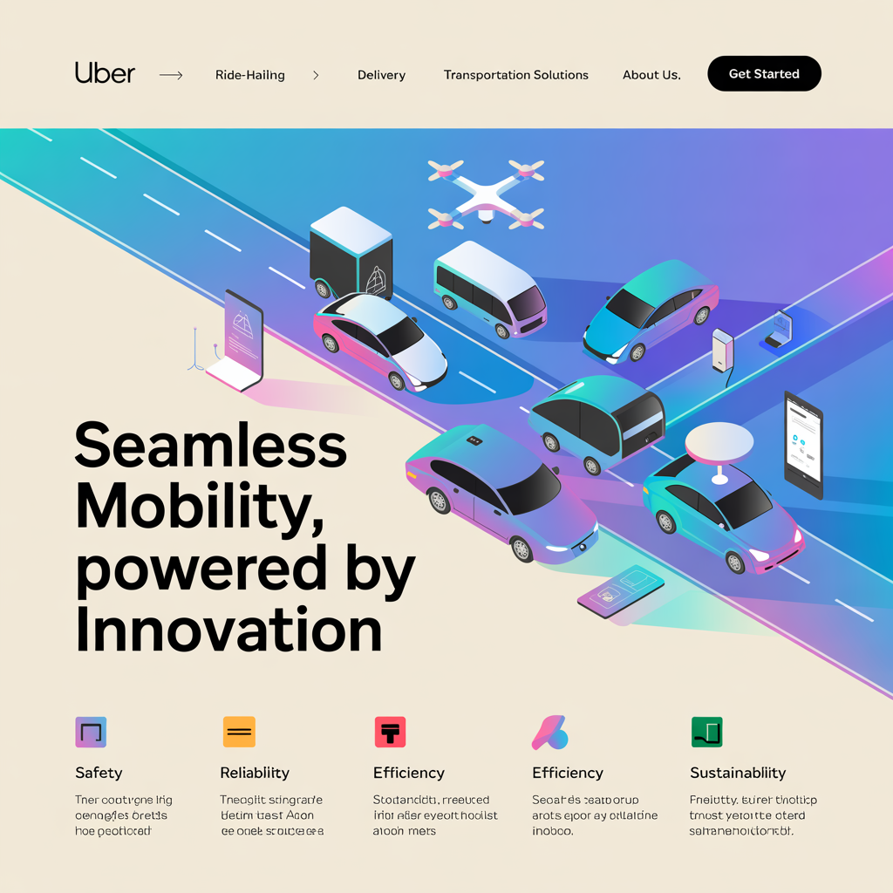
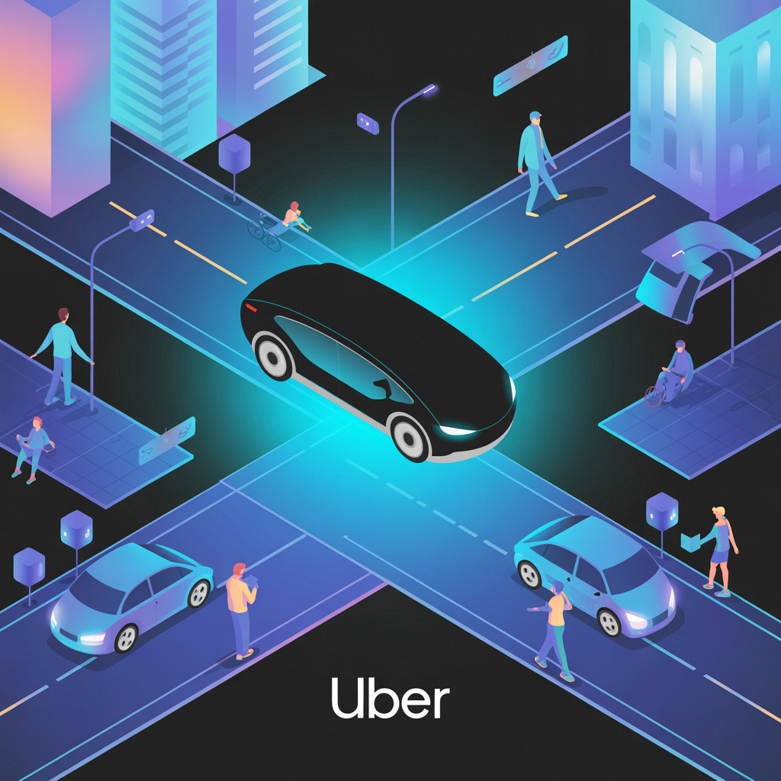
External Focus
External Focus
External Focus
Professional excellence in Technolo...
Innovative solutions for Technology...
Strategic growth and development in...
Internal Focus
Internal Focus
Internal Focus
Collaborative teamwork and company ...
Technology integration and digital ...
Customer success and satisfaction f...
USAGE NOTES: These illustrations define the visual storytelling style of the brand. Use them consistently across presentations, reports, and marketing materials to maintain brand coherence.
BRAND ILLUSTRATIONS

