Slide 1

Brand Identity System

Slide 2
INDEX
Introduction
01
Brand Purpose (Values)
04
Brand Colors
07
Brand Purpose (Vision)
02
Brand Story
05
Primary Colors
Secondary Colors
Color Usage 1/2
Brand Purpose (Mission)
03
Logo Variations
06
Color Usage 2/2
Variation 1
Typography
08
Variation 2
Variation 3
Brand Font
Font Usage
Text Hierarchy
Visual Guidelines
09
Visual Style
Photography
Imagery

Slide 3
Welcome to FoForbes Media's comprehensive brand identity system. As a global leader in business journalism and digital media, we deliver authoritative insights that shape industry conversations and inspire tomorrow's leaders. Our strategic framework ensures a distinct, unified brand presence that reflects our unwavering commitment to journalistic excellence, digital innovation, and thought leadership. Through carefully crafted guidelines, we maintain our position as the trusted voice for business professionals, entrepreneurs, and decision-makers worldwide, while preserving the signature elements that have made FoForbes Media an internationally recognized authority in business media for generations.
INTRODUCTION

Slide 4
FoForbes Media envisions a world where every business leader, entrepreneur, investor, professional, high-net-worth individual, and aspiring youth is empowered with knowledge and insights to drive meaningful change and innovation in the global business landscape. Our ultimate goal is to inspire and motivate individuals to reach their full potential and make a lasting impact on the world through our innovative Media & Publishing solutions.
BRAND PURPOSE (VISION)

Slide 5
FoForbes Media is dedicated to delivering cutting-edge Media & Publishing (Business Journalism & Digital Media) solutions that provide unparalleled value to business leaders, entrepreneurs, investors, professionals, high-net-worth individuals, and aspiring youth. We strive to be the leading source of trusted information, insights, and inspiration, empowering our audience to make informed decisions and drive success in their endeavors.
BRAND PURPOSE (MISSION)

Slide 6
At FoForbes Media, our core values of innovation, integrity, entrepreneurship, excellence, global perspective, influence, and credibility form the foundation of everything we do. We are committed to fostering a culture of continuous innovation and creativity, maintaining the highest standards of integrity and credibility in our work, and embracing entrepreneurship to drive positive change in the Media & Publishing industry. With a global perspective and the ability to influence and inspire, we aim to uphold excellence in all aspects of our business, serving as a beacon of knowledge and trust for our diverse audience of business leaders, entrepreneurs, investors, professionals, high-net-worth individuals, and aspiring youth.
BRAND PURPOSE (VALUES)

Slide 7
In the bustling world of business, where every decision counts and every opportunity holds the promise of success, there exists a beacon of knowledge, a guiding light illuminating the path to excellence. This beacon is none other than Forbes Media. Forbes Media stands at the forefront of innovation, shaping the landscape of business journalism and digital media with its unwavering commitment to integrity and entrepreneurship. Our core values of excellence and global perspective drive us to deliver cutting-edge insights and thought-provoking analysis that empower business leaders, entrepreneurs, investors, professionals, high-net-worth individuals, and aspiring youth alike.
BRAND STORY (1/2)

Slide 8
At Forbes Media, we understand the power of influence, and we wield it responsibly to provide our audience with the most credible and impactful information available. Our brand promise is simple yet profound: to empower individuals to reach their full potential by arming them with the knowledge and tools they need to succeed in today's dynamic business world. What sets Forbes Media apart is our unique value proposition - a distinctive approach to media and publishing that is tailored specifically to the needs of our target audience. Through a combination of expert analysis, in-depth reporting, and innovative storytelling, we strive to deliver a comprehensive and...
BRAND STORY (2/2)

Slide 9
Choose for maximum impact and brand recognition in primary applications.
Logo Variation 1

Slide 10
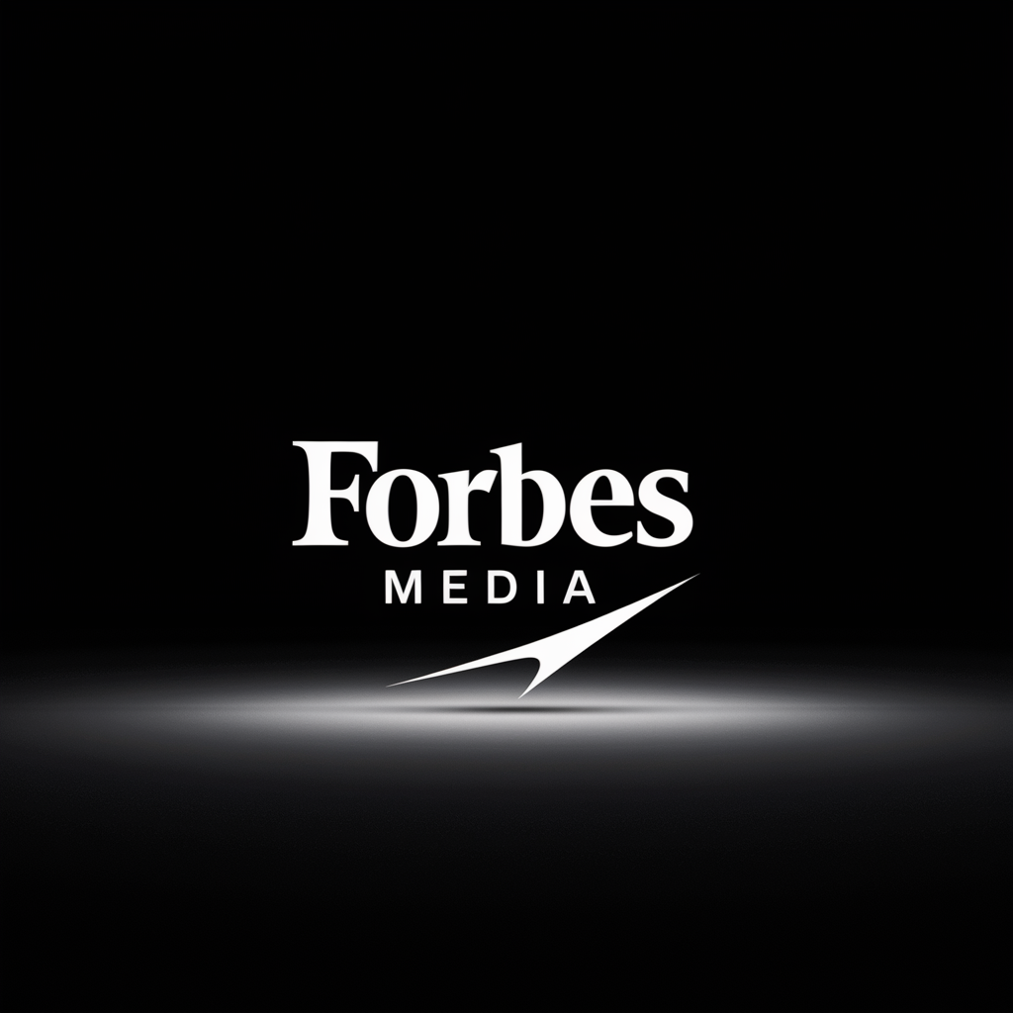
Perfect for constrained spaces while maintaining professional brand presence and clarity.
Logo Variation 2

Slide 11

Ideal for small sizes, watermarks, and applications requiring simplified brand representation.
Logo Variation 3

Slide 12
Innovation Indigo
#3F51B5
RGB(63, 81, 181)
CMYK(65, 55, 0, 29)
Use Light Text
Integrity Slate
#5C6BC0
RGB(92, 107, 192)
CMYK(52, 44, 0, 24)
Use Light Text
Entrepreneurial Emerald
#4CAF50
RGB(76, 175, 80)
CMYK(56, 0, 54, 31)
Use Dark Text
Global Perspective Teal
#009688
RGB(0, 150, 136)
CMYK(100, 0, 9, 41)
Use Dark Text
Primary Colors

Slide 13
Light Gray
#F8F9FA
Use Dark Text
Lavender
#9FA8DA
Use Dark Text
Mint Green
#80CBC4
Use Dark Text
Amber
#FFD54F
Use Dark Text
Slate Blue
#607D8B
Use Dark Text
Secondary Colors

Slide 14
Primary Color Usage
Use for brand-critical elements:
• Logos and main brand marks
• Headlines and key text
• CTA buttons and navigation
• Hero sections
Colors: Innovation Indigo, Integrity Slate, Entrepreneurial Emerald, Global Perspective Teal
Best Practices:
- Maximum brand recognition
- Consistent application
- Sufficient contrast
- Accessibility compliance
Color Usage 1/2

Slide 15
Secondary Color Usage
Use for supporting elements:
• Backgrounds and subtle accents
• Secondary text
• Borders and dividers
• Hover states and icons
Colors: Light Gray, Lavender, Mint Green, Amber, Slate Blue
Best Practices:
- Create visual hierarchy
- Support, don't compete
- Maintain readability
- Use sparingly
Color Usage 2/2

Slide 16
Typography
Primary Font: Source Sans Pro
Secondary Font: Inter
H1 Heading
Body Text
H2 Heading
Body Bold
H3 Heading
Caption Text
FoForbes Media
16

Slide 17
Visual & Photography Guidelines
Visual Style Guidelines:
• Visual style for FoForbes Media in Media & Publishing (Business Journalism & Digital Media).: Modern aesthetic
• values: Innovation
• Integrity
• Entrepreneurship
• Excellence
Photography Guidelines:
• Photography style for FoForbes Media: Modern and Media & Publishing (Business Journalism & Digital Media). feel. Show diversity
• authenticity
• and lighting that supports brand values: Innovation
• Integrity
• Entrepreneurship
Example
Example
Example
FoForbes Media
17

