Slide 1
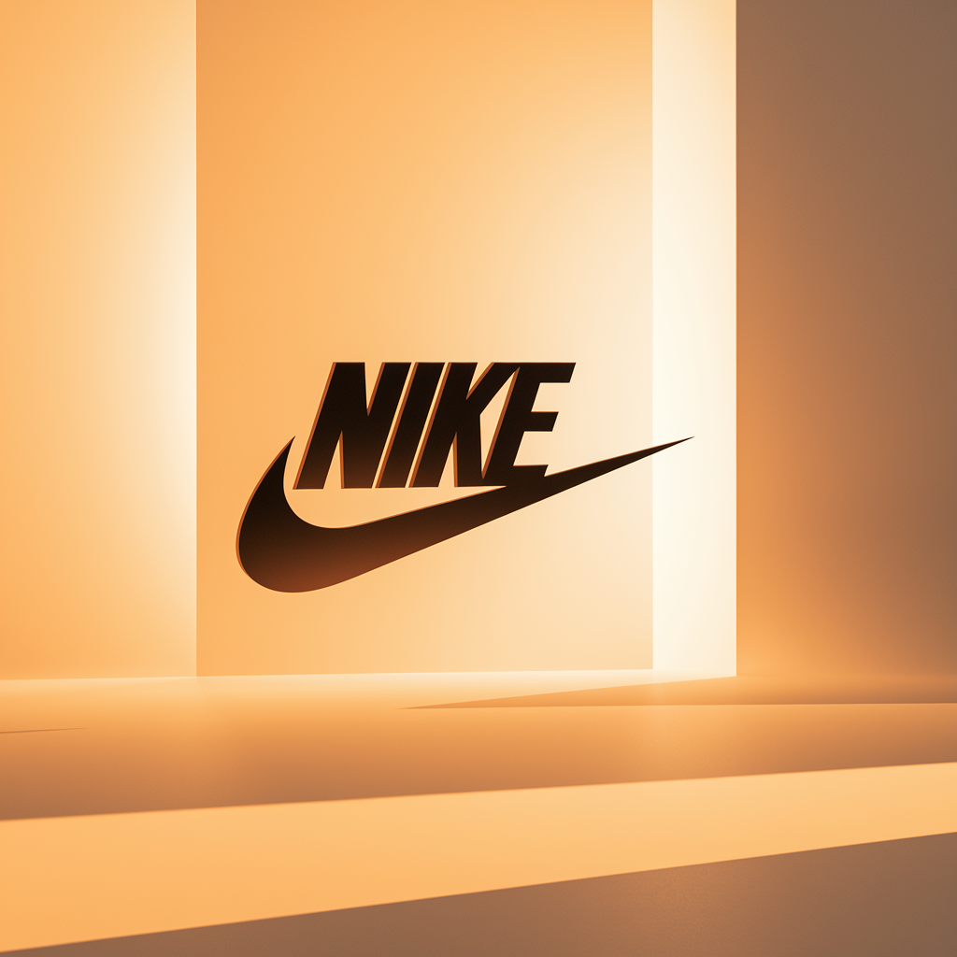
Brand Identity System

Slide 2
INDEX
Introduction
01
Brand Purpose (Values)
04
Brand Colors
07
Brand Purpose (Vision)
02
Brand Story
05
Primary Colors
Secondary Colors
Color Usage 1/2
Brand Purpose (Mission)
03
Logo Variations
06
Color Usage 2/2
Variation 1
Typography
08
Variation 2
Variation 3
Brand Font
Font Usage
Text Hierarchy
Imagery & Visuals
09
Iconography
Illustrations
Merchandise

Slide 3
Welcome to Nike's global brand identity system. Built on our legacy of innovation and athletic excellence, this comprehensive framework delivers a powerful, instantly recognizable presence across our athletic footwear, performance apparel, and sports equipment portfolio. Our system embodies Nike's fundamental commitment to empowering athletes and inspiring movement worldwide, while ensuring consistent, engaging brand experiences at every touchpoint. From elite competitors to everyday enthusiasts, our distinctive identity reflects the dynamic spirit that has made Nike the world's leading sports and lifestyle brand.
INTRODUCTION

Slide 4
At Nike, we envision a world where every step, jump, or sprint fuels the endless pursuit of greatness. Our ultimate goal is to inspire and empower Athletes, Fitness enthusiasts, Youth, Professionals, and Global lifestyle consumers to push beyond their limits, both on and off the field, through innovative Sportswear & Apparel solutions that redefine performance and style.
BRAND PURPOSE (VISION)

Slide 5
Our mission at Nike is to lead the Sportswear & Apparel industry by relentlessly pursuing excellence in design and functionality. We are dedicated to providing Athletes, Fitness enthusiasts, Youth, Professionals, and Global lifestyle consumers with cutting-edge Athletic Footwear, Clothing, and Equipment that not only enhance their performance but also reflect their unique identity and aspirations.
BRAND PURPOSE (MISSION)

Slide 6
Our commitment to Innovation drives us to constantly push the boundaries of what's possible, delivering products that anticipate and meet the evolving needs of our diverse consumer base. Performance is at the core of everything we do, ensuring that every garment, shoe, or accessory we create empowers individuals to excel in their chosen pursuits. We draw Inspiration from the stories and journeys of our customers, fostering a culture of creativity and passion within our brand. Sustainability is ingrained in our DNA, guiding us to design with the planet in mind, creating products that are not only high-performing but also environmentally responsible. Embracing Diversity and promoting Equality are fundamental to our ethos, as we strive to celebrate the unique talents and perspectives of every individual we touch. Through our commitment to Empowerment, we seek to uplift and support communities, creating opportunities for growth and positive change worldwide.
BRAND PURPOSE (VALUES)

Slide 7
In the heart of every athlete, every fitness enthusiast, every young dreamer, and every global lifestyle consumer, there beats a relentless drive for greatness. It's the same pulse that fuels our passion at Nike – a passion for innovation, performance, and empowerment. At Nike, we believe in the power of sport to unleash human potential. We are not just a brand; we are a movement, a force for change, a beacon of inspiration for athletes and dreamers around the world. Our core values of innovation, performance, inspiration, sustainability, diversity, equality, and empowerment guide every step we take, every product we create, and every athlete we support.
BRAND STORY (1/2)

Slide 8
Our brand promise is simple yet profound: to empower athletes, fitness enthusiasts, youth, professionals, and global lifestyle consumers through innovative Sportswear & Apparel solutions. We are not just here to sell clothes and shoes; we are here to revolutionize the way people move, feel, and perform. Our products are not just pieces of fabric and rubber; they are tools of transformation, catalysts for greatness, and symbols of empowerment. What sets Nike apart is our relentless commitment to pushing boundaries, challenging the status quo, and redefining what is possible. Our unique value proposition lies in...
BRAND STORY (2/2)

Slide 9
Choose for maximum impact and brand recognition in primary applications.
Logo Variation 1

Slide 10
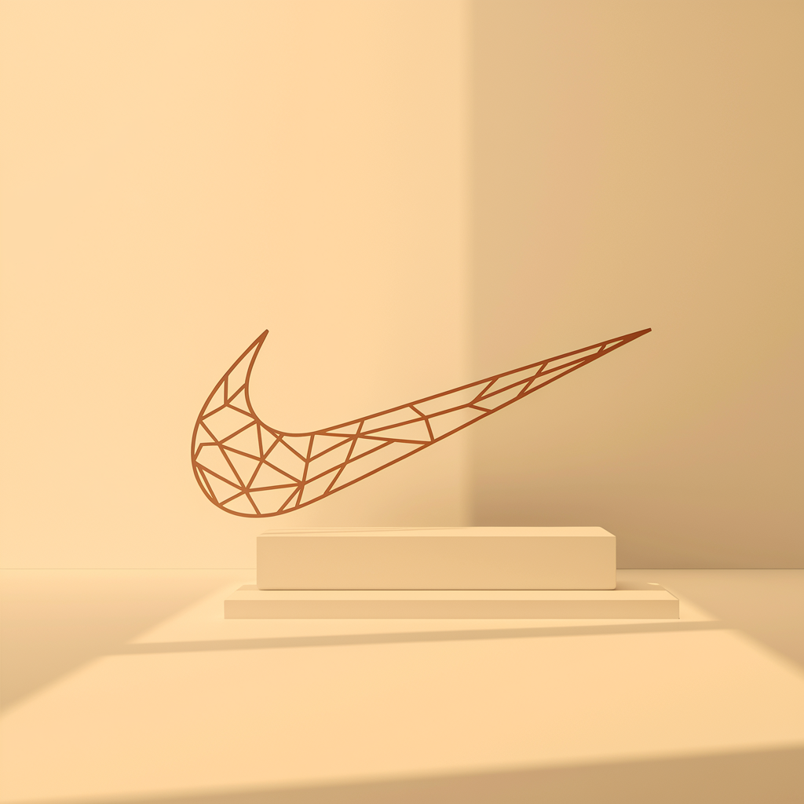
Perfect for constrained spaces while maintaining professional brand presence and clarity.
Logo Variation 2

Slide 11
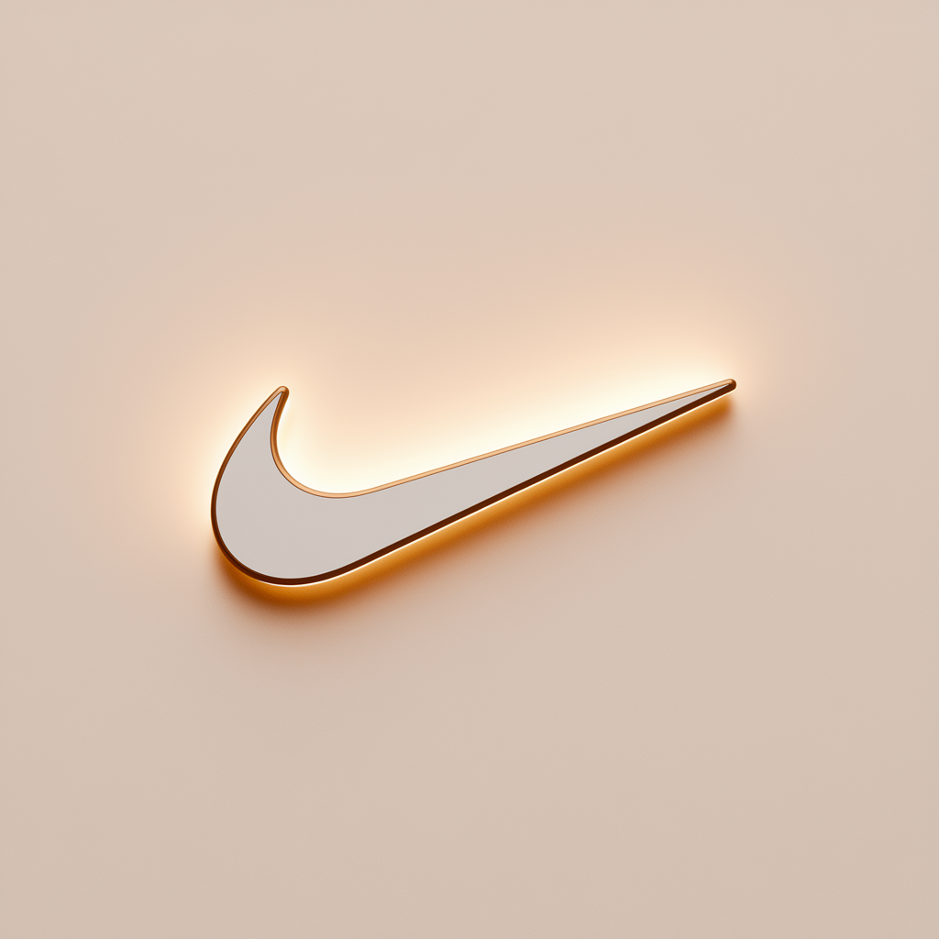
Ideal for small sizes, watermarks, and applications requiring simplified brand representation.
Logo Variation 3

Slide 12
Innovation Green
#4CAF50
RGB(76, 175, 80)
CMYK(56, 0, 54, 31)
Use Dark Text
Empowerment Red
#D32F2F
RGB(211, 47, 47)
CMYK(0, 77, 77, 17)
Use Light Text
Inspiration Yellow
#FFC107
RGB(255, 193, 7)
CMYK(0, 24, 97, 0)
Use Dark Text
Performance Grey
#757575
RGB(117, 117, 117)
CMYK(0, 0, 0, 54)
Use Light Text
Primary Colors

Slide 13
Light Background
#F8F9FA
Use Dark Text
Medium Gray
#6B7280
Use Light Text
Dark Text
#1F2937
Use Light Text
Accent Light
#E5E7EB
Use Dark Text
Warning Orange
#F59E0B
Use Dark Text
Secondary Colors

Slide 14
Primary Color Usage
Use for brand-critical elements:
• Logos and main brand marks
• Headlines and key text
• CTA buttons and navigation
• Hero sections
Colors: Innovation Green, Empowerment Red, Inspiration Yellow, Performance Grey
Best Practices:
- Maximum brand recognition
- Consistent application
- Sufficient contrast
- Accessibility compliance
Color Usage 1/2

Slide 15
Secondary Color Usage
Use for supporting elements:
• Backgrounds and subtle accents
• Secondary text
• Borders and dividers
• Hover states and icons
Colors: Light Background, Medium Gray, Dark Text, Accent Light, Warning Orange
Best Practices:
- Create visual hierarchy
- Support, don't compete
- Maintain readability
- Use sparingly
Color Usage 2/2

Slide 16
Primary Font: Source Sans Pro
Secondary Font: Inter
Font Hierarchy:
• Headlines: Source Sans Pro - Bold, 28-32pt
• Subheadlines: Source Sans Pro - Bold, 20-24pt
• Body Text: Inter - Regular, 16-18pt
• Caption Text: Inter - Regular, 12-14pt
TYPOGRAPHY

Slide 17






Nike - Core Functional Icons Icons
Home Icon
Search Magnifying Glass Icon
Menu Hamburger Lines Icon
Settings Gear Icon
User Profile Person Icon
Notification Bell Icon
ICONOGRAPHY

Slide 18






Nike - Sportswear & Apparel (Athletic Footwear, Clothing, Equipment) Industry Icons Icons
Cloud Computing Icon
Server Database Icon
Programming Code Icon
Network Connection Icon
Artificial Intelligence Icon
Security Lock Icon
ICONOGRAPHY

Slide 19
Style: Minimalist Outline design
Color: #4CAF50 on black background
Size Requirements:
• Minimum: 16px web, 0.5" print
• Recommended: 24px+ web, 0.75"+ print
Spacing:
• Clear space: 50% of icon width
• Consistent grid alignment
USAGE GUIDELINES

Slide 20
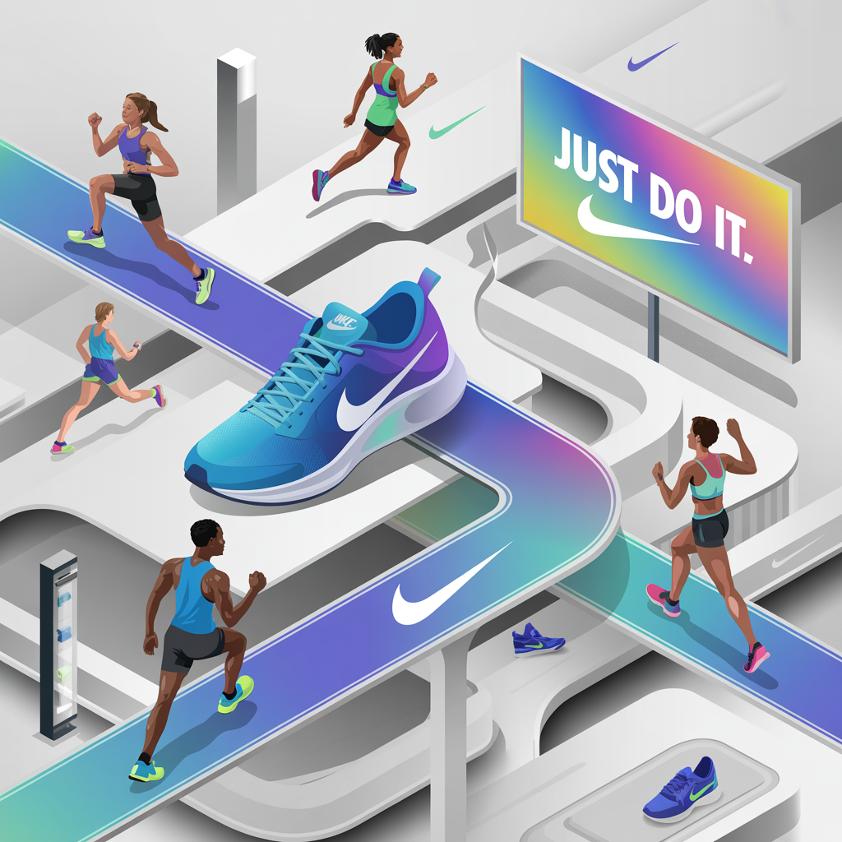
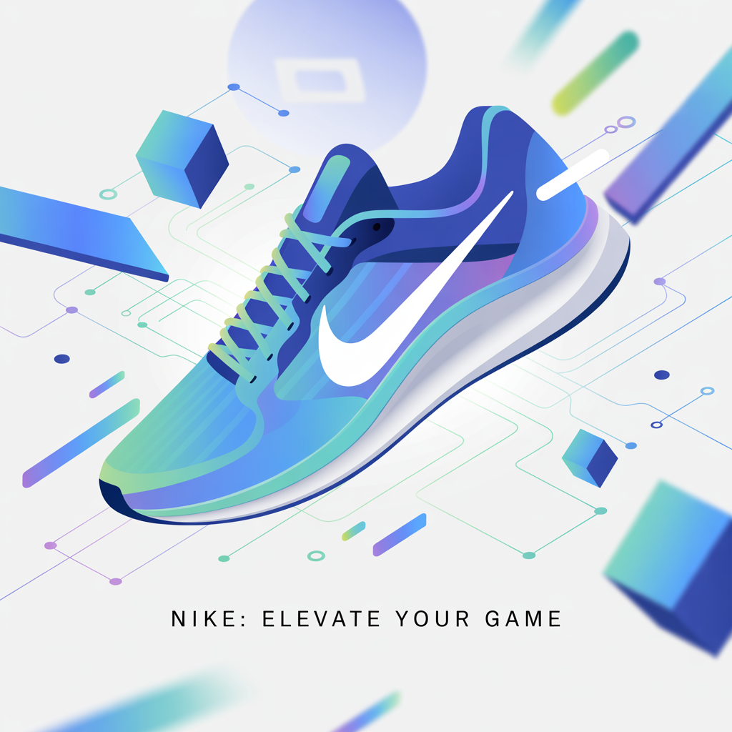
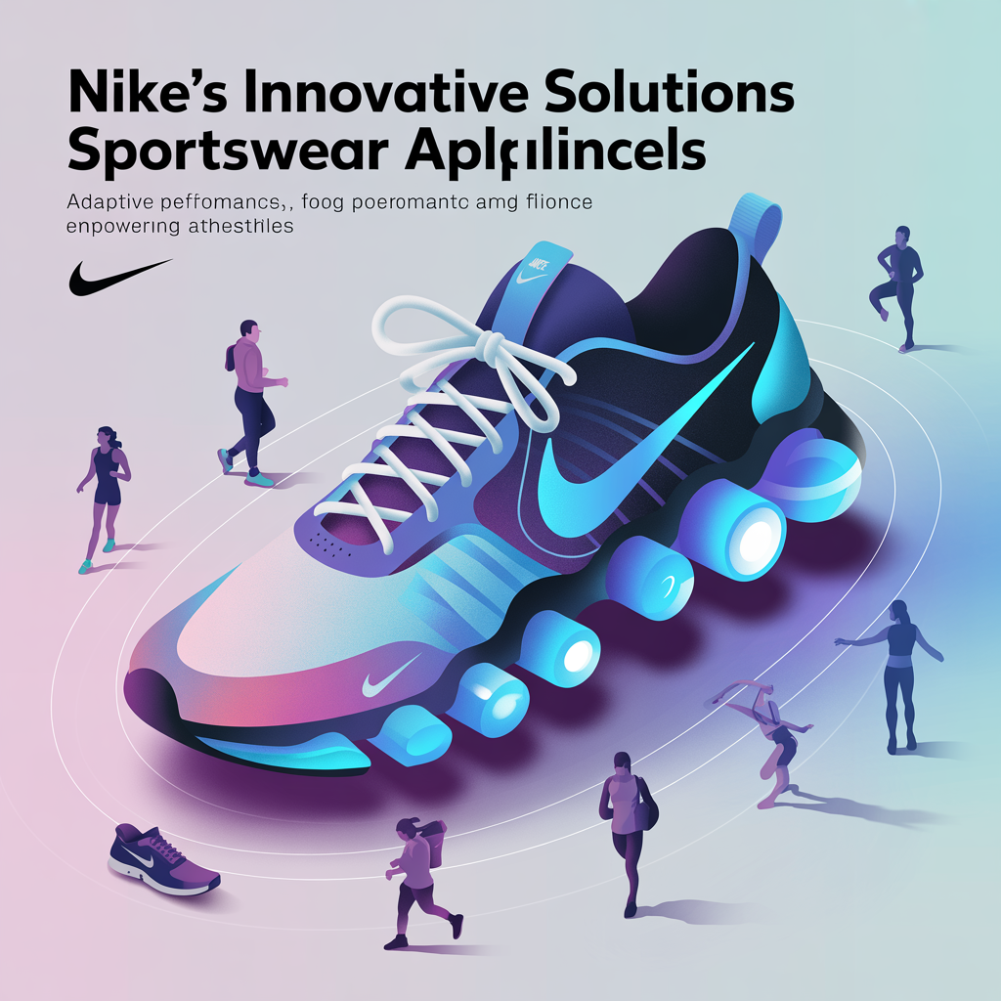
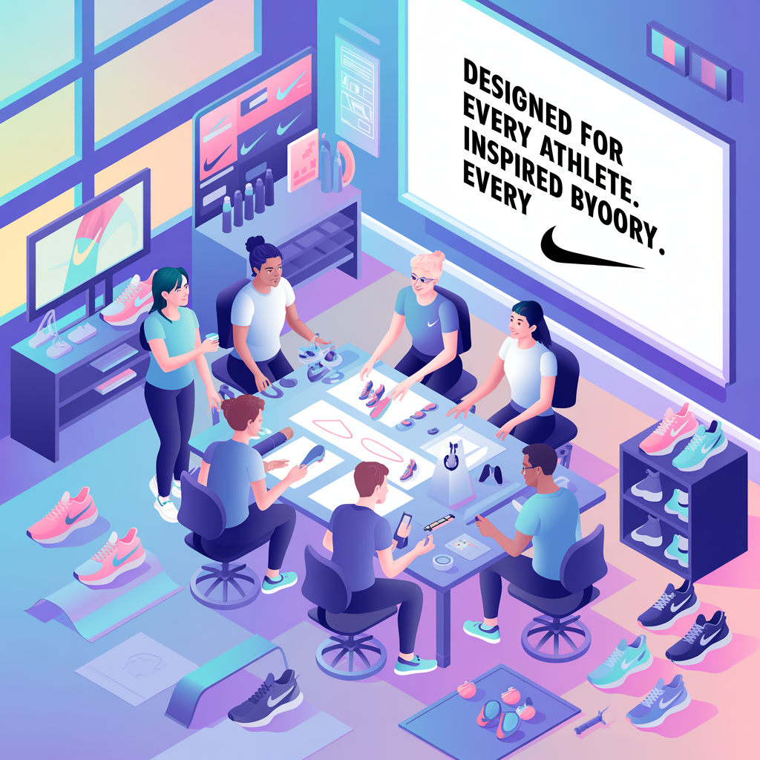

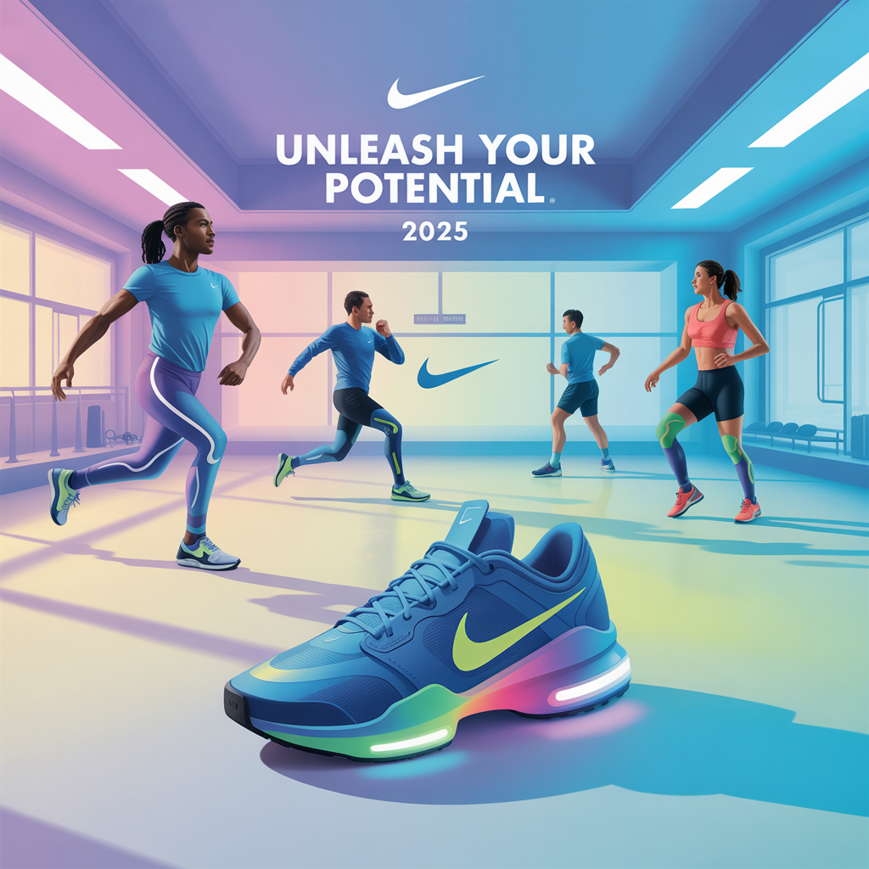
External Focus
External Focus
External Focus
Business growth and success visuali...
Professional excellence in Sportswe...
Innovative solutions for Sportswear...
Internal Focus
Internal Focus
Internal Focus
Collaborative teamwork and company ...
Strategic growth and development in...
Technology integration and digital ...
USAGE NOTES: These illustrations define the visual storytelling style of the brand. Use them consistently across presentations, reports, and marketing materials to maintain brand coherence.
BRAND ILLUSTRATIONS

