Slide 1
CHAAYOS
BRAND IDENTITY SYSTEM

Slide 2
Introduction 01
Brand Story 03
Brand Colors 05
Visual Language 07
Applications 09
Brand Purpose 02
Logo 04
Typography 06
Brand Voice 08
INDEX
01

Slide 3
The following brand identity system for Chaayos is thoughtfully crafted to present our brand in an international, engaging, consistent, recognisable and proprietary way. Unique in form, versatile in its application and unified by a fundamental principle.
Industry: Food & Beverage (F&B), Quick Service Restaurants (QSR), Café/Tea Retail
Target Audience: Urban millennials, Young professionals, Office-goers, Students, Tea enthusiasts, Digital-savvy consumers, Health-conscious individuals, People seeking a modern chai café experience.
INTRODUCTION
02

Slide 4
Distinctive Food & Beverage (F&B), Quick Service Restaurants (QSR), Café/Tea Retail solution focused on Urban millennials, Young professionals, Office-goers, Students, Tea enthusiasts, Digital-savvy consumers, Health-conscious individuals, People seeking a modern chai café experience.
BRAND PURPOSE
03

Slide 5

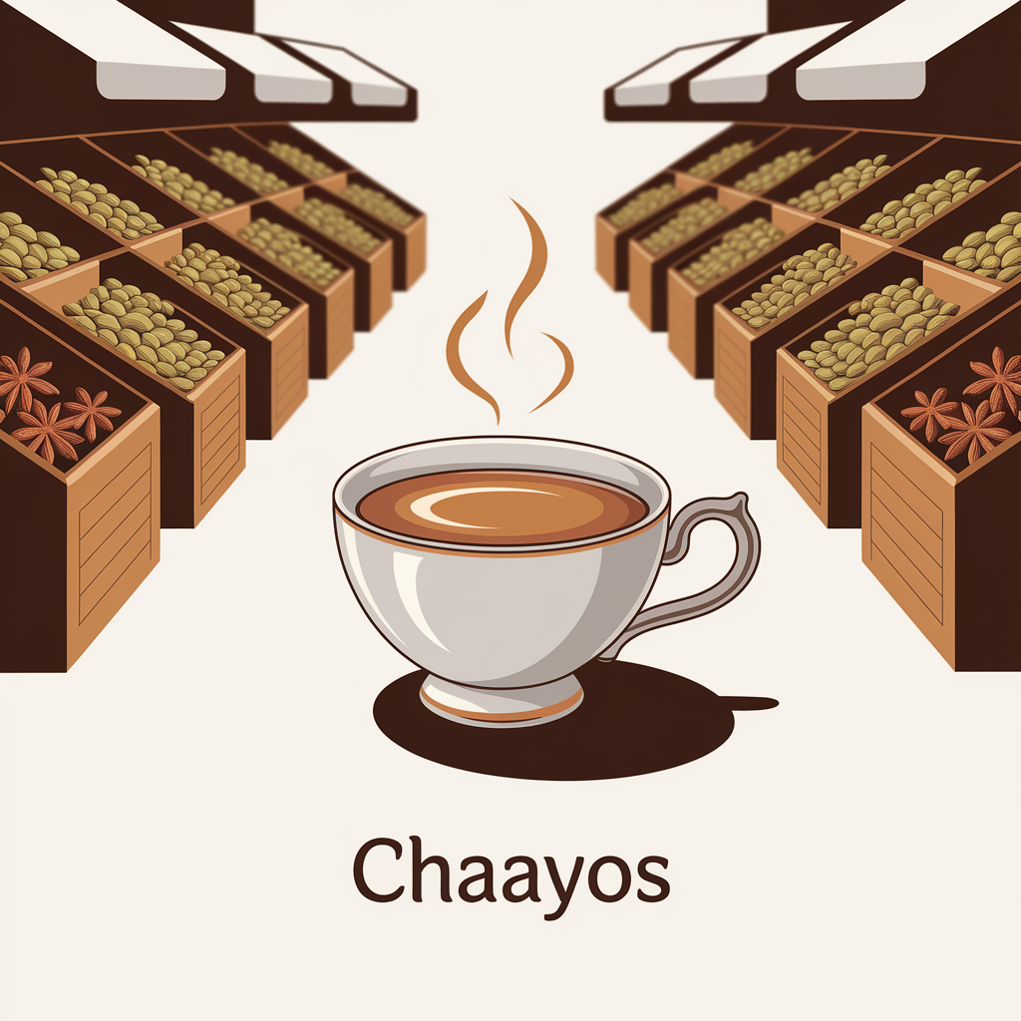

LOGO
04

Slide 6
PRIMARY
#DC2626
SECONDARY
#059669
ACCENT
#2563EB
BRAND COLORS
05

Slide 7
Primary Font: Inter
Secondary Font: Source Sans Pro
Contemporary, highly legible fonts optimized for digital interfaces
TYPOGRAPHY
06

Slide 8
The brand voice for Chaayos is friendly, warm, and inviting. It strikes a balance between being modern and traditional, reflecting the values of innovation, personalization, customer delight, quality, community, convenience, authenticity, and consistency.
The tone is engaging, approachable, and customer-focused, catering to urban millennials, young professionals, office-goers, students, tea enthusiasts, digital-savvy consumers, and health-conscious individuals. It conveys a sense of modernity while also cherishing the traditional aspects of chai culture.
Chaayos aims to create a space where customers feel welcomed
BRAND VOICE
07

